Slide 1
M O D U L E - 6

Slide 2
CONTENT
PROJECT SCHEDULING AND TRACKING
Basic concepts
Relation between people and effort
Defining task set for the software project
Selecting software engineering task
SOFTWARE CONFIGURATION MANAGEMENT
Basics and standards
USER INTERFACE DESIGN
Rules
COMPUTER AIDED SOFTWARE ENGINEERING TOOLS
CASE building blocks
Taxonomy of CASE tools
Integrated CASE environment

Slide 3
PROJECT SCHEDULE

Slide 4
Basic concepts
Reasons for late delivery of software
An unrealistic deadline
Changing customer requirements
underestimate of the amount of effort and/or the number of resources that will be required to do the job.
Predictable or unpredictable risks were not considered
Technical difficulties could not have been foreseen in advance.
Human difficulties that could not have been foreseen in advance.
Miscommunication among project staff that results in delays.
A failure by project management to recognize that the project is falling behind schedule

Slide 5
PROBLEM
Unrealistic deadlines are the main issue of delivery delay
Eg: medical diagnosis s/w
Demanded deadline: 9 months
Estimated deadline:14 months
If it is hard to refuse the demanded deadline, following solutions can be applied

Slide 6
SOLUTIONS
Perform a detailed estimate using historical data from past projects.
Determine the estimated effort and duration for the project.
Develop a software engineering strategy using an incremental process model
This will deliver critical functionality by the imposed deadline
It delays other functionality
Document the plan

Slide 7
SOLUTIONS [2]
Meet with the customer along the detailed estimate
explain why the imposed deadline is unrealistic.
Be certain to note that all estimates are based on performance on past projects.
indicate the percent improvement that would be required to achieve the deadline
Offer the incremental development strategy as an alternative
Provide options to achieve the unrealistic deadline
Eg: Increase the budget
Removing certain functionalities
Compromising the quality

Slide 8
PROJECT SCHEDULING
Problem of late delivery can be overcome using project scheduling
Project manager must have a schedule that helps him to control & monitor the progress of the project
Software project scheduling
it is an activity that distributes estimated effort across the planned project duration by allocating the effort to specific software engineering tasks.

Slide 9
Features of project schedule
Schedule evolves over time.
During early stages of project planning, a macroscopic schedule is developed.
This identifies all major process framework activities and the product functions
As the project gets under way, each entry on the macroscopic schedule is refined into a detailed schedule.
Here, specific software actions and tasks are identified and scheduled.

Slide 10
BASIC PRINCIPLES
Compartmentalization
Interdependency
Time allocation
Effort validation
Defined responsibilities
Defined outcomes
Defined milestones

Slide 11
Compartmentalization
The project must be compartmentalized into a number of manageable activities and tasks.
To accomplish compartmentalization, both the product and the process are decomposed.

Slide 12
Interdependency
The interdependency of each compartmentalized activity or task must be determined.
This is because
Some tasks must occur in sequence
Some others occur in parallel
Some activities cannot commence until the work product produced by another is available.
Other activities can occur independently.

Slide 13
Time allocation
Each task to be scheduled must be allocated with some number of work units
Each task must be assigned a start date and a completion date
This will be a function of the interdependencies,
It depends based on whether work will be conducted on a full-time or part-time basis.

Slide 14
Effort validation
Every project has a defined number of people on the software team.
As time allocation occurs, you must ensure that no more than the allocated number of people has been scheduled at any given time.

Slide 15
Defined responsibilities
Every task that is scheduled should be assigned to a specific team member.

Slide 16
Defined outcomes
Every task that is scheduled should have a defined outcome.
The outcome is normally a work product or a part of a work product.
Work products are often combined in deliverables.

Slide 17
Defined milestones
Every task or group of tasks should be associated with a project milestone.
A Milestone is accomplished when one or more work products has been reviewed for quality and has been approved.

Slide 18
SCHEDULING METHODS

Slide 19
INTRODUCTION
2 types of scheduling methods are
Program evaluation & review technique (PERT)
Critical Path method (CPM)
Both techniques are driven by information obtained from project planning activities:-
Estimates of effort
A decomposition of product function
Selection of appropriate process model & task set
Decomposition of tasks

Slide 20
Work breakdown structure
Tasks are also called as WBS
PERT and CPM provide quantitative tools that allow to
Determine the critical path
It is the chain of tasks that determines the duration of the project,
Establish “most likely” time estimates for individual tasks
Calculate “boundary times” that define a time “window” for a particular task.

Slide 21
Timeline charts
Software project schedule, planner begin with a set of tasks
If automated tools are used,
the work breakdown is inputted as task network or task outline.
Effort, duration, and start date are given as input for each task.
In addition, tasks may be assigned to specific individuals.

Slide 22
Timeline charts
As a consequence of this input, a time-line chart, also called a Gantt chart, is generated.
A time-line chart can be developed for the entire project.
Alternatively, separate charts can be developed for each project function or for each individual working on the project.

Slide 23
Example
Consider a timeline chart which shows the concept scoping task of the word processing s/w
All project tasks for concept scoping are listed in the left-hand column.
The horizontal bars indicate the duration of each task.
When multiple bars occur at the same time on the calendar, task concurrency is implied.
The diamonds indicate milestones.

Slide 24
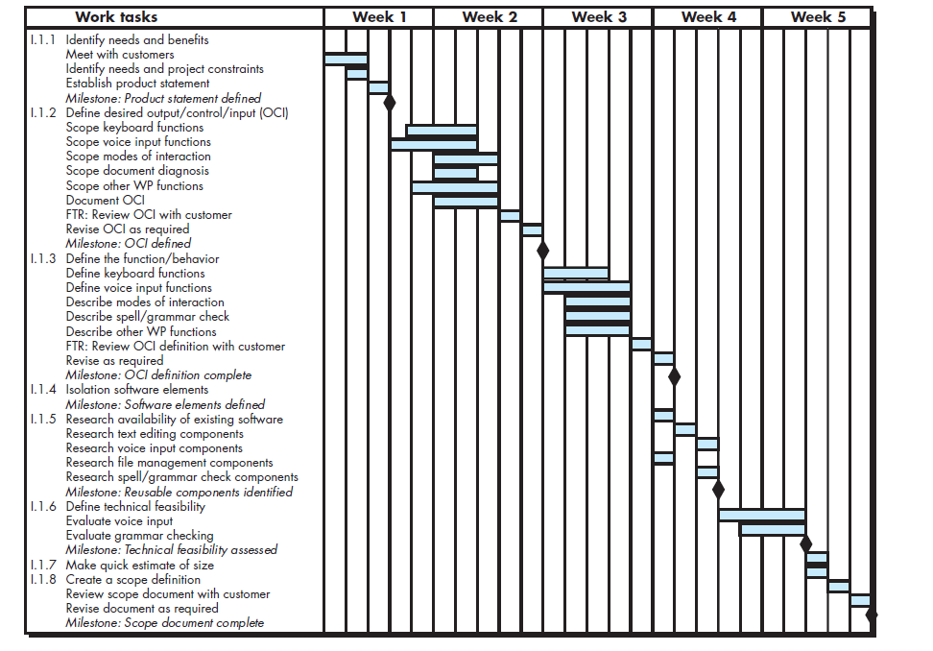
Timeline charts

Slide 25
Project tables
Once the information necessary for a time-line chart has been inputted, software project scheduling tools produce project tables
It is a tabular listing of
All project tasks,
Planned start & end dates of the tasks
Actual start and end dates of the tasks
Variety of related information of the tasks
They are used in conjunction with the time-line chart,
project tables enable you to track progress.

Slide 26
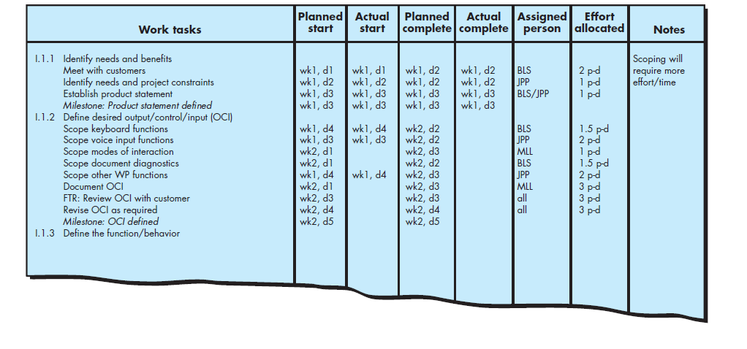
Project tables

Slide 27
TRACKING THE SCHEDULE
Project schedule defines the tasks and milestones to be tracked and controlled as the project proceeds.
Tracking can be accomplished in a number of different ways:

Slide 28
Methods for project tracking
Conducting periodic project status meetings
each team member reports progress and problems.
Evaluating the results of all reviews conducted
Determining whether formal project milestones have been accomplished by the scheduled date.

Slide 29
Methods for project tracking [2]
Comparing the actual start date to the planned start date for each project task listed in the resource table.
Meeting informally with practitioners
to obtain their subjective assessment of progress
To know problems on the horizon.
Using earned value analysis to assess progress quantitatively.

Slide 30
RELATIONSHIP BETWEEN PEOPLE & EFFORT

Slide 31
Introduction
If a software project is small,
the effort of only a single person is required to complete the project
As size of project increases,
effort of more people is required
Common myth that is still believed by many managers
“If we fall behind schedule, we can always add more programmers and catch up later in the project.”

Slide 32
Introduction
Adding people late in a project often has a disruptive effect on the project,
This causes schedules to slip even further.
The people who are added must learn the system,
People who teach them are the same people who were doing the work.
While teaching, no work is done,
So the project falls further behind
More people increase the no: of communication paths and the complexity of communication
Every new communication path requires additional effort and therefore additional time

Slide 33
Elasticity of project schedules
Project schedules are elastic
It is possible to compress a desired project completion date
by adding additional resources to some extent.
It is also possible to extend a completion date
by reducing the number of resources

Slide 34
PNR curve
The Putnam-Norden-Rayleigh (PNR) Curve
This provides an indication of the relationship between effort & delivery time for a software project.
The curve indicates a minimum value t_{o}
This specifies the least cost for delivery
Ie the delivery time that will result in the least effort
As we move left of t_{o}, the curve rises nonlinearly
i.e., as we try to accelerate delivery, effort required increases

Slide 35
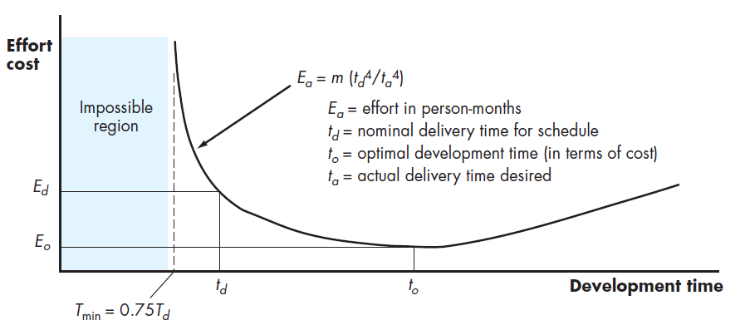
PNR curve

Slide 36
Example
Assume that a project team has estimated a level of effort
Ed (effort) will be required to achieve a nominal delivery time td.
It is possible to accelerate delivery
But the curve rises very sharply to the left of td .
PNR curve indicates that the project delivery time cannot be compressed much beyond 0.75 td
If we attempt further compression,
the project moves into “the impossible region”
risk of failure becomes very high.
The PNR curve also indicates that the lowest cost delivery option is to=2td .
The implication here is that delaying project delivery can reduce costs significantly.

Slide 37
Example
The number of delivered lines of code L, is related to effort and development time by the equation:
L = P x E^{1/3} t ^{4/3}
where E is development effort in person-months,
P is a productivity parameter
typical values for P range between 2000 and 12,000
t is the project duration in calendar months.
Rearranging this software equation, we can arrive at an expression for development effort E:
E= L³/ (P³t⁴ )
E is the effort expended (in person-years)
t is the development time in years.

Slide 38
DEFINING A TASK SET FOR SOFTWARE PROJECT

Slide 39
DEFINING A TASK SET FOR SOFTWARE PROJECT
An effective software process should define a collection of task sets,
A task set is a collection of
Software engineering work tasks
Related work products
Quality assurance points
Project milestones
that must be accomplished to complete a particular project.

Slide 40
DEFINING A TASK SET FOR SOFTWARE PROJECT
The task set must provide enough discipline to achieve high software quality.
It must not burden the project team with unnecessary work
To develop a project schedule, a task set must be distributed on the project time line.
The task set will vary depending upon
The project type
And the degree of rigor with which the software team decides to do its work.

Slide 41
Types of software projects
Concept development projects
Projects that are initiated to explore some new business concept or application of some new technology.
New application development projects
Projects that are undertaken as a consequence of a specific customer request.
Application enhancement projects
Projects that occur when existing software undergoes major modifications to
function,
performance,
interfaces that are observable by the end user.

Slide 42
Application maintenance projects
Projects that correct, adapt, or extend existing software in ways that may not be immediately obvious to the end user.
Reengineering projects
Projects that are undertaken with the intent of rebuilding an existing (legacy) system in whole or in part.

Slide 43
Factors that influence task set
Size of the project
Number of potential users
Mission criticality
Application longevity
Stability of requirements
Ease of customer/developer communication
Maturity of applicable technology
Performance constraints
Embedded and non embedded characteristics
Project staff
Reengineering factors.
These factors provide an indication of
the degree of rigor with which the software process should be applied.

Slide 44
Task set example
Consider a tasks associated with concept development software
Concept development projects are approached by applying the following major tasks:
Concept scoping
determines the overall scope of the project.
Preliminary concept planning
establishes the organization’s ability to undertake the work implied by the project scope.
Technology risk assessment
evaluates the risk associated with the technology to be implemented as part of the project scope.
Proof of concept
demonstrates the viability of a new technology in the software context.

Slide 45
Task set example
Concept implementation
implements the concept representation in a manner that can be reviewed by a customer
It is used for “marketing” purposes when a concept must be sold to other customers or Management.
Customer reaction
Reaction to the concept solicits feedback on a new technology concept
targets specific customer applications.

Slide 46
Refinement of major tasks
The major tasks (i.e., software engineering actions) described in the preceding section may be used to define a macroscopic schedule for a project.
However, the macroscopic schedule must be refined to create a detailed project schedule.
Refinement begins by taking each major task and decomposing it into a set of subtasks (with related work products and milestones).

Slide 47
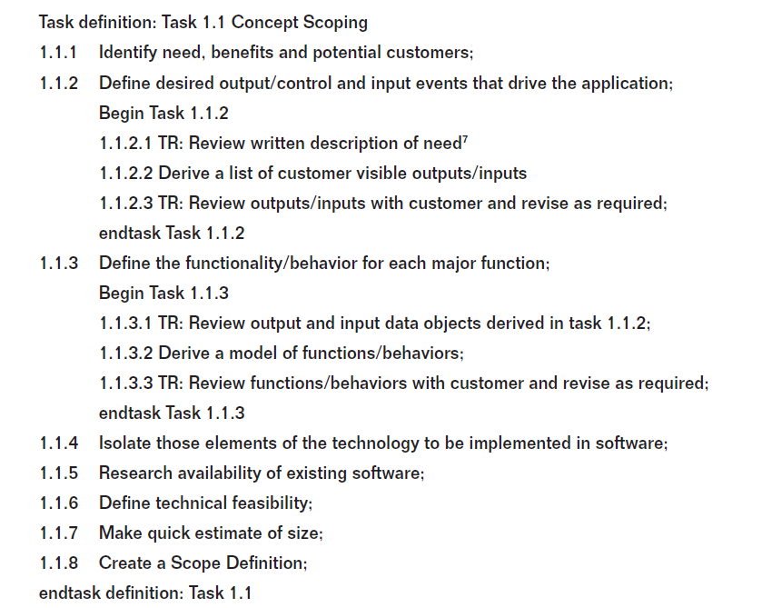
Example : concept scoping

Slide 48
SOFTWARE CONFIGURATION MANAGEMENT (SCM)

Slide 49
Introduction
Results of a s/w development consist of large no: of objects like
Source code
Design document
SRS etc
These results are called as deliverables
These object are referred and modified by a no: of s/w developers through out the life cycle
State of each object changes
as the development progresses
And when bugs are detected & fixed

Slide 50
Definition
Software Configuration management is the art of identifying, organizing, and controlling modifications to the software being built by a programming team.
The goal is to maximize productivity by minimizing mistakes

Slide 51
Necessity of s/w configuration management
Several problems occur if SCM is not done
Inconsistency problem when the objects are replicated
Problems associated with concurrent access
Providing a stable development environment
System accounting & maintaining status information
Handling variants

Slide 52
Inconsistency
Consider a situation where every developer has personal copy of an object
When developer makes changes to his local copy, this has to be intimated to other developers
If changes made are not intimated to other developers, different copies of the object becomes inconsistent
When modules are integrated, they wont work properly

Slide 53
concurrent access
Problems associated with concurrent access
Configuration management control the access to different deliverables
It enforces strict discipline regarding updation & storage of different objects
Otherwise several problems can occur

Slide 54
stable development environment
Providing a stable development environment
When a project is underway, team members need a stable environment to make progress
Suppose a developer is trying to integrate module A, with B and C
Other developer is keep on changing C
This creates problems
Configuration management prevents this by freezing the objects to form a baseline

Slide 55
Baseline
A baseline is a reference point in the software development life cycle marked by the completion and formal approval of a set of predefined work products
It is the status of all the objects under configuration control
When any object under configuration control is changes, a new base line is formed
Changing the object under configuration control
Developer is provided with a copy of baseline item
Requester makes changes to this pvt copy
After all modifications are made in this copy, the configuration is updated & new baseline is created
Baselines are archived periodically
Last baseline can be recovered when there is a disaster

Slide 56
accounting & maintaining status
System accounting & maintaining status information
System accounting denotes keeping track of who made a particular change to an object & when the change was made
Handling variants
Existence of variants of a s/w pdt causes problems
If there are several variants of the same module & a bug exists in one of them
This bug has to be fixed in all its variants
For that we need not fix it in each variant separately
Configuration management allows changes in one program top be reflected in all versions

Slide 57
SCM ACTIVITIES
SCM has 2 activities
Configuration identification
Involves deciding which parts of the s/m should be kept track of
Configuration control
Ensures that the changes to the s/m happen smoothly

Slide 58
CONFIGURATION MANAGEMENT TOOL
Project manager performs configuration management activity using configuration management tools
Functions
Helps to keep track of various deliverables
Project manager can quickly and unambiguously determine the current state of the project
Enables the developer to change various components in a controlled manner

Slide 59
Configuration identification
Project managers classify the deliverables of a project into 3 categories
Controlled
Pre-controlled
Uncontrolled

Slide 60
Configuration identification
Controlled object
Those objects that are already under configuration control
To change these objects, team members has to follow some formal procedures
Precontrolled objects
They are not yet under the configuration control
They eventually come under configuration control
Uncontrolled objects
They are not subject to configuration control
Controllable objects include both controlled and pre-controlled objects

Slide 61
Controllable objects
SRS document
Design document
Source code of each module
Test cases
Problem reports

Slide 62
Configuration management plans
This is written during the project planning phase
It consist of the list of all controlled objects
Managers should have a balance between controlling too much and too little
Too much controlling may create overheads
Less controlling lead to confusion & inconsistency

Slide 63
2. CONFIGURATION CONTROL
Configuration control allows only authorized changes to the controlled objects and prevents unauthorized changes
It is a process of managing the changes to the controlled objects

Slide 64
Steps to change the controlled object
Developer gets a private copy of the module by a reserve operation
Configuration management tool allows only one person to reserve a module at a time
Once a module is reserved, it does not allow any one else to reserve this module until the reserved module is restored
Prevents more than one developer to simultaneously reserve an object
This solves the problem associated with concurrent access

Slide 65
Procedure
Developer who need to change the module make a reserve request
When reserve command executes successfully, a pvt copy of the module is created in his local directory
All the changes are made in the pvt copy

Slide 66
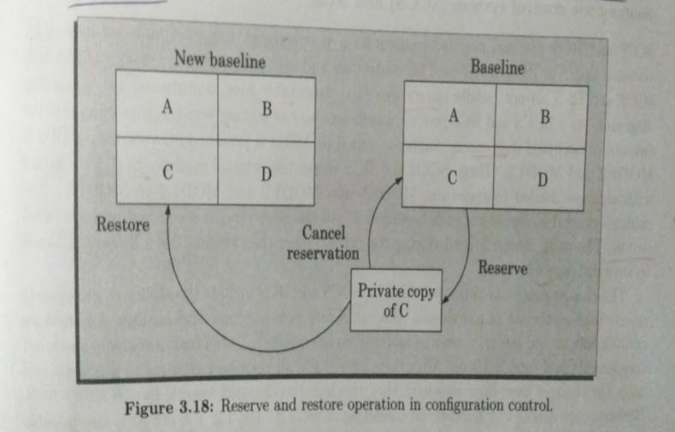

Slide 67
Procedure
After completing all the changes, these are to be restored in the configuration management repository
Restoring the changed module to the system configuration requires the permission of change control board (CCB)

Slide 68
CCB (change control board)
CCB constitutes the developers from the team
CCB reviews the changes made to the controlled objects
It certifies following things about the change
Change is well motivated
Developer has documented the effects of the change
Changes interacts well with the changes made by other developers
Appropriate people have validated the change
Tested the changed code& verified that the change is consistent

Slide 69
CCB
Once CCB reviews the changes to the module,
Project manager updates the old base line through a restore operation
Advantages
Developer can replace the original copy with his local copy only after the authorization of CCB
Avoid accidental overwriting
Only one developer can work on a module at a time
Avoid unintentional changes
Only manager can update the baseline after CCB approval

Slide 70
Source code control (SCCS)
SCCS is a configuration management tool
Available on UNIX s/m
Used for controlling & managing different version of text files
Do not handle binary files
Provide efficient way to store versions using minimum disk space
Eg: Module Mod has 3 versions
Mod1.1
Mod1.2
Mod1.3
SCCS store original module mod1.1 together with the changes needed to transform mod1.1 to mod1.2, mod1.2 to mod1.3

Slide 71
USER INTERFACE DESIGN

Slide 72
INTRODUCTION
User interface design creates an effective communication medium between a human and a computer.
Following a set of interface design principles, design identifies interface objects and actions and then creates a screen layout that forms the basis for a user interface prototype.
A software engineer designs the user interface by applying an iterative process that draws on predefined design principles.

Slide 73
Golden rules of UI design
1. Place the user in control.
2. Reduce the user’s memory load.
3. Make the interface consistent.

Slide 74
Place the user in control
Design principles
Define interaction modes in a way that does not force a user into unnecessary or undesired actions.
Provide for flexible interaction.
Allow user interaction to be interruptible and undoable.
Streamline interaction as skill levels advance and allow the interaction to be customized.
Hide technical internals from the casual user.
Design for direct interaction with objects that appear on the screen.

Slide 75
Reduce the user’s memory load
The more a user has to remember, the more error-prone the interaction will be.
System should “remember” pertinent information and assist the user with an interaction scenario that assists recall.

Slide 76
Design principles
Reduce demand on short-term memory.
Establish meaningful defaults.
Define shortcuts that are intuitive.
The visual layout of the interface should be based on a real-world metaphor.
Disclose information in a progressive fashion.

Slide 77
Make the interface consistent
The interface should present and acquire information in a consistent fashion.
All visual information must be organized according to design rules
Input mechanisms must be constrained to a limited set that is used consistently throughout the application
mechanisms for navigating from task to task must be consistently defined and implemented.

Slide 78
Design principles
Allow the user to put the current task into a meaningful context.
Maintain consistency across a complete product line.
If past interactive models have created user expectations, do not make changes unless there is a compelling reason to do so.

Slide 79
COMPUTER AIDED SOFTWARE ENGINEERING (CASE)

Slide 80
Introduction
Computer-aided software engineering (CASE) tools assist software engineering managers and practitioners in every activity associated with the software process.
CASE is the name given to software used to support software process activities such as
Requirements engineering
Design
Program development and testing
CASE tools include
Design editors
Data dictionaries
Compilers
Debuggers
System building tools and so on.

Slide 81
CASE tools and its scope
CASE tool is a tool that is used for providing automated support for s/w engineering
It is used to automate the activities associated with s/w development
CASE tools assist phase related tasks such as
Specification
Structured analysis
Design
Coding
Testing
CASE tools that focus on non phase activities such as
Project management
Configuration management

Slide 82
CASE tools and its scope[2]
CASE tools are used to improve software development & maintenance
It reduces the efforts of s/w development & maintenance
Help to develop better quality products more efficiently
Increase productivity
Help produce better quality s/w lower cost

Slide 83
CASE classification
CASE classifications help us understand
The types of CASE tools
Their role in supporting software process activities.
CASE tools can be classified based on three perspectives:
Functional perspective
Process perspective
Integration perspective

Slide 84
Functional perspective based classification
CASE tools are classified according to their specific function.
Eg: planning tools like PERT tools, estimation tools and spread sheets
Editing tools like text editors, diagram editors, word processors

Slide 86
Process perspective based classification
CASE tools are classified according to the process activities that they support.
Process phases are supported by a number of types of CASE tools.
Eg:
Estimating
Text editing
Document preparation
configuration management

Slide 88
Classification of CASE systems
Fuggetta proposes that CASE systems should be classified in three categories:
Tools
Workbenches
Environments

Slide 89
Tools
Tools support individual process tasks such as
Checking the consistency of a design,
Compiling a program
Comparing test results.
Tools may be general-purpose.
Standalone tools
Grouped into workbenches.

Slide 90
Workbenches
They support process phases or activities such as
Specification
Design
They normally consist of a set of tools with some greater or lesser degree of integration.

Slide 91
Environments
Environments support all or at least a substantial part of the software process.
They normally include several integrated workbenches.

Slide 93
CASE environment
Individual CASE tools are integrated to a common framework or environment
If different CASE tools are not integrated,
Data generated by one tool has to be inserted to other tool
Involve format conversions as the data developed by different tools will have different formats
This result in additional effort of exporting data from one tool & importing to another

Slide 94
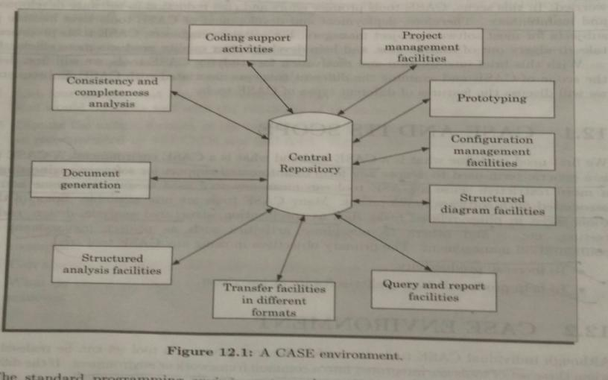

Slide 95
CASE environment provide a central repository
This is to have a consistent view of information's produced by different CASE tools
Different tools cover different stages of s/w development
They all access the info from this central repository
This is a data dictionary that contains the definitions of all data items
Through this central repository, all CASE tools in an environment shares the common info

Slide 96
CASE environment Vs programming environment
CASE environment
Facilitates the automation of step by step methodologies of s/w development
Programming environment
It is an integrated collection of tools to support only the coding phase of s/w development
Tools integrated in programming environment
Text editor
Compiler
Debugger
Eg:
Turbo C environment
Visual Basic
Visual C++

Slide 97
Architecture of a CASE environment
Components of CASE environment
User interface
Tool set
Object management system (OMS)

Slide 98
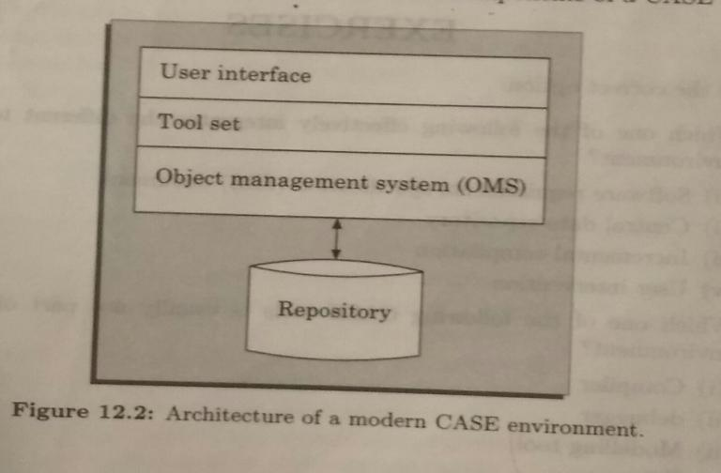

Slide 99
User interface
Provides a consistent framework for accessing different CASE tools
This helps user to interact with different tools
reduces overhead of learning how different tools are used
Object management system
CASE tools represent s/w products as a set of entities
OMS maps these entities into the underlying storage management system (repository)

Slide 100
Benefits of CASE
Cost saving through all s/w development phases
Effort reduction of 30 -40%
Improvements in quality
Less effort needed in every phases
Reduction of human errors
Produce high quality & consistent documents
Since data is stored in central repository, redundancy is reduced & maintain consistency
Reduces the drudgery of engineers work while creating and balancing DFD’s
Cost saving in maintenance
Creates an impact on the working style of a company

Slide 101
Changes needed to transform baseline file to next version is stored
This is called deltas

