Slide 1
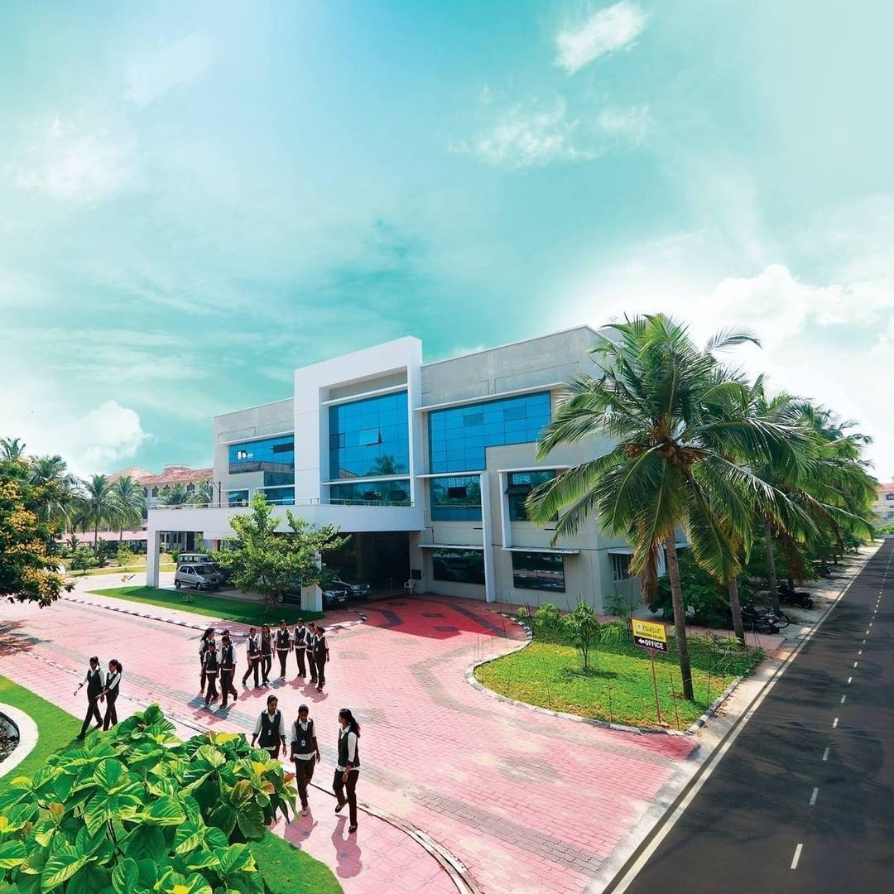

MARIAN ENGINEERING COLLEGE
KAZHAKUTTOM, TRIVANDRUM
REPORT OF
INNOVATION & ENTREPRENEURSHIP DEVELOPMENT CENTER (IEDC)
For the academic year 2025

Slide 2
VISION: Inspira Marian IEDC envisions creating a dynamic ecosystem where innovation thrives, and students are inspired to transform their ideas into impactful solutions. We aim to cultivate an entrepreneurial mindset that drives positive change in society and shapes a future led by creative thinkers and problem-solvers.
MISSION: Our mission is to empower students with the skills, resources, and mentorship needed to turn their entrepreneurial dreams into reality. By fostering a culture of collaboration, critical thinking, and continuous learning, Inspira Marian IEDC strives to support the growth of sustainable startups and nurture future leaders who can make a difference in the world.
At Inspira Marian IEDC, we believe in the transformative power of ideas and the potential of every student to become an innovator and leader. Through workshops, mentorship programs, networking opportunities, and access to cutting-edge resources, we create an environment where creativity and entrepreneurship flourish. Our initiatives are designed to encourage students to think beyond traditional boundaries, embrace challenges, and develop solutions that have a lasting impact on their communities and the world. By building strong industry connections and fostering a spirit of collaboration, we aim to bridge the gap between academic learning and real-world applications, ensuring that our students are well-equipped to lead in a rapidly evolving global landscape.

Slide 3
The activities of Marian IEDC was initiated by formulating the IEDC core committee of faculty members for the year 2025. Heads of the Departments of various departments nominated the following faculty members.
Sl No | Name | Designation | Department
1 | Dr. M. Manoj | Nodal Officer
2 | Abishek | Assistant Nodal Officer
3 | Sreena Ragul | Dept. Representative | ECE
4 | Sonia S Raj | Dept. Representative | ME
5 | Keerthi | Dept. Representative | CSE
6 | Asha Davood | Dept. Representative | CE
7 | Sumithra K | Dept. Representative | EEE
8 | Abishek | Dept. Representative | ES
9 | Ashwathy T K | Dept. Representative | AH
Department representatives addressed all classes in their respective departments and invited membership from interested students. Class representatives were selected and through interview process office bearers were selected

Slide 4
The following students were selected as Officer Bearers for one the upcoming year.
 | NAME | YEAR | SPECIALISATION
CEO | Adithya | 4th | CSE
COO | Anas | 4th | AH
CCO | Arjun | 4th | AH
CTO | Shibinsha | 4th | CSE
CFO | Vaishnav | 4th | ECE
CMO | Tomson | 3rd | CSE
CDO | Gauri | 3rd | ECE

Slide 5
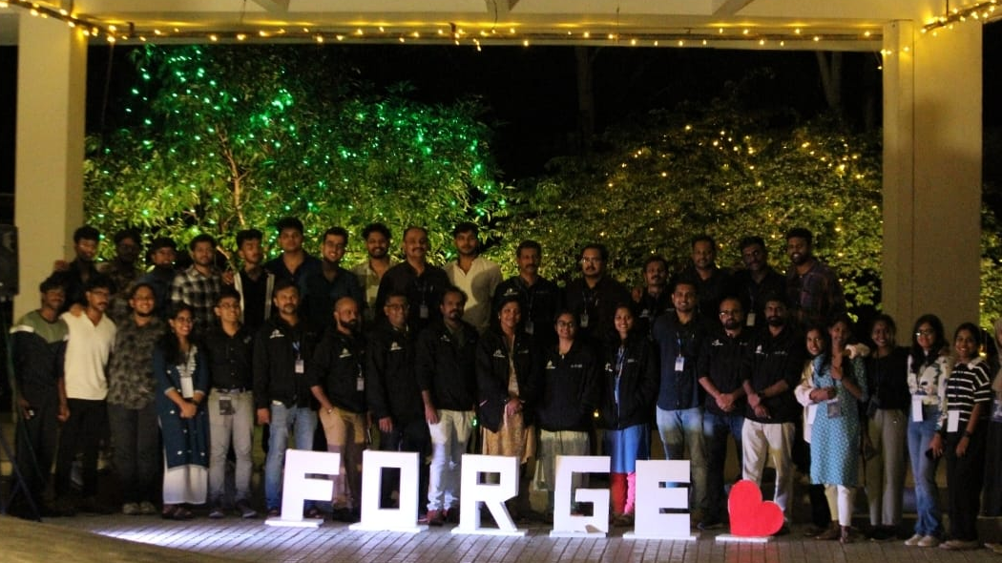
Forge
FORGE was a two-day residential bootcamp held on 13th & 14th June 2025 at Marian Engineering College,organized by Inspira Marian IEDC in association with Kerala Startup Mission (KSUM), the event brought together IEDC nodal officers and core committee members from across Kerala.The program focused on collaboration, idea exchange, and strategic planning, equipping participants to strengthen IEDCs as hubs of innovation and leadership.

Slide 6
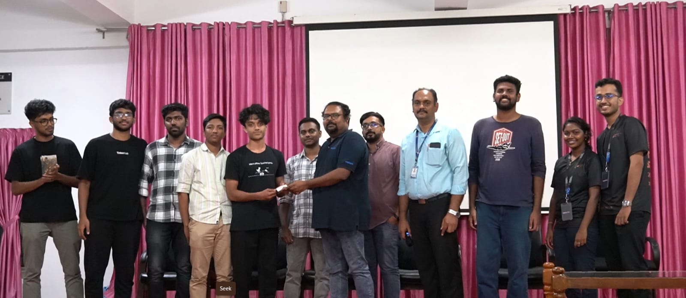
Eden 4.0
EDEN 4.0 was a 24-hour state-level hackathon held on 27th & 28th June 2025 at Marian Engineering College, Kazhakuttom.Organized by Inspira Marian IEDC, the event brought together students from across Kerala for an intensive coding and innovation experience.EDEN 4.0 fostered creativity, collaboration, and problem-solving, concluding with the recognition of outstanding teams and innovative solutions

Slide 7
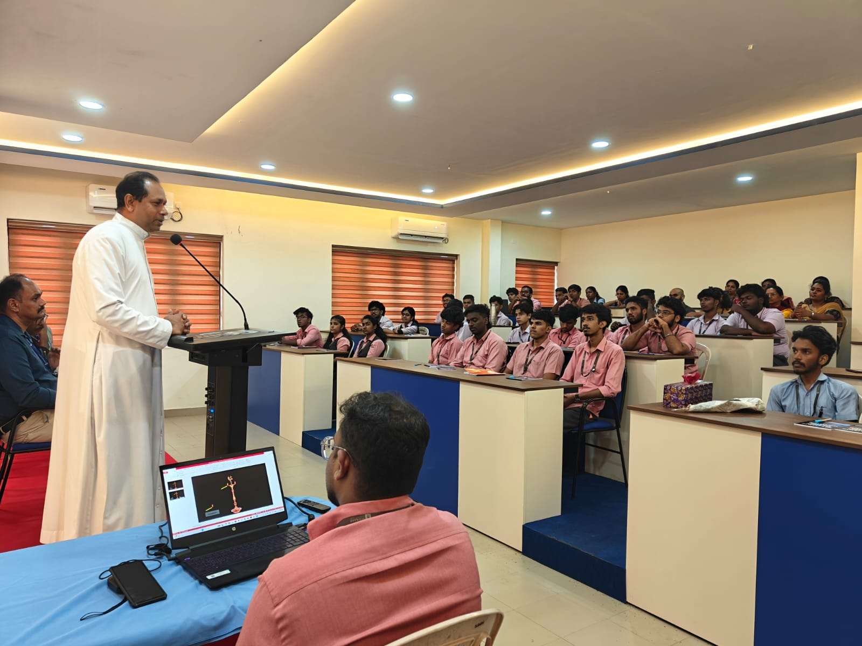
IPR Workshop
The IPR Workshop on Intellectual Property Rights and Patent Filing was conducted on 30th July 2025 at the MBA Seminar Hall, Marian Engineering College.Organized by the IEDC and Civil Engineering Department in association with the IPR Information Centre – Kerala (KSCSTE), the program targeted students and faculty.The workshop offered practical insights into patent filing and IPR fundamentals, supporting innovation and research culture.

Slide 8
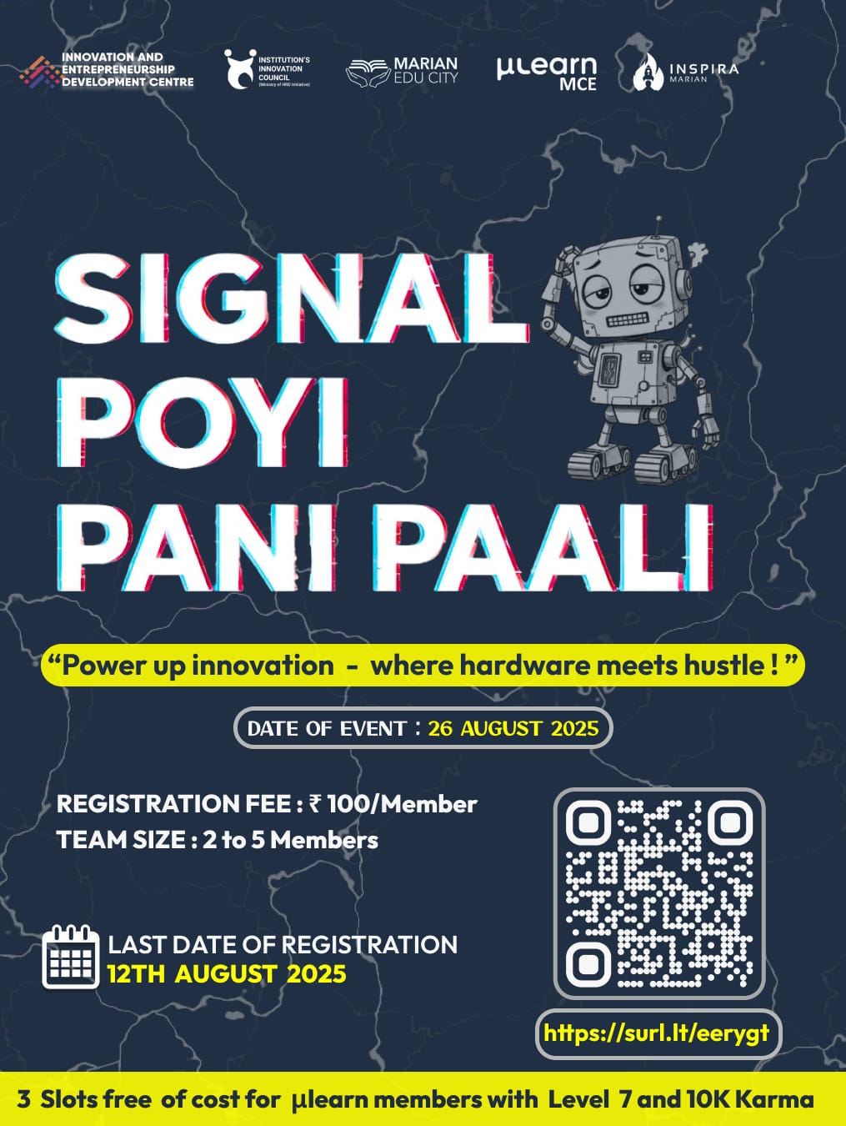
Signal Poyi Pani Paali
Signal Poyi Pani Paali, a hardware hackathon, was organized on 26th August 2025 at the IEDC Hall by IEDC in association with the Department of Electronics and µLearn MCE. The event encouraged students to develop and present innovative hardware-based solutions through teamwork and practical implementation. Overall, it provided an engaging platform that promoted creativity, collaboration, and real-world problem solving.

Slide 9
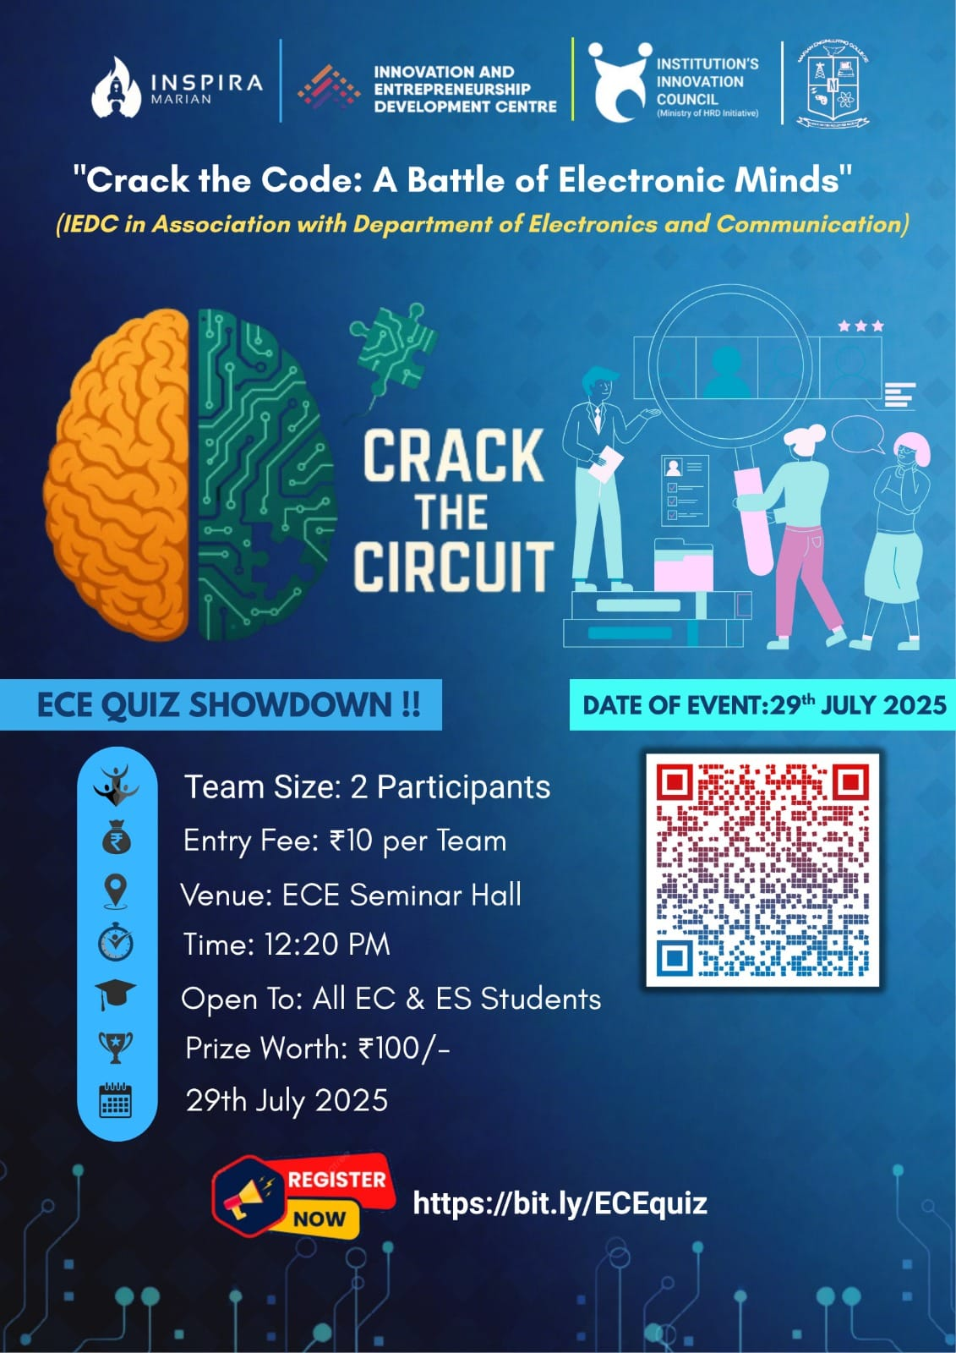
Crack the Circuit
Crack the Circuit, a quiz competition, was organized on 29th July 2025 at the EC Seminar Hall by IEDC in association with the Department of Electronics and Communication. The event tested the electronics knowledge and quick thinking of EC and ES students through a competitive two-round format. Overall, it was an engaging and intellectually stimulating program that encouraged teamwork and healthy competition.

Slide 10
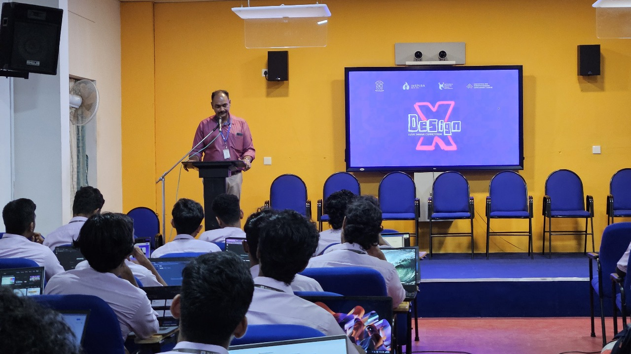
DesignX
DesignX was conducted on 18th July 2025 at the IEDC Hall, Marian Engineering College, organized by the IEDC CSE department in association with Marian IEDC. The event challenged 60 participants to redesign outdated websites, encouraging creativity, aesthetic sense, and problem-solving skills. Overall, DesignX provided an engaging platform for students to showcase their design talent and innovative thinking.

Slide 11
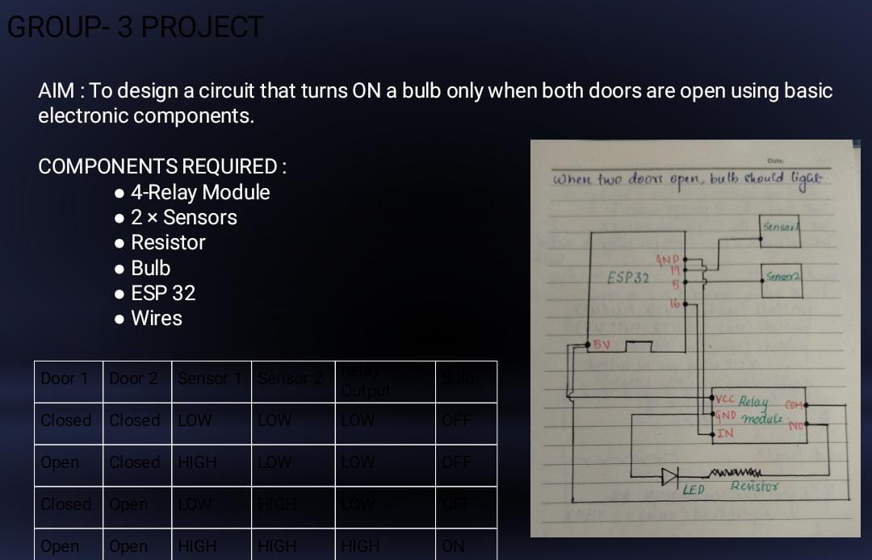
IOT Unplugged
IoT Unplugged: Build, Code, Connect was successfully organized from 2nd to 20th June 2025 at Bishop Pereira Hall, Marian Engineering College, in collaboration with Inspira Marian IEDC and the Electronics Association. The event aimed to introduce students to the world of IoT through hands-on learning, expert talks, and interactive sessions that highlighted real-world applications and innovation. Overall, the program was engaging and informative, inspiring participants to explore technology with creativity, collaboration, and social responsibility.

Slide 12

Career Compass
Inspira Marian IEDC hosted Career Compass on 11th July 2025 with Ms. Joan Liz Geogy, ex-IEDC lead and HR professional at UST, guiding students on technical recruitment, essential skills, and final-year project management. The session included an interactive Q&A and a resume-building segment, equipping participants with practical strategies to align their preparation with industry expectations.

Slide 13
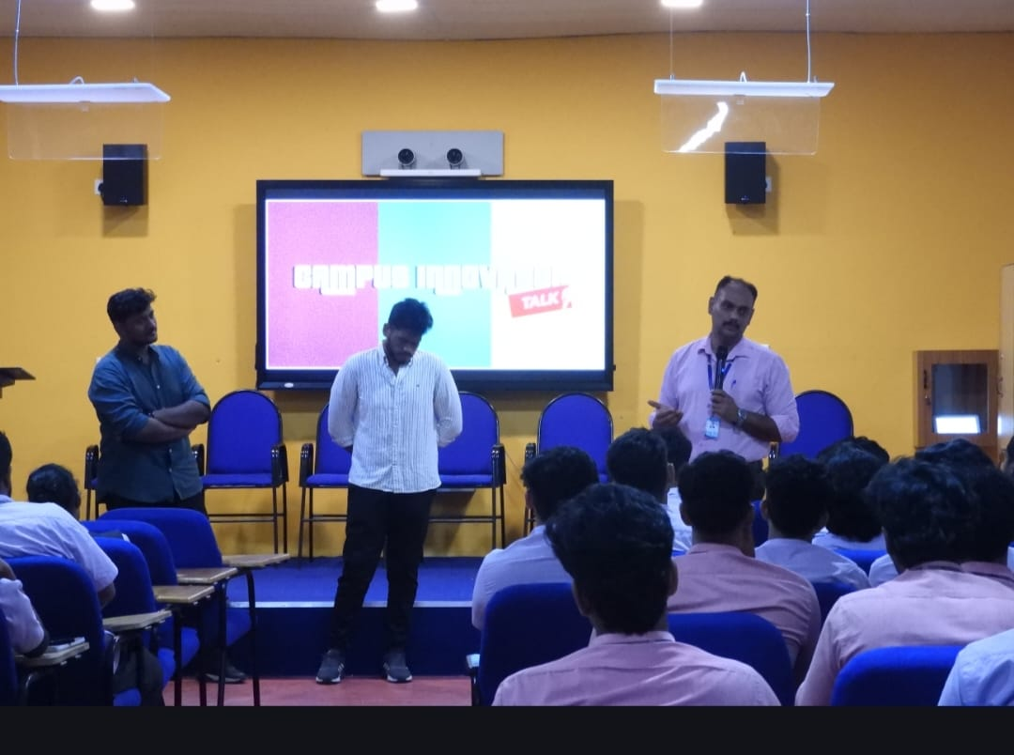
Campus Innovator Talk
The Campus Innovator Talk was held on 15th July 2025 and featured alumni entrepreneurs Mr. Vimal Victor and Mr. Aswin of TetherUp, who shared their journey from Marian Engineering College students to startup founders. They emphasized the role of IEDC in fostering innovation, the importance of market research, effective pitching, intellectual property, and exploring emerging industries, inspiring students to consider entrepreneurship as a meaningful career path.

Slide 14
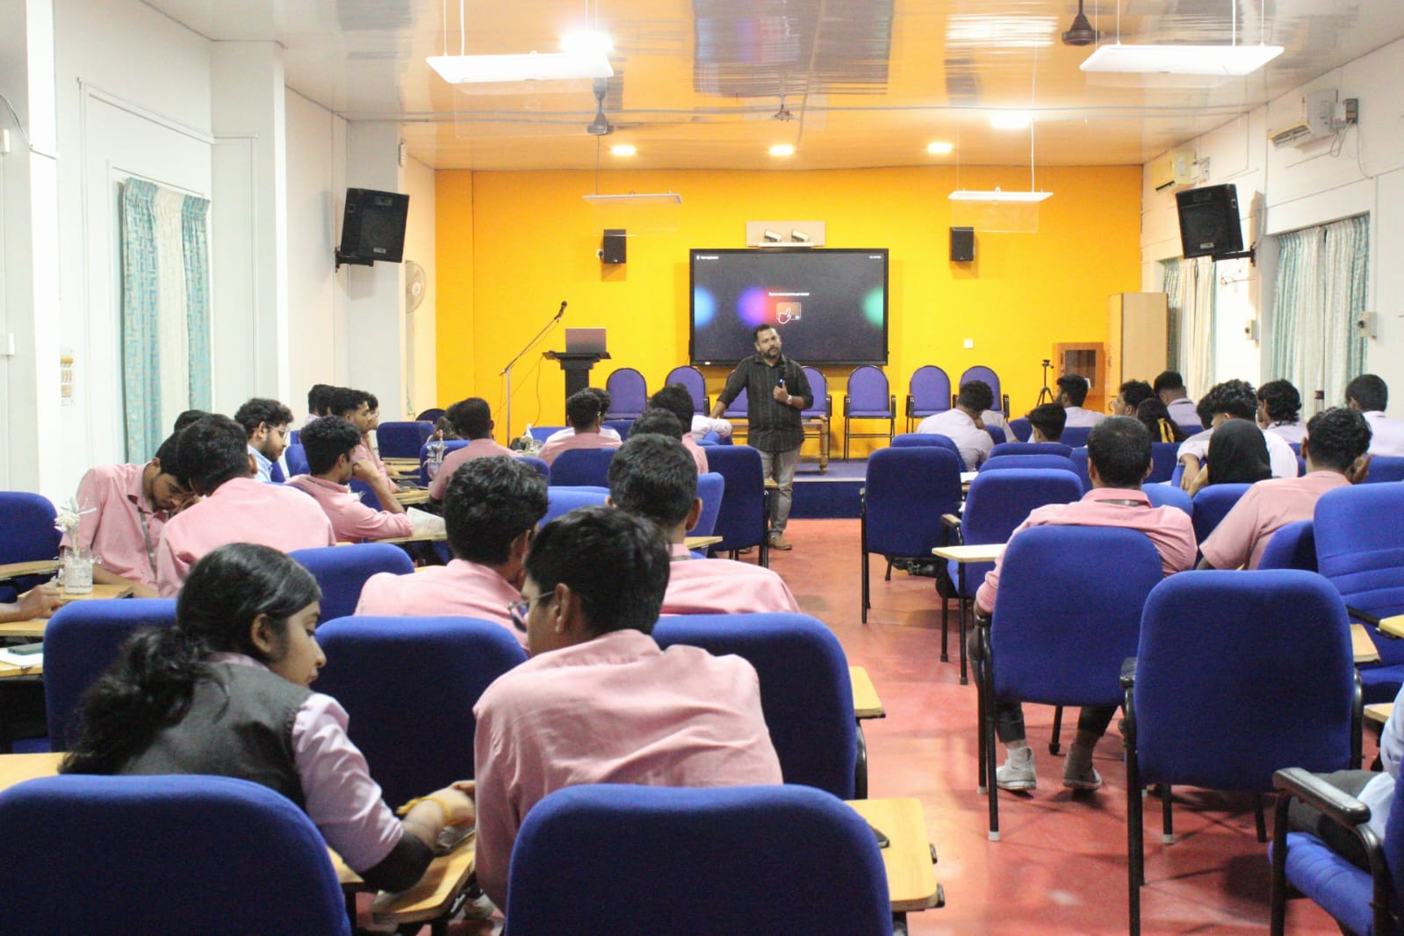
Spark and Scale
Spark and Scale took place on 21st July 2025 and was led by Dr. Pradeep Raj R, providing a hands-on entrepreneurship experience where students brainstormed, pitched, and developed product ideas in teams. The session covered core concepts of innovation, refining ideas, customer feedback, marketing strategies, and cross-functional collaboration, equipping students with practical skills and motivation to pursue startups confidently.

Slide 15
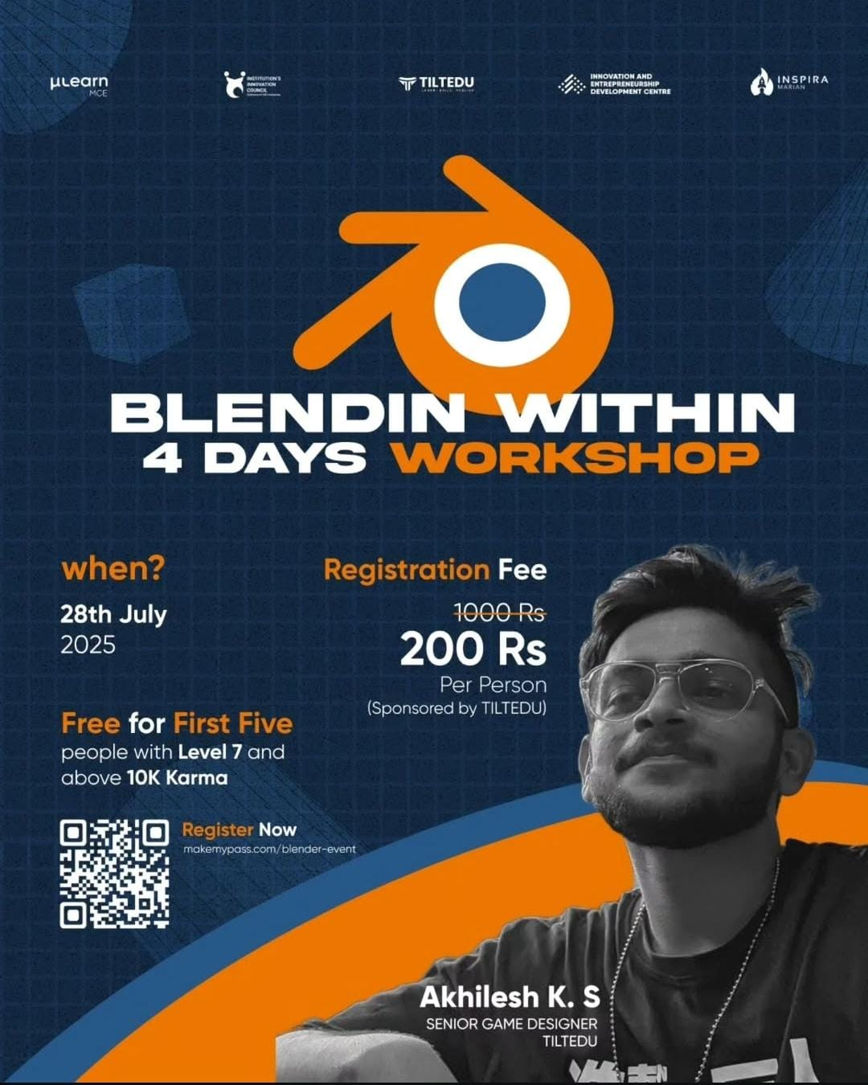
Blendin Within – Let’s 3D This!
The 4-day immersive sprint Blendin Within – Let’s 3D This! began on 28th July 2025 and introduced 42 Marian students to 3D design and animation using Blender. Led by Mr. Akhilesh K S, participants learned modeling, keyframing, and animation workflows through hands-on offline and online sessions. The program combined creativity with technical skills, providing industry insights and sparking interest in digital content creation and animation.

Slide 16
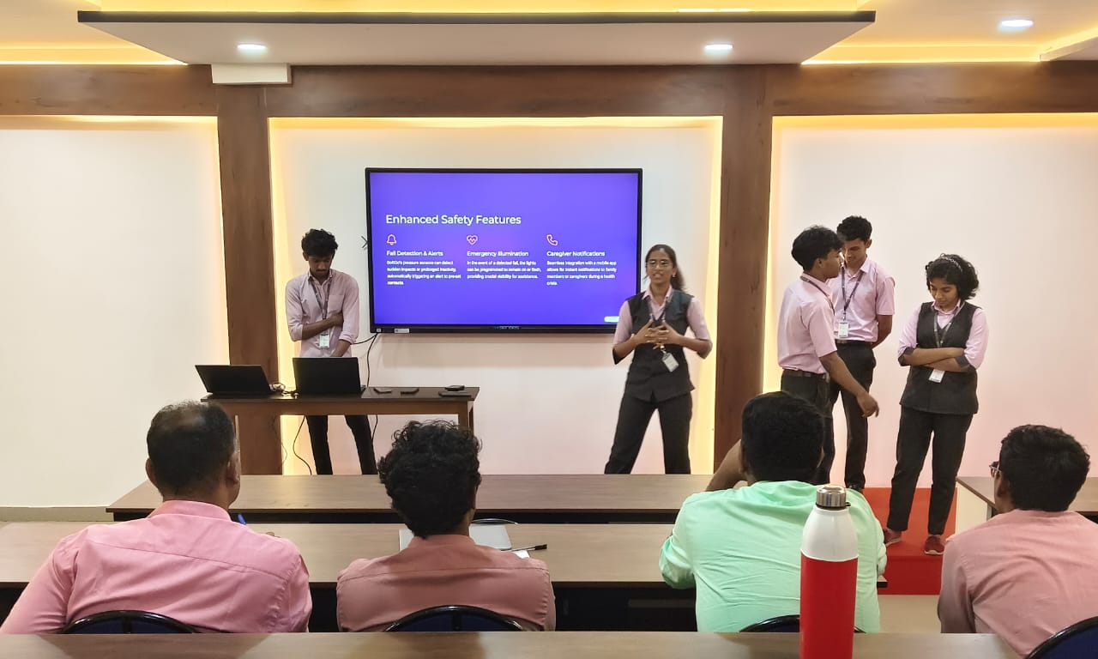
Shalyam 2.0
Shalyam 2.0 was held on 1st August 2025 as a one-day ideathon, enabling 13 student teams to pitch innovative solutions to real-world problems before judges Dr. M Manoj and Mr. Abhishek J B. The event encouraged creativity, practical problem-solving, public speaking, and entrepreneurial thinking, fostering a supportive environment for aspiring innovators to develop and refine their ideas.

Slide 17
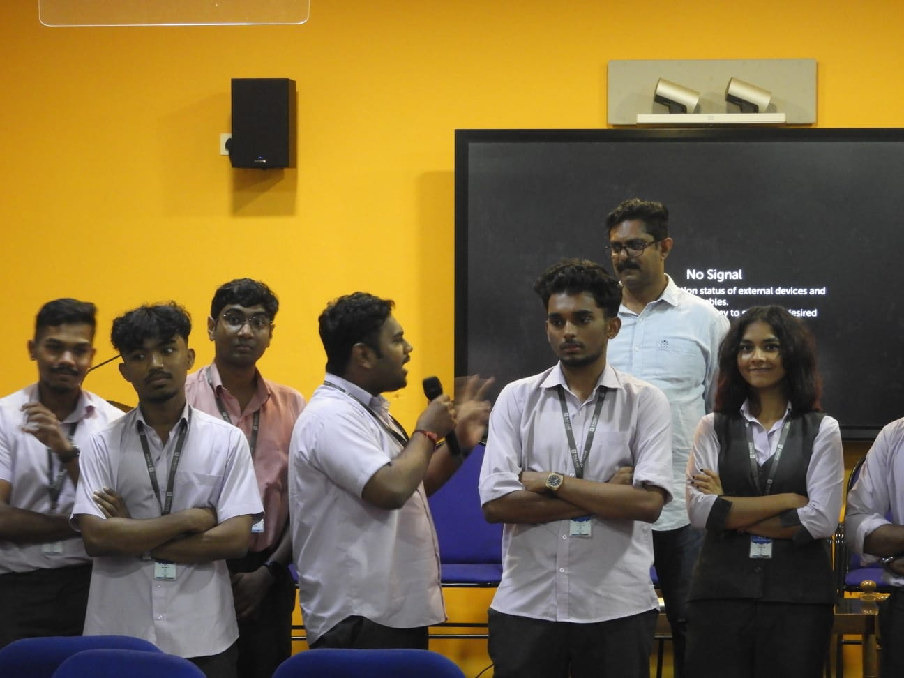
Founders’ Formula
Founders’ Formula took place on 29th September 2025 and focused on refining startup ideas and evaluating entrepreneurial potential. Conducted by Pramod S, the session involved interactive group discussions, case studies, and scenario-based exercises, helping students strengthen concepts, analyze real-world challenges, and strategize market entry, equipping them to turn innovative ideas into viable ventures.

Slide 18
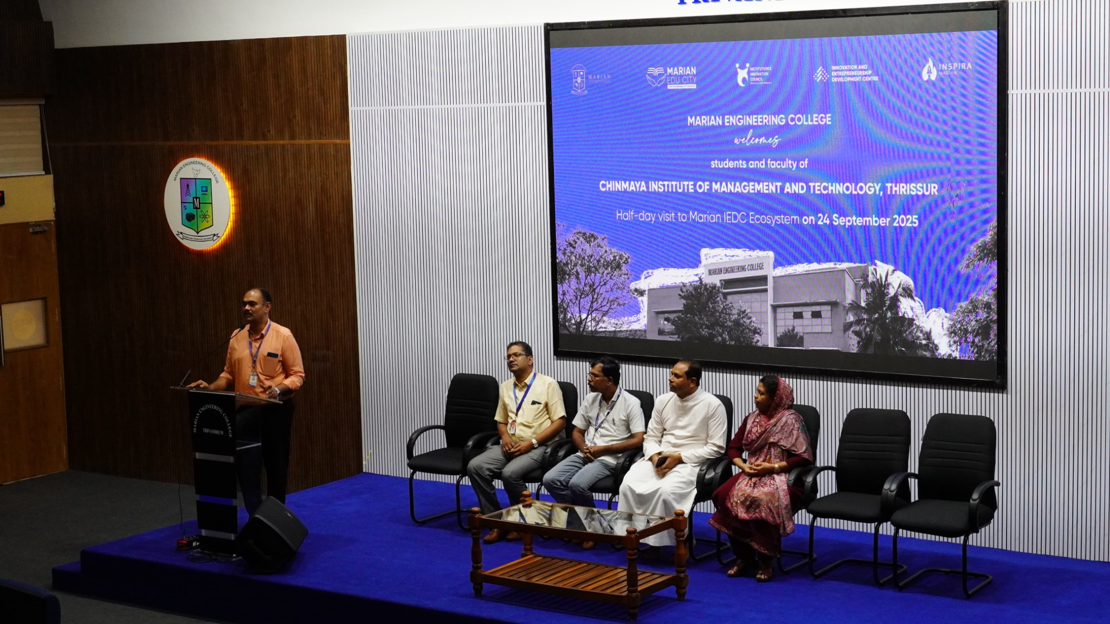
Chatbot Building and Ideation Workshop
The Chatbot Building and Ideation Workshop was conducted on 18th September 2025 at the IEDC Hall, Marian Engineering College, organized by the Inspira Marian IEDC, CSE Department. The session began with an introduction by Dr. M. Manoj, IEDC Nodal Officer. The technical session on chatbot development using Python was led by Ms. Manupriya Dhanush Vayalambron from LBSITW, followed by an ideation and soft skills session conducted by Mr. Druvajith Kalita, a certified life skills trainer. The workshop provided hands-on technical exposure while fostering creativity, teamwork, and problem-solving skills among participants from the AI and CSE departments.

Slide 19
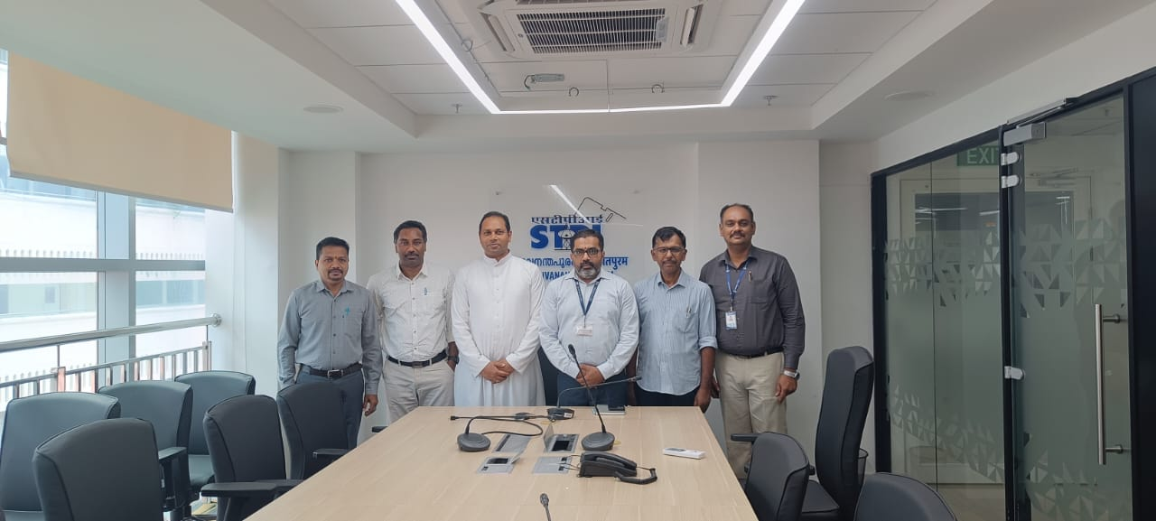
Meeting with STPI Director
A meeting with Shri. Ganesh Nayak, Director of the Software Technology Park of India (STPI), was held on 13th September 2025 to discuss the establishment of a Center of Entrepreneurship in collaboration with STPI. Representatives from Marian Engineering College participated in the discussion, which focused on potential areas of partnership, support mechanisms, and opportunities to strengthen the entrepreneurial ecosystem. The meeting marked an important step toward enhancing industry–institution collaboration.

Slide 20
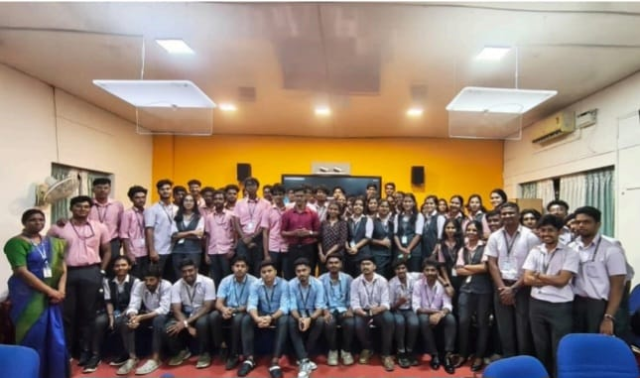
Visit from Chinmaya Institute of Management and Technology
A visit from the students and faculty of Chinmaya Institute of Management and Technology was organized on 24th September 2025 at Marian Engineering College by Inspira Marian IEDC. The session began with an overview of the IEDC ecosystem by Dr. M. Manoj, IEDC Nodal Officer, and was graced by Rev. Fr. Dr. A. R. John and Dr. Abdul Nizar, Principal of Marian Engineering College. The visiting delegates interacted with incubated startups and the IEDC Execom team, gaining valuable insights into the institution’s innovation and entrepreneurial ecosystem.

Slide 21
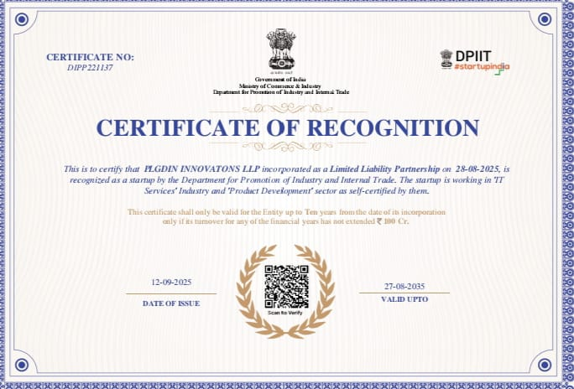
ACHIEVEMENTS
PluggedIn
PluggedIn was founded in Trivandrum by five Computer Science students to make IoT technology affordable and practical for everyday use.The startup began at Marian Engineering College, focusing on reliable, AI-driven solutions that improve lives through automation and connectivity.Virtually incubated at Marian TBI, PluggedIn has received DPIIT recognition under the Startup India initiative.

