Slide 1
SOFTWARE PROCESS MODELS

Slide 2
The software process
A structured set of activities required to develop a software system.
Many different software processes but all involve:
  Specification – defining what the system should do;
  Design and implementation – defining the organization of the system and implementing the system;
  Validation – checking that it does what the customer wants;
  Evolution – changing the system in response to changing customer needs.
A software process model is an abstract representation of a process. It presents a description of a process from some particular perspective.

Slide 3
Software process descriptions
When we describe and discuss processes, we usually talk about the activities in these processes such as specifying a data model, designing a user interface, etc. and the ordering of these activities.
Process descriptions may also include:
  Products, which are the outcomes of a process activity;
  Roles, which reflect the responsibilities of the people involved in the process;
  Pre- and post-conditions, which are statements that are true before and after a process activity has been enacted or a product produced.

Slide 4
Plan-driven and agile processes
Plan-driven processes are processes where all of the process activities are planned in advance and progress is measured against this plan.
In agile processes, planning is incremental and it is easier to change the process to reflect changing customer requirements.
In practice, most practical processes include elements of both plan-driven and agile approaches.
There are no right or wrong software processes.

Slide 5
Software process models
The waterfall model
  Plan-driven model. Separate and distinct phases of specification and development.
Incremental development
  Specification, development and validation are interleaved. May be plan-driven or agile.
Reuse-oriented software engineering
  The system is assembled from existing components. May be plan-driven or agile.
In practice, most large systems are developed using a process that incorporates elements from all of these models.

Slide 6
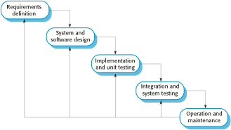
The waterfall model
Waterfall model phases
There are separate identified phases in the waterfall model:
  Requirements analysis and definition
  System and software design
  Implementation and unit testing
  Integration and system testing
  Operation and maintenance
The main drawback of the waterfall model is the difficulty of accommodating change after the process is underway. In principle, a phase has to be complete before moving onto the next phase.

Slide 7
The waterfall model
Waterfall model phases
There are separate identified phases in the waterfall model:
  Requirements analysis and definition
  System and software design
  Implementation and unit testing
  Integration and system testing
  Operation and maintenance
The main drawback of the waterfall model is the difficulty of accommodating change after the process is underway. In principle, a phase has to be complete before moving onto the next phase.

Slide 9
Waterfall model problems
Inflexible partitioning of the project into distinct stages makes it difficult to respond to changing customer requirements.
  Therefore, this model is only appropriate when the requirements are well-understood and changes will be fairly limited during the design process.
  Few business systems have stable requirements.
The waterfall model is mostly used for large systems engineering projects where a system is developed at several sites.
  In those circumstances, the plan-driven nature of the waterfall model helps coordinate the work.

Slide 10
Waterfall model problems
Inflexible partitioning of the project into distinct stages makes it difficult to respond to changing customer requirements.
  Therefore, this model is only appropriate when the requirements are well-understood and changes will be fairly limited during the design process.
  Few business systems have stable requirements.
The waterfall model is mostly used for large systems engineering projects where a system is developed at several sites.
  In those circumstances, the plan-driven nature of the waterfall model helps coordinate the work.

Slide 11
The Waterfall Model

Slide 12
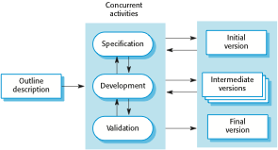
Incremental development

Slide 13
Incremental development
Incremental Development is based on the idea of developing an initial implementation, exposing this to user comment and evolving it through several versions until an adequate system has been developed. Specification, development and validation activities are interleaved rather than separate, with rapid feedback across activities.
It is better for business,e-commerce and software systems.
The customer can evaluate the system at a relatively early stage in the development to see if it delivers what is required. If not, then only the current increment has to be changed and possibly new functionality defined for later increments.

Slide 14
Example
Increment 1
Increment 2
Increment 3
SIGNUP OR LOGIN
SIGNUP OR LOGIN
send Friend Request
SIGNUP OR LOGIN
send Friend Request
Accept Friend Request

Slide 15
Incremental development benefits
The cost of accommodating changing customer requirements is reduced.
  The amount of analysis and documentation that has to be redone is much less than is required with the waterfall model.
It is easier to get customer feedback on the development work that has been done.
  Customers can comment on demonstrations of the software and see how much has been implemented.
More rapid delivery and deployment of useful software to the customer is possible.
  Customers are able to use and gain value from the software earlier than is possible with a waterfall process.

Slide 16
Incremental development problems
The process is not visible.
  Managers need regular deliverables to measure progress. If systems are developed quickly, it is not cost-effective to produce documents that reflect every version of the system.
System structure tends to degrade as new increments are added.
  Unless time and money is spent on refactoring to improve the software, regular change tends to corrupt its structure. Incorporating further software changes becomes increasingly difficult and costly.

Slide 17
2-Process activities
Real software processes are inter-leaved sequences of technical, collaborative and managerial activities with the overall goal of specifying, designing, implementing and testing a software system.
The four basic process activities of specification, development, validation and evolution are organized differently in different development processes.
In the waterfall model, they are organized in sequence, whereas in incremental development they are inter-leaved.

Slide 18
2.1 Software specification/requirement Engg
The process of establishing and defining what services are required from the system and identifying the constraints on the system’s operation and development.
Is a particularly critical stage of the software process as errors at this stage inevitably lead to later problems in system design and implementation.
RE process aims to produce an agreed requirements document that specifies a system satisfying stakeholder requirements.
Requirements are presented at two levels:
End users and customers need a high level statement of the requirements;
system developers need a more detailed system specification.

Slide 19
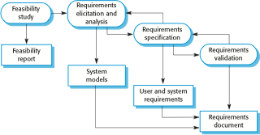
The requirements engineering process

Slide 20
Software specification
The process of establishing what services are required and the constraints on the system’s operation and development.
Requirements engineering process constitute 4 main activities
  1)Feasibility study
    Is it technically and financially feasible to build the system?
    Developed within the existing budgetary constraints.(cost effective)
  2)Requirements elicitation and analysis
    What do the system stakeholders require or expect from the system?
    Observations from existing systems, discussions with potential users ,task analysis.
    This may involve the development of one or more models and prototypes

Slide 21
  3)Requirements specification
    Is the activity of translating the information gathered during the analysis activity into a document
    Two types of requirements
    User requirements :are abstract statements of the system requirements for the customer and end user of the system.
    System requirements are a more detailed description of the functionality to be provided.
  4)Requirements validation
    Checking the validity of the requirements(realism,consistent/complete)

Slide 22
2.2 Software design and implementation
The process of converting the system specification into an executable system.
Software design
  Design a software structure that realises the specification;
Implementation
  Translate this structure into an executable program;
The activities of design and implementation are closely related and may be inter-leaved.

Slide 23
Software design and implementation
Software platform-the environment in which software will execute.
Information about this platform is an essential input to the design process,as designers must decide how best to integrate it with the software ‘s environment.
The requirement specification is the description of the functionality the software must provide and its performance and dependability requirements.
If the system is to process existing data, then the description of that data may be included in the platform specification.
Otherwise ,the data description must be an input to the design process so that the system data organization to be defined.

Slide 24
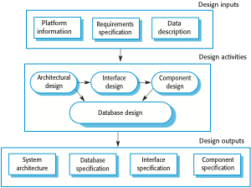

Slide 25
Abstract model of the process showing the inputs to the design process,process activities and the documents produced as outptsfrom this process.

Slide 26
Four activities that may part of the design process for information system.
Architectural design-Identify the overall structure of the system,the prinipal components,their relationship,and how they are distributed.
Interface Design-define interface between system components. With a precise interface
a component can be used without other components knowing how it is implemeted. you
Component -where you take each system component and design how it will operate.
Database design, where you design the system data structures and how these are to be represented in a database. The work depends on whether an existing database is to be reused or a new database is to be created.

Slide 27

MANAGEMENT OF SOFTWARE SYSTEMS CST 309 S5 CSE(KTU)
◆ Software platform-the environment in which software will execute.
◆ Information about this platform is an essential input to the design process, as designers must decide how best to integrate it with the software‘s environment.
◆ The requirement specification is the description of the functionality the software must provide and its performance and dependability requirements.
◆ If the system is to process existing data, then the description of that data
may be included in the platform specification.
◆ Otherwise, the data description must be an input to the design process so that the system data organization to be defined.
Design Activities
Architectural design, where you identify the overall structure of the system, the principal components (sometimes called sub-systems or modules), their relationships and how they are distributed.
Interface design, where you define the interfaces between system components. This interface specification must be unambiguous
Component design, where you take each system component and design how it will operate.
Database design, where you design the system data structures and how these are to be represented in a database. The work depends on whether an existing database is to be reused or a new database is to be created.
3. Software Validation
Verification and validation (V & V) is intended to show that a system conforms to its specification and meets the requirements of the system customer.
Involves checking processes such as inspections and reviews.
System testing involves executing the system with test cases that are derived from the specification of the real data to be processed by the system.
Testing is the most commonly used V & V activity.
Stages of Testing
3 stage process
KAVITHA V K
DEPT OF CSE

Slide 28
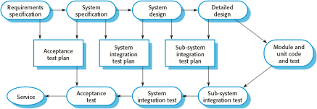
MANAGEMENT OF SOFTWARE SYSTEMS CST 309 S5 CSE(KTU)
System components are tested (component defects are discovered early in the process) then the integrated system is tested, (interface problems are found when the system is integrated), finally the system is tested with the customer’s data.
Testing Stages
Development or component testing
  Individual components are tested independently;
  Components may be functions or objects or coherent groupings of these entities.
  Test automation tools such as JUnit that can rerun component tests when new versions of the components are created, are commonly used.
System testing
  Testing of the system as a whole.
  Concerned with showing the system meets its functional and non-functional requirements, Testing of emergent properties is particularly important.
Acceptance testing(alpha testing)
  This is the final stage in the testing process before the system is accepted for operational use.
  The system is tested with data supplied by the system customer rather than with simulated test data .Testing with customer data to check that the system meets the customer’s needs.
Testing Phases in a Plan-Driven Software Process
DEPT OF CSE

Slide 29
MANAGEMENT OF SOFTWARE SYSTEMS CST 309 S5 CSE(KTU)
◆ Acceptance testing(alpha testing)
◆ Alpha Testing is a type of software testing performed to identify bugs before releasing the product to real users or to the public. Alpha Testing is one of the user acceptance testing.
◆ Custom systems are developed for a single client
◆ This alpha testing process continues until the system developer and the
client agree that the delivered system is an acceptable implementation of requirements.
Beta testing
When software is to be marketed as a software product, beta testing is used.
Beta Testing is performed by real users of the software application in a real environment.
This involves delivering a system to a number of potential users who agree to use that system.
They report problem to system developers.
This exposes the product to real use and detects errors that may not have been anticipated by the system builders.
After this feedback, the system is modified and released either for further beta testing or general sale.
KAVITHA V K
DEPT OF CSE

Slide 30
MANAGEMENT OF SOFTWARE SYSTEMS CST 309
S5 CSE(KTU)
Alpha Testing | Beta Testing
Alpha testing involves both the white box and black box testing. | Beta testing commonly uses black box testing.
Alpha testing is performed by testers who are usually internal employees of the organization. | Beta testing is performed by clients who are not part of the organization.
Alpha testing is performed at developer’s site. | Beta testing is performed at end-user of the product.
Reliability and security testing are not checked in alpha testing. | Reliability, security and robustness are checked during beta testing.
Alpha testing ensures the quality of the product before forwarding to beta testing. | Beta testing also concentrates on the quality of the product but collects users input on the product and ensures that the product is ready for real time users.
Alpha testing requires a testing environment or a lab. | Beta testing doesn’t require a testing environment or lab.
Alpha testing may require long execution cycle. | Beta testing requires only a few weeks of execution.
Developers can immediately address the critical issues or fixes in alpha testing. | Most of the issues or feedback collected from beta testing will be implemented in future versions of the product.
KAVITHA V K
DEPT OF CSE

Slide 31

MANAGEMENT OF SOFTWARE SYSTEMS CST 309 S5 CSE(KTU)
4. Software Evolution
Software is inherently flexible and can change.
As requirements change through changing business circumstances, the software that supports the business must also evolve and change.
Although there has been a demarcation between development and evolution (maintenance) this is increasingly irrelevant as fewer and fewer systems are completely new.
Coping with change
Change is inevitable in all large software projects.
  Business changes lead to new and changed system requirements
  New technologies open up new possibilities for improving implementations
  Changing platforms require application changes
Change leads to rework so the costs of change include both rework (e.g. re-analysing requirements) as well as the costs of implementing new functionality.
Reducing the Costs of Rework
Change avoidance, where the software process includes activities that can anticipate possible changes before significant rework is required.
  For example, a prototype system may be developed to show some key features of the system to customers.
Change tolerance, where the process is designed so that changes can be accommodated at relatively low cost.
  This normally involves some form of incremental development. Proposed changes may be implemented in increments that have not yet been developed.
KAVITHA V K
DEPT OF CSE

Slide 32
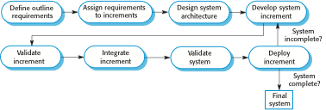
MANAGEMENT OF SOFTWARE SYSTEMS CST 309
S5 CSE(KTU)
Incremental Delivery Incremental Delivery Problems
Most systems require a set of basic facilities that are used by different parts of the system.
  As requirements are not defined in detail until an increment is to be implemented, it can be hard to identify common facilities that are needed by all increments.
The essence of iterative processes is that the specification is developed in conjunction with the software.
  However, this conflicts with the procurement model of many organizations, where the complete system specification is part of the system development contract.
Boehm’s spiral model
Process is represented as a spiral rather than as a sequence of activities with backtracking.
Each loop in the spiral represents a phase in the process.
No fixed phases such as specification or design - loops in the spiral are chosen depending on what is required.
Risks are explicitly assessed and resolved throughout the process.
KAVITHA V K
DEPT OF CSE

Slide 33
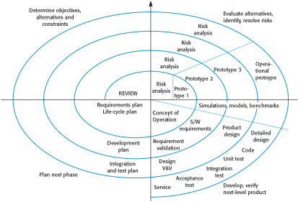
MANAGEMENT OF SOFTWARE SYSTEMS CST 309
S5 CSE(KTU)
Each loop in the Spiral Model is split into 4 Sectors
Objective setting
  Specific objectives for the phase are identified. Constraints on the process and the product are identified and a detailed management plan is drawn up. Project risks are identified. Alternative strategies may planned.
Risk assessment and reduction
  Risks are assessed and activities put in place to reduce the key risks.
Development and validation
  A development model for the system is chosen which can be any of the generic models.
Planning
  The project is reviewed and the next phase of the spiral is planned. Spiral Model Usage
Spiral model has been very influential in helping people think about iteration in software processes and introducing the risk-driven approach to development.
In practice, however, the model is rarely used as published for practical software development.
KAVITHA V K
DEPT OF CSE

Slide 34
MANAGEMENT OF SOFTWARE SYSTEMS CST 309
S5 CSE(KTU)
Agile Software Development
Rapid software development became known as agile development or agile methods. Rapid development and delivery is now often the most important requirement for software systems
Businesses operate in a fast changing requirement and it is practically impossible to produce a set of stable software requirements
Software has to evolve quickly to reflect changing business needs.
Agile development characteristics
Specification, design and implementation are inter-leaved, there is no detailed system specification, and design documentation is minimized or generated automatically by the programming environment used to implement the system.
System is developed as a series of versions with stakeholders involved in version evaluation. They may propose changes to the software and new requirements that should be implemented in a later version of the system.
Extensive tool support is used to support the development process. Tools that may be used include automated testing tools, tools to support configuration management, and system integration and tools to automate user interface production.User interfaces are often developed using an IDE and graphical toolset.
Agile methods are incremental development methods in which the increments are small,
and, typically, new releases of the system are created (frequent release)and made available to customers every two or three weeks. They involve customers in the development process to get rapid feedback on changing requirements. They minimize documentation by using informal communications rather than formal meetings with written documents.
In a plan-driven software development process, iteration occurs within activities, with formal documents used to communicate between stages of the process. For example, the requirements will evolve, and, ultimately, a requirements specification will be produced. This is then an input to the design and implementation process.
In an agile approach, iteration occurs across activities. Therefore, the requirements and the design are developed together rather than separately
KAVITHA V K
DEPT OF CSE

Slide 35
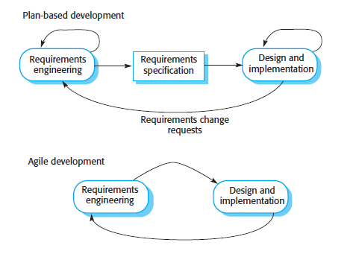
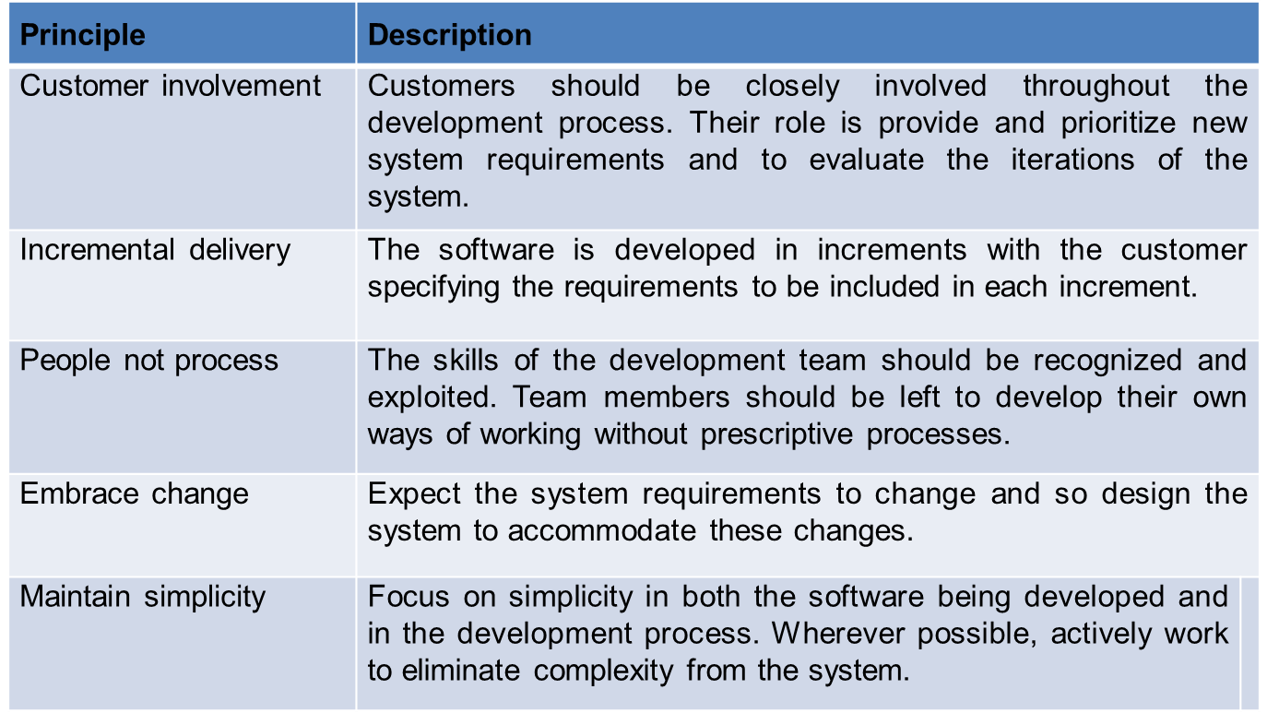
MANAGEMENT OF SOFTWARE SYSTEMS CST 309
S5 CSE(KTU)
Agile Methods
  Dissatisfaction with the overheads involved in software design methods of the 1980s and 1990s led to the creation of agile methods. These methods:
    Focus on the code rather than the design
    Are based on an iterative approach to software development
    Are intended to deliver working software quickly and evolve this quickly to meet changing requirements.
  The aim of agile methods is to reduce overheads in the software process (e.g. by limiting documentation) and to be able to respond quickly to changing requirements without excessive rework.
Principles of agile methods
KAVITHA V K
DEPT OF CSE

Slide 36
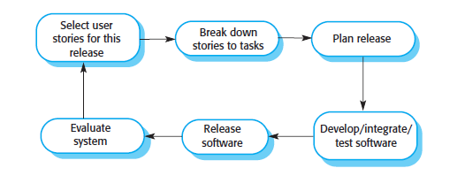
MANAGEMENT OF SOFTWARE SYSTEMS CST 309
S5 CSE(KTU)
Agile Manifesto
We are uncovering better ways of developing software by doing it and helping others do it. Through this work we have come to value:
Individuals Working Customer
and software
interactions over processes and tools over comprehensive
documentation negotiation
collaboration over contract
Responding to change over following a plan
That is, while there is value in the items on the right, we value the items on the left more.
Agile Development Techniques
XP: Figure illustrates the XP process an increment of the system that is being developed.
XP Release cycle
In XP, requirements are expressed as scenarios (called user stories), which are implemented directly as a series of tasks. Programmers work in pairs and develop tests for each task before writing the code. All tests must be successfully executed when new code is integrated into the system. There is a short time gap between releases of the system.
Extreme programming was an agile practices that were summarized and reflect the principles of the agile manifesto:
1. Incremental development is supported through small, frequent releases of the system. Requirements are based on simple customer stories or scenarios that are used as a basis for deciding what functionality should be included in a system increment.
KAVITHA V K
DEPT OF CSE

Slide 37
MANAGEMENT OF SOFTWARE SYSTEMS CST 309 S5 CSE(KTU)
Customer involvement is supported through the continuous engagement of the customer in the development team. The customer representative takes part in the development and is responsible for defining acceptance tests for the system.
People, not process, are supported through pair programming, collective ownership of the system code, and a sustainable development process that does not involve excessively long working hours.
Change is embraced through regular system releases to customers, test-first development, refactoring to avoid code degeneration, and continuous integration of new
functionality.
Maintaining simplicity is supported by constant refactoring that improves code quality and by using simple designs that do not unnecessarily anticipate future changes to the
system.
XP programming practices
Some important practices used in the agile development (XP) are User stories:
Software requirements always change. In Agile methods , requirements elicitation is integrated with development by the idea of “user stories” where a user story is a scenario of use that might be experienced by a system user.
After the discussion of development team with customer, they develop a “story card” that briefly describes a story that encapsulates the customer needs. The development team then aims to implement that scenario in a future release of the software.
User stories may be used in planning system iterations. Once the story cards have been developed, the development team breaks these down into tasks and estimates the effort and resources required for implementing each task.
This usually involves discussions with the customer to refine the requirements. The customer then prioritizes the stories for implementation, choosing those stories that can be used immediately to deliver useful business support.
The intention is to identify useful functionality that can be implemented in about two weeks, when the next release of the system is made available to the customer.
If changes are required for a system that has already been delivered, new story cards are developed and again, the customer decides whether these changes should have priority over new functionality.
User stories can be helpful in getting users involved in suggesting requirements during an initial predevelopment requirements elicitation activity.
Cons:
  The principal problem with user stories is completeness. It is difficult to judge if enough user stories have been developed to cover all of the essential requirements of a system.
KAVITHA V K
DEPT OF CSE

Slide 38
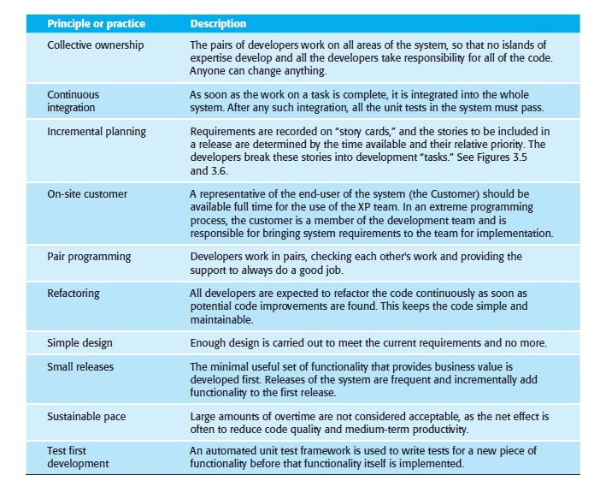
MANAGEMENT OF SOFTWARE SYSTEMS CST 309 S5 CSE(KTU)
It is also difficult to judge if a single story gives a true picture of an activity. Experienced users are often so familiar with their work that they leave things out when describing it.
Refactoring:
Changes will always have to be made to the code being developed. Refactoring means that the programming team look for possible improvements to the software and implements them immediately.
Refactoring improves the software structure and readability and avoids the structural deterioration that naturally occurs when software is changed.
KAVITHA V K
DEPT OF CSE

Slide 39
MANAGEMENT OF SOFTWARE SYSTEMS CST 309 S5 CSE(KTU)
Test-first development:
Extreme Programming developed a new approach to program testing to address the difficulties of testing without a specification. Testing is automated and is central to the development process, and development cannot proceed until all tests have been successfully executed. The key features of testing in XP are:
test-first development:
  Write test before write the code.
  Writing tests implicitly defines both an interface and a specification of behaviour for the functionality being developed.
  Problems of requirements and interface misunderstandings are reduced.
  Test-first development requires there to be a clear relationship between system requirements and the code implementing the corresponding requirements.
  In XP, this relationship is clear because the story cards representing the requirements are broken down into tasks and the tasks are the principal unit of implementation.
  In test-first development, the task implementers have to thoroughly understand the specification so that they can write tests for the system.
  This means that ambiguities and omissions in the specification have to be clarified before implementation begins. It also avoids the problem of “test- lag.” This may happen when the developer of the system works at a faster pace than the tester.
Incremental test development from scenarios,
  Develop each tasks, so that the development schedule can be maintained.
User involvement in the test development and validation, and
  The role of the customer in the testing process is to help develop acceptance tests for the stories that are to be implemented in the next release of the system.
The use of automated testing frameworks.
  Test automation is essential for test-first development. Tests are written as executable Components before the task is implemented. These testing components should be stand-alone, should simulate the submission of input to be tested, and
should check that the result meets the output specification.
  An automated test framework is a system that makes it easy to write executable
tests and submit a set of tests for execution. JUnit is a widely used example of an automated testing framework for Java programs.
Pair programming:
The programming pair sits at the same computer to develop the software. However, the same pair do not always program together. Rather, pairs are created dynamically so that all
team members work with each other during the development process.
KAVITHA V K
DEPT OF CSE

Slide 40
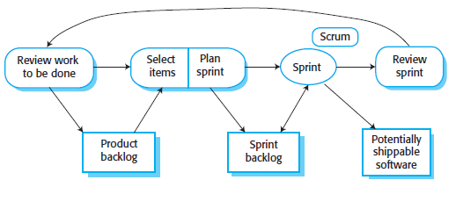
MANAGEMENT OF SOFTWARE SYSTEMS CST 309 S5 CSE(KTU)
Pair programming has a number of advantages.
It supports the idea of collective ownership and responsibility for the system. This reflects Weinberg’s idea of egoless programming where the software is owned by the team as a whole and individuals are not held responsible for problems with the code. Instead, the team has collective responsibility for resolving these problems.
It acts as an informal review process because each line of code is looked at by at least two people.
It encourages refactoring to improve the software structure.
Agile Project Management
The principal responsibility of software project managers is to manage the project so that the software is delivered on time and within the planned budget for the project.
Scrum
The Scrum approach is a general agile method and focus is on managing iterative development rather than specific agile practices.
The Scrum Process
The Sprint Cycle
Each process iteration produces a product increment that could be delivered to customers.
The starting point for planning is the product backlog, which is the list of work to be done on the project. —the list of items such as product features, requirements, user stories and engineering improvement that have to be worked on by the Scrum team.
The product owner has a responsibility to ensure the level of specification is appropriate for the work to be done.
KAVITHA V K
DEPT OF CSE

Slide 41
MANAGEMENT OF SOFTWARE SYSTEMS CST 309 S5 CSE(KTU)
Each sprint cycle lasts a fixed length of time, which is usually between 2 and 4 weeks. At the beginning of each cycle, the Product Owner prioritizes the items on the product backlog to define which are the most important items to be developed in that cycle.
Sprints are never extended to take account of unfinished work. Items are returned to the product backlog if these cannot be completed within the allocated time for the sprint.
The whole team is then involved in selecting which of the highest priority items they believe can be completed. They then estimate the time required to complete these items. To make these estimates, they use the velocity attained in previous sprints, that is, how much of the backlog could be covered in a single sprint. This leads to the creation of a sprint backlog—the work to be done during that sprint.
The team self-organizes to decide who will work on what, and the sprint begins.
Teamwork in Scrum
The ‘Scrum master’ is a facilitator who arranges daily meetings, tracks the backlog of work to be done, records decisions, measures progress against the backlog and communicates with customers and management outside of the team.
The whole team attends short daily meetings (scrum)where all team members share information, describe their progress since the last meeting, problems that have arisen and what is planned for the following day.
This means that everyone on the team knows what is going on and, if problems arise, can re-plan short-term work to cope with them, there is no top-down direction from the Scrum Master.
Everyone participates in this short-term planning; the daily interactions among Scrum teams may be coordinated using a Scrum board. This is an office whiteboard that includes information and post-it notes about the Sprint backlog, work done, unavailability of staff, and so on. This is a shared resource for the whole team, and anyone can change or move items on the board. It means that any team member can, at a glance, see what others are doing and what work remains to be done.
At the end of each sprint, there is a review meeting, which involves the whole team. This meeting has two purposes. First, it is a means of process improvement. The team reviews the way they have worked and reflects on how things could have been done better. Second, it provides input on the product and the product state for the product backlog review that precedes the next sprint.
Scrum Benefits
The product is broken down into a set of manageable and understandable chunks.
Unstable requirements do not hold up progress.
The whole team have visibility of everything and consequently team communication is improved.
Customers see on-time delivery of increments and gain feedback on how the product works.
KAVITHA V K
DEPT OF CSE

Slide 42
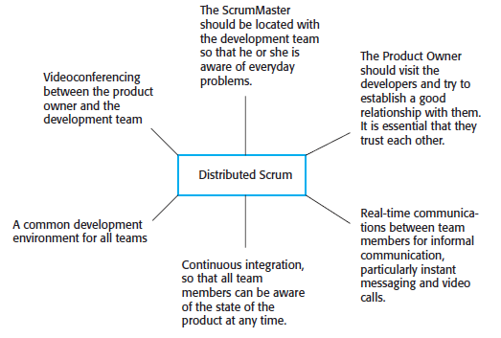
MANAGEMENT OF SOFTWARE SYSTEMS CST 309 S5 CSE(KTU)
Trust between customers and developers is established and a positive culture is created in which everyone expects the project to succeed.
For offshore development, the product owner is in a different country from the development team, which may also be distributed. Figure shows the requirements for Distributed Scrum
Key Points
Agile methods are incremental development methods that focus on rapid development, frequent releases of the software, reducing process overheads and producing high- quality code. They involve the customer directly in the development process.
The decision on whether to use an agile or a plan-driven approach to development should depend on the type of software being developed, the capabilities of the development team and the culture of the company developing the system.
The Scrum method is an agile method that provides a project management framework. It is centred round a set of sprints, which are fixed time periods when a system increment is developed.
Scaling agile methods for large systems is difficult. Large systems need up-front design and some documentation.
KAVITHA V K
DEPT OF CSE

Slide 43
MANAGEMENT OF SOFTWARE SYSTEMS CST 309 S5 CSE(KTU)
MODULE 1 : Introduction to Software Engineering (7 hours)
Introduction to Software Engineering - Professional software development, Software engineering ethics
Software process models - The waterfall model, Incremental development. Process activities - Software specification, Software design and implementation, Software validation, Software evolution. Coping with change - Prototyping, Incremental delivery, Boehm's Spiral Model.
Agile software development - Agile methods, agile manifesto - values and principles. Agile development techniques, Agile Project Management.
Case studies: An insulin pump control system. Mentcare - a patient information system for mental health care.
1.1 Professional software development
Software is not just a program themselves but also all associated documentation and configuration data.
Frequently asked questions about software engineering
Question | Answer
What is software? | Computer programs and associated documentation. Software products may be developed for a particular customer or may be developed for a general market.
What are the attributes of good software? | Good software should deliver the required functionality and performance to the user and should be maintainable, dependable and usable.

Slide 44
MANAGEMENT OF SOFTWARE SYSTEMS CST 309
S5 CSE(KTU)
What is software engineering? | Software engineering is an engineering discipline that is concerned with all aspects of software production.
What are the fundamental software engineering activities? | Software specification, software development, software validation and software evolution.
What is the difference between software engineering and computer science? | Computer science focuses on theory and fundamentals; software engineering is concerned with the practicalities of developing and delivering useful software.
What is the difference between software engineering and system engineering? | System engineering is concerned with all aspects of computer-based systems development including hardware, software and process engineering. Software engineering is part of this more general process.
What are the key challenges facing software engineering? | Coping with increasing diversity, demands for reduced delivery times and developing trustworthy software.
What are the costs of software engineering? | Roughly 60% of software costs are development costs, 40% are testing costs. For custom software, evolution costs often exceed development costs.

Slide 45
MANAGEMENT OF SOFTWARE SYSTEMS CST 309
S5 CSE(KTU)
What are the best software engineering techniques and methods? | While all software projects have to be professionally managed and developed, different techniques are appropriate for different types of system. For example, games should always be developed using a series of prototypes whereas safety critical control systems require a complete and analyzable specification to be developed. You can’t, therefore, say that one method is better than another.
What differences has the web made to software engineering? | The web has led to the availability of software services and the possibility of developing highly distributed service- based systems. Web-based systems development has led to important advances in programming languages and software reuse.
Software Products
Generic products
  Stand-alone systems that are marketed and sold to any customer who wishes to buy them.
  Examples – PC software such as graphics programs, project management tools; CAD software; software for specific markets such as appointments systems for dentists.
  Organization that develops the software controls the software specification.
Customized products(bespoke)
  Software that is commissioned by a specific customer to meet their own needs.

Slide 46
MANAGEMENT OF SOFTWARE SYSTEMS CST 309 S5 CSE(KTU)
Examples – embedded control systems, air traffic control software, traffic monitoring systems.
Specification is developed and controlled by the organization ie buying the software.
Essential Attributes of Good Software
Product characteristics | Description
Maintainability | Software should be written in such a way so that it can evolve to meet the changing needs of customers. This is a critical attribute because software change is an inevitable requirement of a changing business environment.
Dependability and security | Software dependability includes a range of characteristics including reliability, security and safety. Dependable software should not cause physical or economic damage in the event of system failure. Malicious users should not be able to access or damage the system.
Efficiency | Software should not make wasteful use of system resources such as memory and processor cycles. Efficiency therefore includes responsiveness, processing time, memory utilisation, etc.
Acceptability | Software must be acceptable to the type of users for which it is designed. This means that it must be understandable, usable and compatible with other systems that they use.
D

Slide 47
MANAGEMENT OF SOFTWARE SYSTEMS CST 309
S5 CSE(KTU)
1.1.1 Software Engineering
Software engineering is an engineering discipline that is concerned with all aspects of software production from the early stages of system specification through to maintaining the system after it has gone into use.
Engineering discipline
  Using appropriate theories and methods to solve problems within the organizational and financial constraints.
All aspects of software production
  Not just technical process of development. Also project management and the development of tools, methods etc. to support software production.
Software Process Activities
Software specification, where customers and engineers define the software that is to be produced and the constraints on its operation.
Software development, where the software is designed and programmed.
Software validation, where the software is checked to ensure that it is what the customer requires.
Software evolution, where the software is modified to reflect changing customer and market requirements.
General issues that affect most Software
Heterogeneity
  Increasingly, systems are required to operate as distributed systems across networks that include different types of computer and mobile devices.
Business and social change
  Business and society are changing incredibly quickly as emerging economies develop and new technologies become available. They need to be able to change their existing software and to rapidly develop new software.
Security and trust
  As software is intertwined with all aspects of our lives, it is essential that we can trust that software.

Slide 48
MANAGEMENT OF SOFTWARE SYSTEMS CST 309
S5 CSE(KTU)
1.1.2 Software Engineering Diversity
There are many different types of software system and there is no universal set of software techniques that is applicable to all of these.
The software engineering methods and tools used depend on the type of application being developed, the requirements of the customer and the background of the development team.
Application Types
Stand-alone applications
  These are application systems that run on a local computer, such as a PC. They include all necessary functionality and do not need to be connected to a network.
Interactive transaction-based applications
  Applications that execute on a remote computer and are accessed by users from their own PCs or terminals. These include web applications such as e-commerce applications.
Embedded control systems
  These are software control systems that control and manage hardware devices. Numerically, there are probably more embedded systems than any other type of system.
Batch processing systems
  These are business systems that are designed to process data in large batches. They process large numbers of individual inputs to create corresponding outputs.
Entertainment systems
  These are systems that are primarily for personal use and which are intended to entertain the user.
Systems for modeling and simulation
  These are systems that are developed by scientists and engineers to model physical processes or situations, which include many, separate, interacting objects.

Slide 49
MANAGEMENT OF SOFTWARE SYSTEMS CST 309
Data collection systems
S5 CSE(KTU)
These are systems that collect data from their environment using a set of sensors and send that data to other systems for processing.
Systems of systems
  These are systems that are composed of a number of other software systems.
  software that has already been developed rather than write new software.
1.1.3 Software Engineering and the Web
The Web is now a platform for running application and organizations are increasingly developing web-based systems rather than local systems.
Web services allow application functionality to be accessed over the web.
Cloud computing is an approach to the provision of computer services where applications run remotely on the ‘cloud’.
  Users do not buy software buy pay according to use.
Web software Engineering
Software reuse is the dominant approach for constructing web-based systems.
  When building these systems, you think about how you can assemble them from pre-existing software components and systems.
Web-based systems should be developed and delivered incrementally.
  It is now generally recognized that it is impractical to specify all the requirements for such systems in advance.
User interfaces are constrained by the capabilities of web browsers.
  Technologies such as AJAX allow rich interfaces to be created within a web browser but are still difficult to use. Web forms with local scripting are more commonly used.
Web based Software Engineering
Web-based systems are complex distributed systems but the fundamental principles of software engineering discussed previously are as applicable to them as they are to any other types of system.

Slide 50
MANAGEMENT OF SOFTWARE SYSTEMS CST 309 S5 CSE(KTU)
The fundamental ideas of software engineering, discussed in the previous section, apply to web-based software in the same way that they apply to other types of software system.
1.2 Software Engineering Ethics
Software engineering involves wider responsibilities than simply the application of technical skills.
Software engineers must behave in an honest and ethically responsible way if they are to be respected as professionals.
Ethical behaviour is more than simply upholding the law but involves following a set of principles that are morally correct.
Issues of Professional Responsibility
Confidentiality
  Engineers should normally respect the confidentiality of their employers or clients irrespective of whether or not a formal confidentiality agreement has been signed.
Competence
  Engineers should not misrepresent their level of competence. They should not knowingly accept work which is outwith their competence.
Intellectual property rights
  Engineers should be aware of local laws governing the use of intellectual property such as patents, copyright, etc. They should be careful to ensure that the intellectual property of employers and clients is protected.
Computer misuse
  Software engineers should not use their technical skills to misuse other people’s computers. Computer misuse ranges from relatively trivial (game playing on an employer’s machine, say) to extremely serious (dissemination of viruses).
ACM/IEEE Code of Ethics
The professional societies in the US have cooperated to produce a code of ethical practice.
Members of these organisations sign up to the code of practice when they join.

Slide 51
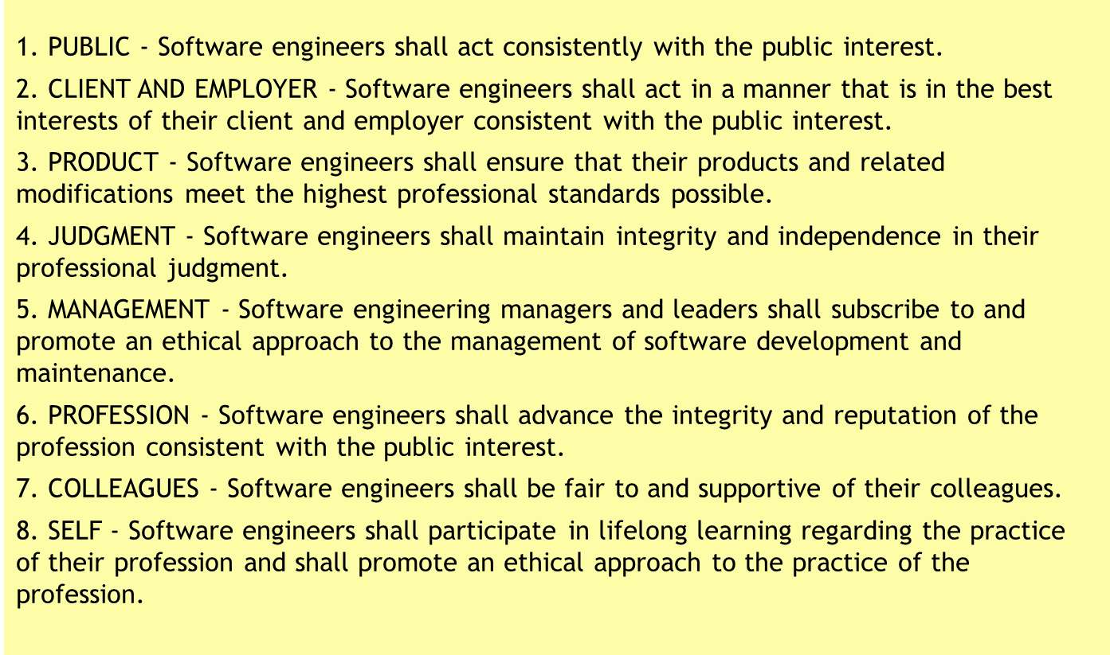
MANAGEMENT OF SOFTWARE SYSTEMS CST 309 S5 CSE(KTU)
The Code contains eight Principles related to the behaviour of and decisions made by professional software engineers, including practitioners, educators, managers, supervisors and policy makers, as well as trainees and students of the profession.
ACM/IEEE Code of Ethics
Software Engineering Code of Ethics and Professional Practice
ACM/IEEE-CS Joint Task Force on Software Engineering Ethics and Professional Practices
PREAMBLE
The short version of the code summarizes aspirations at a high level of the abstraction; the clauses that are included in the full version give examples and details of how these aspirations change the way we act as software engineering professionals. Without the aspirations, the details can become legalistic and tedious; without the details, the aspirations can become high sounding but empty; together, the aspirations and the details form a cohesive code.
Software engineers shall commit themselves to making the analysis, specification, design, development, testing and maintenance of software a beneficial and respected profession. In accordance with their commitment to the health, safety and welfare of the public, software engineers shall adhere to the following Eight Principles:
Ethical principles

Slide 52
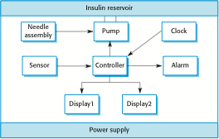
MANAGEMENT OF SOFTWARE SYSTEMS CST 309
S5 CSE(KTU)
1.3 Case Studies
A personal insulin pump
  An embedded system in an insulin pump used by diabetics to maintain blood glucose control.
A mental health case patient management system
  A system used to maintain records of people receiving care for mental health problems.
A wilderness weather station
  A data collection system that collects data about weather conditions in remote areas.
1.3.1 Insulin Pump Control System
Collects data from a blood sugar sensor and calculates the amount of insulin required to be injected.
Calculation based on the rate of change of blood sugar levels.
Sends signals to a micro-pump to deliver the correct dose of insulin.
Safety-critical system as low blood sugars can lead to brain malfunctioning, coma and death; high-blood sugar levels have long-term consequences such as eye and kidney damage.
Insulin Pump Hardware Architecture

Slide 53
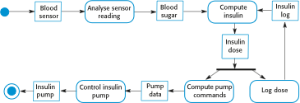
MANAGEMENT OF SOFTWARE SYSTEMS CST 309
S5 CSE(KTU)
Activity model of the insulin pump
Essential High-Level Requirements
The system shall be available to deliver insulin when required.
The system shall perform reliably and deliver the correct amount of insulin to counteract the current level of blood sugar.
The system must therefore be designed and implemented to ensure that the system always meets these requirements.
1.3.2 A Patient Information System for Mental Health Care
A patient information system to support mental health care is a medical information system that maintains information about patients suffering from mental health problems and the treatments that they have received.
Most mental health patients do not require dedicated hospital treatment but need to attend specialist clinics regularly where they can meet a doctor who has detailed knowledge of their problems.
To make it easier for patients to attend, these clinics are not just run in hospitals. They may also be held in local medical practices or community centres.

Slide 54
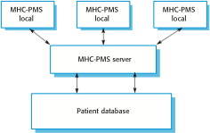
MANAGEMENT OF SOFTWARE SYSTEMS CST 309
S5 CSE(KTU)
MHC-PMS
The MHC-PMS (Mental Health Care-Patient Management System) is an information system that is intended for use in clinics.
It makes use of a centralized database of patient information but has also been designed to run on a PC, so that it may be accessed and used from sites that do not have secure network connectivity.
When the local systems have secure network access, they use patient information in the database but they can download and use local copies of patient records when they are disconnected.
MHC-PMS goals
To generate management information that allows health service managers to assess performance against local and government targets.
To provide medical staff with timely information to support the treatment of patients. The organization of the MHC-PMS
MHC-PMS Key Features
Individual care management
  Clinicians can create records for patients, edit the information in the system, view patient history, etc. The system supports data summaries so that doctors

Slide 55
MANAGEMENT OF SOFTWARE SYSTEMS CST 309 S5 CSE(KTU)
can quickly learn about the key problems and treatments that have been prescribed.
Patient monitoring
  The system monitors the records of patients that are involved in treatment and issues warnings if possible problems are detected.
Administrative reporting
  The system generates monthly management reports showing the number of patients treated at each clinic, the number of patients who have entered and left the care system, number of patients sectioned, the drugs prescribed and their costs, etc.
MHC-PMS concerns
Privacy
  It is essential that patient information is confidential and is never disclosed to anyone apart from authorised medical staff and the patient themselves.
Safety
  Some mental illnesses cause patients to become suicidal or a danger to other people. Wherever possible, the system should warn medical staff about potentially suicidal or dangerous patients.
  The system must be available when needed otherwise safety may be compromised and it may be impossible to prescribe the correct medication to patients.
1.3.3 Wilderness Weather Station
The government of a country with large areas of wilderness decides to deploy several hundred weather stations in remote areas.
Weather stations collect data from a set of instruments that measure temperature and pressure, sunshine, rainfall, wind speed and wind direction.
  The weather station includes a number of instruments that measure weather parameters such as the wind speed and direction, the ground and air temperatures, the barometric pressure and the rainfall over a 24-hour period. Each of these instruments is controlled by a software system that takes

Slide 56

MANAGEMENT OF SOFTWARE SYSTEMS CST 309 S5 CSE(KTU)
parameter readings periodically and manages the data collected from the instruments.
The Weather Station’s Environment
Weather information system
The weather station system
This is responsible for collecting weather data, carrying out some initial data processing and transmitting it to the data management system.
The data management and archiving system
This system collects the data from all of the wilderness weather stations, carries out data processing and analysis and archives the data.
The station maintenance system
This system can communicate by satellite with all wilderness weather stations to monitor the health of these systems and provide reports of problems.
Additional software functionality
Monitor the instruments, power and communication hardware and report faults to the management system.
Manage the system power, ensuring that batteries are charged whenever the environmental conditions permit but also that generators are shut down in potentially damaging weather conditions, such as high wind.
Support dynamic reconfiguration where parts of the software are replaced with new versions and where backup instruments are switched into the system in the event of system failure.

Slide 57
MANAGEMENT OF SOFTWARE SYSTEMS CST 309
S5 CSE(KTU)
The Software Process
A structured set of activities required to
develop
a
software system.
Many different software processes but all involve:
  Specification – defining what the system should do;
  Design and implementation – defining the organization of the system and implementing the system;
  Validation – checking that it does what the customer wants;
  Evolution – changing the system in response to changing customer needs.
A software process model is an abstract representation of a process. It presents a description of a process from some particular perspective.
Software Process Descriptions
When we describe and discuss processes, we usually talk about the activities in these processes such as specifying a data model, designing a user interface, etc. and the ordering of these activities.
Process descriptions may also include:
  Products, which are the outcomes of a process activity;
  Roles, which reflect the responsibilities of the people involved in the process;
  Pre- and post-conditions, which are statements that are true before and after a process activity has been enacted or a product produced.
Plan-Driven and Agile Processes
Plan-driven processes are processes where all of the process activities are planned in advance and progress is measured against this plan.
In agile processes, planning is incremental and it is easier to change the process to reflect changing customer requirements.
In practice, most practical processes include elements of both plan-driven and agile approaches.
There are no right or wrong software processes.
Software Process Models
The waterfall model

Slide 58
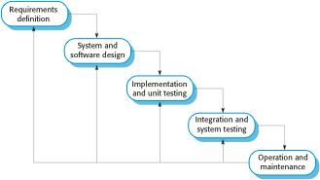
MANAGEMENT OF SOFTWARE SYSTEMS CST 309 S5 CSE(KTU)
Plan-driven model. Separate and distinct phases of specification and development.
Incremental development
  Specification, development and validation are interleaved. May be plan-driven or agile.
Reuse-oriented software engineering(Operation and maintenance)
  The system is assembled from existing components. May be plan-driven or agile.
In practice, most large systems are developed using a process that incorporates elements from all of these models.
The Waterfall Model
Waterfall model phases
There are separate identified phases in the waterfall model:
Requirements analysis and definition: The system services, constraints and goals are established by consultation with system users.
System and software design: The systems design process allocates the requirements to either hardware or software systems by establishing an overall system architecture. Software design involves identifying and

Slide 59
MANAGEMENT OF SOFTWARE SYSTEMS CST 309 S5 CSE(KTU)
describing the fundamental software system abstractions and their relationships.
Implementation and unit testing: During this stage, the software design is realized as a set of programs or program units. Unit testing involves verifying that each unit meets its multiplication.
Integration and system testing: The individual program units or programs are integrated and tested as a complete system to ensure that the software requirements have been met. After testing, the software system is delivered to the customer.
Operation and maintenance: longest phase, the system is installed and put into the practical use. Maintenance involves correcting errors which were not discovered in earlier stages of the life cycle, improves the implementation of system units and enhancing the system’s services as new requirements are discovered.
The main drawback of the waterfall model is the difficulty of accommodating change after the process is underway. In principle, a phase has to be complete before moving onto the next phase.
Waterfall Model Problems
Inflexible partitioning of the project into distinct stages makes it difficult to respond to changing customer requirements.
  Therefore, this model is only appropriate when the requirements are well- understood and changes will be fairly limited during the design process.
  Few business systems have stable requirements.
The waterfall model is mostly used for large systems engineering projects where a system is developed at several sites.
  In those circumstances, the plan-driven nature of the waterfall model helps coordinate the work.

Slide 60

MANAGEMENT OF SOFTWARE SYSTEMS CST 309 S5 CSE(KTU)
Incremental Development
Incremental Development is based on the idea of developing an initial implementation, exposing this to user comment and evolving it through several versions until an adequate
system has been developed. Specification, development and validation activities are interleaved rather than separate, with rapid feedback across activities.
Each increment of the system incorporates some functionality that is needed by the
customer. This means that the customer can evaluate the system at a relatively early stage in the development to see if it delivers what is required. If not, then only the current increment has to be changed, and new functionality defined for later increments.
Incremental Development Benefits
The cost of accommodating changing customer requirements is reduced.
  The amount of analysis and documentation that has to be redone is much less than is required with the waterfall model.
It is easier to get customer feedback on the development work that has been done.
  Customers can comment on demonstrations of the software and see how much has been implemented.
More rapid delivery and deployment of useful software to the customer is possible.

Slide 61
MANAGEMENT OF SOFTWARE SYSTEMS CST 309 S5 CSE(KTU)
Customers are able to use and gain value from the software earlier than is possible with a waterfall process.
Incremental Development Problems
  The process is not visible.
    Managers need regular deliverables to measure progress. If systems are developed quickly, it is not cost-effective to produce documents that reflect every version of the system.
  System structure tends to degrade as new increments are added.
    Unless time and money is spent on refactoring to improve the software, regular change tends to corrupt its structure. Incorporating further software changes becomes increasingly difficult and costly.
Process Activities
  Real software processes are inter-leaved sequences of technical, collaborative and managerial activities with the overall goal of specifying, designing, implementing and testing a software system.
  The four basic process activities of Specification, Development, Validation and Evolution are organized differently in different development processes. In the waterfall model, they are organized in sequence, whereas in incremental development they are inter-leaved.
Software Specification
  The process of establishing and defining what services are required from the system and identifying the constraints on the system’s operation and development.
  Is a particularly critical stage of the software process as errors at this
stage inevitably lead to later problems in system design and implementation.
RE process aims to produce an agreed requirements document that specifies a system satisfying stakeholder requirements.
Requirements are presented at two levels: End users and customers need a high level statement of the requirements; system developers need a more detailed system specification

Slide 62

MANAGEMENT OF SOFTWARE SYSTEMS CST 309
S5 CSE(KTU)
Requirements engineering process
Feasibility study
  Is it technically and financially feasible to build the system?
  Developed within the existing budgetary constraints.(cost effective)
Requirements elicitation and analysis
  What do the system stakeholders require or expect from the system?
  Observations from existing systems, discussions with potential users, task analysis.
  This may involve the development of one or more models and prototypes
Requirements specification
  Is the activity of translating the information gathered during the analysis activity into a document.

Slide 63
MANAGEMENT OF SOFTWARE SYSTEMS CST 309
S5 CSE(KTU)
Two types of requirements
User requirements: are abstract statements of the system requirements for the customer and end user of the system.
System requirements are a more detailed description of the functionality to be provided.
Requirements validation
  Checking the validity of the requirements(consistent/complete)
2. Software Design and Implementation
The process of converting the system specification into an executable system.
Software design
  Design a software structure that realises the specification;
Implementation
  Translate this structure into an executable program;
The activities of design and implementation are closely related and may be inter-leaved.
A General Model of the Design Process

Slide 64
MANAGEMENT OF SOFTWARE SYSTEMS CST 309 S5 CSE(KTU)
◆ Software platform-the environment in which software will execute.
◆ Information about this platform is an essential input to the design process, as designers must decide how best to integrate it with the software‘s environment.
◆ The requirement specification is the description of the functionality the software must provide and its performance and dependability requirements.
◆ If the system is to process existing data, then the description of that data
may be included in the platform specification.
◆ Otherwise, the data description must be an input to the design process so that the system data organization to be defined.
Design Activities
Architectural design, where you identify the overall structure of the system, the principal components (sometimes called sub-systems or modules), their relationships and how they are distributed.
Interface design, where you define the interfaces between system components. This interface specification must be unambiguous
Component design, where you take each system component and design how it will operate.
Database design, where you design the system data structures and how these are to be represented in a database. The work depends on whether an existing database is to be reused or a new database is to be created.
3. Software Validation
Verification and validation (V & V) is intended to show that a system conforms to its specification and meets the requirements of the system customer.
Involves checking processes such as inspections and reviews.
System testing involves executing the system with test cases that are derived from the specification of the real data to be processed by the system.
Testing is the most commonly used V & V activity.
Stages of Testing
3 stage process

Slide 65
MANAGEMENT OF SOFTWARE SYSTEMS CST 309 S5 CSE(KTU)
System components are tested (component defects are discovered early in the process) then the integrated system is tested, (interface problems are found when the system is integrated), finally the system is tested with the customer’s data.
Testing Stages
Development or component testing
  Individual components are tested independently;
  Components may be functions or objects or coherent groupings of these entities.
  Test automation tools such as JUnit that can rerun component tests when new versions of the components are created, are commonly used.
System testing
  Testing of the system as a whole.
  Concerned with showing the system meets its functional and non-functional requirements, Testing of emergent properties is particularly important.
Acceptance testing(alpha testing)
  This is the final stage in the testing process before the system is accepted for operational use.
  The system is tested with data supplied by the system customer rather than with simulated test data .Testing with customer data to check that the system meets the customer’s needs.
Testing Phases in a Plan-Driven Software Process

Slide 66
MANAGEMENT OF SOFTWARE SYSTEMS CST 309 S5 CSE(KTU)
◆ Acceptance testing(alpha testing)
◆ Alpha Testing is a type of software testing performed to identify bugs before releasing the product to real users or to the public. Alpha Testing is one of the user acceptance testing.
◆ Custom systems are developed for a single client
◆ This alpha testing process continues until the system developer and the
client agree that the delivered system is an acceptable implementation of requirements.
Beta testing
When software is to be marketed as a software product, beta testing is used.
Beta Testing is performed by real users of the software application in a real environment.
This involves delivering a system to a number of potential users who agree to use that system.
They report problem to system developers.
This exposes the product to real use and detects errors that may not have been anticipated by the system builders.
After this feedback, the system is modified and released either for further beta testing or general sale.

Slide 67
MANAGEMENT OF SOFTWARE SYSTEMS CST 309
S5 CSE(KTU)
Alpha Testing | Beta Testing
Alpha testing involves both the white box and black box testing. | Beta testing commonly uses black box testing.
Alpha testing is performed by testers who are usually internal employees of the organization. | Beta testing is performed by clients who are not part of the organization.
Alpha testing is performed at developer’s site. | Beta testing is performed at end-user of the product.
Reliability and security testing are not checked in alpha testing. | Reliability, security and robustness are checked during beta testing.
Alpha testing ensures the quality of the product before forwarding to beta testing. | Beta testing also concentrates on the quality of the product but collects users input on the product and ensures that the product is ready for real time users.
Alpha testing requires a testing environment or a lab. | Beta testing doesn’t require a testing environment or lab.
Alpha testing may require long execution cycle. | Beta testing requires only a few weeks of execution.
Developers can immediately address the critical issues or fixes in alpha testing. | Most of the issues or feedback collected from beta testing will be implemented in future versions of the product.

Slide 68
MANAGEMENT OF SOFTWARE SYSTEMS CST 309 S5 CSE(KTU)
4. Software Evolution
Software is inherently flexible and can change.
As requirements change through changing business circumstances, the software that supports the business must also evolve and change.
Although there has been a demarcation between development and evolution (maintenance) this is increasingly irrelevant as fewer and fewer systems are completely new.
Coping with change
Change is inevitable in all large software projects.
  Business changes lead to new and changed system requirements
  New technologies open up new possibilities for improving implementations
  Changing platforms require application changes
Change leads to rework so the costs of change include both rework (e.g. re-analysing requirements) as well as the costs of implementing new functionality.
Reducing the Costs of Rework
Change avoidance, where the software process includes activities that can anticipate possible changes before significant rework is required.
  For example, a prototype system may be developed to show some key features of the system to customers.
Change tolerance, where the process is designed so that changes can be accommodated at relatively low cost.
  This normally involves some form of incremental development. Proposed changes may be implemented in increments that have not yet been developed.

Slide 69
MANAGEMENT OF SOFTWARE SYSTEMS CST 309 S5 CSE(KTU)
If this is impossible, then only a single increment (a small part of the system) may have be altered to incorporate the change.
Software Prototyping
A prototype is an initial version of a system used to demonstrate concepts and try out design options, and find out more about the problem and its possible solutions.
Where a version of the system or part of the system is developed quickly to check the customer requirements.
Rapid, iterative development of the prototype is essential, so that costs are controlled and system stakeholders can experiment with the prototype early in the software process.
A prototype can be used in:
  The requirements engineering process can help with requirements elicitation and validation;
In design processes to explore particular software solutions options and develop a UI design;
Benefits of Prototyping
Improved system usability.
A closer match to users’ real needs.
Improved design quality.
Improved maintainability.
Reduced development effort.

Slide 70

MANAGEMENT OF SOFTWARE SYSTEMS CST 309
S5 CSE(KTU)
The Process of Prototype Development
The objectives of prototyping should be made explicit from the start of the process. This may develop a system to prototype the user interface, or to validate he functional requirements, to demonstrate the feasibility of the application to managers. The same prototype cannot meet all objcetives.so they misunderstand the functionality of the prototype development. - May be based on rapid prototyping languages or tools.
The second stage is to decide what to put into /leave out of the prototype system. To reduce prototyping costs and accelerate the delivery schedule, leave some functionality out of the prototype-May be some nonfunctional requirements. Focus on functional rather than non-functional requirements such as reliability and security
Prototype should focus on areas of the product that are not well-understood;
Error checking and recovery may not be included in the prototype;
Final stage is evaluation.
Developers are pressured by managers to deliver Throw away prototypes, when there are delays in delivering the final version of the software.
Throw-Away Prototypes
Prototypes should be discarded after development as they are not a good basis for a production system:
  It may be impossible to tune the system to meet non-functional requirements; such as performance ,security ,robustness

Slide 71
MANAGEMENT OF SOFTWARE SYSTEMS CST 309 S5 CSE(KTU)
Prototypes are normally undocumented; only design specification is prototype code. This is not good enough for long term maintenance.
The prototype structure is usually degraded through rapid change;the system will be difficult and expensive to maintain,.
The prototype probably will not meet normal organizational quality standards.
Incremental Delivery
Rather than deliver the system as a single delivery, the development and delivery is broken down into increments with each increment delivering part of the required functionality.
In an incremental delivery process, customers define which of the services are most important.
User requirements are prioritised and the highest priority requirements are included in
early increments.
Once the system increments have been identified, the requirements for the services to be delivered in the first increment are defined in detail and that increment is developed. During development, further requirements analysis for later increments can take place, but requirements changes for the current increment are not accepted.
Once an increment is completed and delivered, it is installed in the customer’s normal working environment. They can experiment with the system, and this helps them clarify their requirements for later system increments. As new increments are completed, they are integrated with existing increments so that system functionality improves with each delivered increment.
Incremental Delivery Advantages
Customer value can be delivered with each increment so system functionality is available earlier.
Early increments act as a prototype to help elicit requirements for later increments.
Lower risk of overall project failure.
The highest priority system services tend to receive the most testing.

Slide 72
MANAGEMENT OF SOFTWARE SYSTEMS CST 309
S5 CSE(KTU)
Incremental Delivery Incremental Delivery Problems
Most systems require a set of basic facilities that are used by different parts of the system.
  As requirements are not defined in detail until an increment is to be implemented, it can be hard to identify common facilities that are needed by all increments.
The essence of iterative processes is that the specification is developed in conjunction with the software.
  However, this conflicts with the procurement model of many organizations, where the complete system specification is part of the system development contract.
Boehm’s spiral model
Process is represented as a spiral rather than as a sequence of activities with backtracking.
Each loop in the spiral represents a phase in the process.
No fixed phases such as specification or design - loops in the spiral are chosen depending on what is required.
Risks are explicitly assessed and resolved throughout the process.

Slide 73
MANAGEMENT OF SOFTWARE SYSTEMS CST 309
S5 CSE(KTU)

Slide 74
Each loop in the Spiral Model is split into 4 Sectors
Objective setting
  Specific objectives for the phase are identified. Constraints on the
  process and the product are identified and a detailed management
  plan is drawn up. Project risks are identified. Alternative strategies
  may planned.
Risk assessment and reduction
  Risks are assessed and activities put in place to reduce the key risks.
Development and validation
  A development model for the system is chosen which can be any
  of the generic models.
Planning
  The project is reviewed and the next phase of the spiral is planned.
  Spiral Model Usage
Spiral model has been very influential in helping people think about
iteration in software processes and introducing the risk-driven approach to development.
In practice, however, the model is rarely used as published for
practical software development.

Slide 75
MANAGEMENT OF SOFTWARE SYSTEMS CST 309
S5 CSE(KTU)
Agile Software Development
Rapid software development became known as agile development or agile methods. Rapid development and delivery is now often the most important requirement for software systems
Businesses operate in a fast changing requirement and it is practically impossible to produce a set of stable software requirements
Software has to evolve quickly to reflect changing business needs.
Agile development characteristics
Specification, design and implementation are inter-leaved, there is no detailed system specification, and design documentation is minimized or generated automatically by the programming environment used to implement the system.

Slide 76
System is developed as a series of versions with stakeholders involved in version evaluation. They may propose changes to the software and new requirements that should be implemented in a later version of the system.
System user interphases are developed with interactive development system like drawing and placing icon on the interface.

Slide 77
Agile methods are incremental development methods in which the increments are small,
and, typically, new releases of the system are created (frequent release)and made available to customers every two or three weeks. They involve customers in the development process to get rapid feedback on changing requirements. They minimize documentation by using informal communications rather than formal meetings with written documents.
In a plan-driven software development process, iteration occurs within activities, with formal documents used to communicate between stages of the process. For example, the requirements will evolve, and, ultimately, a requirements specification will be produced. This is then an input to the design and implementation process.
In an agile approach, iteration occurs across activities. Therefore, the requirements and the design are developed together rather than separately

Slide 78
MANAGEMENT OF SOFTWARE SYSTEMS CST 309
S5 CSE(KTU)

Slide 80
MANAGEMENT OF SOFTWARE SYSTEMS CST 309
S5 CSE(KTU)
Agile Manifesto
We are uncovering better ways of developing software by doing it and helping others do it. Through this work we have come to value:
Individuals Working Customer
and software
interactions over processes and tools over comprehensive
documentation negotiation
collaboration over contract
Responding to change over following a plan
That is, while there is value in the items on the right, we value the items on the left more.

Slide 82
XP Release cycle
In XP, requirements are expressed as scenarios (called user stories), which are implemented directly as a series of tasks. Programmers work in pairs and develop tests for each task before writing the code. All tests must be successfully executed when new code is integrated into the system. There is a short time gap between releases of the system.
Extreme programming was an agile practices that were summarized and reflect the principles of the agile manifesto:
1. Incremental development is supported through small, frequent releases of the system. Requirements are based on simple customer stories or scenarios that are used as a basis for deciding what functionality should be included in a system increment.
Customer involvement is supported through the continuous engagement of the customer in the development team. The customer representative takes part in the development and is responsible for defining acceptance tests for the system.
People, not process, are supported through pair programming, collective ownership of the system code, and a sustainable development process that does not involve excessively long working hours.
Change is embraced through regular system releases to customers, test-first development, refactoring to avoid code degeneration, and continuous integration of new
functionality.
Maintaining simplicity is supported by constant refactoring that improves code quality and by using simple designs that do not unnecessarily anticipate future changes to the
system.

Slide 83
MANAGEMENT OF SOFTWARE SYSTEMS CST 309 S5 CSE(KTU)
XP programming practices
Some important practices used in the agile development (XP) are User stories:
Software requirements always change. In Agile methods , requirements elicitation is integrated with development by the idea of “user stories” where a user story is a scenario of use that might be experienced by a system user.
After the discussion of development team with customer, they develop a “story card” that briefly describes a story that encapsulates the customer needs. The development team then aims to implement that scenario in a future release of the software.
User stories may be used in planning system iterations. Once the story cards have been developed, the development team breaks these down into tasks and estimates the effort and resources required for implementing each task.
This usually involves discussions with the customer to refine the requirements. The customer then prioritizes the stories for implementation, choosing those stories that can be used immediately to deliver useful business support.
The intention is to identify useful functionality that can be implemented in about two weeks, when the next release of the system is made available to the customer.
If changes are required for a system that has already been delivered, new story cards are developed and again, the customer decides whether these changes should have priority over new functionality.
User stories can be helpful in getting users involved in suggesting requirements during an initial predevelopment requirements elicitation activity.
Cons:
  The principal problem with user stories is completeness. It is difficult to judge if enough user stories have been developed to cover all of the essential requirements of a system.

Slide 84
MANAGEMENT OF SOFTWARE SYSTEMS CST 309 S5 CSE(KTU)
It is also difficult to judge if a single story gives a true picture of an activity. Experienced users are often so familiar with their work that they leave things out when describing it.
Refactoring:
Changes will always have to be made to the code being developed. Refactoring means that the programming team look for possible improvements to the software and implements them immediately.
Refactoring improves the software structure and readability and avoids the structural deterioration that naturally occurs when software is changed.

Slide 85
MANAGEMENT OF SOFTWARE SYSTEMS CST 309 S5 CSE(KTU)
Test-first development:
Extreme Programming developed a new approach to program testing to address the difficulties of testing without a specification. Testing is automated and is central to the development process, and development cannot proceed until all tests have been successfully executed. The key features of testing in XP are:
test-first development:
  Write test before write the code.
  Writing tests implicitly defines both an interface and a specification of behaviour for the functionality being developed.
  Problems of requirements and interface misunderstandings are reduced.
  Test-first development requires there to be a clear relationship between system requirements and the code implementing the corresponding requirements.
  In XP, this relationship is clear because the story cards representing the requirements are broken down into tasks and the tasks are the principal unit of implementation.
  In test-first development, the task implementers have to thoroughly understand the specification so that they can write tests for the system.
  This means that ambiguities and omissions in the specification have to be clarified before implementation begins. It also avoids the problem of “test- lag.” This may happen when the developer of the system works at a faster pace than the tester.
Incremental test development from scenarios,
  Develop each tasks, so that the development schedule can be maintained.
User involvement in the test development and validation, and
  The role of the customer in the testing process is to help develop acceptance tests for the stories that are to be implemented in the next release of the system.
The use of automated testing frameworks.
  Test automation is essential for test-first development. Tests are written as executable Components before the task is implemented. These testing components should be stand-alone, should simulate the submission of input to be tested, and
should check that the result meets the output specification.
  An automated test framework is a system that makes it easy to write executable
tests and submit a set of tests for execution. JUnit is a widely used example of an automated testing framework for Java programs.
Pair programming:
The programming pair sits at the same computer to develop the software. However, the same pair do not always program together. Rather, pairs are created dynamically so that all
team members work with each other during the development process.

Slide 86
MANAGEMENT OF SOFTWARE SYSTEMS CST 309 S5 CSE(KTU)
Pair programming has a number of advantages.
It supports the idea of collective ownership and responsibility for the system. This reflects Weinberg’s idea of egoless programming where the software is owned by the team as a whole and individuals are not held responsible for problems with the code. Instead, the team has collective responsibility for resolving these problems.
It acts as an informal review process because each line of code is looked at by at least two people.
It encourages refactoring to improve the software structure.
Agile Project Management
The principal responsibility of software project managers is to manage the project so that the software is delivered on time and within the planned budget for the project.
Scrum
The Scrum approach is a general agile method and focus is on managing iterative development rather than specific agile practices.
The Scrum Process
The Sprint Cycle
Each process iteration produces a product increment that could be delivered to customers.
The starting point for planning is the product backlog, which is the list of work to be done on the project. —the list of items such as product features, requirements, user stories and engineering improvement that have to be worked on by the Scrum team.
The product owner has a responsibility to ensure the level of specification is appropriate for the work to be done.

Slide 87
MANAGEMENT OF SOFTWARE SYSTEMS CST 309 S5 CSE(KTU)
Each sprint cycle lasts a fixed length of time, which is usually between 2 and 4 weeks. At the beginning of each cycle, the Product Owner prioritizes the items on the product backlog to define which are the most important items to be developed in that cycle.
Sprints are never extended to take account of unfinished work. Items are returned to the product backlog if these cannot be completed within the allocated time for the sprint.
The whole team is then involved in selecting which of the highest priority items they believe can be completed. They then estimate the time required to complete these items. To make these estimates, they use the velocity attained in previous sprints, that is, how much of the backlog could be covered in a single sprint. This leads to the creation of a sprint backlog—the work to be done during that sprint.
The team self-organizes to decide who will work on what, and the sprint begins.
Teamwork in Scrum
The ‘Scrum master’ is a facilitator who arranges daily meetings, tracks the backlog of work to be done, records decisions, measures progress against the backlog and communicates with customers and management outside of the team.
The whole team attends short daily meetings (scrum)where all team members share information, describe their progress since the last meeting, problems that have arisen and what is planned for the following day.
This means that everyone on the team knows what is going on and, if problems arise, can re-plan short-term work to cope with them, there is no top-down direction from the Scrum Master.
Everyone participates in this short-term planning; the daily interactions among Scrum teams may be coordinated using a Scrum board. This is an office whiteboard that includes information and post-it notes about the Sprint backlog, work done, unavailability of staff, and so on. This is a shared resource for the whole team, and anyone can change or move items on the board. It means that any team member can, at a glance, see what others are doing and what work remains to be done.
At the end of each sprint, there is a review meeting, which involves the whole team. This meeting has two purposes. First, it is a means of process improvement. The team reviews the way they have worked and reflects on how things could have been done better. Second, it provides input on the product and the product state for the product backlog review that precedes the next sprint.
Scrum Benefits
The product is broken down into a set of manageable and understandable chunks.
Unstable requirements do not hold up progress.
The whole team have visibility of everything and consequently team communication is improved.
Customers see on-time delivery of increments and gain feedback on how the product works.

Slide 88
MANAGEMENT OF SOFTWARE SYSTEMS CST 309 S5 CSE(KTU)
Trust between customers and developers is established and a positive culture is created in which everyone expects the project to succeed.
For offshore development, the product owner is in a different country from the development team, which may also be distributed. Figure shows the requirements for Distributed Scrum
Key Points
Agile methods are incremental development methods that focus on rapid development, frequent releases of the software, reducing process overheads and producing high- quality code. They involve the customer directly in the development process.
The decision on whether to use an agile or a plan-driven approach to development should depend on the type of software being developed, the capabilities of the development team and the culture of the company developing the system.
The Scrum method is an agile method that provides a project management framework. It is centred round a set of sprints, which are fixed time periods when a system increment is developed.
Scaling agile methods for large systems is difficult. Large systems need up-front design and some documentation.

