Slide 1
Module 2

Slide 2
Module 2
Self-awareness: definition, need for self-awareness; Coping With Stress and Emotions, Human Values, tools and techniques of SA: questionnaires, journaling, reflective questions, meditation, mindfulness, psychometric tests, feedback.
Stress Management: Stress, reasons and effects, identifying stress, stress diaries, the four A's of stress management, techniques, Approaches: action-oriented, emotion-oriented, acceptance- oriented, resilience, Gratitude Training,
Coping with emotions: Identifying and managing emotions, harmful ways of dealing with emotions, PATH method and relaxation techniques.
Morals, Values and Ethics: Integrity, Civic Virtue, Respect for Others, Living Peacefully. Caring, Sharing, Honesty, Courage, Valuing Time, Time management, Co operation, Commitment, Empathy, Self-Confidence, Character, Spirituality, Avoiding Procrastination, Sense of Engineering Ethics.

Slide 3
SELF AWARENESS
Being aware of the self
Conscious and on going attention to oneself
Evenly hovering attention – By Sigmund Freud.
In a wider sense, Self Awareness involves
  Metacognition – Being aware of your thoughts
  Metamood – Being aware of your feelings
  Objective Self Assessment
  Accepting yourself
  Being Confident

Slide 4
Need of self awareness
It is a key cornerstone of intelligence.
Ability to monitor our emotion and thoughts.
It is a key to understand our self better, being at peace .

Slide 5
HUMAN VALUES
A value is an enduring belief that influence our choice in life to promote well being.
Values are the principle that reflect ones judgment.
Ethical values that governs virtuous behavior

Slide 6
TOOLS AND TECHNIQUES
Questionnaire
Journaling
Reflective questions
Meditation
Mindfulness
Psychometric test
Feedback

Slide 7
STRESS MANAGEMENT

Slide 8
STRESS MANAGEMENT
It is the reaction of the body to any change that require an adjustment.
It is the normal part of life.
SOME COMMON REASONS
Being unhappy in your job.
Having a heavy workload .
Working long hours.
Working under dangerous conditions. Etc...

Slide 9
EFFECTS
Stress usually affects human body both positive and negative.
Getting a job promotion , greater responsibility , keeping us alert and ready to avoid danger are positive stress.
Stress become negative when a person faces continuous challenges without relief or relaxation between challenges.

Slide 10
HOW TO IDENTIFY STRESS?
Psychological signs
Emotional sign.
Physical sign.
Behavioral sign.
Stress diary.

Slide 11
FOUR A’S OF STRESS MANAGEMENT
It is a stress management tool kit by mastering four strategies for copying with stress: Avoid, Alter, Accept, and Adapt.
AVOID
1.Take control of your surroundings
2. Avoid people who bother you.
3. Learn to say NO.
ALTER
1.Respectfully ask others to change their behavior.
2. Communicate your feelings openly.
3. Manage your time better.
4. State limits in advance.

Slide 12
ACCEPT
Accept the Situation
Practice forgiveness
Acknowledge your feelings and emotions
Maintain positive outlook.
ADAPT
Adjust your standards.
Stop negative thought patterns.
Adopt a different viewpoint.
Ask questions like
  Will this matter five years from now?
  How important is this ??

Slide 13
STRESS MANAGEMENT TECHNIQUES
Five healthy techniques that psychological research has shown to reduce stress.
Take a break.
Do breathing exercise
Cognitive reframing (Different way of looking at things)
Smile and laugh.
Get social support
Meditate

Slide 14
ACTION ORIENTED
HOW TO BECOME ACTION ORIENTED ?
Read a book on the subject.
Take an online learning course on the subject.
Consult an expert.
Attend a workshop or course on aspects of this subject.
Manage for action.
Clarify accountability
Follow up
Address problems promptly.
Break complex assignment
Practice.

Slide 15
Emotional oriented
It is the opportunity to tailor the care to the individual needs of demanding elderly.
The change for the care sector is to develop guidelines to determine which approach should be applied.
With psychological therapy effect an increase in the well being and improve functioning in which patient.

Slide 16
Acceptance oriented
In this something occurred in which we have zero power or control of our emotion.
As a result the only way to deal with these situation is just learning to cope with stress and having control.
Popular approaches are :
Imagery- retreating to a stress free place in your mind.
Meditation – consciously relaxing your body and focusing you thoughts one thing for a sustained period.

Slide 17
3. Self hypnosis-fill your mind with positive statements and affirmation that build your confidence and ability to manage stress,
4. Physical relaxation- using deep breathing and muscle relaxation exercises.

Slide 18
resilience
It is that ineffable quality that allows some people to be locked down by life and comeback at least as strong before.
Finding a way to rise from ashes.
Psychologist have identified some of the factors that make a person resilient such as positive attitude, optimism, the ability to regulate emotion and the ability to see failure as a form of helpful feedback.

Slide 19
Gratitude training
Gratitude is correlate with positive emotional functioning, social relationship, and overall well being.
Being thankful can also protect against mental health problems.
Questions mainly referred are:
1. What do I take for gratitude?
2. What am I truly grateful for in my life?
3.What relationships and people am I thankful for?
4. Why am I lucky to live in the place that I live?

Slide 20
Copying with emotion

Slide 21
Identifying emotion
Based on the way they make you feel, think and act.
Questions include are:
1. What am I feeling now?
2. What are my senses telling me?
3. What is it that I want?
4. What judgments or conclusions have I made?
5. What is the emotion trying to tell me?

Slide 22
Managing emotion
Understanding our emotion makes it possible makes it possible to manage them so that they work for rather than against you.
If you are sad you can take steps to make yourself feel happy.
Assuming you are in emotionally intelligent person how to manage hurtful comment
First by recognizing that your pounding head and racing heart are signs that you are angry.
Second by thinking your goal with regional to your relationship with your boss.
Later after the meeting is done you can think about ways to handle to your boss tendency to put you down.

Slide 23
Harmful ways dealing with emotion
Identify the emotion you are feeling.
Try breathing relaxation techniques.
Try a self soothing techniques.
Try progressive muscle relaxation
Try meditating or praying.
Try throwing the negative thought away.
Use positive imagery.
Talk to a friend.

Slide 24
Path method
It revealed perceived stress reactivity .
Indirect effect on the appraisal of higher stressor intensity, lower perceived control, negative emotion.

Slide 25
Relaxation techniques
Breath focus
Body scan
Guided imagery
Mindfulness meditation
Yoga , tai chi and qigong- three ancient arts combine rhythmic breathing with a series of postures.
Repetitive prayer.

Slide 26
Moral values and ethics
Integrity
– It is often a misunderstood value and that’s the reason it is reasonable to ask whether it is always moral values.
- It is the quality of being honest.
-Having strong moral principles moral uprightness
It relates to ones choice of action and consistency in application.
- it is often treated as a mean in order to serve a purpose.

Slide 27


Slide 28
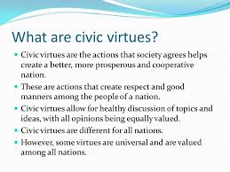

Slide 29
Civic virtues
-It is the cultivation of habits important for the success of the community.
- Examines the definition of civic virtue as morality or a standard of righteous behavior in relationship to a citizen's involvement in society.
Civic virtue helps people understand their ties to the community and their responsibilities within it

Slide 30
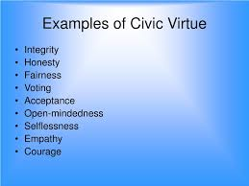

Slide 31
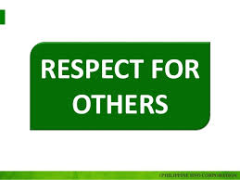

Slide 32
1. Listen
Listening to what another person has to say is a basic way to respect them. Everyone wants to have their say
2. Affirm
When we affirm someone, we’re giving evidence that they matter. That they have value. That they’re important. And that they’re worthy of respect.
Simply affirming someone virtually guarantees that you respect them. To affirm someone, you just have to notice something positive about that person and verbalize this observation.
“You’ve shown great determination over the past 2 years to get your business off the ground.”

Slide 33
3. Serve
Life on earth is about serving others. In fact, our professions, our careers, and our jobs should revolve around a desire to serve others. To give back to others. To use our talents and abilities to make life better for others.
Serving shows that we care. And caring shows that we respect. Serving is an important element in showing respect.

Slide 34
4. Be Kind
Though kindness and service are first cousins, they aren’t identical. We can serve without being kind. But it’s very difficult to be kind without serving.
Kindness is an expression of respect. Respect for the fact that someone else is simply in need. We have all been in need. And what a relief it was when someone showed us kindness. Kindness is a tangible way of showing respect.

Slide 35
5. Be Polite
It’s appalling to witness the decline of politeness in the modern world. Whether it’s on the highway, at the grocery store, in the parking lot, on the athletic field, on Facebook, or in political rhetoric – polite discourse and interaction is rapidly becoming a lost art.

Slide 36
6. Be Thankful
When someone does something for you that’s beneficial. Or they say something to you that’s helpful in some way. Or they honestly affirm you in some way that’s important to you. You should thank them.

Slide 37


Slide 38
1. Seek to love, not control others.
Ceasing to seek power over people and outcomes in your life is the first major step to living peacefully.
2. Find Your Inner Peace.
At least once a day spend ten minutes in a peaceful place, such as under a shady tree or in the park, anywhere where you can sit quietly without distractions. Without inner peace, you’ll feel in a constant state of conflict.

Slide 39
3. Moderate your convictions.
Thinking in absolutes and holding to opinions without considering the viewpoints of others is a sure way to live a life without peace.
4. Be tolerant.
Tolerance in all that you think and do will make a difference in your life and in the lives of others around you.
5. Be Peace.
A peaceful person does not use violence against another person or animal (that includes small obnoxious insects too).

Slide 40
6. Reflection of thought.
If someone hurts you physically or mentally, do not react with anger or violence. Stop and think. Choose instead to respond peacefully.
7. Seek forgiveness, not revenge.
Live in the present, not the past. Dwelling on that which should have been and reliving past wounds will keep the negativity of the past alive and bring constant internal conflict.

Slide 41
8. Live in joy.
Choosing to see the wonders of the world is an antidote to violence. It’s hard to be violent against that which you see as beautiful, wondrous, amazing, and joyful. The greatest despair arising from wars comes from the destruction of innocence.
9. Be the change you wish to see in the World.
Violence starts with your acceptance of its possibility as a solution. It’s within yourself that you need to stop violence and become peaceful. Change yourself before you can change the world.

Slide 42
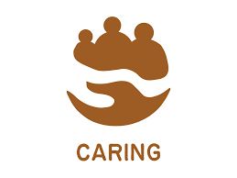

Slide 43
Caring can be a rich source of satisfaction in people's lives.
It can be life-affirming.
It can help deepen and strengthen relationships.
It can teach you a multitude of skills and help you realise potential you never thought you had.
Caring is something that will affect each and every one of us in our lifetime, whether we become a carer, or need care ourselves.

Slide 44
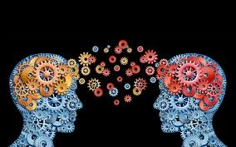
SHARING

Slide 45
Sharing is the joint use of a resource or space.
It is also the process of dividing and distributing.
Sharing can actually mean giving something as an outright gift: for example, to "share" one's food really means to give some of it as a gift.
Sharing is a basic component of human interaction, and is responsible for strengthening social ties and ensuring a person’s well-being.

Slide 46
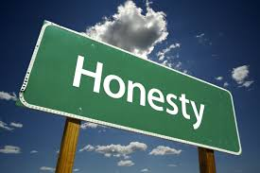

Slide 47
Honesty is not just about telling the truth. It’s about being real with yourself and others about who you are, what you want and what you need to live your most authentic life. Honesty promotes openness, empowers us and enables us to develop consistency in how we present the facts.
Honesty sharpens our perception and allows us to observe everything around us with clarity.

Slide 48


Slide 49
the ability to control your fear in
Practical Steps to Cultivate Courage
Acknowledge your situation and any fear around it. Admitting where you are and what you are afraid of—even if only to yourself—is always the first step toward progress. Example: I’m SO nervous for this audition. I’m afraid I won’t get the part I want!
Reality check: What are the possible outcomes? Are you attached to a certain outcome? Just like you try on clothes when you go shopping, ‘try on’ how different possible outcomes will make you feel.

Slide 50
Ask: Where is the love? I find myself asking ‘What is the most loving action I can take?’ a lot these days. What is the most loving thing I can do for myself & for others? What do I love more than I fear? Example: I LOVE to sing. I LOVE to act. I LOVE to dance. I love being a part of a show.
Turn your love into the courage to face your fears. Take what energizes you and use it to help you deal with the possibility of disappointment.

Slide 51
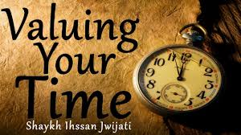

Slide 52
Value of time.
In transport economics, the value of time is the opportunity cost of the time that a traveller spends on his/her journey.
In essence, this makes it the amount that a traveller would be willing to pay in order to save time, or the amount they would accept as compensation for lost time.

Slide 53
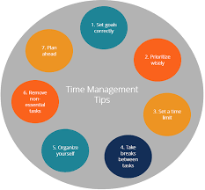

Slide 54
1: Create a time audit.
2: Before meetings, determine your desired results.
3: Put a time limit on tasks.
4: Plan your week on Sunday.
5: Create a daily plan.

Slide 55
6: Add a “done list” to your to-do list.
7: Complete your most important and demanding tasks first thing in the morning.
8: Block out distractions.
9: Don’t multitask.
10: Don’t wait for inspiration - do it now.
11: Don’t strive for perfection.

Slide 56
12: Don’t get hung up on small details.
13: Schedule breaks between tasks.
14: Make the most of waiting times.
15: Organize your email.
16: Train the other side of your brain.
17: Exercise often.
18: Sleep well.
19: Use your calendar.
20: Schedule relaxation time.

Slide 57
21: Learn to say No.
22: Be early.
23: Don’t answer the phone just because it’s ringing.
24: Turn your system into habits.
25: Let go of bad habits in the meantime.
26: Log your time with Toggl!

Slide 58
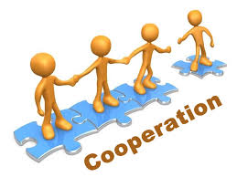

Slide 59
Cooperation or co-operation, refers to the practice of people or greater entities working in common with commonly agreed upon goals and possibly methods, instead of working separately in competition.
Cooperation is the antithesis of competition, however, the need or desire to compete with others is a very common impetus that motivates individuals to organize into a group and cooperate with each other in order to form a stronger competitive force.
Cooperation in many areas such as, farming and housing may be in the form of a cooperative or, alternately, in the form of a conventional business.

Slide 60
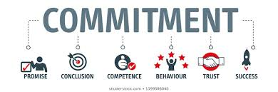

Slide 61
A commitment is something which regularly takes up some of your time because of an agreement you have made or because of responsibilities that you have.
It usually evokes a strong sense of intention and focus.
It typically is accompanied by a statement of purpose or a plan of action.
Very often, we utilize this word in regard to proclamations we may make about the seriousness of our relationships.

Slide 62
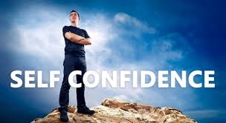

Slide 63
Self-confidence is an essential part of humanity.
A person with self-confidence generally likes themselves, is willing to take risks to achieve their personal and professional goals, and thinks positively about the future.

Slide 64
Identify your negative thoughts
Turn your negative thoughts to positive thoughts.
Refuse to focus on negative thoughts more often than positive thoughts.
Maintain a positive support network
Eliminate reminders of your negativity.
Identify your talents.
Take pride in yourself.
Accept compliments gracefully.
Look in the mirror and smile

Slide 65
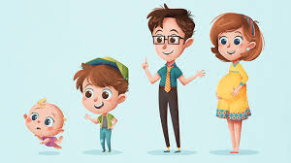
CHARACTER

Slide 66
Character traits are valued aspects of a person's behavior. ... Character traits are often labeled with descriptive adjectives such as patient, unfaithful, or jealous. Often, someone's character and personality are intertwined.

Slide 67
Types of characters in literature
The main character (Protagonist) Every story has this type of character and evolves around it. ...
Character opposing the main character (Antagonist) ...
Static or flat character. ...
Changing or dynamic character. ...
Confidante character. ...
Foil character. ...
Stock character. ...
Round character.

Slide 68
In general, people who are considered to have good character often have traits like integrity, honesty, courage, loyalty, fortitude, and other important virtues that promote good behavior. These character traits define who they are as people—and highly influence the choices they make in their lives.

Slide 69
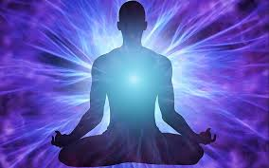
spirituality

Slide 70
Spirituality is a broad concept with room for many perspectives.\
It includes a sense of connection to something bigger than ourselves, and it typically involves a search for meaning in life.
As such, it is a universal human experience—something that touches us all.

Slide 71
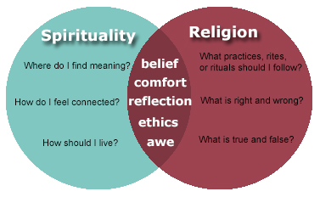

Slide 72
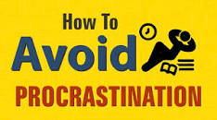

Slide 73
1. Get organized
2. Set simple, achievable goals
3. Create a timeline/schedule
4. Set a deadline
5. Get rid of distractions
6. Time yourself
7. Take a break
8. Use incentives
9. Get the hard stuff done first
10. Tell someone about your goal

Slide 74
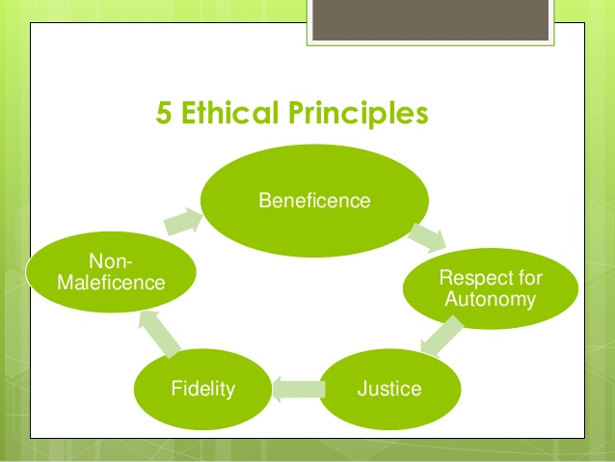

Slide 75
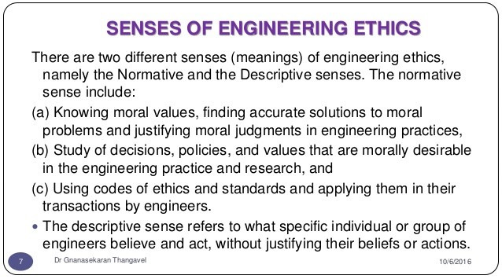

Slide 76
THANK YOU

