Slide 1
MODULE 3
21rst centaury skills
Prepared By
Asst.Prof Sreeti Gangadharan

Slide 2

COLLABORATION

Slide 3
Collaboration is a working practice whereby individuals work together to a common purpose to achieve business benefit

Slide 4
Collaboration at the conceptual level, involves:
Awareness – We become part of a working entity with a shared purpose
Motivation – We drive to gain consensus in problem solving or development
Self-synchronization – We decide as individuals when things need to happen
Participation – We participate in collaboration and we expect others to participate
Mediation – We negotiate and we collaborate together and find a middle point

Slide 5
Reciprocity – We share and we expect sharing in return through reciprocity
Reflection – We think and we consider alternatives
Engagement – We proactively engage rather than wait and see
Collaboration relies on openness and knowledge sharing but also some level of focus and accountability on the part of the business organizations.

Slide 6
NEED FOR CREATIVITY IN THIS CENTUARY
Creativity drives innovation.
Creativity drives prosperity.
Creativity solves “VUCA” problems..
Creativity tips the scales toward success.
Creativity increases employee engagement.
Creativity makes you “future-proof
Creativity promotes well-being and happiness.

Slide 7


Slide 8
“Imagination is more important than knowledge. For knowledge is limited to all we now know and understand, while imagination embraces the entire world, and all there ever will be to know and understand.”

Slide 9
It helps to make knowledge applicable in solving problems and in fundamental to integrating experience and the learning process.
It is a cognitive process used in mental functioning .
It is used in conjunction with psychological imagery.
It can be expressed through stories as fairy tales or fantasies.

Slide 10
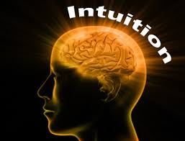

Slide 11
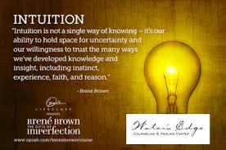

Slide 12
Intuition is essentially the brain on autopilot, performing the actions of processing information without the person's conscious awareness that it is operating.
It is nonconscious thinking.
Intuition can encompass the ability to know valid solutions to problems and decision making

Slide 13


Slide 14
Experience
It is the knowledge of an event gained through involvement.
With considerable experience in a specific field one can gain a reputation as an expert.
There are:
Physical experience
Mental experience
Emotional experience
Spiritual experience
Subjective experience
Religious experience
Social experiences
Virtual and simulation

Slide 15
Sources of creativity
Mantra meditation – mind will be naturally awaken with creativity
Time in nature – it is work to align ourselves with the universal source of creativity by getting deeply in touch with nature
Love – practicing compassion and empathy in our everyday life also open your heart and allows creativity to spring abundantly forth.

Slide 16
Lateral thinking
It represents a means of problem solving by an indirect , non sequential method using reasoning which is not clear.
The two main aspects of lateral thinking
Freeing our thought process from old ideas.
Stimulating the creation of new ideas.
Lateral thinking helps in handling problems.

Slide 17
Left brain and right brain function
The left brain is also connected to:
logic
sequencing
linear thinking
mathematics
facts
thinking in words

Slide 18
The right brain is also connected to:
imagination
holistic thinking
intuition
arts
rhythm
nonverbal cues
feelings visualization
daydreaming

Slide 19
Tips for keeping your brain sharp
Spend some time each day reading, writing, or both.
Never stop learning. Take a class, go to a lecture, or try to acquire a new skill.
Tackle. challenging crossword and sudoku puzzles
Play memory games, board games, card games, or video games.
Take on a new hobby that requires you to focus.

Slide 20
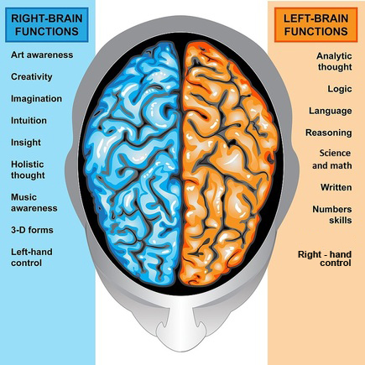

Slide 21
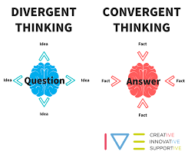

Slide 22
Differences Between Convergent and Divergent Thinking
Convergent Thinking | Divergent Thinking
The process of figuring out a concrete solution to any problem is called Convergent Thinking. | Divergent thinking is the process of thinking that explores multiple possible solutions in order to generate creative ideas.
It’s a straight forward process that focuses on figuring out the most effective answer to a problem. | In contrast, divergent thinking refers to opening the mind in various directions and trying out multiple solutions for a problem.
Its characteristics include Speed Accuracy Logic | Its characteristics include Spontaneous Free-flowing Non-linear

Slide 23
Convergent Thinking | Divergent Thinking
Examples: | Examples:
Variety of tests, such as multiple choice tests, standardized tests, quizzes, spelling tests and similar other tests require convergent thinking, because only one answer can be 100% correct. | Divergent thinking wouldn’t be applicable in multiple choice tests or standardized tests, which require a single absolute answer.
A convergent thinker would only regard a person be either sick or healthy. | A person can be both sick and healthy. For instance, a man can be under great stress mentally but perfectly fit physically.

Slide 24
Convergent Thinking | Divergent Thinking
A medical student can be either a doctor or nothing. | A medical student doesn’t always have to be either a doctor or nothing. She could very well make a career switch in the future and be a writer, or a painter, and varieties of other possibilities.

Slide 25
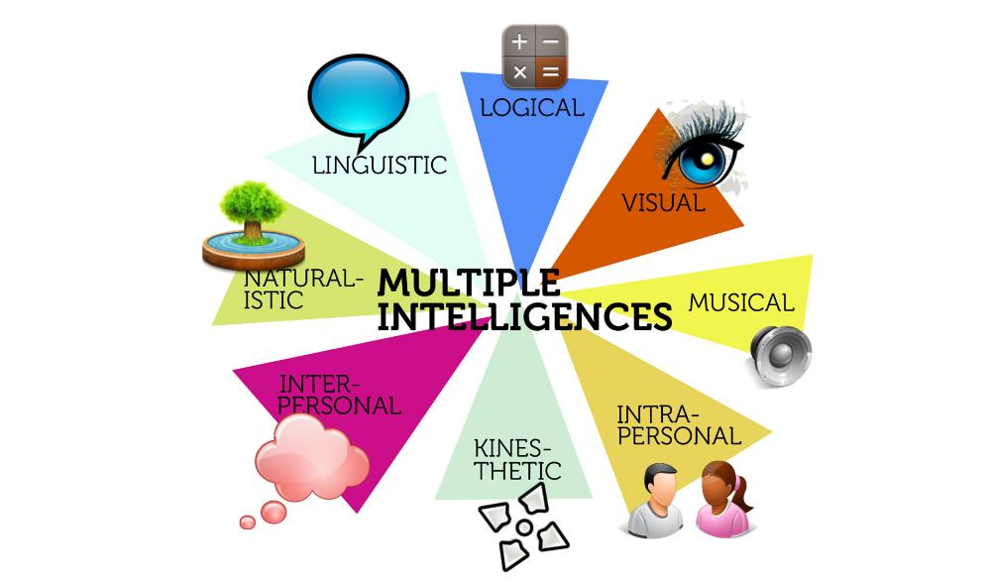

Slide 26
Howard Gardner of Harvard has identified eight distinct intelligences. This theory has emerged from recent cognitive research and "documents the extent to which students possess different kinds of minds and therefore learn, remember, perform, and understand in different ways,

Slide 27
1.Logical -Mathematical - reasoning, calculating. Think conceptually, abstractly and are able to see and explore patterns and relationships.
2.Linguistic - using words effectively. These learners have highly developed auditory skills and often think in words. They like reading, playing word games, making up poetry or stories.

Slide 28
3.Musical - show sensitivity to rhythm and sound. They love music, but they are also sensitive to sounds in their environments. Tools include musical instruments, music, radio, stereo, CD-ROM, multimedia.
4.Bodily-kinesthetic - use the body effectively, like a dancer or a surgeon. Keen sense of body awareness. They like movement, making things, touching.

Slide 29
5.Interpersonal - understanding, interacting with others. These students learn through interaction. They have many friends, empathy for others, street smarts. They can be taught through group activities, seminars, dialogues.
6.Intrapersonal - understanding one's own interests, goals. These learners tend to shy away from others. They can be taught through independent study and introspection.
7.Bodily-kinesthetic - use the body effectively, like a dancer or a surgeon. Keen sense of body awareness. They like movement, making things, touching.

Slide 30
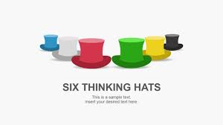

Slide 31
The White Hat calls for information known or needed. "The facts, just the facts."
The Yellow Hat symbolizes brightness and optimism. Under this hat you explore the positives and probe for value and benefit.
The Black Hat is judgment - the devil's advocate or why something may not work. Spot the difficulties and dangers; where things might go wrong

Slide 32
The Red Hat signifies feelings, hunches and intuition. When using this hat you can express emotions and feelings and share fears, likes, dislikes, loves, and hates.
The Green Hat focuses on creativity; the possibilities, alternatives, and new ideas. It's an opportunity to express new concepts and new perceptions.
The Blue Hat is used to manage the thinking process. It's the control mechanism that ensures the Six Thinking Hats® guidelines are observed.

Slide 33
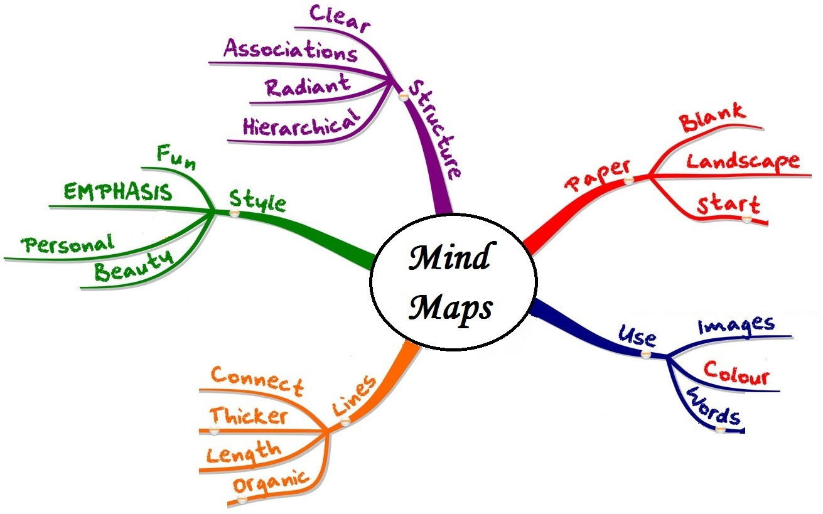
Mind mapping

Slide 34
Mind mapping is a highly effective way of getting information in and out of your brain.
Mind mapping is a creative and logical means of note-taking and note-making that literally "maps out" your ideas.

Slide 35
The Five Essential Characteristics of Mind Mapping:
1.The main idea, subject or focus is crystallized in a central image
2.The main themes radiate from the central image as 'branches'
3.The branches comprise a key image or key word drawn or printed on its associated line
4.Topics of lesser importance are represented as 'twigs' of the relevant branch
5.The branches form a connected nodal structure

Slide 36
The Rules of Mind Mapping
Rule no. 1 states that you must start at the center of a blank sheet of
Rule no. 2 advises us to use a picture for the central idea of our mind maps.landscape-oriented paper.
Rule no. 3 talks about using colours throughout the mind map.
Rule no. 4 advises mind mappers to connect the main branches to the central image and branch out from that.

Slide 37
Rule no. 5 simply says, “Make your branches curved, organic and flowing, Rule no. 6 is a hotly debated one. It says, “Use one keyword per line.”tapering outward.”
Rule no. 7 asks mindmappers to use images throughout their mind maps
Rule no. 8 is the one I like best: Develop your own personal style of mind maps.

Slide 38
Rule no. 9 states: Use emphasis and show associations in your mind map.
Rule no 10, the last one, says, “Use ‘radiant’ hierarchy, numerical order or outlines to embrace your branches.”

Slide 39
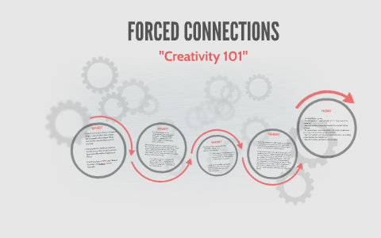

Slide 40
Forced connections are based on the brain’s ability to link two disparate items -such as words, objects , feelings, and ideas- and then use the new language generated by the linkages to think through the problem. It is called Forced Connections because it relies on random external triggers that force people to make a connection between the problem at hand and the trigger. These triggers cause people to broaden their perspective.

Slide 41
Like brainstorming, forced connections are particularly useful when your group is blocked while trying to generate new ideas or to solve problems.
In these circumstances it is usually imperative to introduce external triggers to get people thinking in new ways.

Slide 42
Analytical thinking is a critical component of visual thinking that gives one the ability to solve problems quickly and effectively. It involves a methodical step-by-step approach to thinking that allows you to break down complex problems into single and manageable components.

Slide 43
7 STEPS TO IMPROVE YOUR ANALYTICAL THINKING SKILLS
Be Observant
Read Books
Learn How Things Work
Ask Questions
Play Brain Games
Practice Your Problem Solving Skills
Think About Your Decisions

Slide 44
NUMERIC REASONING
In a numerical reasoning test, you are required to answer questions using facts and figures presented in statistical tables. In each question you are usually given a number of options to choose from.
Only one of the options is correct in each case.
Test takers are usually permitted to use a rough sheet of paper and/or a calculator. However, the use of a calculator may not be permitted in all tests.

Slide 45
A reasoning is an operation of cognition that allows – following implicit links (rules, definitions, axioms, etc.) – to produce new knowledge from already existing knowledge. The reasoning is said to be automated when done by an algorithm. There is a great variety of reasonings among which mention may be made of : probabilistic, statistical, possibilistic, symbolic, deductive, inductive, abductive, modal.

Slide 46

SYMBOLIC REASONING

Slide 47
The reasoning is said to be symbolic when he can be performed by means of primitive operations manipulating elementary symbols. Usually, symbolic reasoning refers to mathematical logic, more precisely first-order (predicate) logic and sometimes higher orders.
The reasoning is considered to be deductive when a conclusion is established by means of premises that is the necessary consequence of it, according to logical inference rules.

Slide 48
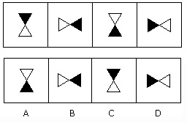
GRAPHIC REASONING

Slide 49
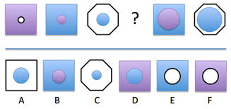

Slide 50
Diagrammatic reasoning is reasoning by means of visual representations. The study of diagrammatic reasoning is about the understanding of concepts and ideas, visualized with the use of diagrams and imagery instead of by linguistic or algebraic means.

Slide 51


Slide 52
Scientific temper refers to an attitude of logical and rational thinking. An individual is considered to have scientific temper if he employs a scientific method of decision-making in everyday life.

Slide 53
A section of intellectuals believes that scientific temperament is declining in the current scenario.
They believe that it is happening because some powers are promoting religious dogmas radically.
For them, promoting a scientific temperament is a necessity in India.
These people give references to Article 51A, Fundamental Duties of Indian citizens, which also include the duty to develop a scientific temper.

Slide 54
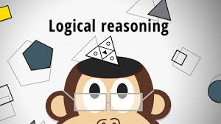

Slide 55
Logical thinkers observe and analyze phenomena, reactions, and feedback and then draw conclusions based on that input. They can justify their strategies, actions, and decisions based on the facts they gather.

Slide 56
Example: A sales representative modifies a presentation about a product to highlight its user-friendly qualities after receiving feedback from customers indicating that ease of use was the primary reason that they had purchased the product.

Slide 57
Thank you

