Slide 1
MODULE 4
4.1-SOFTWARE PROJECT MANAGEMENT

Slide 2
PROJECT MANAGEMENT
Software project management is an essential part of software engineering.
Projects need to be managed because professional software engineering is always subject to organizational budget and schedule constraints. The project manager's job is to ensure that the software project meets and overcomes these constraints as well as delivering high-quality software. Good management cannot guarantee project success. However, bad management usually results in project failure: The software may be delivered late, cost more than originally estimated, or fail to meet the expectations of customers.
The success criteria for project management obviously vary from project to pro ject, but, for most projects, important goals are:
to deliver the software to the customer at the agreed time:
to keep overall costs within budget;
to deliver software that meets the customer's expectations;
to maintain a coherent and well-functioning development team.

Slide 3
However, a number of fundamental project management activities are common to all organizations:
1. Project planning Project managers are responsible for planning, estimating, and scheduling project development and assigning people to tasks. They supervise the work to ensure that it is carried out to the required standards, and they monitor progress to check that the development is on time and within budget.
2. Risk management Project managers have to assess the risks that may affect a project, monitor these risks, and take action when problems arise.
3. People management Project managers are responsible for managing a team of people. They have to choose people for their team and establish ways of work ing that lead to effective team performance.
4. Reporting Project managers are usually responsible for reporting on the progress of a project to customers and to the managers of the company developing the software. They have to be able to communicate at a range of levels, from detailed technical information to management summaries. They have to write concise, coherent documents that abstract critical information from detailed project" reports. They must be able to present this information during progress reviews.
5. Proposal writing The first stage in a software project may involve writing a proposal to win a contract to carry out an item of work. The proposal describes the objectives of the project and how it will be carried out. It usually includes cost and schedule estimates and justifies why the project contract should be awarded to a particular organization or team. Proposal writing is a critical task as the survival of many software companies depends on having enough proposals accepted and contracts awarded.

Slide 4
1 Risk management
Risk management one of the most important jobs a project manager. a risk as something that you'd prefer to have happen. Risks may the project, the is software that is being developed, or the organization.
A complementary classification is to classify risks according to what these risks affect.
1. Project risks affect the project schedule or resources. An example of a project risk is the loss of an experienced system architect. Finding a replacement archi tect with appropriate skills and experience may take a long time; consequently, it will take longer to develop the software design than originally planned.
2. Product risks affect the quality or performance of the software being developed.
An example of a product risk is the failure of a purchased component to perform

Slide 5
as expected. This may affect the overall performance of the system so that it is slower than expected.
3. Business risks affect the organization developing or procuring the software. For example, a competitor introducing a new product is a business risk. The introduction of a competitive product may mean that the assumptions made about sales of existing software products may be unduly optimistic

Slide 6
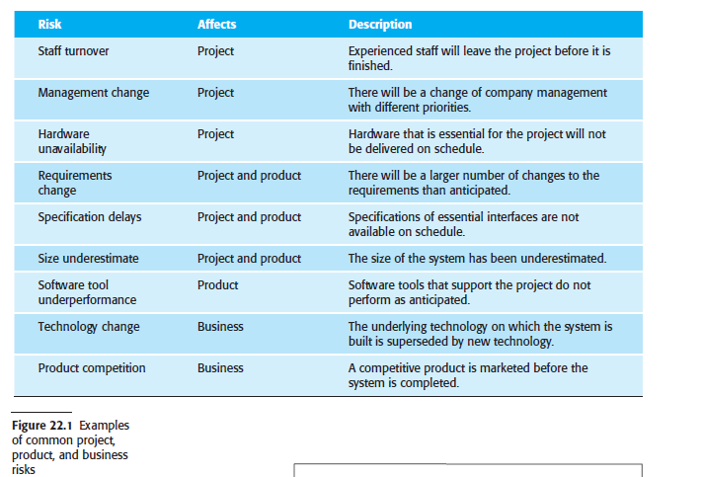
The specific risks that may affect a project depend on the project and the organizational environment in which the software is being developed. However, there are also common risks that are independent of the type of software being developed.
These can occur in any software development project. Some examples of these common risks are shown in Figure 22.1.Software risk management is important

Slide 7
An outline of the process of risk management is presented in Figure 22.2. It
involves several stages:
1. Risk identification You should identify possible project, product, and business risks.
2. Risk analysis You should assess the likelihood and consequences of these risks.
3. Risk planning You should make plans to address the risk, either by avoiding it or by minimizing its effects on the project.
4. Risk monitoring You should regularly assess the risk and your plans for risk mitigation and revise these plans when you learn more about the risk.

Slide 8
1.1 Risk identification
Risk identification is the first stage of the risk management process. It is concerned with identifying the risks that could pose a major threat to the software engineering process, the software being developed, or the development organization. Risk identification may be a team process in which a team gets together to brainstorm possible risks. Alternatively, project managers may identify risks based on their experience of what went wrong on previous projects.
As a starting point for risk identification, a checklist of different types of risk may
be used. Six types of risk may be included in a risk checklist:
1. Estimation risks arise from the management estimates of the resources required to build the system.
2. Organizational risks arise from the organizational environment where the software is being developed.
3. People risks are associated with the people in the development team.
4. Requirements risks come from changes to the customer requirements and the process of managing the requirements change.
5. Technology risks come from the software or hardware technologies that are used to develop the system.
6. Tools risks come from the software tools and other support software used to develop the system.

Slide 10
1.2 Risk analysis
During the risk analysis process, you have to consider each identified risk and make
a judgment about the probability and seriousness of that risk. There is no easy way to
do so. You have to rely on your judgment and experience of previous projects and
the problems that arose in them. It is not possible to make precise, numeric assessment
of the probability and seriousness of each risk. Rather, you should assign the
risk to one of a number of bands:
1. The probability of the risk might be assessed as insignificant, low, moderate,
high, or very high.
2. The effects of the risk might be assessed as catastrophic (threaten the survival of
the project), serious (would cause major delays), tolerable (delays are within
allowed contingency), or insignificant.

Slide 12
1.3 Risk planning
The risk planning process develops strategies to manage the key risks that threaten
the project. For each risk, you have to think of actions that you might take to minimize
the disruption to the project if the problem identified in the risk occurs. You
should also think about the information that you need to collect while monitoring the
project so that emerging problems can be detected before they become serious.
In risk planning, you have to ask “what-if” questions that consider both individual
risks, combinations of risks, and external factors that affect these risks.
For example,questions that you might ask are:
1. What if several engineers are ill at the same time?
2. What if an economic downturn leads to budget cuts of 20% for the project?
3. What if the performance of open-source software is inadequate and the only
expert on that open-source software leaves?
4. What if the company that supplies and maintains software components goes out
of business?
5. What if the customer fails to deliver the revised requirements as predicted?

Slide 13
Based on the answers to these “what-if” questions, you may devise strategies for managing the risks. Figure 22.5 shows possible risk management strategies that have been identified for the key risks (i.e., those that are serious or intolerable) shown in Figure 22.4. These strategies fall into three categories:
1. Avoidance strategies Following these strategies means that the probability that
the risk will arise is reduced. An example of a risk avoidance strategy is the
strategy for dealing with defective components shown in Figure 22.5.
2. Minimization strategies Following these strategies means that the impact of the
risk is reduced. An example of a risk minimization strategy is the strategy for
staff illness shown in Figure 22.5.
3. Contingency plans Following these strategies means that you are prepared for
the worst and have a strategy in place to deal with it. An example of a contingency
strategy is the strategy for organizational financial problems that I have
shown in Figure 22.5.

Slide 15
1.4 Risk monitoring
Risk monitoring is the process of checking that your assumptions about the product, process, and business risks have not changed. You should regularly assess each of the identified risks to decide whether or not that risk is becoming more or less probable.
Figure 22.6 gives some examples of factors that may be helpful in assessing these risk types.
You should monitor risks regularly at all stages in a project. At every management
review, you should consider and discuss each of the key risks separately. You
should decide if the risk is more or less likely to arise and if the seriousness and
consequences of the risk have changed.

Slide 17
2 Managing people
The people working in a software organization are its greatest assets. It is expensive
to recruit and retain good people, and it is up to software managers to ensure
that the engineers working on a project are as productive as possible. In successful
companies and economies, this productivity is achieved when people are
respected by the organization and are assigned responsibilities that reflect their
skills and experience.
It is important that software project managers understand the technical issues that
influence the work of software development. Unfortunately, however, good software
engineers are not always good people managers. Software engineers often have
strong technical skills but may lack the softer skills that enable them to motivate and
lead a project development team. As a project manager, you should be aware of the
potential problems of people management and should try to develop people management
skills.

Slide 18
There are four critical factors that influence the relationship between a manager
and the people that he or she manages:
1. Consistency All the people in a project team should be treated in a comparable way. No one expects all rewards to be identical, but people should not feel that their contribution to the organization is undervalued.
2. Respect Different people have different skills, and managers should respect these differences. All members of the team should be given an opportunity to make a contribution. In some cases, of course, you will find that people simply don’t fit into a team and they cannot continue, but it is important not to jump to conclusions about them at an early stage.
3. Inclusion People contribute effectively when they feel that others listen to them and take account of their proposals. It is important to develop a working environment where all views, even those of the least experienced staff, are considered.
4. Honesty As a manager, you should always be honest about what is going well and what is going badly in the team. You should also be honest about your level of technical knowledge and be willing to defer to staff with more knowledge when necessary. If you try to cover up ignorance or problems, you will eventually be found out and will lose the respect of the group.

Slide 19
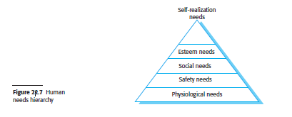
2.1 Motivating people
In practice, motivation means organizing work and its environment to encourage people to work as effectively as possible.
If people are not motivated, they will be less interested in the work they are
doing. They will work slowly, be more likely to make mistakes, and will not contribute to the broader goals of the team or the organization.
These needs are arranged in a series of levels, as shown in Figure 22.7.
The lower levels of this hierarchy represent fundamental needs for food, sleep, and
so on, and the need to feel secure in an environment. Social need is concerned with
the need to feel part of a social grouping. Esteem need represents the need to feel
respected by others, and self-realization need is concerned with personal development.
People need to satisfy lower-level needs such as hunger before the more
abstract, higher-level needs.
.

Slide 20
Making sure that peoples’ social, esteem, and self-realization needs are satisfied is most important
from a management point of view.
1. To satisfy social needs, you need to give people time to meet their co-workers
and provide places for them to meet. Software companies such as Google provide
social space in their offices for people to get together. This is relatively
easy when all of the members of a development team work in the same place,
but, increasingly, team members are not located in the same building
Social networking systems and teleconferencing can be used for remote communications,
but my experience with these systems is that they are most effective when people already know each other.
2. To satisfy esteem needs, you need to show people that they are valued by the
organization. Public recognition of achievements is a simple and effective way
of doing this. Obviously, people must also feel that they are paid at a level that
reflects their skills and experience.
3. Finally, to satisfy self-realization needs, you need to give people responsibility
for their work, assign them demanding (but not impossible) tasks, and provide
opportunities for training and development where people can enhance their
skills. Training is an important motivating influence as people like to gain new
knowledge and learn new skills.

Slide 21
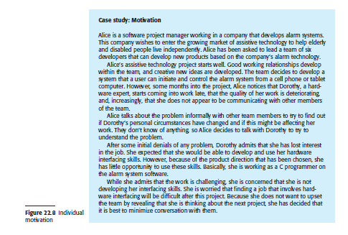
In Figure 22.8, Illustrate a problem of motivation that managers often have to face. In this example, a competent group member loses interest in the work and in the group as a whole. The quality of her work falls and becomes unacceptable. This situation has to be dealt with quickly. If you don’t sort out the problem, the other group members will become dissatisfied and feel that they are doing an unfair share
of the work.
Personal difficulties commonly affect motivation because people
cannot therefore concentrate on their work. You may have to give them time and
support to resolve these issues, although you also have to make it clear that they still
have a responsibility to their employer.
Dorothy’s motivation problem is one

Slide 22
Personal difficulties commonly affect motivation because people cannot therefore concentrate on their work. You may have to give them time and support to resolve these issues, although you also have to make it clear that they still have a responsibility to their employer.
Psychological personality type also influences motivation. Bass and Dunteman
(Bass and Dunteman 1963) identified three classifications for professional workers:
1. Task-oriented people, who are motivated by the work they do. In software engineering,
these are people who are motivated by the intellectual challenge of software
development.
2. Self-oriented people, who are principally motivated by personal success and
recognition. They are interested in software development as a means of achieving
their own goals. They often have longer-term goals, such as career progression,
that motivate them, and they wish to be successful in their work to help realize these goals.
3. Interaction-oriented people, who are motivated by the presence and actions of
co-workers. As more and more attention is paid to user interface design, interaction-
oriented individuals are becoming more involved in software engineering.

Slide 23
2.3 Teamwork
It is impossible for everyone in a large group to work together on a single problem,
Large teams are usually split into a number of smaller groups.
Each group is responsible for developing part of the overall system. The best size for a software engineering group is 4 to 6 members, and they should never have more than 12 members. When groups are small, communication problems are reduced.
Everyone knows everyone else, and the whole group can get around a table for a meeting to discuss the project and the software that they are developing.

Slide 24
Putting together a group that has the right balance of technical skills, experience,
and personalities is a critical management task.
A good group is cohesive and thinks of itself as a strong, single unit. The people
involved are motivated by the success of the group as well as by their own personal
goals.
In a cohesive group, members think of the group as more important than the
individuals who are group members. Members of a well-led, cohesive group are
loyal to the group. They identify with group goals and other group members.
They attempt to protect the group, as an entity, from outside interference. This
makes the group robust and able to cope with problems and unexpected
situations.

Slide 25
The benefits of creating a cohesive group are:
1. The group can establish its own quality standards Because these standards are
established by consensus, they are more likely to be observed than external
standards imposed on the group.
2. Individuals learn from and support each other Group members learn by working together. Inhibitions caused by ignorance are minimized as mutual learning is encouraged.
3. Knowledge is shared Continuity can be maintained if a group member leaves.
others in the group can take over critical tasks and ensure that the project is not
unduly disrupted.
4. Refactoring and continual improvement is encouraged Group members work
collectively to deliver high-quality results and fix problems, irrespective of the
individuals who originally created the design or program.

Slide 26
Good project managers should always try to encourage group cohesiveness. They
may try to establish a sense of group identity by naming the group and establishing a
group identity and territory.
Some managers like explicit group-building activities such as sports and games, although these are not always popular with group members.
Social events for group members and their families are a good way to bring
people together.
One of the most effective ways of promoting cohesion is to be inclusive. That is,
you should treat group members as responsible and trustworthy, and make information
freely available. Sometimes managers feel that they cannot reveal certain information
to everyone in the group. This invariably creates a climate of mistrust. An
effective way of making people feel valued and part of a group is to make sure that
they know what is going on.

Slide 27
Given a stable organizational and project environment, the three factors that have
the biggest effect on team working are:
1. The people in the group You need a mix of people in a project group as software
development involves diverse activities such as negotiating with clients, programming,testing, and documentation.
2. The way the group is organized A group should be organized so that individuals
can contribute to the best of their abilities and tasks can be completed as
expected.
3. Technical and managerial communications Good communication between
group members, and between the software engineering team and other project
stakeholders, is essential.

Slide 28
3.1 Selecting group members
A manager or team leader’s job is to create a cohesive group and organize that group so that they work together effectively.
This task involves selecting a group with the right balance of technical skills and personalities.
Sometimes people are hired from outside the organization; more often, software engineering groups are put together from current employees who have experience on other projects.
Technical knowledge and ability should not be the only factor used to select group members .
People who are motivated by the work are likely to be the strongest technically.
People who are self-oriented will probably be best at pushing the work forward to finish the job.
People who are interaction-oriented help facilitate communications within the group.

Slide 30
2.3 Group organization
The way a group is organized affects the group’s decisions, the ways information is exchanged, and the interactions between the development group and external project stakeholders. Important organizational questions for project managers include the following:
Should the project manager be the technical leader of the group?
The technical leader or system architect is responsible for the critical technical decisions made during software development.
2. Who will be involved in making critical technical decisions, and how will these
decisions be made? Will decisions be made by the system architect or the project manager or by reaching consensus among a wider range of team members?
3. How will interactions with external stakeholders and senior company management
be handled?
In many cases, the project manager will be responsible for these
interactions, assisted by the system architect if there is one..

Slide 31
4. How can groups integrate people who are not co-located?
It is now common for groups to include members from different organizations and for people to work from home as well as in a shared office. This change has to be considered in group decision-making processes.
5. How can knowledge be shared across the group?
Group organization affects information sharing as certain methods of organization are better for sharing than others. However, you should avoid too much information sharing as people become overloaded and excessive information distracts them from their work.

Slide 32
Small programming groups are usually organized in an informal way. The group
leader gets involved in the software development with the other group members. In an
informal group, the group as a whole discusses the work to be carried out, and tasks
are allocated according to ability and experience. More senior group members may be
responsible for the architectural design.
Agile development teams are always informal groups. Agile enthusiasts claim
that formal structure inhibits information exchange
Informal groups can be very successful, particularly when most group members
are experienced and competent. Such a group makes decisions by consensus, which
improves cohesiveness and performance.
If a group is composed mostly of inexperienced or incompetent members, informality can be a hindrance. With no experienced engineers to direct the work, .

Slide 33
In hierarchical groups the group leader is at the top of the hierarchy. He or she has
more formal authority than the group members and so can direct their work.
There is a clear organizational structure, and decisions are made toward the top of the hierarchy and implemented by people lower down.
Hierarchical groups can work well when a well-understood problem can be easily
broken down into software components that can be developed in different parts of the hierarchy. This grouping allows for rapid decision making, which is why military organizations follow this model. However, it rarely works well for complex software engineering.

Slide 34
In software development, effective team communications at all levels is essential:
1. Changes to the software often require changes to several parts of the system, and this requires discussion and negotiation at all levels in the hierarchy.
2. Software technologies change so fast that more junior staff may know more about new technologies than experienced staff.
Top-down communications may mean that the project manager does not find out about the opportunities of using these new technologies. More junior staff may become frustrated because of what they see as old-fashioned technologies being used for development.

Slide 35
3.3 Group communications
The effectiveness and efficiency of communications are influenced by:
1. Group size As a group gets bigger, it gets harder for members to communicate
effectively.
The number of one-way communication links is n * (n − 1), where n
is the group size, so, with a group of eight members, there are 56 possible
communication
pathways. This means that it is quite possible that some people
will rarely communicate with each other. Status differences between group
members mean that communications are often one-way. Managers and experienced
engineers tend to dominate communications with less experienced staff,
who may be reluctant to start a conversation or make critical remarks
2. Group structure People in informally structured groups communicate more
effectively than people in groups with a formal, hierarchical structure. In hierarchical
groups, communications tend to flow up and down the hierarchy. People
at the same level may not talk to each other. This is a particular problem in a
large project with several development groups. If people working on different
subsystems only communicate through their managers, then there are more
likely to be delays and misunderstandings.
3. Group composition People with the same personality types (discussed in
Section 22.2) may clash, and, as a result, communications can be inhibited.
Communication is also usually better in mixed-sex groups than in single-sex
groups (Marshall and Heslin 1975). Women are often more interaction-oriented
than men and may act as interaction controllers and facilitators for the group.
4. The physical work environment The organization of the workplace is a major factor
in facilitating or inhibiting communications. While some companies use standard
open-plan offices for their staff, others invest in providing a workspace that includes
a mixture of private and group working areas. This allows for both collaborative
activities and individual development that require a high level of concentration.
5. The available communication channels There are many different forms of
communication—
face to face, email messages, formal documents, telephone,
and technologies such as social networking and wikis. As project teams become
increasingly distributed, with team members working remotely, you need to
make use of interaction technologies, such as conferencing systems, to facilitate
group communications.

Slide 36
MODULE 4.2
PROJECT PLANNING

Slide 37
1 Project planning
Project planning is one of the most important jobs of a software project manager.
As a manager, you have to break down the work into parts and assign them to project team members, anticipate problems that might arise, and prepare tentative solutions to those problems.
The project plan, which is created at the start of a project and updated as the project progresses, is used to show how the work will be done and to assess progress on the project.

Slide 38
Project planning takes place at three stages in a project life cycle:
1. At the proposal stage, when you are bidding for a contract to develop or provide
a software system. You need a plan at this stage to help you decide if you have
the resources to complete the work and to work out the price that you should quote to a
customer.
2. During the project startup phase, when you have to plan who will work on the
project, how the project will be broken down into increments, how resources
will be allocated across your company, and so on.
3. Periodically throughout the project, when you update your plan to reflect new
information about the software and its development. You learn more about the
system being implemented and the capabilities of your development team. As
software requirements change, the work breakdown has to be altered and the
schedule extended. This information allows you to make more accurate estimates
of how long the work will take.

Slide 39
The project plan always evolves during the development process because of
requirements changes, technology issues, and development problems.
Development planning is intended to ensure that the project plan remains a useful document for staff to understand what is to be achieved and when it is to be delivered. Therefore, the schedule, cost estimate, and risks all have to be revised as the software is developed.
If an agile method is used, there is still a need for a project startup plan because
regardless of the approach used, the company still needs to plan how resources will
be allocated to a project. However, this is not a detailed plan, and you only need to
include essential information about the work breakdown and project schedule.

Slide 40
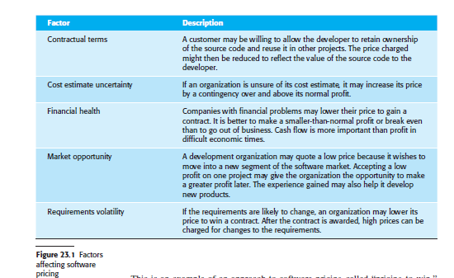
1.1 Software Pricing
In principle, the price of a software system developed for a customer is simply the cost of development plus profit for the developer.
In practice, however, the relationship between the project cost and the price quoted to the customer is not usually so simple.
When calculating a price, you take broader organizational, economic, political, and business considerations into account (Figure 23.1)

Slide 41
A small software company, PharmaSoft, employs 10 software engineers. It has
just finished a large project but only has contracts in place that require five
development staff. However, it is bidding for a very large contract with a
major pharmaceutical company that requires 30 person-years of effort over
two years. The project will not start for at least 12 months but, if granted, it
will transform the finances of the company.
PharmaSoft gets an opportunity to bid on a project that requires six people
and has to be completed in 10 months. The costs (including overheads of this
project) are estimated at $1.2 million. However, to improve its competitive
position, PharmaSoft decides to bid a price to the customer of $0.8 million.
This means that, although it loses money on this contract, it can retain specialist
staff for the more profitable future projects that are likely to come on stream
in a year’s time.

Slide 42
This is an example of an approach to software pricing called “pricing to win.”Pricing to win means that a company has some idea of the price that the customer
expects to pay and makes a bid for the contract based on the customer’s expected
price. This may seem unethical and unbusinesslike, but it does have advantages for
both the customer and the system provider.
A project cost is agreed on the basis of an outline proposal. Negotiations then take place between client and customer to establish the detailed project specification.
This specification is constrained by the agreed cost. The buyer and seller must agree on what is acceptable system functionality.
The fixed factor in many projects is not the project requirements but the cost.
The requirements may be changed so that the project costs remain within budget.

Slide 43
For example, say a company (OilSoft) is bidding for a contract to develop a fuel delivery system for an oil company that schedules deliveries of fuel to its service
stations. There is no detailed requirements document for this system, so OilSoft estimates that a price of $900,000 is likely to be competitive and within the oil company’s
budget. After being granted the contract, OilSoft then negotiates the detailed
requirements of the system so that basic functionality is delivered. It then estimates
the additional costs for other requirements.
This approach has advantages for both the software developer and the customer.
The requirements are negotiated to avoid requirements that are difficult
to implement and potentially very expensive. Flexible requirements make it easier
to reuse software. The oil company has awarded the contract to a known
company that it can trust. Furthermore, it may be possible to spread the cost of

Slide 44
1.2 Plan-driven development
Plan-driven or plan-based development is an approach to software engineering
where the development process is planned in detail
A project plan is created that records the work to be done, who will do it, the development schedule, and the work products.
Managers use the plan to support project decision making and as a way of
measuring progress.
Plan-driven development is based on engineering project management techniques and can be thought of as the “traditional” way of managing large software development projects.
Agile development involves a different planning process, where decisions are delayed.
The problem with plan-driven development is that early decisions have to be revised
because of changes to the environments in which the software is developed and used.
Delaying planning decisions avoids unnecessary rework. However, the arguments in favor
of a plan-driven approach are that early planning allows organizational issues (availability
of staff, other projects, etc.) to be taken into account. Potential problems and dependencies
are discovered before the project starts, rather than once the project is underway.
In my view, the best approach to project planning involves a sensible mixture

Slide 45
The best approach to project planning involves a sensible mixture of
plan-based and agile development.
The balance depends on the type of project and skills of the people who are available.
At one extreme, large security and safetycritical systems require extensive up-front analysis and may have to be certified before they are put into use. These systems should be mostly plan-driven.
At the other extreme, small to medium-size information systems, to be used in a rapidly changing competitive environment, should be mostly agile. Where several companies are involved in a development project, a plan-driven approach is normally used to coordinate the work across each development site.

Slide 46
2.1 Project plans
In a plan-driven development project, a project plan sets out the resources available to
the project, the work breakdown, and a schedule for carrying out the work. The plan
should identify the approach that is taken to risk management as well as risks to the project
and the software under development. The details of project plans vary depending on
the type of project and organization but plans normally include the following sections:
1. Introduction Briefly describes the objectives of the project and sets out the constraints (e.g., budget, time) that affect the management of the project.
2. Project organization Describes the way in which the development team is organized, the people involved, and their roles in the team.

Slide 47
3. Risk analysis Describes possible project risks, the likelihood of these risks arising,
and the risk reduction strategies (discussed in Chapter 22) that are proposed.
4. Hardware and software resource requirements Specifies the hardware and support
software required to carry out the development. If hardware has to be purchased,
estimates of the prices and the delivery schedule may be included.
5. Work breakdown Sets out the breakdown of the project into activities and identifies
the inputs to and the outputs from each project activity.
6. Project schedule Shows the dependencies between activities, the estimated time
required to reach each milestone, and the allocation of people to activities. The
ways in which the schedule may be presented are discussed in the next section
of the chapter.
7. Monitoring and reporting mechanisms Defines the management reports that should be produced, when these should be produced, and the project monitoring mechanisms to be used.

Slide 48
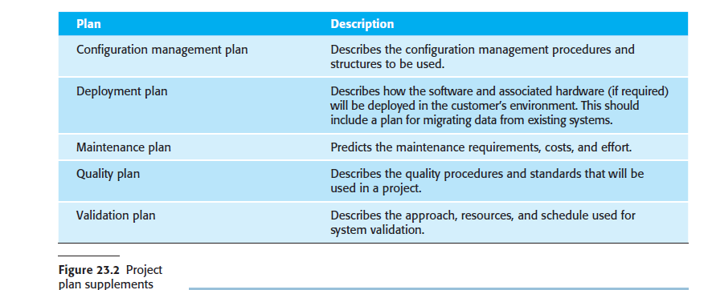
The main project plan should always include a project risk assessment and a schedule for the project. In addition, you may develop a number of supplementary plans for activities such as testing and configuration management. Figure 23.2 shows some supplementary plans that may be developed.

Slide 49
2.2 The planning process
Project planning is an iterative process that starts when you create an initial project plan during the project startup phase. Figure 23.3 is a UML activity diagram that shows a typical workflow for a project planning process.

Slide 50
At the beginning of a planning process, you should assess the constraints affecting
the project. These constraints are the required delivery date, staff available, overall budget, available tools, and so on. In conjunction with this assessment, you should also identify the project milestones and deliverables. Milestones are points in the schedule against which you can assess progress, for example, the handover of the system for testing. Deliverables are work products that are delivered to the customer, for example, a requirements document for the system.

Slide 51
3 Project scheduling
Project scheduling is the process of deciding how the work in a project will be organized as separate tasks, and when and how these tasks will be executed.
You estimate the calendar time needed to complete each task and the effort required, and you suggest who will work on the tasks that have been identified.
You also have to estimate the hardware and software resources that are needed to complete each task.
For example, if you are developing an embedded system, you have to estimate the time that you need on specialized hardware and the costs of running a system simulator.

Slide 52
Both plan-based and agile processes need an initial project schedule, although less detail is included in an agile project plan.
This initial schedule is used to plan how people will be allocated to projects and to check the progress of the project against its contractual commitments.
In traditional development processes, the complete schedule is initially developed and then modified as the project progresses.
In agile processes ,there has to be an overall schedule that identifies when the major phases of the project will be completed. An iterative approach to scheduling is then used to plan each phase.

Slide 53
Scheduling in plan-driven projects (Figure 23.4) involves breaking down the total work involved in a project into separate tasks and estimating the time required to
complete each task. Tasks should normally last at least a week and no longer than
2 months. Finer subdivision means that a disproportionate amount of time must be
spent on re-planning and updating the project plan. The maximum amount of time
for any task should be 6 to 8 weeks. If a task will take longer than this, it should be
split into subtasks for project planning and scheduling.

Slide 54
If a project is technically advanced, initial estimates will almost certainly be optimistic
even when you try to consider all eventualities.
In this respect, software scheduling is no different from scheduling any other type of large advanced project.
New aircraft, bridges, and even new models of cars are frequently late because of
unanticipated problems. Schedules, therefore, must be continually updated as better
progress information becomes available. If the project being scheduled is similar to
a previous project, previous estimates may be reused. However, projects may use
different design methods and implementation languages, so experience from previous
projects may not be applicable in the planning of a new project.
When you are estimating schedules, you must take into account the possibility
that things will go wrong. People working on a project may fall ill or leave, hardware
may fail, and essential support software or hardware may be delivered late. If the
project is new and technically advanced, parts of it may turn out to be more difficult
and take longer than originally anticipated.

Slide 55
3.1 Schedule presentation
Project schedules may simply be documented in a table or spreadsheet showing the tasks, estimated effort, duration, and task dependencies (Figure 23.5).
However, this style of presentation makes it difficult to see the relationships and dependencies between the different activities.

Slide 56
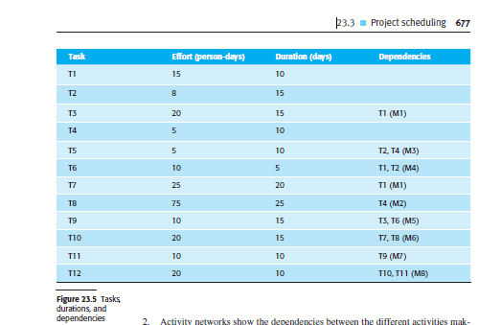

Slide 57
For this reason, alternative graphical visualizations of project schedules have been developed that are often easier to read and understand.
Two types of visualization are commonly used:
Calendar-based bar charts show who is responsible for each activity, the expected elapsed time, and when the activity is scheduled to begin and end. Bar charts are also called Gantt charts.
2. Activity networks show the dependencies between the different activities making up a project.

Slide 58
Project activities are the basic planning element.
Each activity has:
■ a duration in calendar days or months;
■ an effort estimate, which shows the number of person-days or person-months to complete the work;
■ a deadline by which the activity should be complete; and
■ a defined endpoint, which might be a document, the holding of a review meeting,the successful execution of all tests, or the like.

Slide 59
When planning a project, you may decide to define project milestones.
A milestone is a logical end to a stage of the project where the progress of the work can be reviewed.
Each milestone should be documented by a brief report (often simply
an email) that summarizes the work done and whether or not the work has been completed as planned.
Milestones may be associated with a single task or with groups of related activities. For example, in Figure 23.5, milestone M1 is associated with task T1 and marks the end of that activity. Milestone M3 is associated with a pair of tasks T2 and T4; there is no individual milestone at the end of these tasks.

Slide 60
Figure 23.5 shows a hypothetical set of tasks, their estimated effort and duration, and task dependencies.
From this table, you can see that
task T3 is dependent on task T1. This means that task T1 has to be completed
before T3 starts.
For example, T1 might be the selection of a system for reuse and T3, the configuration of the selected system. You can’t start system configuration until you have chosen and installed the application system to be modified.
Notice that the estimated duration for some tasks is more than the effort required and vice versa.
If the effort is less than the duration, the people allocated to that task
are not working full time on it.
If the effort exceeds the duration, this means that several team members are working on the task at the same time.

Slide 61
Figure 23.6 takes the information in Figure 23.5 and presents the project schedule
as a bar chart showing a project calendar and the start and finish dates of tasks.
Reading from left to right, the bar chart clearly shows when tasks start and end. The
milestones (M1, M2, etc.) are also shown on the bar chart.
Notice that tasks that are independent may be carried out in parallel. For example, tasks T1, T2, and T4 all start at the beginning of the project.

Slide 62
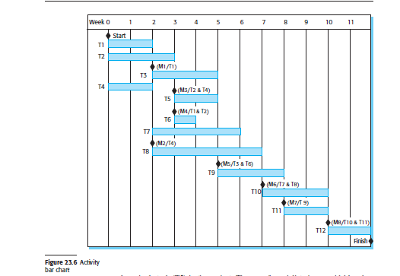

Slide 64
The key resource is, of course, the software engineers who will do the work. They have to be assigned to project activities.
The resource allocation can be analyzed by project management tools, and a bar chart can be generated showing when staff are working on the project (Figure 23.7).
People may be working on more than one task at the same time, and sometimes they are not working on the project. They may be on holiday, working on other projects, or attending training courses.
I show part-time assignments using a diagonal line crossing the bar.

Slide 65
In Figure 23.7, you can see that Mary is a specialist who works on only a single task (T5) in the project.
The use of specialists is unavoidable when complex systems are being developed, but it can lead to scheduling problems.
If one project is delayed while a specialist is working on it, this may affect other projects where the specialist is also required. These projects may be delayed because the specialist is not available.
If a task is delayed, later tasks that

Slide 66
23.4 Agile planning
Agile methods of software development are iterative approaches where the software is developed and delivered to customers in increments. Unlike plan-driven approaches, the functionality of these increments is not planned in advance but is decided during the development.
The decision on what to include in an increment depends on progress and on the customer’s priorities. The argument for this approach is that the customer’s priorities and requirements change, so it makes sense to have a flexible plan that can accommodate these changes.

Slide 67
Agile development methods such as Scrum and Extreme Programming have a two-stage approach to planning, corresponding to the startup phase in plan-driven development and development planning:
1. Release planning, which looks ahead for several months and decides on the features that should be included in a release of a system.
2. Iteration planning, which has a shorter term outlook and focuses on planning the next increment of a system. This usually represents 2 to 4 weeks of work for the team.

Slide 68
The Scrum approach to planning which is based on project backlogs and daily reviews of work to be done. It is primarily geared to iteration planning.
Another approach to agile planning, which was developed as
part of Extreme Programming, is based on user stories. The so-called planning game can be used in both release planning and iteration planning.

Slide 69
The basis of the planning game (Figure 23.8) is a set of user stories that cover all of the functionality to be included in the final system.
The development team and the software customer work together to develop these stories. The team members read and discuss the stories and rank them based on the amount of time they think it will take to implement the story. Some stories may be too large to implement in a single iteration, and these are broken down into smaller stories.

Slide 70
Once the stories have been estimated, the relative effort is translated into the first
estimate of the total effort required by using the idea of “velocity.”
Velocity is the number of effort points implemented by the team, per day.
This can be estimated
either from previous experience
or
by developing one or two stories to see how much time is required.
The velocity estimate is approximate but is refined during the
development process. Once you have a velocity estimate, you can calculate the total
effort in person-days to implement the system.

Slide 71
Iteration planning is the first stage in developing a deliverable system increment.
Stories to be implemented during that iteration are chosen,
`with the number of stories reflecting the time to deliver an workable system (usually 2 or 3 weeks)
the team’s velocity.
When the delivery date is reached, the development iteration is complete,
even if all of the stories have not been implemented. The team considers the stories
that have been implemented and adds up their effort points. The velocity can then be
recalculated, and this measure is used in planning the next version of the system.

Slide 72
At the start of each development iteration, there is a task planning stage where the
developers break down stories into development tasks. A development task should
take 4–16 hours.
All of the tasks that must be completed to implement all of the stories
in that iteration are listed. The individual developers then sign up for the specific
tasks that they will implement. Each developer knows their individual velocity and
so should not sign up for more tasks than they can implement in the time allotted.
This approach to task allocation has two important benefits:
1. The whole team gets an overview of the tasks to be completed in an iteration.They therefore have an understanding of what other team members are doing
and who to talk to if task dependencies are identified.
2. Individual developers choose the tasks to implement; they are not simply allocated
tasks by a project manager. They therefore have a sense of ownership in
these tasks, and this is likely to motivate them to complete the task.

Slide 74
MODULE 4.3
ESTIMATION TECHNIQUES

Slide 75
1 Estimation techniques
Two types of techniques can be used for making estimates:
1. Experience-based techniques The estimate of future effort requirements is based on the manager’s experience of past projects and the application domain.
Essentially, the manager makes an informed judgment of what the effort requirements are likely to be.
2. Algorithmic cost modeling In this approach, a formulaic approach is used to compute the project effort based on estimates of product attributes, such as size,process characteristics, and experience of staff involved.

Slide 76
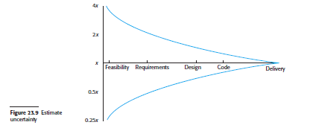
In both cases, you need to use your judgment to estimate either the effort directly or the project and product characteristics.
In the startup phase of a project, these estimates have a wide margin of error. Based on data collected from a large number of projects.
If the initial estimate of effort required is x months of effort, they
found that the range may be from 0.25x to 4x of the actual effort as measured when
the system was delivered. During development planning, estimates become more
and more accurate as the project progresses (Figure 23.9).
Experience-based techniques rely on the manager’s experience

Slide 77
Experience-based techniques rely on the manager’s experience of past projects and the actual effort expended in these projects on activities that are related to software development. Typically, you identify the deliverables to be produced in a project and the different software components or systems that are to be developed.
You document these in a spreadsheet, estimate them individually, and compute the total effort required. It usually helps to get a group of people involved in the effort estimation and to ask each member of the group to explain their estimate. This often reveals factors that others have not considered, and you then iterate toward an agreed group estimate.

Slide 78
1.1 Algorithmic cost modeling
Algorithmic cost modeling uses a mathematical formula to predict project costs
based on estimates of the project size, the type of software being developed, and
other team, process, and product factors.
Algorithmic cost models are developed by analyzing the costs and attributes of completed projects, then finding the closest-fit formula to the actual costs incurred
.
Algorithmic cost models are primarily used to make estimates of software development costs.

Slide 79
Effort = A * Size$^B$ * M
A: a constant factor, which depends on local organizational practices and the type
of software that is developed.
Size: an assessment of the code size of the software or a functionality estimate
expressed in function or application points.
B: represents the complexity of the software and usually lies between 1 and 1.5.
M: is a factor that takes into account process, product and development attributes,
such as the dependability requirements for the software and the experience of the
development team. These attributes may increase or decrease the overall difficulty
of developing the system.

Slide 80
SLOC :
The number of lines of source code (SLOC) in the delivered system is the fundamental size metric that is used in many algorithmic cost models.
To estimate the number of lines of code in a system, you may use a combination of approaches:
Compare the system to be developed with similar systems and use their code size as the basis for your estimate.
2. Estimate the number of function or application points in the system and formulaically convert these to lines of code in the programming language used.
3. Rank the system components using judgment of their relative sizes and use a known reference component to translate this ranking to code sizes.

Slide 81
The idea of using a scientific and objective approach to cost estimation is an
attractive one, but all algorithmic cost models suffer from two key problems:
1. It is practically impossible to estimate Size accurately at an early stage in a project, when only the specification is available. Function-point and application point
estimates (see later) are easier to produce than estimates of code size but
are also usually inaccurate.
2. The estimates of the complexity and process factors contributing to B and M are
subjective. Estimates vary from one person to another, depending on their background
and experience of the type of system that is being developed.
Algorithmic cost models are a systematic way to estimate the effort required to
develop a system. However, these models are complex and difficult to use.

Slide 82
2 COCOMO cost modeling
The best known algorithmic cost modeling technique and tool is the COCOMO II
model.
These data were analyzed to discover the formulas that were the best fit to the observations.
These formulas linked the size of the system and product, project, and team factors to the effort to develop the system.
COCOMO II is a freely available model that is supported with open-source tools.
COCOMO II was developed from earlier COCOMO (Constructive Cost
Modeling) cost estimation models, which were largely based on original code development

Slide 83
The sub models (Figure 23.10) that are part of the COCOMO II model are:
1. An application composition model This models the effort required to develop
systems that are created from reusable components, scripting, or database programming.
Software size estimates are based on application points, and a simple
size/productivity formula is used to estimate the effort required.
2. An early design model This model is used during early stages of the system
design after the requirements have been established.
Estimates are based on function points,which are then converted to number of lines of source code.

Slide 85
1. An application composition model This models the effort required to develop systems that are created from reusable components, scripting, or database programming.
Software size estimates are based on application points, and a simple
size/productivity formula is used to estimate the effort required.
2. An early design model This model is used during early stages of the system design after the requirements have been established. The estimate is based on the standard estimation formula that I discussed in the introduction of this chapter,with a simplified set of seven multipliers. Estimates are based on function points, which are then converted to number of lines of source code.

Slide 86
3. A reuse model This model is used to compute the effort required to integrate reusable components and/or automatically generated program code.
It is normally used in co njunction with the post-architecture model.
4. A post-architecture model Once the system architecture has been designed, a more accurate estimate of the software size can be made. Again, this model uses
the standard formula for cost estimation discussed above. However, it includes a more extensive set of 17 multipliers reflecting personnel capability, product, and project characteristics.

Slide 87
23.6.1 The application composition model
The application composition model was introduced into COCOMO II to support
the estimation of effort required for prototyping projects and for projects where
the software is developed by composing existing components. It is based on an
estimate of weighted application points (sometimes called object points), divided
by a standard estimate of application point productivity (B. W. Boehm et al.
2000). The number of application points in a program is derived from four simpler
estimates:
■ the number of separate screens or web pages that are displayed;
■ the number of reports that are produced;
■ the number of modules in imperative programming languages (such as Java); and
■ the number of lines of scripting language or database programming code.

