Slide 1
MODULE VI
Image processing – Introduction - Fundamental steps in image processing – digital image representations – relationship between pixels – gray level histogram –spatial convolution and correlation – edge detection – Robert, Prewitt, Sobel.

Slide 2
Text Book
E. Gose, R. Johnsonbaugh and S. Jost., Pattern Recognition and Image Analysis, PHI PTR, 1996

Slide 14
Considering 3 types of computerized processes

Slide 15
Digital Image Processing
Refers to processing digital images by means of a digital computer

Slide 18
Fundamental Steps in Digital Image Processing:
Outputs of these processes generally are images
Colour Image Processing
Wavelets & Multiresolution processing
Image Compression
Morphological Processing
Image Restoration
Knowledge Base
Segmentation
Outputs of these processes generally are image attributes
Image Enhancement
Representation & Description
Image Acquisition
Object Recognition
Problem Domain

Slide 19
Step 1: Image Acquisition
Involves preprocessing, such as scaling
Refers to the process of capturing real-world images & storing them into a computer

Slide 20
Step 2: Image Enhancement
The process of manipulating an image so that the result is more suitable than the original for specific applications.
bring out details that are hidden
highlight certain features of interest in an image.
Eg:- increasing the contrast of an image to look better

Slide 21
Step 3: Image Restoration
Improving the appearance of an image
Blurred images can be removed
Tend to be based on mathematical or probabilistic models.
objective
Enhancement, on the other hand, is based on human subjective preferences regarding what constitutes a “good” enhancement result.

Slide 22
Step 4: Colour Image Processing (1)
Is an area that has been gaining its importance because of significant increase in the use of digital images over the internet.
Requires an understanding of the physics of light as well as the physiology of color perception

Slide 23
Step 4: Colour Image Processing (2)
Color is the perceptual sensation of light in the visible range incident upon the retina
Color is used as the basis for extracting features of interest in an image

Slide 24
Step 5: Wavelets & Multiresolution Processing
Are the foundation for representing images in various degrees of resolution.
Wavelet transform divides a signal into a number of segments each corresponding to a different frequency band

Slide 25
Step 6: Compression
Techniques for reducing the storage required to save an image or the bandwidth required to transmit it.
JPEG – image compression standard
Joint photographic Expert Group

Slide 26
Step 7: Morphological Processing
Tools for extracting image components that are useful in the representation and description of shape.

Slide 27
Step 8: Image Segmentation
partition an image into its constituent parts or objects.
Autonomous Segmentation is one of the most difficult tasks in digital image processing

Slide 28
Step 9: Representation and Description
Representation: Make a decision whether the data should be represented as a boundary or as a complete region.
It is almost always follows the output of a segmentation stage.
Boundary Representation: Focus on external shape characteristics, such as corners
Region Representation: Focus on internal properties, such as texture or skeleton shape

Slide 29
Step 9: Representation and Description
Choosing a representation is only part of the solution for transforming raw data into a form suitable for subsequent computer processing (mainly recognition)
- Description: also called, feature selection, deals with extracting attributes that result in some information of interest.

Slide 30
Step 10: Object Recognition
the process that assigns label to an object based on the information provided by its description.
Eg:- vehicle

Slide 31
Step 11: Knowledge Base
Knowledge about a problem domain is coded into an image processing system in the form of a knowledge database.

Slide 35
Basic Relationship between pixels

Slide 38
8-Neighbours

Slide 55
Step 4: mapping of gray-level by one-to-one correspondence

Slide 57
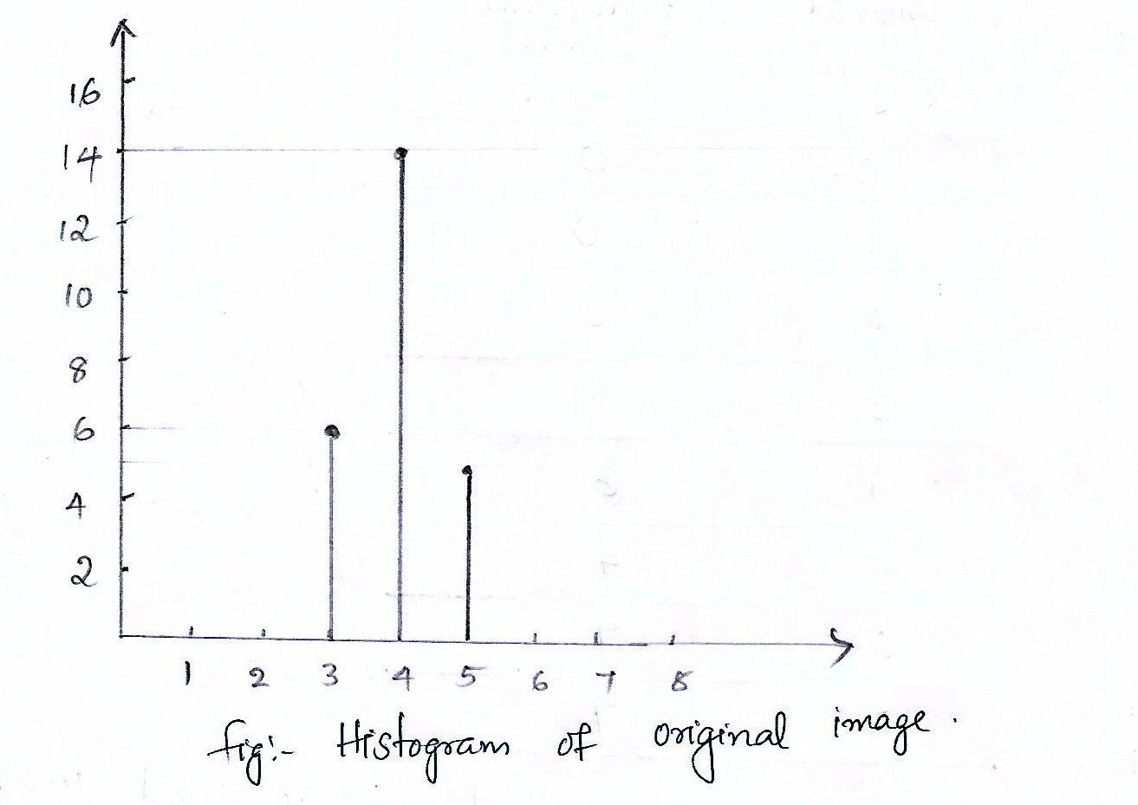

Slide 58
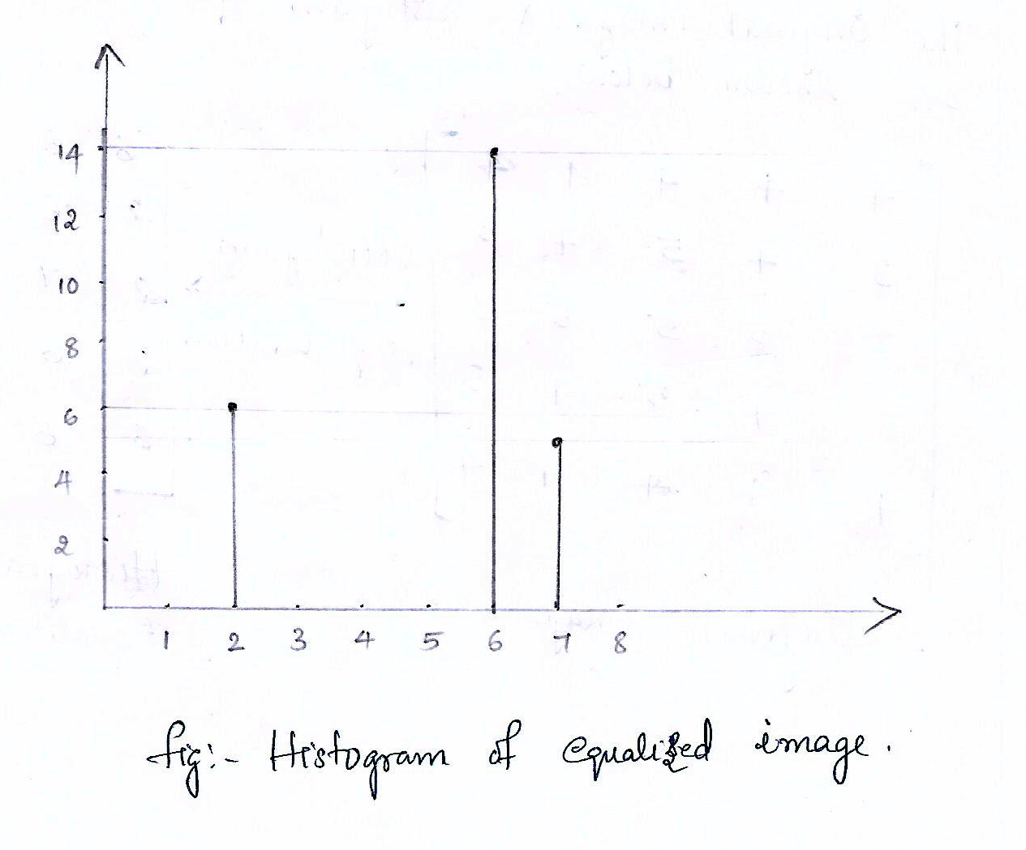

Slide 59
Edge Detection

Slide 61
Why Edge Detection?

Slide 64
Edge point Detection

Slide 65
Edge Localization

Slide 66
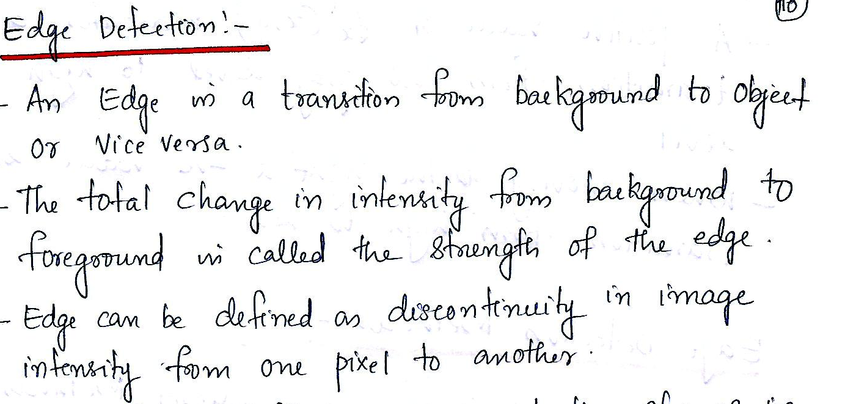

Slide 67
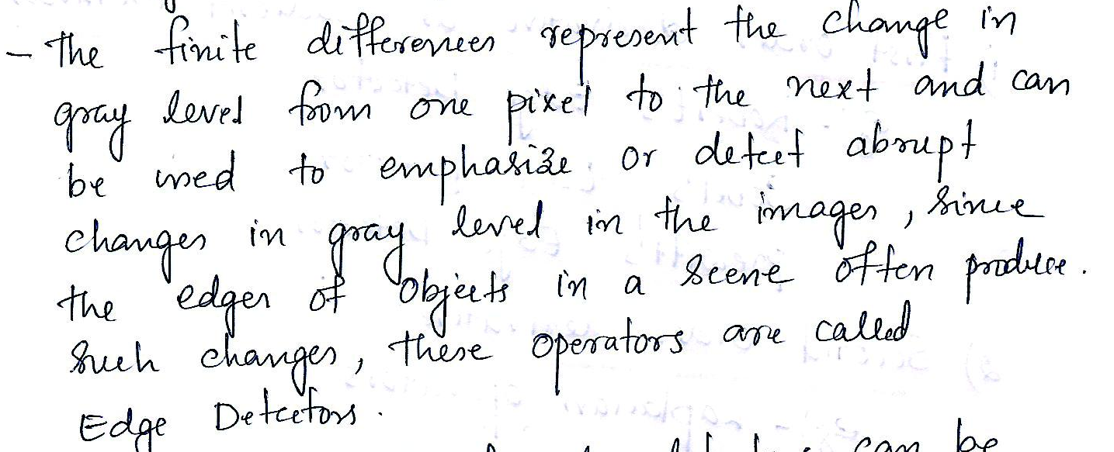

Slide 69
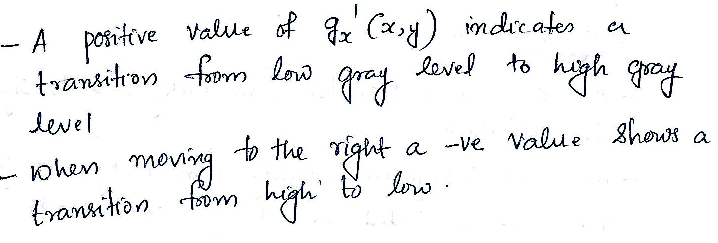

Slide 70
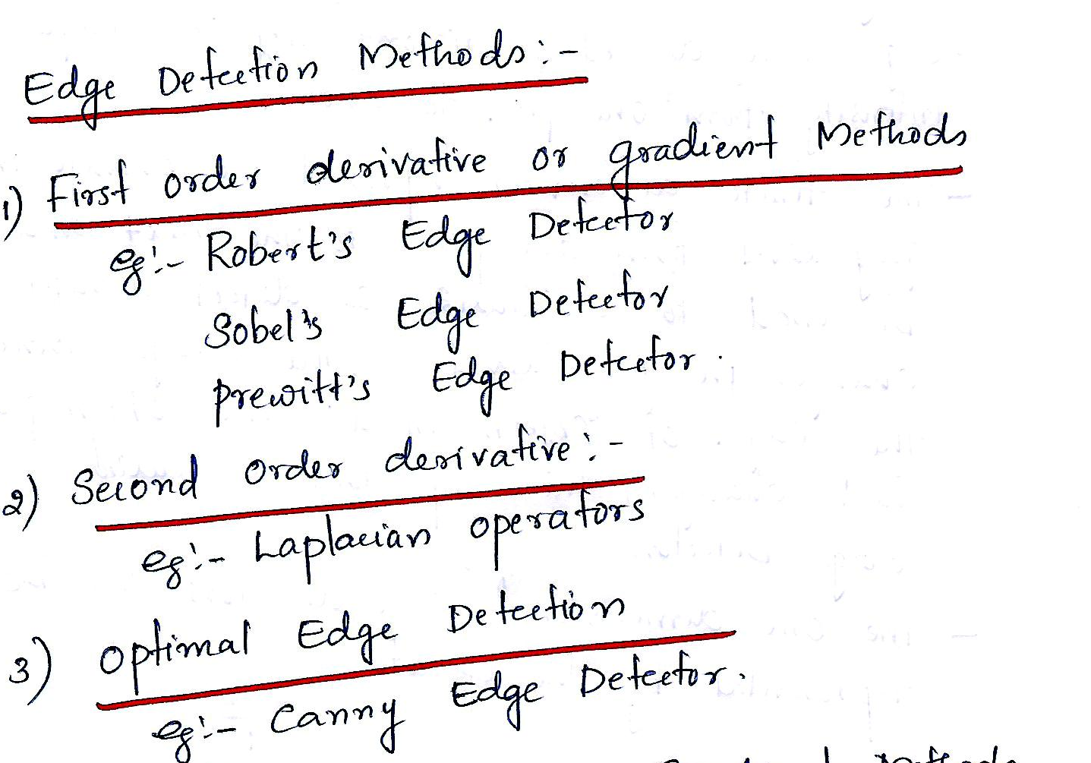

Slide 71
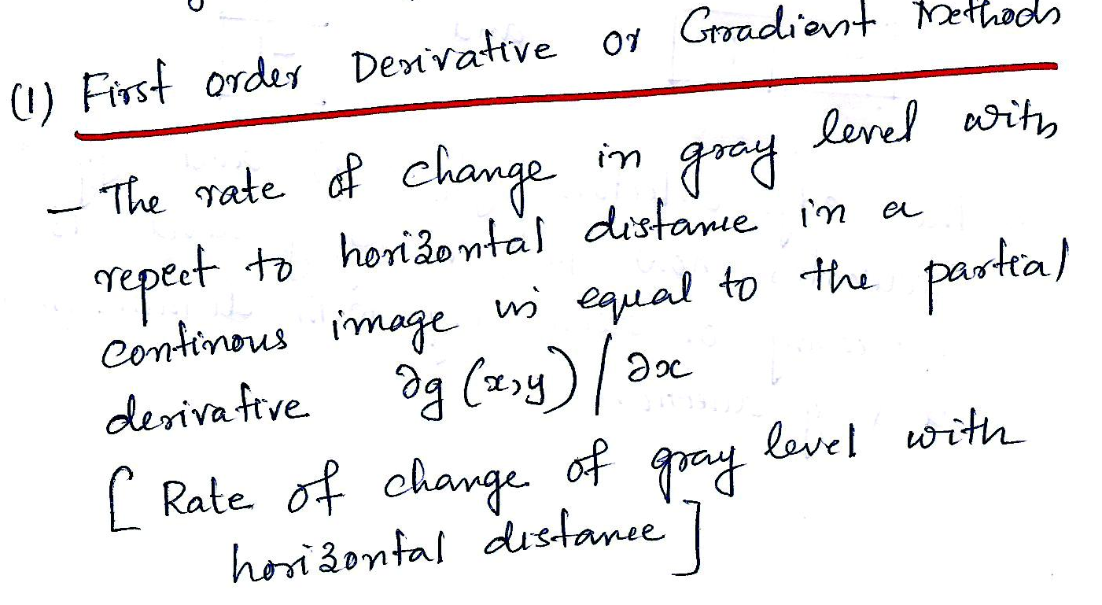

Slide 72
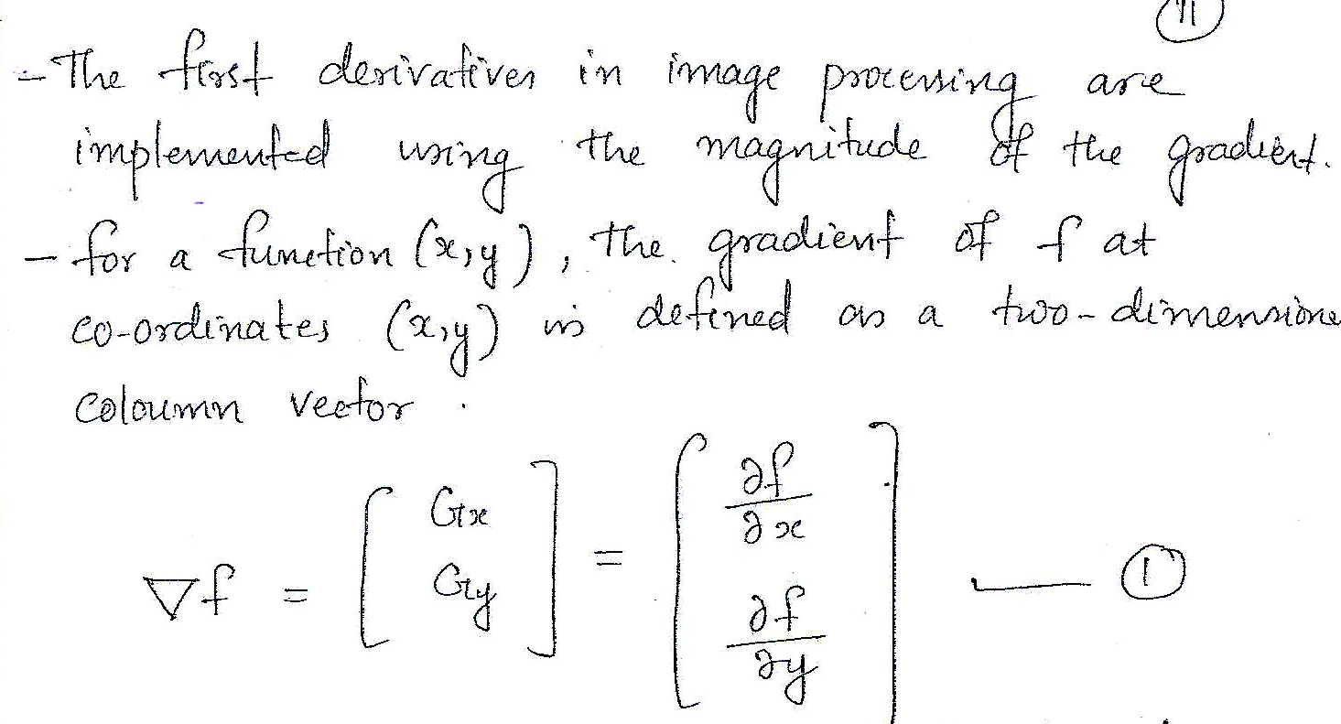

Slide 73
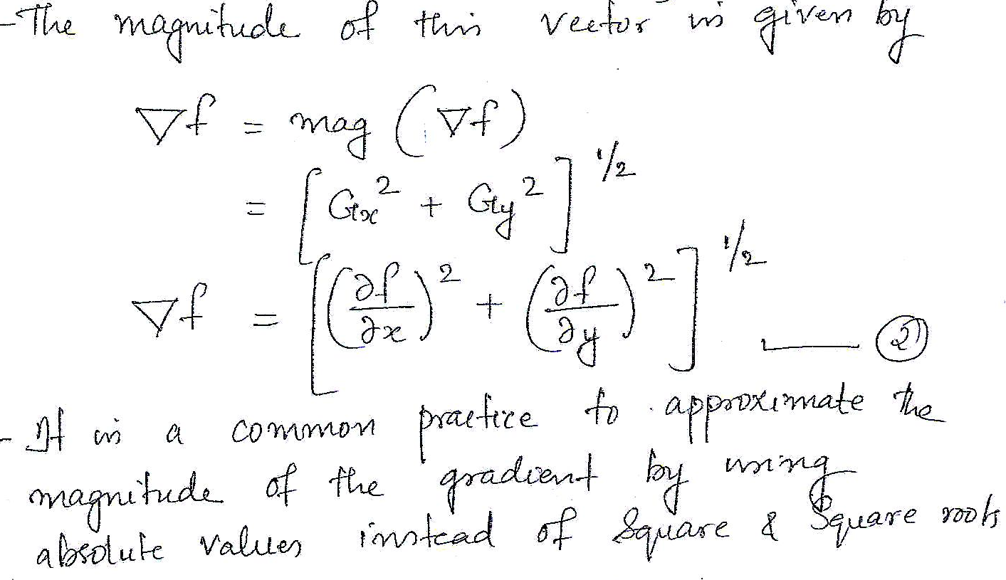

Slide 74
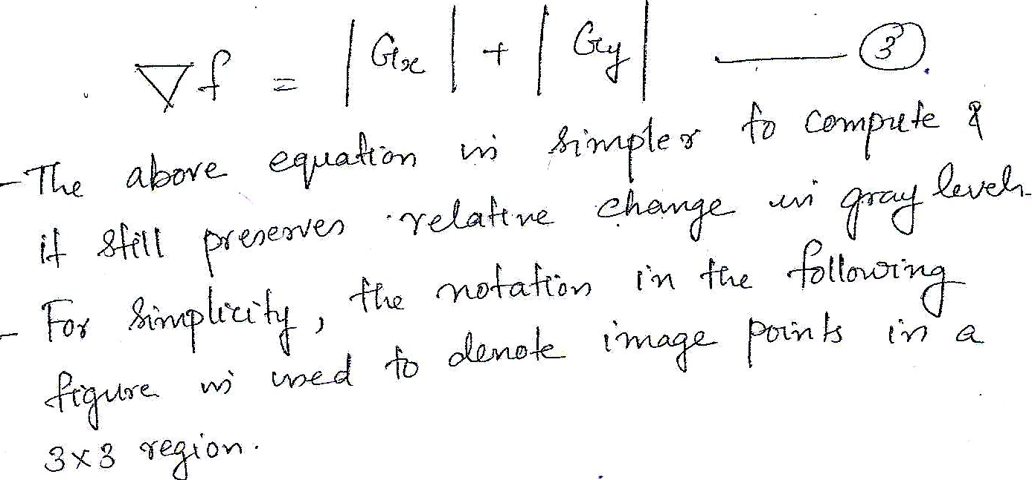

Slide 75
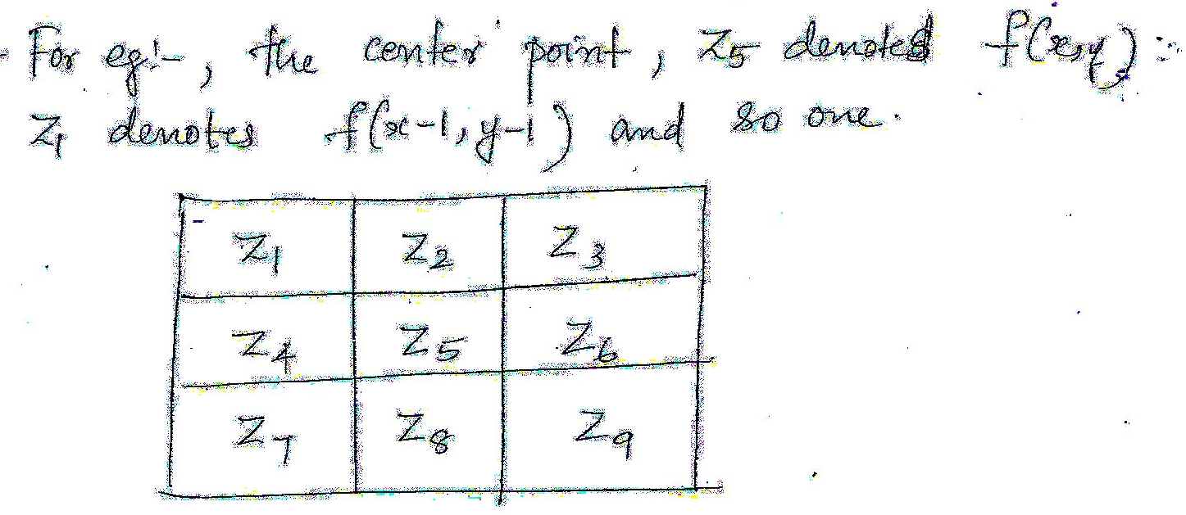

Slide 77
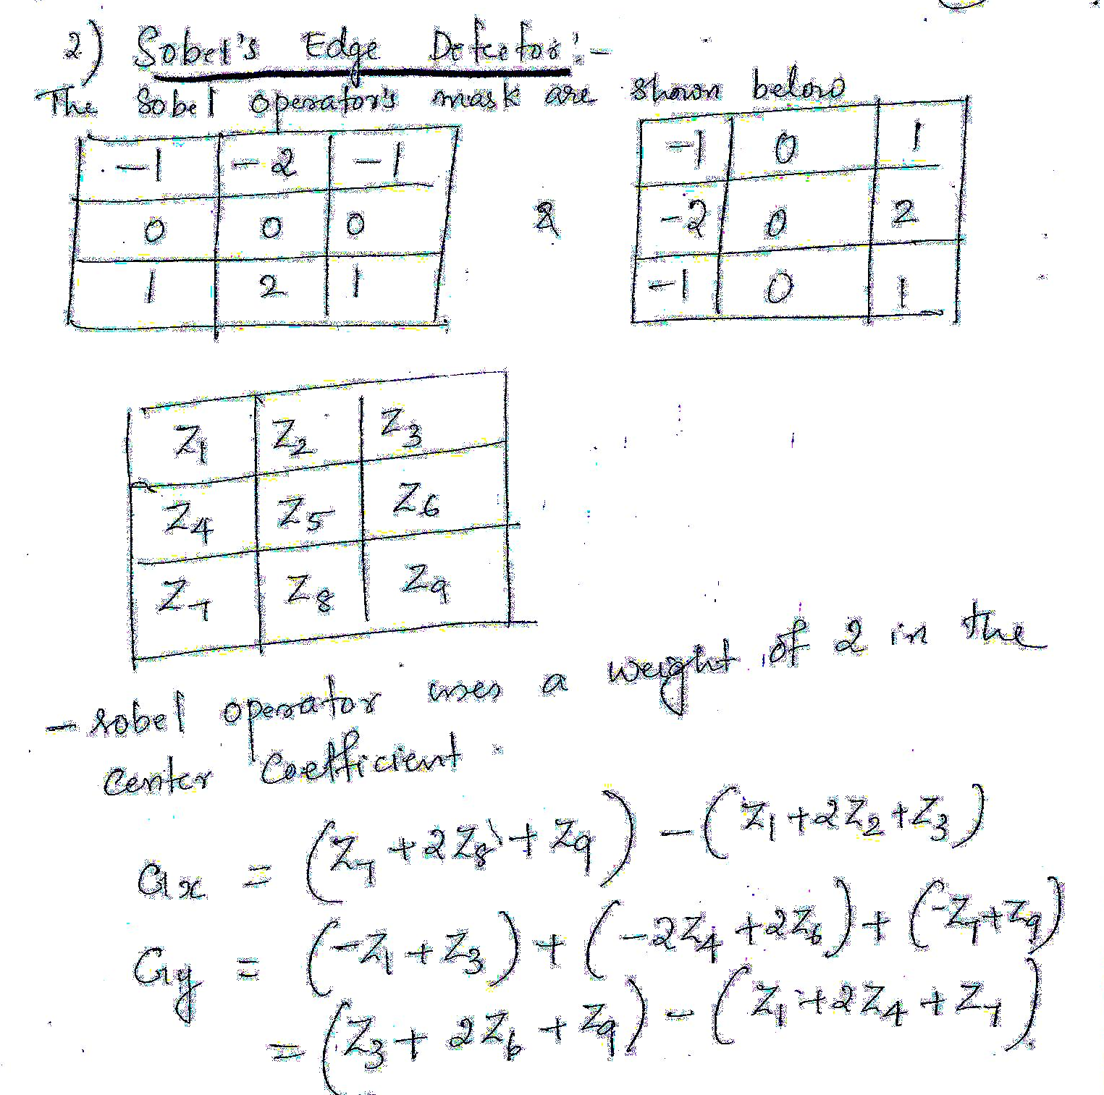

Slide 78
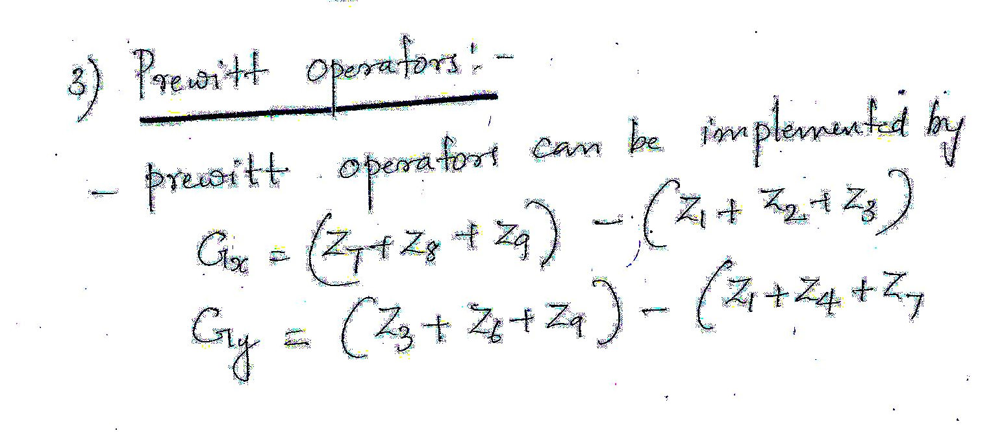

Slide 79
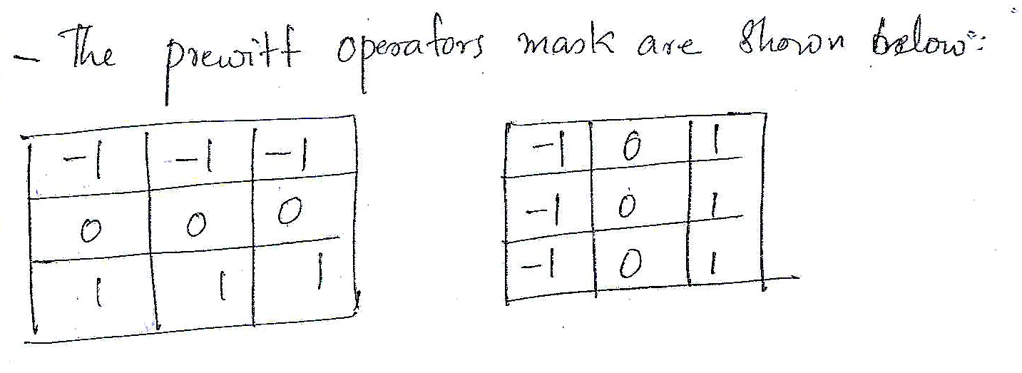

Slide 80
Convolution & Correlation
Correlation and Convolution are basic operations that we will perform to extract information from images.
the simplest operations that we can perform on an image
correlation is a measure of similarity between two signals
convolution is a measure of effect of one signal on the other.

Slide 81
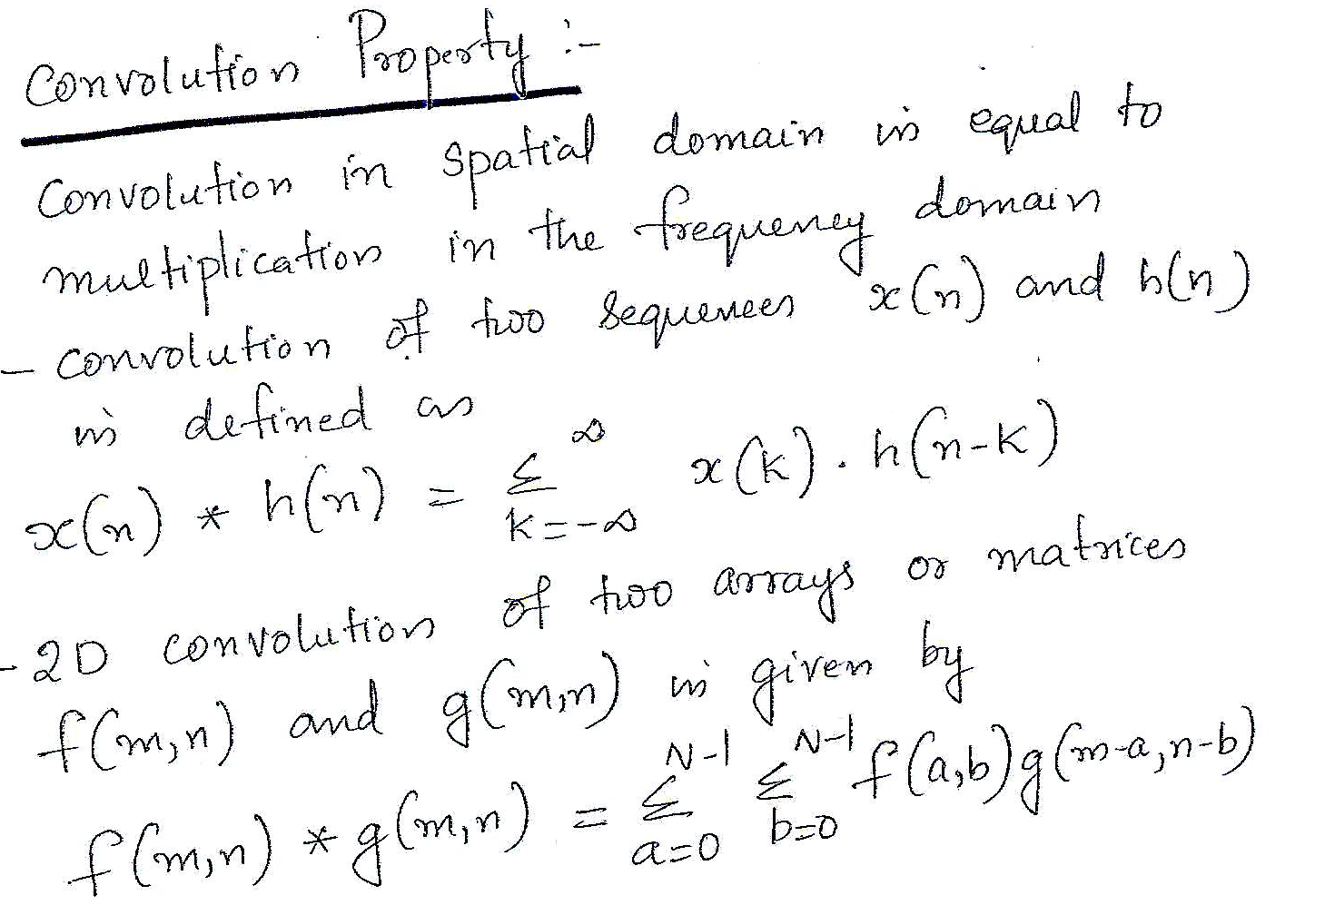

Slide 82
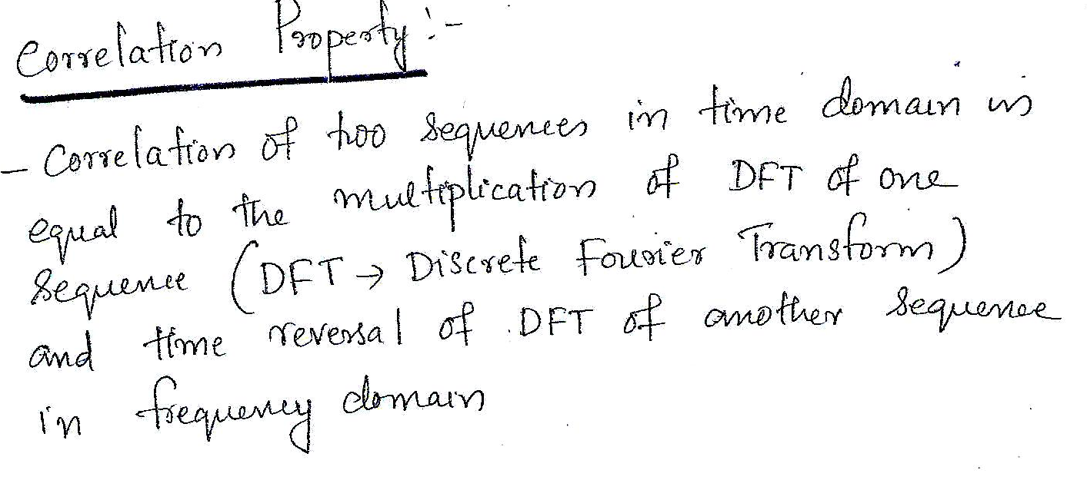

Slide 83
