Slide 1
MODULE 3
2D TRANSFORMATIONS

Slide 2
MODULE III
Two dimensional transformations. Homogeneous coordinate systems – matrix formulation and concatenation of transformations. Windowing concepts –Window to Viewport Transformation- Two dimensional clipping-Line clipping – Cohen Sutherland, Midpoint Subdivision algorithm

Slide 3
Two dimensional transformations
Changes in orientation, size, and shape are accomplished with geometric transformations that alter the coordinate descriptions of 2D objects.
Basic Geometric Transformations
    Translation
    Rotation
    Scaling
    Reflection
    Shear

Slide 4
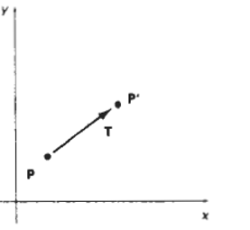

1. Translation (1)
A translation is applied to an object by repositioning it along a straight-line path from one coordinate location to another.
Translate a two-dimensional point by adding
translation distances t_{x} and t_{y} to the original
co-ordinate position (x, y) to move
the point to a new position ( x ' , y‘)
x' = x + t_{x}
y' = y + t_{y}
The translation distance pair (t_{x}, t_{y}) is called
a translation vector or shift vector.

Slide 5

1. Translation (2)
The translation equations can be expressed as a single matrix equation by using column vectors to represent coordinate positions and the translation vector:
The 2D translation equations in the matrix form as
P’=P+T

Slide 6
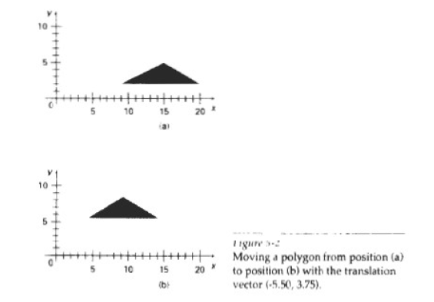
1. Translation (3)
Translation is a rigid-body transformation that moves objects without deformation. That is, every point on the object is translated by the same amount.
Polygons are translated by adding
the translation vector to the
coordinate position of each vertex
and regenerating the polygon
using the new set of vertex
coordinates

Slide 7
2. Rotation (1)
Rigid body transformation that move objects without deformation. Every point on an object is rotated through the same angle.
A two-dimensional rotation is applied to an object by repositioning it along a circular path in the xy plane.
specify a rotation angle θ and the position (x,y) of the rotation point (or pivot point) about which the object is to be rotated
Positive values for the rotation angle define counter clockwise rotations about the pivot point, and negative values rotate objects in the clockwise direction.

Slide 8
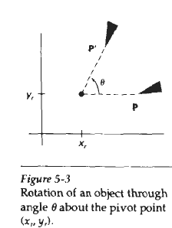
2. Rotation (2)
This transformation can also be described as a rotation about a rotation axis that is perpendicular to the xy plane and passes through the pivot point.

Slide 9
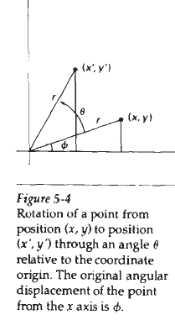
2. Rotation (3)
From the fig. using, standard trigonometric identities express the transformed Coordinates (x’,y’) in terms of angles θ and Ф as
x’=r cos(Ф + θ )
y’=r sin(Ф + θ )

Slide 10
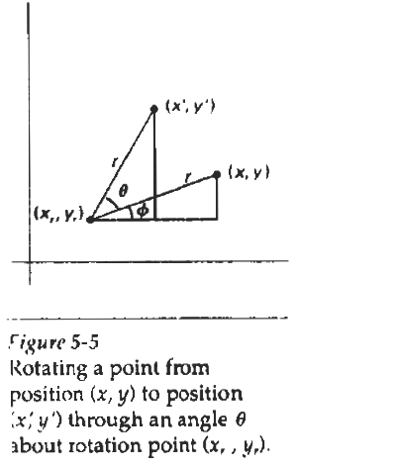
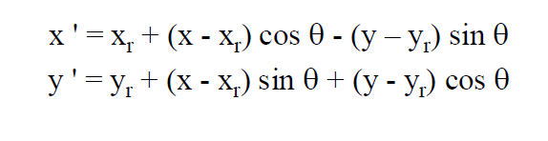

Slide 11
2. Rotation (4)

Slide 12
3. Scaling (1)
A scaling transformation alters the size of an object.
This operation can be carried out for polygons by multiplying the coordinate values (x, y) of each vertex by scaling factors s_{x}, and s_{y}, to produce the transformed coordinates (x', y'):
Scaling factor s_{x}, scales objects in the x direction, while s_{y} scales in the y direction.
P’ = S . P

Slide 13
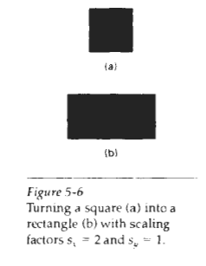


3. Scaling (1)
The transformation equations can also be written in the matrix form:

Slide 14
Scaling
When s_{x}, and s_{y}, are assigned the same value, a uniform scaling is produced that maintains relative object proportions.
Unequal values for s_{x} and s_{y} result in a differential scaling

Slide 15
Reflection
A reflection is a transformation that produces a mirror image of an object.
The mirror image for a two-dimensional reflection is generated relative to an axis of reflection by rotating the object 180" about the reflection axis.

Slide 16
Reflection
Reflection about the line y = 0, the x axis, is accomplished with the transformationmatrix
This transformation keeps
x values the same, but
"flips" the y values of
Coordinate positions.

Slide 17
A reflection about the y axis flips x coordinates while keeping y coordinates the same.
The matrix for this
transformation is

Slide 18
We flip both the x and y coordinates of a point by reflecting relative to an axis that is perpendicular to the xy plane and that passes through the coordinate origin.
This transformation, referred
to as a reflection relative to the
coordinate origin, has the
matrix repressentation:

Slide 19
If we chose the reflection axis as the diagonal line y = x , the reflection matrix is
We can derive this matrix by concatenating a sequence of rotation and coordinate-axis reflection matrices.

Slide 20
first perform a clockwise rotation
through a 45" angle, which rotates
the line y= x onto the x axis.
Next, we perform a reflection
with respect to the x axis.
The final step is to rotate the
line y = x back to its original
Position with a counterclockwise
rotation through 45".

Slide 21
Shearing
A transformation that distorts the shape of an object.
Two common shearing transformations are those that shift coordinate x values and those that shift y values.

Slide 22
X- direction Shear
The x- direction shear preserves the y coordinates, but changes the x values which cause vertical lines to tilt right or left as shown in figure
The Transformations matrix for x-shear is

Slide 24
Y- direction Shear
The y shear preserves the x coordinates, but changes the y values which cause horizontal lines which slope up or down
The Transformations matrix for y-shear is

Slide 26
Homogeneous coordinate System
Matrix representation for translation, scaling & rotations are respectively
P’=T+P , P’= S.P , P’=R.P
each of the basic transformations can be expressed in the general matrix form
P’=M₁.P+M₂
    with coordinate positions P and P' represented as column vectors.
    Matrix M₁ is a 2 by 2 array containing multiplicative factors, and M₂, is a two-element column matrix containing translational terms.
    For translation, M₁ is the identity matrix.
    For rotation or scaling, M₂ contains the translational terms associated with the pivot point or scaling fixed point.

Slide 27
Homogeneous co-ordinates (h)
Expanding 2 by 2 matrix representation to 3 by 3 matrix
Allows to express all transformation equations as matrix multiplications
(x,y → (x_{h},y_{h},h) where x = x_{h} / h, y = y_{h} / h
h- non-zero value
  x_{h}=x.h y_{h}=y.h
Eg:- (2,3)
Assume h=2
  (2*2, 3*2 ,2 )
  (2,3) ➔ (4,6,2)

Slide 28
Homogeneous coordinates
Add a third coordinate, h
A 2D point is a 3 coordinates vector:

Slide 29
Homogeneous coordinates (2)
Two points are equal if and only if:
x’/h’ = x/h and y’/h’= y/h
Numbers x/h & y/h – Cartesian co-ordinates at the homogenous point
h=0: points at infinity
  useful for projections and curve drawing
Homogenize = divide by h.
Homogenized points:

Slide 30
Homogeneous coordinates
Treat all 3 transformations in a consistent way, so that they can be combined easily
If points are expressed in homogeneous co-ordinates, all three transformations can be treated as multiplication
Cartesian coordinate position (x,y) is represented as homogeneous coordinate triple(x,y,h)
• Represent coordinates as (x,y,h)
• Actual coordinates drawn will be (x/h,y/h)

Slide 31
For Translation

Slide 32
For rotation

Slide 33
For scaling

Slide 34
Composite Transformations
A composite transformation is a sequence of transformations; one followed by the other.
we can set up a matrix for any sequence of transformations as a composite transformation matrix by calculating the matrix product of the individual transformations
For column-matrix representation of coordinate positions, we form composite transformations by multiplying matrices in order from right to left.
That is, each successive transformation matrix premultiplies the product of the preceding transformation matrices.

Slide 43
Composite transformations
Two successive translations are additive.
Two successive rotations are additive.
Two successive scaling operations are multiplicative.

Slide 44
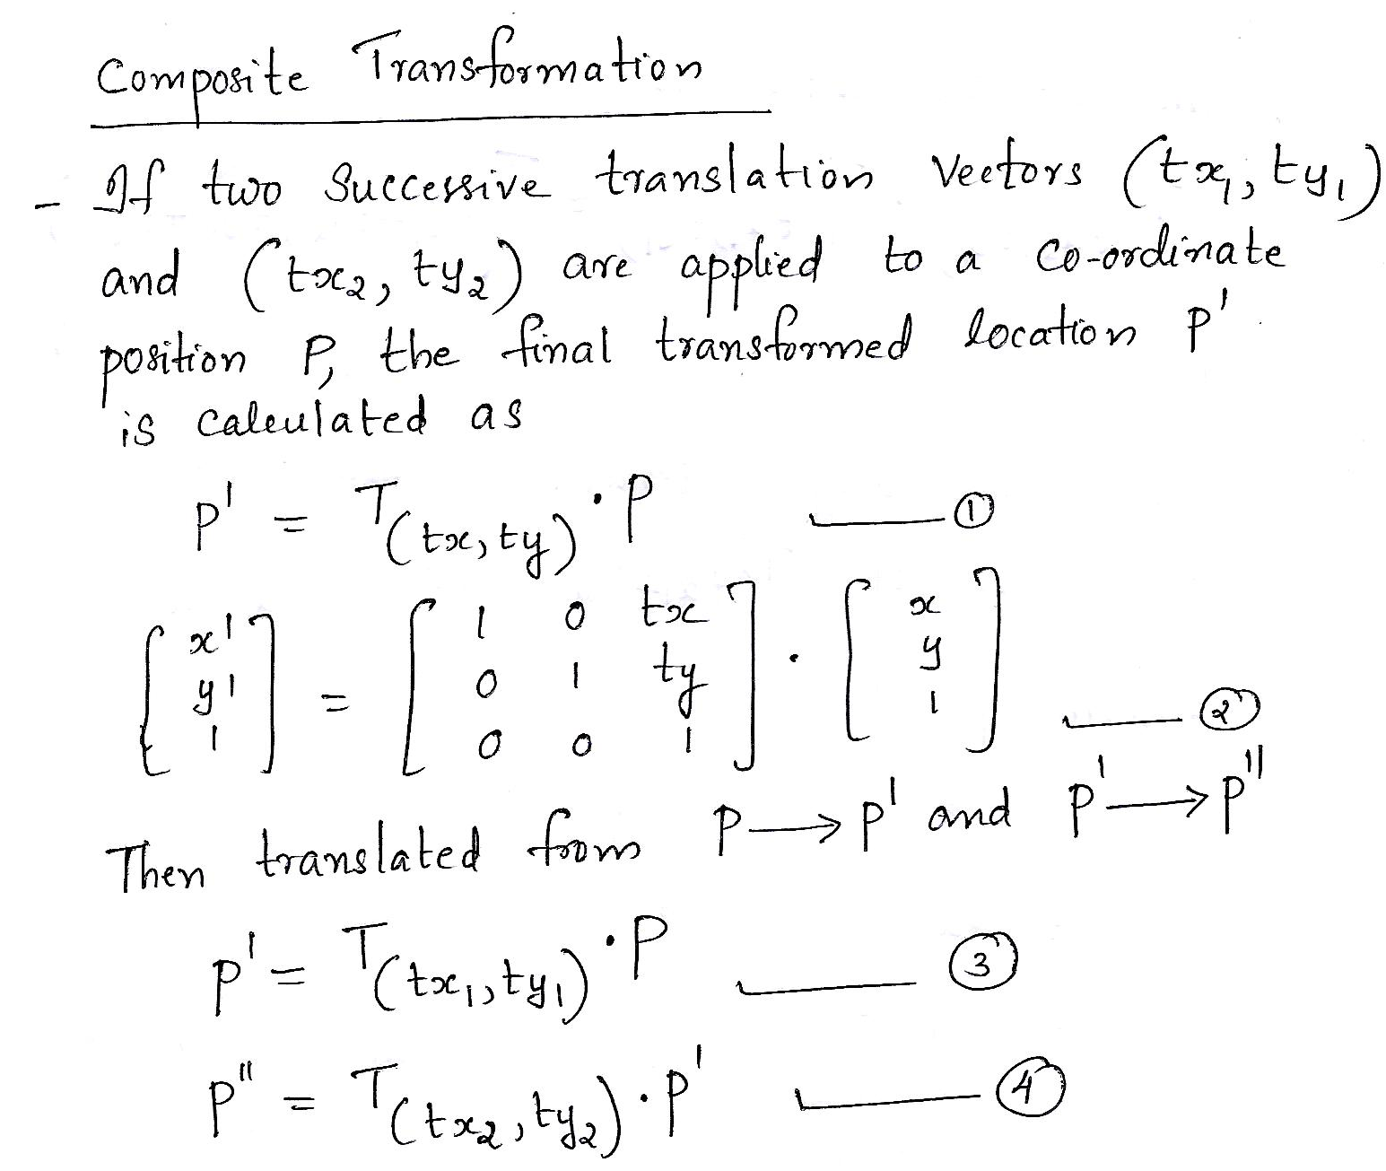

Slide 45
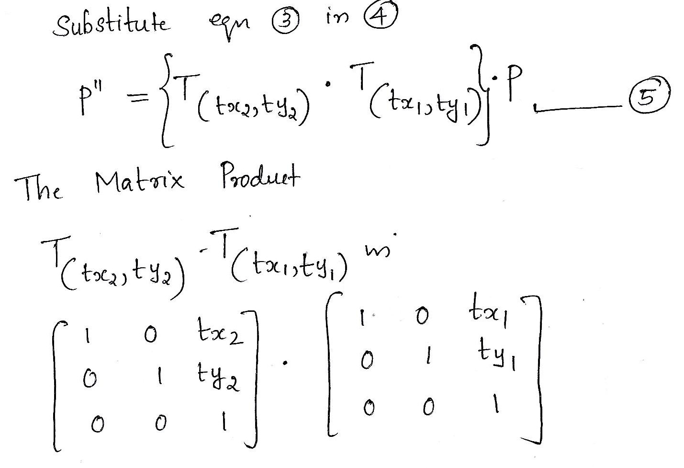

Slide 46
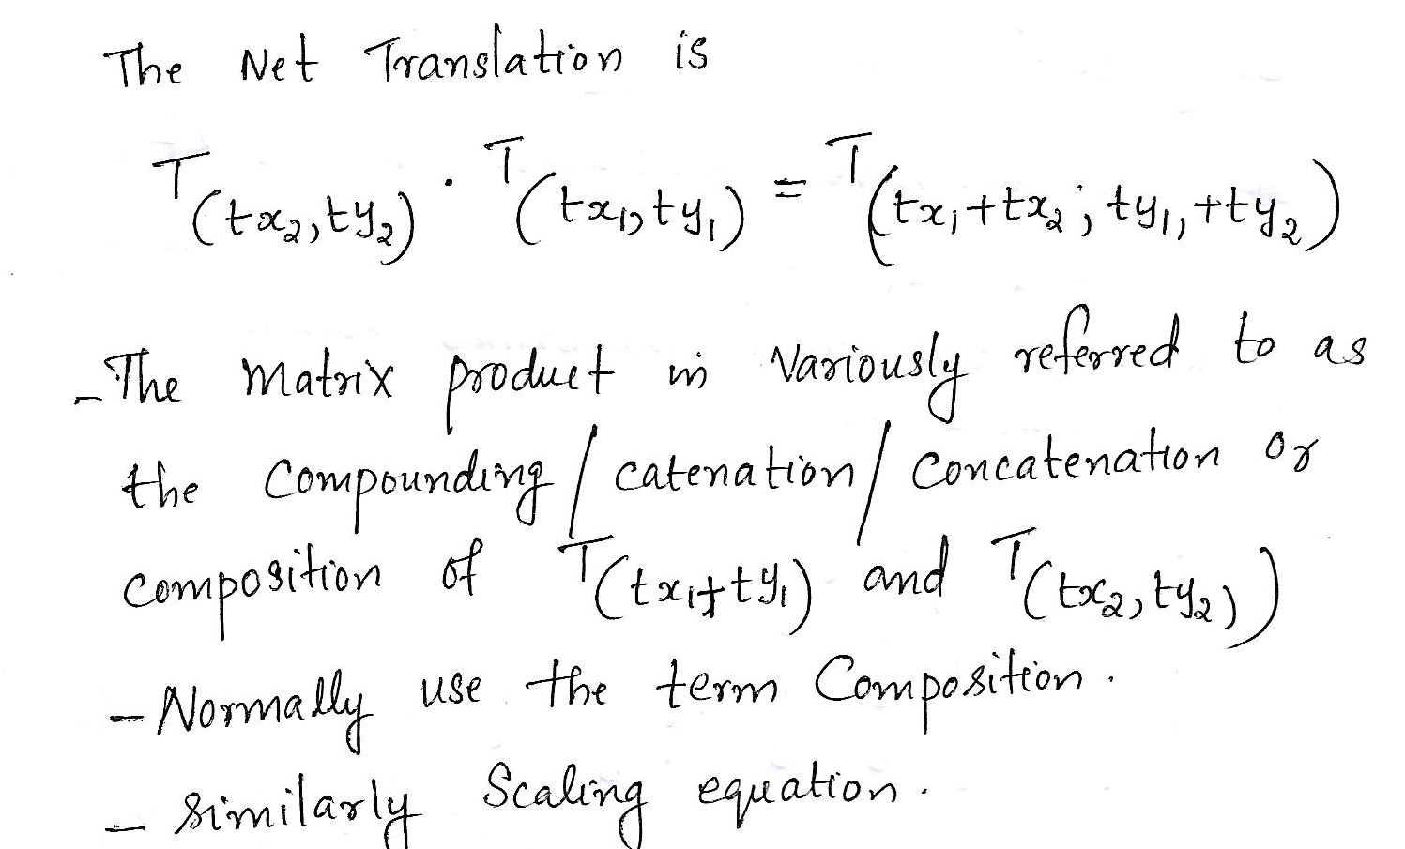

Slide 47
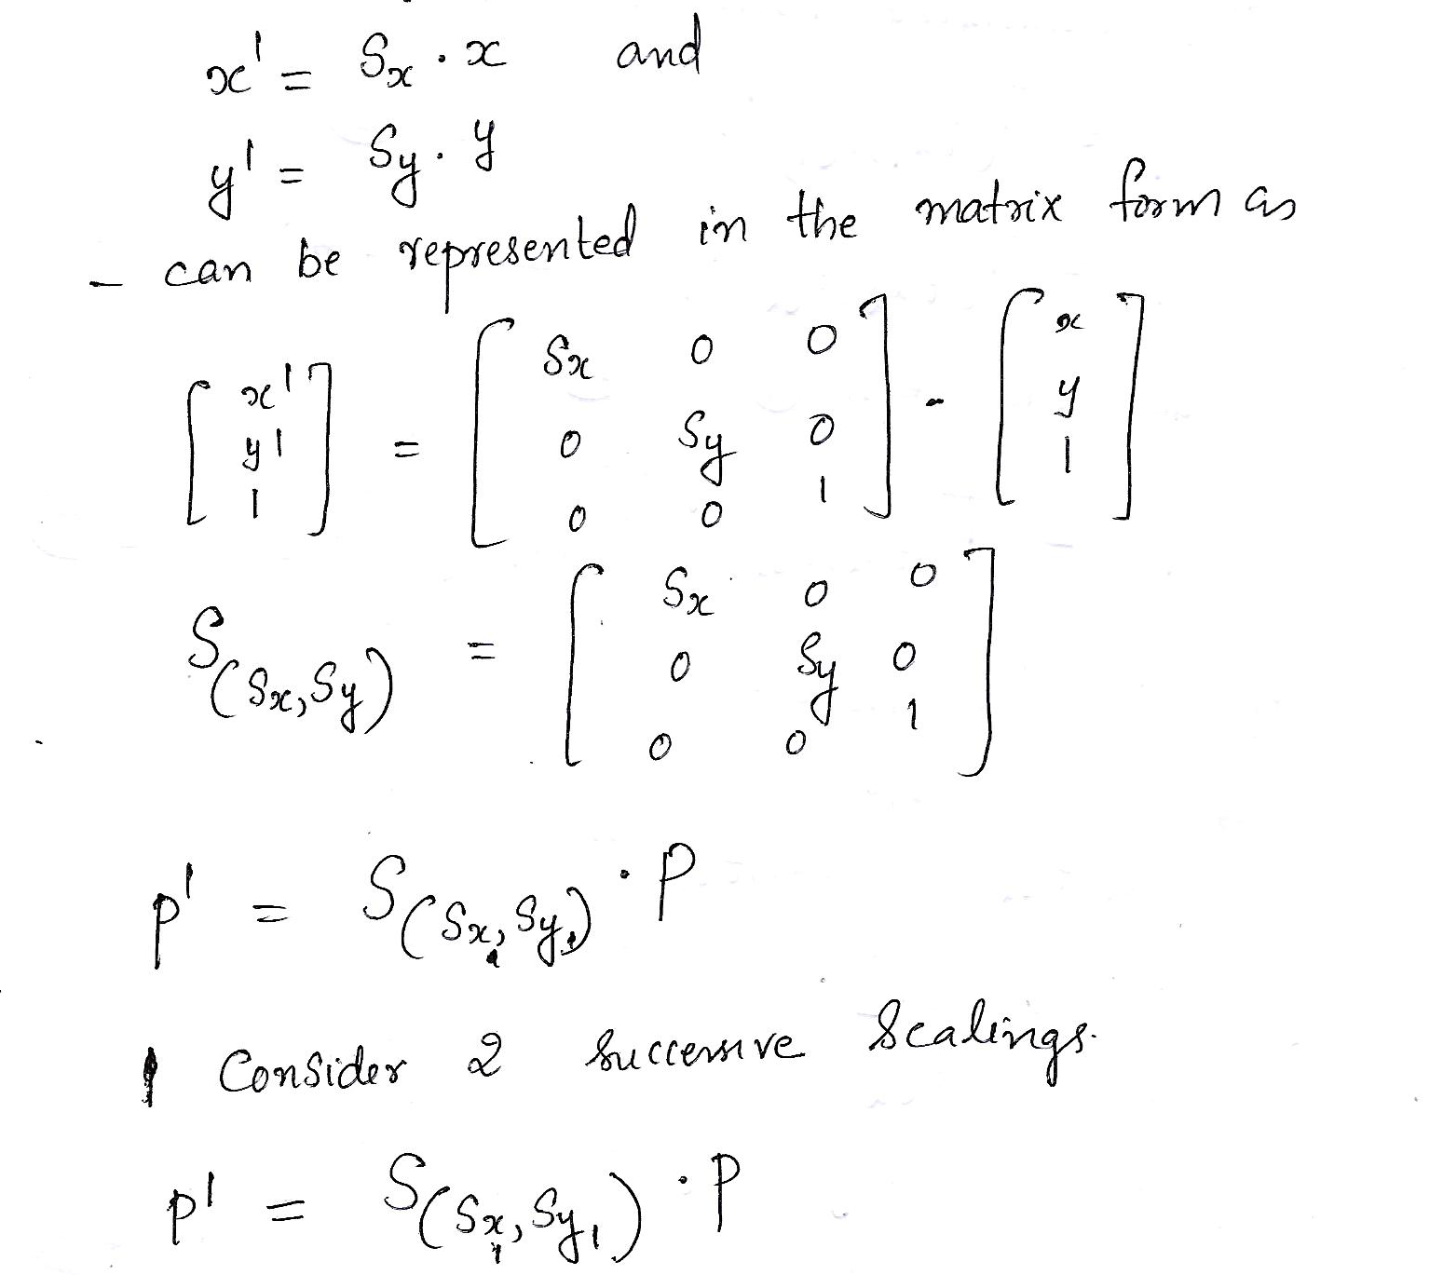

Slide 48
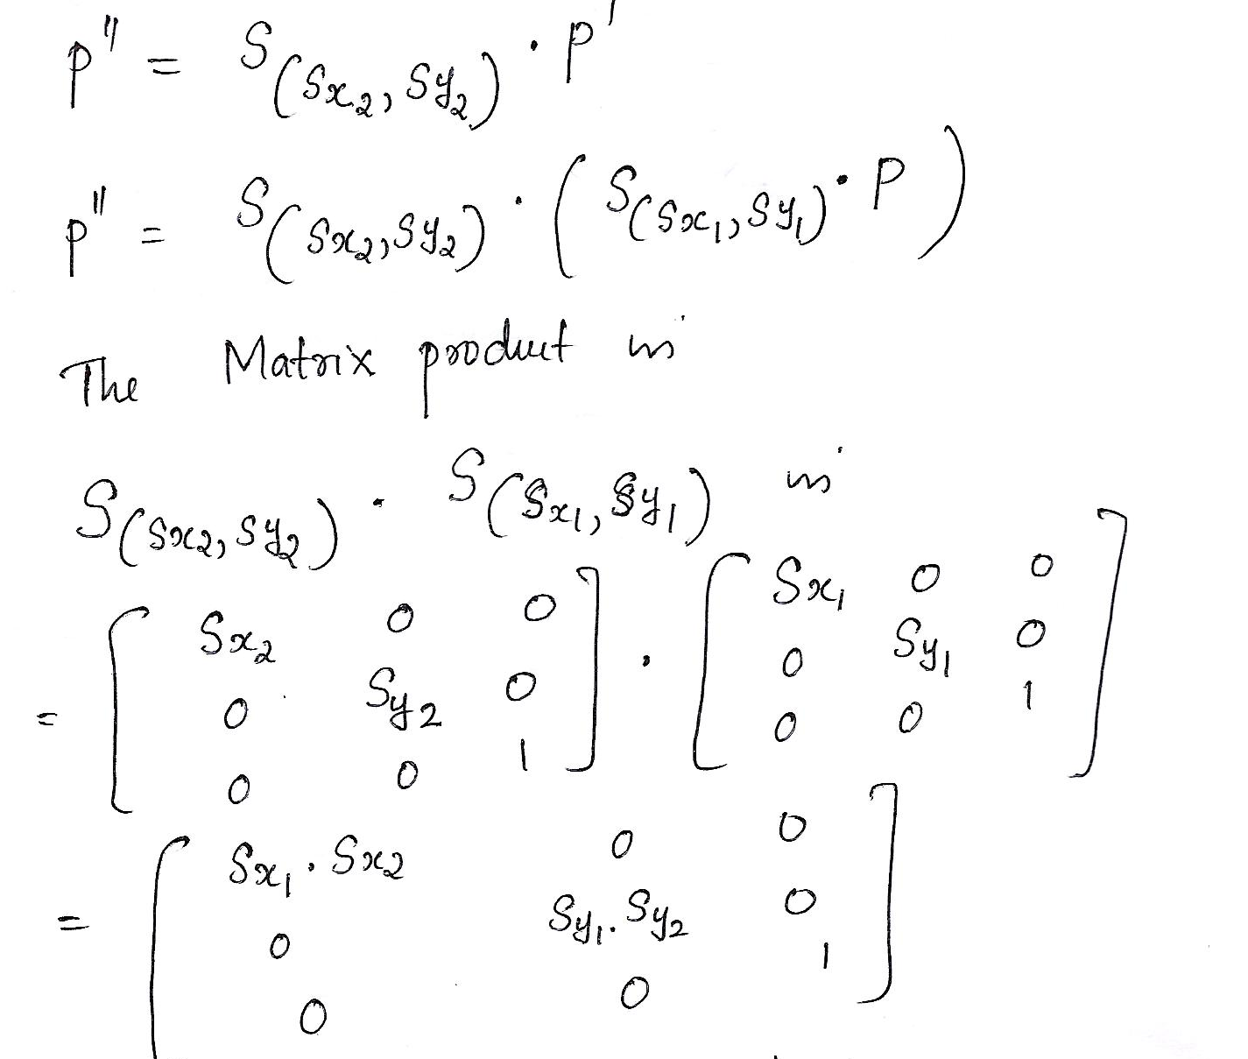

Slide 49
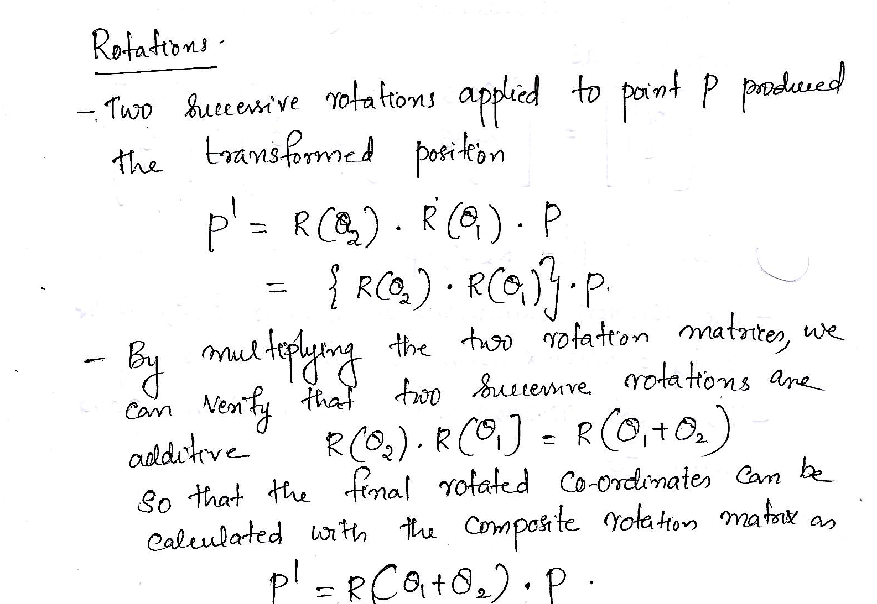

Slide 50
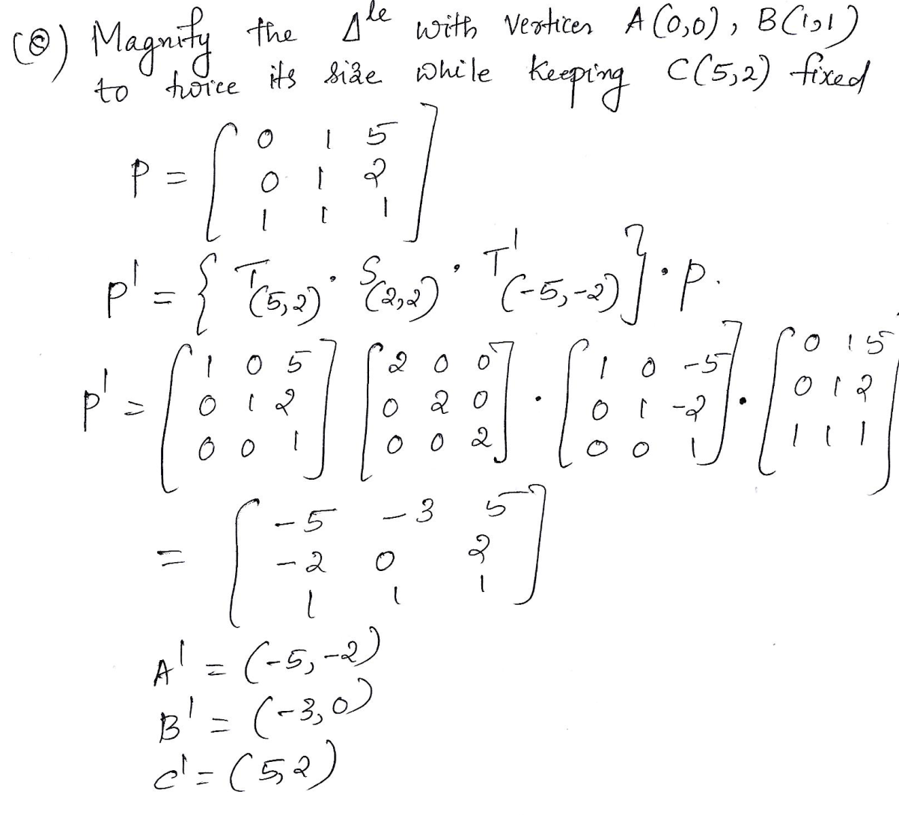



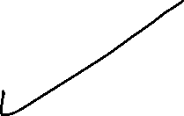



Slide 51
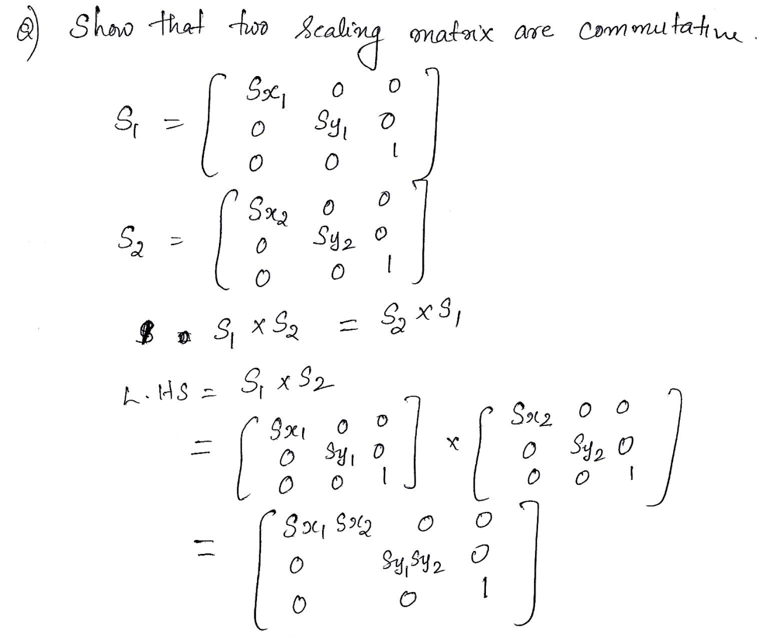

Slide 52
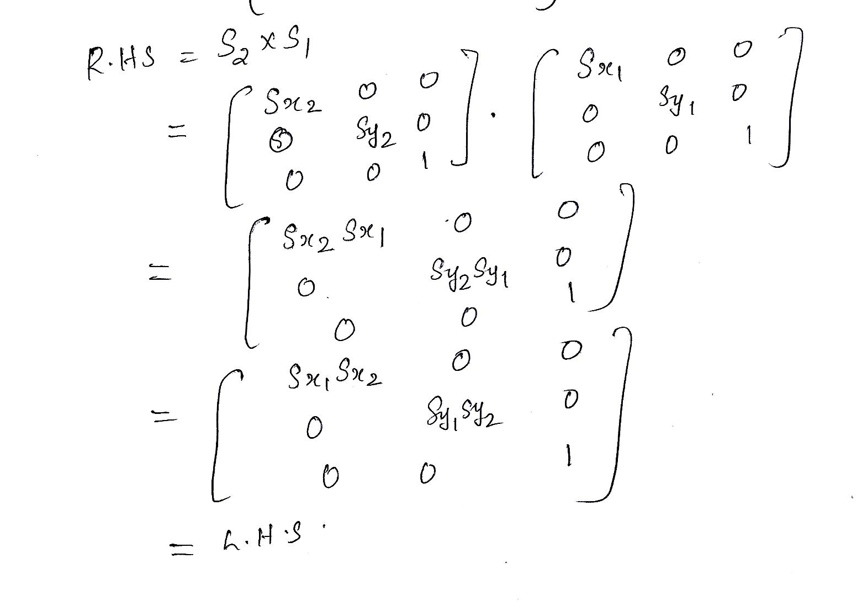

Slide 53
ASSIGNMENT QUESTIONS
1) Perform a 45°rotation of the triangle whose co-ordinates are A(0, 0), B(2, 2), C(4, 2) about the origin and about the pivot point P(-2,-2)
2) Show that the order in which transformations are performed is important by the transformation of triangle A(1, 0), B(0, 1), C(1, 1) by (i) rotating 90 degree in clockwise direction about the origin and then translating it in the x-direction for 3 units (ii) First Translation and then rotation
3) Create an animation of “Rabbit and Tortoise Race” using the various 2D Transformations.

Slide 54
MODULE III
Two dimensional transformations. Homogeneous coordinate systems – matrix formulation and concatenation of transformations. Windowing concepts –Window to Viewport Transformation- Two dimensional clipping-Line clipping – Cohen Sutherland, Midpoint Subdivision algorithm

Slide 55
Windowing Concepts
A world – co-ordinate area selected for display is called a window
An area on a display device to which a window is mapped is called a viewport.
Window defines what is to be displayed.
Viewport defines where it is to be displayed.
Windows & viewports are rectangles in standard position,with rectangle edges parallel to the co-ordinate axes.

Slide 56
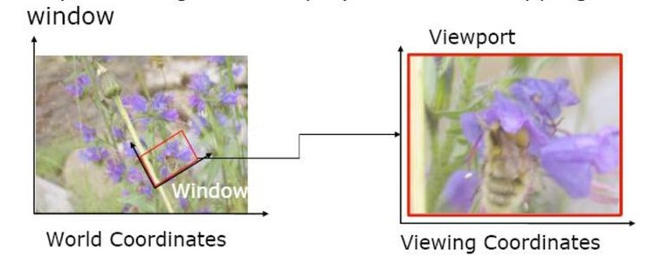
Windowing Concepts

Slide 57
Viewing Transformation
The mapping of a part of a world-coordinate scene to device coordinates is referred to as a viewing transformation.
Sometimes the two-dimensional viewing transformation is simply referred to as the window-to-viewport transformation or the windowing transformation.

Slide 58
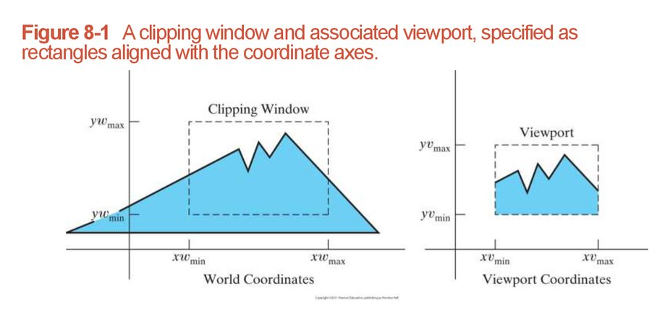
Viewing Transformation
the term window refers to an area of a world co-ordinate scene that has been selected for display picture that is selected for viewing

Slide 59
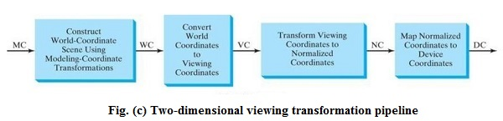
2D viewing Pipeline
Some graphics packages that provide window and viewport operations allow only standard rectangles,
but a more general approach is to allow the rectangular window to have any orientation.
In this case, we carry out the viewing transformation in several steps, as indicated in this figure

Slide 60
Viewing transformation pipeline (1)
First, we construct the scene in world coordinates using the output primitives and attributes
Next. To obtain a particular orientation for the window, we can set up a two-dimensional viewing-coordinate system in the world-coordinate plane, and define a window in the viewing-coordinate system.
The viewing coordinate reference frame is used to provide a method for setting up arbitrary orientations for rectangular windows.
Once the viewing reference frame is established, we can transform descriptions in world coordinates to viewing coordinates.

Slide 61
Viewing transformation pipeline (1)
We then define a viewport in normalized coordinates (in the range from 0 to 1 ) and map the viewing-coordinate description of the scene to normalized coordinates.
At the final step, all parts of the picture that lie outside the viewport are clipped, and the contents of the viewport are transferred to device coordinates.

Slide 62
Zooming and Panning effects
By changing the position of the viewport, we can view objects at different positions on the display area of an output device.
Also, by varying the size of viewports, we can change the size and proportions of displayed objects.
We achieve zooming effects by successively mapping different-sized windows on a fixed-size viewport.
As the windows are made smaller, we zoom in on some part of a scene to view details that are not shown with larger windows.
Similarly, more overview is obtained by zooming out from a section of a scene with successively larger windows.
Panning effects are produced by moving a fixed-size window across the various objects in a scene

Slide 63
VIEWING COORDINATE REFERENCE FRAME
This coordinate system provides the reference frame for specifying the world coordinate window

Slide 64
VIEWING COORDINATE REFERENCE FRAME
We set up the viewing coordinate system using the following procedures:
First, a viewing-coordinate origin is selected at some world position: po = (x₀, y₀).
Then we need to establish the orientation, or rotation, of this reference frame.
One way to do this is to specify a world vector v that defines the viewing y_{v}, direction.
Vector v is called the view up vector.

Slide 65
VIEWING COORDINATE REFERENCE FRAME
Given V, we can calculate the components of unit vectors v = (vx, vy) and
U = (ux, uy) for the viewing yv, and xv, axes, respectively.
These unit vectors are used to form the first and second rows of the rotation matrix r that aligns the viewing xv yv axes with the world xw yw axes.
We obtain the matrix for converting world coordinate positions to viewing
Coordinates as a two-step composite transformation:
First, we translate the viewing origin to the world origin,
  then we rotate to align the two coordinate reference frames.

Slide 66
VIEWING COORDINATE REFERENCE FRAME
the composite two-dimensional transformation to convert world coordinates to viewing coordinate is
Where T is the translation matrix that takes the viewing origin point po to the world origin, and R is the rotation matrix that aligns the axes of the two reference frames.

Slide 67
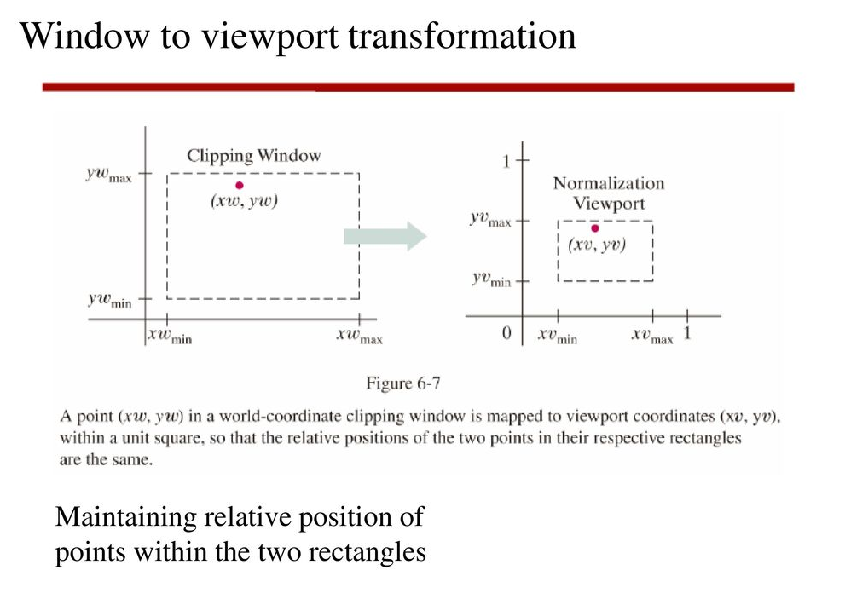

Slide 68
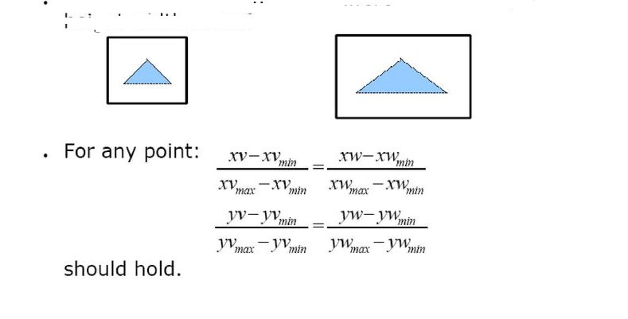

Slide 69
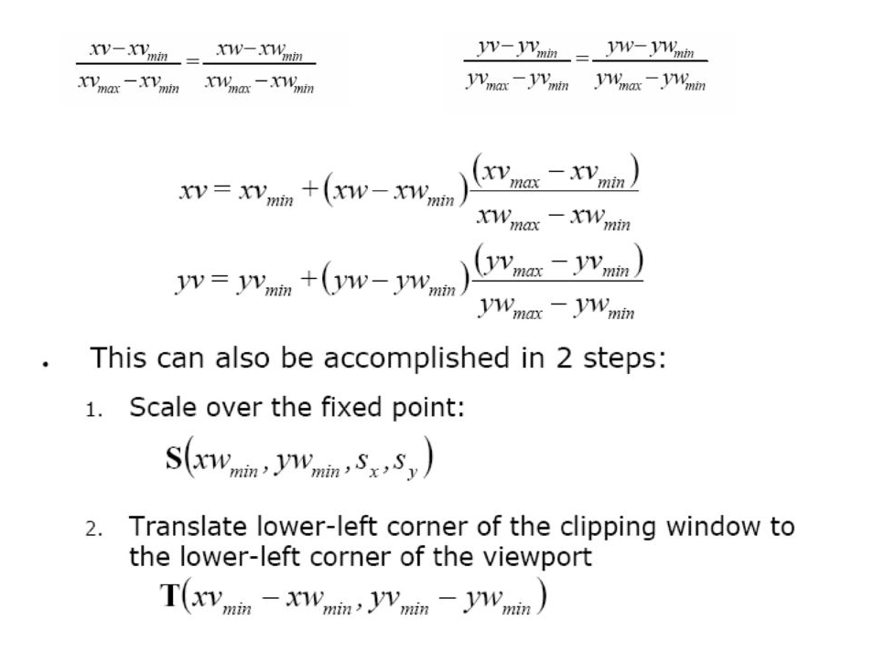

Slide 70
Clipping Operations
Procedure that identifies those portions of a picture that are either inside or outside of a specified region of space
Region against which an object is to be clipped is called a clip window

Slide 71
Point Clipping
The Clip window is a rectangle to the standard position, we save a point P=(x,y) for display if the following inequalities are satisfied:
Where the edges of the clip window (xwmin ,xwmax) and (ywmin, ywmax), can be either the coordinate window boundaries. If any one of these four inequalities is not satisfied , the point is clipped.
xwmin<=x<=xwmax
ywmin<=y<=ywmax

Slide 72
ywmax
P( x, y)
ywmin
xwmin
xwmax
Figure: Point Clipping

Slide 73
Line Clipping
Line that do not intersect the clipping window are either completely inside the window or completely outside the window. In the case of line clipping , three different cases are possible.
p4
p9
p3
ywmax
p2
p10
p1
p6
Window
p7
p5
ywmin
p8
xwmin
xwmax

Slide 74
Different cases for Line Clipping
1. Both endpoints of the line lie with in the clipping area. This means that the line is included completely in the clipping area, so that the whole line must be drawn.
B
B
A
A
Clip
rectangle

Slide 75
2. One end point of the line lies with in the other outside the clipping area. It is necessary to determine the intersection point of the line with the bounding rectangle of the clipping area. Only a part of the line should be drawn.
D
D’
D’
B
B
C
C
C
A
A
Clip
rectangle

Slide 76
3. Both end points are located outside the clipping area and the line do not intersect the clipping area. In the case , the line lies completely outside the clipping area and can be neglected for the scene.
4. Both endpoints are located outside the clipping area and the line intersect the clipping area. The two intersection points of the line with the clipping are must be determined. Only the part of the line between these two intersection points should be drawn.
D
E
D’
D’
B
H
C
B
C
F
H'
J
A
H'
G’
A
J’
G’
Clip
rectangle
G
I’
I

Slide 77
This algorithm divides a 2D space into 9 parts, of which only the middle part is
visible.
This method is used:
To save a line segment.
To discard line segment
To divide the line according to window co- ordinate.
Cohen Sutherland performs line clipping in two phases:
Phase1: Find visibility of line.
Phase2: clip the line falling in category 3 (candidate for Clipping).

Slide 78
COHEN-SUTHERLAND LINE CLIPPING ALGORITHM
This is one of the oldest and most popular line-clipping procedures.
The method speeds up the processing of line segments by performing initial tests that reduce the number of intersections that must be calculated.
Every line endpoint in a picture is assigned a four digit binary code called a region code that identifies the location of the point relative to the boundaries of the clipping rectangle.

Slide 79
Binary region codes assigned to line end points according to relative position with respect to the clipping rectangle.
Region are set up in reference as shown in figure:
Figure :Bit Code for Cohen- Sutherland clipping
LEFT
RIGHT
y
1010
1001
1000
ywmax
TOP
window
0001
0000
0010
ywmin
BOTTOM
0101
0100
0110
xwmin
xwmax
x

Slide 80
Each bit position in region code is used to indicate one of four relative coordinate positions of points with respect to clip window: to the left, right, top or bottom.
By numbering the bit positions in the region code as 1 through 4 from right to left, the coordinate regions are corrected with bit positions as bit 1: left bit 2: right bit 3: below bit4: above
A value of 1 in any bit position indicates that the point is in that relative position.
Otherwise the bit position is set to 0.
If a point is within the clipping rectangle the region code is 0000.
A point that is below and to the left of the rectangle has a region code of 0101.

Slide 81
region-code bit values can be determined with following two steps.
(1) Calculate differences between endpoint coordinates and clipping boundaries.
(2) Use the resultant sign bit of each difference calculation to set the corresponding value in the region code.
    bit 1 is the sign bit of x – xwmin
    bit 2 is the sign bit of xwmax - x
    bit 3 is the sign bit of y – ywmin
    bit 4 is the sign bit of ywmax - y.

Slide 82
Once we have established region codes for all line endpoints, we can quickly determine which lines are completely inside the clip window and which are clearly outside.
Any lines that are completely contained within the window boundaries have a region code of 0000 for both endpoints, and we accept these lines.
Any lines that have a 1 in the same bit position in the region codes for each endpoint are completely outside the clipping rectangle, and we reject these lines.

Slide 83
COHEN-SUTHERLAND LINE CLIPPING ALGORITHM
Step 1
Compute the regioncodes for the two end points of the segment
Step 2
Enter a loop, within the loop check to see if both the regioncodes are zero. Then enter the segment into the display file, exit the loop & return

Slide 84
COHEN-SUTHERLAND LINE CLIPPING ALGORITHM
Step 3
If both the region codes are not zero then take Logical AND of both the regioncodes & check for non-zero result. If so , then reject the line, exit the loop & return.
Step 4
If the result is 0, then subdivide the line segment from intersection point of line segment & clipping boundary.
Step 5
Repeat steps (2), (3) & (4) for each segment.

Slide 85
Intersection points with a clipping boundary can be calculated using the slope-intercept form of the line equation.
For a line with endpoint coordinates (x1,y1) and (x2,y2)
  the y coordinate of the intersection point with a vertical boundary can be calculated as
y =y1 +m (x-x1)
where x value is set either to xwmin or to xwmax and
slope of line is calculated as m = (y2- y1) / (x2- x1)
the x coordinate of the intersection point with a horizontal boundary can be calculated as
x= x1 +( y- y1) / m
with y set to either to ywmin or to ywmax.

Slide 86
Example:
Starting with the bottom
endpoint of the line from
P1 to P2, we check P1 against
the left, right, and bottom
boundaries in turn and find that
this point is below the clipping
rectangle.
We then find the intersection point P1’ with the bottom boundary and discard the line section from P1 to P1’.
The line now has been reduced to the section from P1’ to P2

Slide 87
Since P2, is outside the clip window, we check this endpoint against the boundaries and find that it is to the left of the window.
Intersection point P2’ is calculated, but this point is above the window.
So the final intersection calculation yields P2”, and the line from P1’ to P2”is saved. This completes processing for this line
Point P3 in the next line is to the left of the clipping rectangle, so we determine the intersection P3’, and eliminate the line section from P3 to P3’.
By checking region codes for the line section from P3'to P4 we find that the remainder of the line is below the clip window and can be discarded also.

Slide 88
Mid point subdivision algorithm
This method divide the line into three category:
Category 1: Visible line
Category 2: not visible line
Category 3: candidate for Clipping.
An alternative way to process a line in category 3 is based on binary search. The line is divided at its midpoints into two shorter line segments. Each line in a category three is divided again into shorter segments and categorized. This bisection and categorization process continue until each line segment that spans across a window boundary reaches a threshold for line size and all other segments are either in a category 1 (visible) or in category 2 (Not visible.)

Slide 89
Mid point subdivision algorithm
An alternative way to process a line in category 3 is based on binary search.
The line is divided at its midpoints into two shorter line segments.
Each line in a category three is divided again into shorter segments and categorized.
This bisection and categorization process continue until each line segment that spans across a window boundary reaches a threshold for line size and all other segments are either in a category 1 (visible) or in category 2 (Not visible.)

Slide 90
Mid-point subdivision algorithm
The mid points coordinates are (x _{m} , y _{m}) of a line joining the points(X₁,Y₁)and (X₂,Y₂) are given by:
X _{m}= X₁+X₂/2 and
Y _{M}= Y₁+Y₂/2
Q
I2
3
4
2
1
I1
5
8
7
6
P
Figure: illustrates how midpoint subdivision is used to zoom in onto the two Intersection points I1 and I2 with 10 bisection.

Slide 91
Comparison b/w Cohen-Sutherland and Mid-point subdivision clipping Algorithm
Midpoint subdivision algorithm is a special case of Cohen-sutherland algorithm, where the intersection is not computed by equation solving.
It is computed by a midpoint approximation method, which is suitable for hardware and it is very fast and efficient.
The maximum time is consume in the clipping process is to do intersection calculation with the window boundaries.
The Cohen-sutherland algorithm reduces these calculation by first discarding that lines those can be trivially accepted or rejected.

