Slide 1
MODULE V
Projections – Parallel and perspective projections – vanishing points. Visible surface detection methods– Back face removal- Z-Buffer algorithm, A-buffer algorithm, Depth-sorting method, Scan line algorithm

Slide 2
Projections
Once world co-ordinate descriptions of the object in a scene are converted to viewing co-ordinates, we can project the 3-dimensional object onto the 2D plane

Slide 3
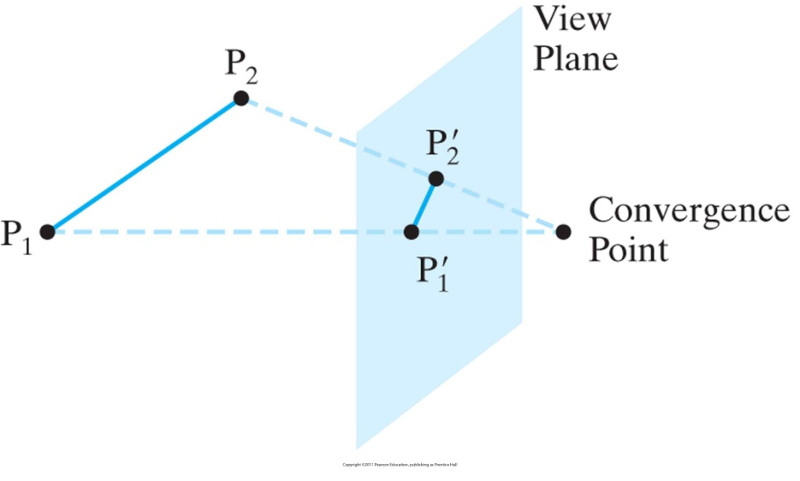
Projections
In parallel projection, coordinate positions are transferred to view plane along parallel lines
orthogonal/orthographic
oblique
For perspective projection, coordinates are transferred to view plane along lines that converge at a point

Slide 4
Types of Parallel Projection

Slide 5
Figure 10-17 Orthogonal projections of an object, displaying plan and elevation views.
Orthogonal Projections
Projection along lines parallel to the view-plane normal N
Front, side, rear orthogonal projections are often called elevations
The top one is called plan view

Slide 6
Axonometric and Isometric Orthogonal Projections .
Orthogonal projections which show more than one face of an object are called axonometric orthogonal projections
Isometric: Most common axonometric projections that are generated by aligning projection plane so that it intersects principal axes at the same distance from origin

Slide 7
Oblique Projection
direction of projection is not normal to the projection of plane.
In oblique projection, we can view the object better than orthographic projection.
There are two types of oblique projections − Cavalier and Cabinet.

Slide 8
Cavalier projection
makes 45° angle with the projection plane.
The projection of a line perpendicular to the view plane has the same length as the line itself in Cavalier projection.
In a cavalier projection, the foreshortening factors for all three principal directions are equal.

Slide 9
Cabinet projection
makes 63.4° angle with the projection plane.
In Cabinet projection, lines perpendicular to the viewing surface are projected at ½ their actual length.

Slide 10
Figure 10-33 A perspective projection of two equal-length line segments at different distances from the view plane.
Perspective Projections
Project objects to view plane along converging paths to projection reference point (or center of projection)

Slide 11
Types of Perspective Projection

Slide 12
Vanishing Points
The point at which a set of projected parallel lines appears to coverge is called a vanishing points
Vanishing points for lines parallel to principal axes are principal vanishing points
How many principal v.p.s can be seen depends on projection plane orientation
1-point, 2-point, or 3-point projections

Slide 15
Oblique parallel projection
An oblique projection is obtained by projecting points along parallel lines that are not perpendicular to the projection plane
In some applications packages, an oblique projection vector is specified with two angles, α and Ø,
Point (x, y, z) is projected to position (x_{p}, y_{p}) on the view plane.
Orthographic projection coordinates on the plane are (x, y).

Slide 16
Oblique parallel projection

Slide 17
Oblique parallel projection
The oblique projection line from (x, y, z) to (x_{p}, y_{p}) makes an angle α with the line on the projection plane that joins (x_{p}, y_{p}) and (x, y).
This line, of length L, is at an angle Ø with the horizontal direction in the projection plane.
We can express the projection coordinates in terms of x, y, L, and Ø as

Slide 18
x_{p}= x+Lcos Ø
y_{p}= y+Lsin Ø
Length L depends on angle α & the z coordinate of the point to be projected:
tan α = z/L
Thus, L=z/ tan α
Let, L₁=1/ tan α (L₁ is the inverse of tan α, which is also the value of L when z = 1. )
Thus, L = zL₁

Slide 19
We can then write the oblique projection equations as
x_{p}= x + z(L₁cosØ)
y_{p}= y+ z(L₁sinØ)
The transformation matrix for producing any parallel projection onto the x_{v}y_{v} plane can be written as
M_{parallel} =

Slide 33
VISIBLE SURFACE DETECTION METHODS
Hidden-surface elimination methods
Identifying visible parts of a scene from a viewpoint
Numerous algorithms
More memory - storage
More processing time – execution time
Only for special types of objects - constraints
Deciding a method for a particular application
Complexity of the scene
Type of objects
Available equipment
Static or animated scene

Slide 34
Classification of Visible-Surface Detection Algorithms
Object-space methods vs. Image-space methods
Object definition directly vs. their projected images
Most visible-surface algorithms use image-space methods
Object-space can be used effectively in some cases
Ex) Line-display algorithms
Object-space methods
Compares objects and parts of objects to each other
Image-space methods
Point by point at each pixel position on the projection plane

Slide 35
Sorting and Coherence Methods
To improve performance
Sorting
Facilitate depth comparisons
Ordering the surfaces according to their distance from the viewplane
Coherence
Take advantage of regularity

Slide 36
Back-Face Detection
Fast & simple object-space method
For identifying back faces of a polyhedron
Based on inside-outside tests

Slide 37
Inside-outside test
A point (x, y, z) is “inside” a surface with plane parameters A, B, C, and D
The polygon is a back face if
V is a vector in the viewing direction from the eye(camera)
N is the normal vector to a polygon surface
N = (A, B, C)
V

Slide 38
Advanced Configuration
In the case of concave polyhedron
Need more tests
Determine faces totally or partly obscured by other faces
In general, back-face removal can be expected to eliminate about half of the surfaces from further visibility tests
View of a concave polyhedron with
one face partially hidden by other surfaces>

Slide 39
Depth-Buffer Method Characteristics
Commonly used image-space approach
Compares depths of each pixel on the projection plane
Referred to as the z-buffer method
Usually applied to scenes of polygonal surfaces
Depth values can be computed very quickly
Easy to implement
S₃
Y_{v}
S₂
S₁
(x, y)
X_{v}
Z_{v}

Slide 40
Depth Buffer & Refresh Buffer
Two buffer areas are required
Depth buffer
Store depth values for each (x, y) position
All positions are initialized to minimum depth
Refresh buffer
Stores the intensity values for each position
All positions are initialized to the background intensity

Slide 41
Algorithm
Initialize the depth buffer and refresh buffer
depth(x, y) = 0, refresh(x, y) = I_{backgnd}
For each position on each polygon surface
Calculate the depth for each (x, y) position on the polygon
If z > depth(x, y), then set
depth(x, y) = z, refresh(x, y) = I_{surf}(x, y)
Advanced
With resolution of 1024 by 1024
Over a million positions in the depth buffer
Process one section of the scene at a time
Need a smaller depth buffer
The buffer is reused for the next section

Slide 42
A-Buffer Method

Slide 43
A-Buffer Method Characteristics
An extension of the ideas in the depth-buffer method
The origin of this name
At the other end of the alphabet from “z-buffer”
Antialiased, area-averaged, accumulation-buffer
A drawback of the depth-buffer method
Deals only with opaque surfaces
Can’t accumulate intensity values
for more than one surface
Foreground
transparent surface
Background
opaque surface

Slide 44
A- Buffer Algorithm
Each position in the buffer can reference a linked list of surfaces
Several intensities can be considered at each pixel position
Object edges can be antialiased
Each position in the A-buffer has two fields
Depth field
Stores a positive or negative real number
Intensity field
Stores surface-intensity information or a pointer value
Depth
field
d > 0
I
d < 0
Surf1
Surf2
• • •
Intensity
field
Intensity
field
<Organization of an A-buffer pixel position : (a) single-surface overlap (b) multiple-surface overlap>

Slide 45
Algorithm
If the depth field is positive
The number at that position is the depth
The intensity field stores the RGB
If the depth field is negative
Multiple-surface contributions to the pixel
The intensity field stores a pointer to a linked list of surfaces
Data for each surface in the linked list

Slide 46
Scan-Line Method

Slide 47
Scan Line Method Characteristics
Extension of the scan-line algorithm for filling polygon interiors
For all polygons intersecting each scan line
Processed from left to right
Depth calculations for each overlapping surface
The intensity of the nearest position is entered into the refresh buffer

Slide 48
Tables for The Various Surfaces
Edge table
Coordinate endpoints for each line
Slope of each line
Pointers into the polygon table
Identify the surfaces bounded by each line
Polygon table
Coefficients of the plane equation for each surface
Intensity information for the surfaces
Pointers into the edge table

Slide 49
Active List & Flag
Active list
Contain only edges across the current scan line
Sorted in order of increasing x
Flag for each surface
Indicate whether inside or outside of the surface
At the leftmost boundary of a surface
The surface flag is turned on
At the rightmost boundary of a surface
The surface flag is turned off

Slide 50
Example
Active list for scan line 1
Edge table
AB, BC, EH, and FG
Between AB and BC, only
the flag for surface S₁ is on
No depth calculations are necessary
Intensity for surface S₁ is entered into the refresh buffer
Similarly, between EH and FG, only the flag for S₂ is on
B
y_{v}
E
F
A
Scan line 1
S₁
S₂
Scan line 2
H
Scan line 3
C
D
G
x_{v}

Slide 51
Example(cont.)
For scan line 2, 3
AD, EH, BC, and FG
Between AD and EH, only the flag for S₁ is on
Between EH and BC, the flags for both surfaces are on
Depth calculation is needed
Intensities for S₁ are loaded into the refresh buffer until BC
Take advantage of coherence
Pass from one scan line to next
Scan line 3 has the same active list as scan line 2
Unnecessary to make depth calculations between EH and BC

Slide 52
Depth-Sorting Method

Slide 53
Depth Sorting Method Operations
Image-space and object-space operations
Sorting operations in both image and object-space
The scan conversion of polygon surfaces in image-space
Basic functions
Surfaces are sorted in order of decreasing depth
Surfaces are scan-converted in order, starting with the surface of greatest depth

Slide 54
Algorithm
Referred to as the painter’s algorithm
In creating an oil painting
First paints the background colors
The most distant objects are added
Then the nearer objects, and so forth
Finally, the foregrounds are painted over all objects
Each layer of paint covers up the previous layer
Process
Sort surfaces according to their distance from the viewplane
The intensities for the farthest surface are then entered into the refresh buffer
Taking each succeeding surface in decreasing depth order

Slide 55
Overlapping Tests
Tests for each surface that overlaps with S
The bounding rectangle in the xy plane for the two surfaces do not overlap (1)
Surface S is completely behind the overlapping surface relative to the viewing position (2)
The overlapping surface is completely in front of S relative to the viewing position (3)
The projections of the two surfaces onto the view plane do not overlap (4)
If all the surfaces pass at least one of the tests, none of them is behind S
No reordering is then necessary and S is scan converted
Easy
Difficult

Slide 56
Overlapping Test Examples
S
S’
(1)
x_{v}
(2)
x_{v}
z_{v}
z_{v}
S
S
S’
S’
(3)
x_{v}
(4)
x_{v}
z_{v}
z_{v}

Slide 57
Surface Reordering
If all four tests fail with S’
Interchange surfaces S and S’ in the sorted list
Repeat the tests for each surface that is reordered in the list
S
S’’
S’
S
S’
x_{v}
x_{v}
z_{v}
<S ←→ S’>
z_{v}
<S ←→ S’’, then S’’ ←→ S’>

Slide 58
Drawback
If two or more surfaces alternately obscure each other
Infinite loop
Flag any surface that has been reordered to a farther depth
It can’t be moved again
If an attempt to switch the surface a second time
Divide it into two parts to eliminate the cyclic loop
The original surface is then replaced by the two new surfaces

Slide 59
Drawback
Only if surfaces don’t cut through or otherwise cyclically overlap each other
If any kind of cyclic overlap is present
Divide the surfaces

