Slide 1
MODULE 3: SQL DML (Data Manipulation Language), Physical Data Organization

Slide 2
SYLLABUS
SQL DML (Data Manipulation Language)
SQL queries on single and multiple tables, Nested queries (correlated and non-correlated), Aggregation and grouping, Views, assertions, Triggers, SQL data types.
Physical Data Organization
Review of terms: physical and logical records, blocking factor, pinned and unpinned organization. Heap files, Indexing, Singe level indices, numerical examples, Multi-level-indices, numerical examples, B-Trees & B+-Trees (structure only, algorithms not required), Extendible Hashing, Indexing on multiple keys – grid files

Slide 3
Data-manipulation language(DML)
The SQL DML provides the ability to query information from the database and to insert tuples into, delete tuples from, and modify tuples in the database.
Integrity
The SQL DDL includes commands for specifying integrity constraints that the data stored in the database must satisfy. Updates that violate integrity constraints are disallowed.
View definition
The SQL DDL includes commands for defining views.
Transaction control
SQL includes commands for specifying the beginning and end of transactions.

Slide 4
Basic Retrieval Queries in SQL
SQL has one basic statement for retrieving information from a database;
the SELECT statement
This is not the same as the SELECT operation of the relational algebra
SELECT * FROM TABLENAME

Slide 5
SELECT <attribute list>
FROM <table list>
WHERE <condition>
<attribute list>
is a list of attribute names whose values are to be retrieved by the query
<table list>
is a list of the relation names required to process the query
<condition>
is a conditional (Boolean) expression that identifies the tuples to be retrieved by the query

Slide 8
QO. Retrieve the birth date and address of the employee(s) whose name is ‘John B. Smith’.

Slide 9
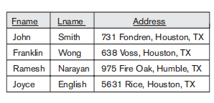
Q1. Retrieve the name and address of all employees who work for the ‘Research’ department.

Slide 10
Q 2. For every project located in ‘Stafford’, list the project number, the controlling department number, and the department manager’s last name, address, and birth date.

Slide 12
Ambiguous Attribute Names, Aliasing, Renaming, and Tuple Variables
In SQL, we can use the same name for two (or more) attributes as long as the attributes are in different relations
a multitable query refers to two or more attributes with the same name, we must qualify the attribute name with the relation name to prevent ambiguity
This is done by prefixing the relation name to the attribute name and separating the two by a period(.).

Slide 14
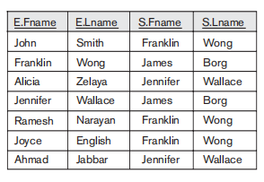
Q8. For each employee, retrieve the employee’s first and last name and the first and last name of his or her immediate supervisor.

Slide 15
Alternative relation names E and S are called aliases or tuple variables, for the EMPLOYEE relation.
An alias follow the keyword AS
It is also possible to rename the relation attributes within the query in SQL by giving them aliases.

Slide 17
Unspecified WHERE Clause and Use of the Asterisk
missing WHERE clause indicates no condition on tuple selection;
hence, all tuples of the relation specified in the FROM clause qualify and are selected for the query result

Slide 18
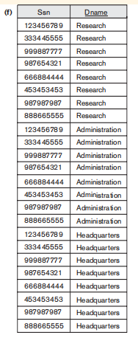
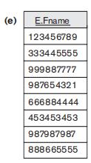
Q 9 and 10. Select all EMPLOYEE Ssns (Q9) and all combinations of EMPLOYEE Ssn and DEPARTMENT Dname (Q10) in the database.

Slide 19
To retrieve all the attribute values of the selected tuples, we do not have to list the attribute names explicitly in SQL;
we just specify an asterisk (*), which stands for all the attributes

Slide 20
Q1C retrieves all the attribute values of any EMPLOYEE who works in DEPARTMENT number 5

Slide 21
Q1D Retrieves all the attributes of an EMPLOYEE and the attributes of the DEPARTMENT in which he or she works for every employee of the ‘Research’ department

Slide 22
DISTINCT Keyword
to eliminate duplicate tuples from the result of an SQL queries we use the keyword DISTINCT in the SELECT clause
only distinct tuples should remain in the result
a query with SELECT DISTINCT eliminates duplicates, whereas a query with SELECT ALL does not.

Slide 23
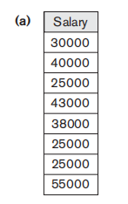
Q11 retrieves the salary of every employee without distinct

Slide 24
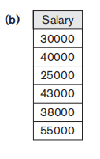
Q11A retrieves the salary of every employee using keyword DISTINCT

Slide 25
EXCEPT and INTERSECT
set union (UNION), set difference (EXCEPT), and set intersection (INTERSECT) operations.
The relations resulting from these set operations are sets of tuples; duplicate tuples are eliminated from the result.
we must make sure that the two relations on which we apply the operation have the same attributes and that the attributes appear in the same order in both relations

Slide 26
Q4. Make a list of all project numbers for projects that involve an employee whose last name is ‘Smith’, either as a worker or as a manager of the department that controls the project
The first SELECT query retrieves the projects that involve a ‘Smith’ as manager of
the department that controls the project, and the second retrieves the projects that
involve a ‘Smith’ as a worker on the project. Notice that if several employees have the
last name ‘Smith’, the project names involving any of them will be retrieved.
Applying the UNION operation to the two SELECT queries gives the desired result.

Slide 27
UNION ALL
The UNION ALL command combines the result set of two or more SELECT statements (allows duplicate values).
The following SQL statement returns the cities (duplicate values also) from both the "Customers" and the "Suppliers" table:

Slide 28
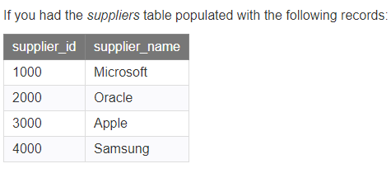
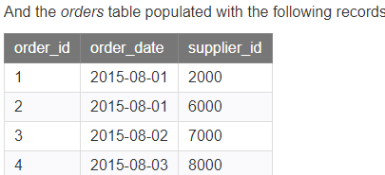
This SQL UNION ALL example would return the supplier_id multiple times in
the result set if that same value appeared in both the suppliers and orders table.
The SQL UNION ALL operator does not remove duplicates. If you wish to remove
duplicates, try using the UNION operator.

Slide 30
INTERSECT Operator
INTERSECT operator is used to return the records that are in common between two SELECT statements or data sets.
If a record exists in one query and not in the other, it will be omitted from the INTERSECT results.
It is the intersection of the two SELECT statements.

Slide 34
EXCEPT
The SQL EXCEPT clause/operator is used to combine two SELECT statements and returns rows from the first SELECT statement that are not returned by the second SELECT statement.
This means EXCEPT returns only rows, which are not available in the second SELECT statement.
Just as with the UNION operator, the same rules apply when using the EXCEPT operator.

Slide 36
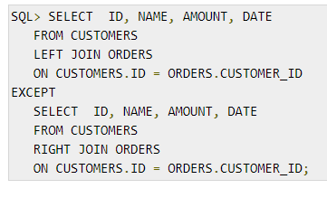
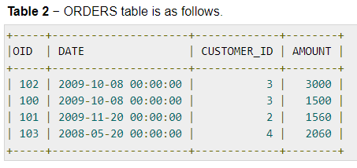
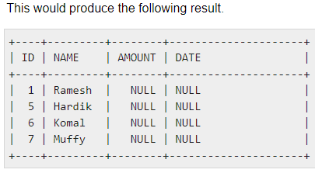

Slide 38
Ordering of Query Results
The ORDER BY statement in sql is used to sort the fetched data in either ascending or descending according to one or more columns.
By default ORDER BY sorts the data in ascending order.
We can use the keyword DESC to sort the data in descending order and the keyword ASC to sort in ascending order.

Slide 39
Q. Fetch all data from the table Student and sort the result in descending order according to the column ROLL_NO
Student Table

Slide 41
Sort according to multiple columns Q. Fetch all data from the table Student and then sort the result in ascending order first according to the column Age. and then in descending order according to the column ROLL_NO.

Slide 42
Q15. Retrieve a list of employees and the projects they are working on, ordered by department and, within each department, ordered alphabetically by last name, then first name.

Slide 46
Q 12. Retrieve all employees whose address is in Houston, Texas.

Slide 47
Q 12A. Find all employees who were born during the 1950s.
To retrieve all employees who were born during the 1950s,
Here, ‘5’ must be the third character of the string (according to our format for date),
so we use the value ‘_ _ 5 _ _ _ _ _ _ _’, with each underscore serving as a placeholder for an arbitrary character.

Slide 51
Aggregate Functions in SQL
Aggregate functions are used to summarize information from multiple tuples into a single-tuple summary.
Grouping is used to create sub-groups of tuples before summarization.
A number of built-in aggregate functions exist:
COUNT,
SUM,
MAX,
MIN, and
AVG

Slide 52
COUNT function returns the number of tuples or values as specified in a query.
The functions SUM, MAX, MIN, and AVG can be applied to a set or multiset of numeric values and return, respectively, the sum, maximum value, minimum value, and average (mean) of those values
These functions can be used in the SELECT clause or in a HAVING clause

Slide 53
Q19. Find the sum of the salaries of all employees, the maximum salary,the minimum salary, and the average salary.

Slide 54
Q 20. Find the sum of the salaries of all employees of the ‘Research’ department, as well as the maximum salary, the minimum salary, and the average salary in this department.

Slide 55
Q21. Retrieve the total number of employees in the company
SELECT COUNT(*)
FROM EMPLOYEE;

Slide 56
Q22. The number of employees in the ‘Research’ department
Here the asterisk (*) refers to the rows (tuples),
so COUNT (*) returns the number of rows in the
result of the query. We may also use the COUNT
function to count values in a column rather
than tuples

Slide 57
Query 23. Count the number of distinct salary values in the database.
If we write COUNT(SALARY) instead of COUNT(DISTINCT SALARY) then
duplicate values will not be eliminated. However, any tuples with NULL for SALARY
will not be counted. In general, NULL values are discarded when aggregate functions are applied to a particular column

Slide 58
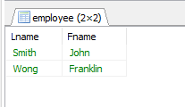
Q. Retrieve the names of all employees who have two or more dependents
The correlated nested query counts the number of dependents that each employee
has; if this is greater than or equal to two, the employee tuple is selected.

Slide 59
ARITHMETIC OPERATORS
The standard arithmetic operators for addition (+), subtraction (–), multiplication (*), and division (/) can be applied to numeric values or attributes with numeric domains

Slide 60
Q13. Show the resulting salaries if every employee working on the ‘ProductX’ project is given a 10 percent raise.
suppose that we want to see the effect of giving all employees who work on the
‘ProductX’ project a 10 percent raise; we can issue Query 13 to see what their
salaries would become. This example also shows how we can rename an attribute in
the query result using AS in the SELECT clause.

Slide 61
Another comparison operator, which can be used for convenience, is BETWEEN

Slide 62
Q 14. Retrieve all employees in department 5 whose salary is between $30,000 and $40,000.
The condition (Salary BETWEEN 30000 AND 40000) in Q14
is equivalent to the condition
((Salary >= 30000) AND (Salary <= 40000))

Slide 63
Grouping: The GROUP BY and HAVING Clauses
In many cases we want to apply the aggregate functions to subgroups of tuples in a relation, where the subgroups are based on some attribute values.
For example,
we may want to find the average salary of employees in each department or
the number of employees who work on each project.
In these cases we need to partition the relation into nonoverlapping subsets (or groups) of tuples.
Each group (partition) will consist of the tuples that have the same value of some attributes called the grouping attributes.

Slide 64
GROUP BY
The GROUP BY clause specifies the grouping attributes, which should also appear in the SELECT clause, so that the value resulting from applying each aggregate function to a group of tuples appears along with the value of the grouping attributes

Slide 65
Q24. For each department, retrieve the department number, the number of employees in the department, and their average salary
the EMPLOYEE tuples are partitioned into groups—each group having
the same value for the grouping attribute Dno. Hence, each group contains the
employees who work in the same department.

Slide 66
If NULLs exist in the grouping attribute, then a separate group is created for all
tuples with a NULL value in the grouping attribute.
For example, if the EMPLOYEE table had some tuples that had NULL for the grouping attribute Dno, there would be a separate group for those tuples in the result of Q24

Slide 67
Query 25. For each project, retrieve the project number, the project name, and the number of employees who work on that project.

Slide 68
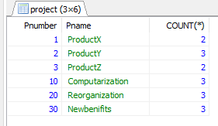

Slide 69
HAVING clause
In GROUP BY the grouping and functions are applied after the joining of the two relations.
Sometimes we want to retrieve the values of these functions only for groups that satisfy certain conditions
HAVING clause, which can appear in conjunction with a GROUP BY clause
HAVING provides a condition on the summary information regarding the group of tuples associated with each value of the grouping attributes.
Only the groups that satisfy the condition are retrieved in the result of the query.

Slide 70
Q 26. For each project on which more than two employees work, retrieve the project number, the project name, and the number of employees who work on the project.

Slide 71
After applying the WHERE clause but before applying HAVING

Slide 72
After applying the HAVING clause condition

Slide 73
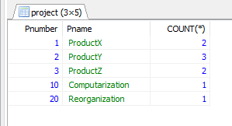
Query 27. For each project, retrieve the project number, the project name, and the number of employees from department 5 who work on the project.

Slide 74
SQL JOIN
How do I get data from multiple tables?
A SQL JOIN combines records from two tables.
A JOIN locates related column values in the two tables.
A query can contain zero, one, or multiple JOIN operations.
INNER JOIN is the same as JOIN; the keyword INNER is optional

Slide 75
Four different types of JOINs
(INNER) JOIN:
Select records that have matching values in both tables.
FULL (OUTER) JOIN:
Selects all records that match either left or right table records.
LEFT (OUTER) JOIN:
Select records from the first (left-most) table with matching right table records.
RIGHT (OUTER) JOIN:
Select records from the second (right-most) table with matching left table records

Slide 77
JOIN Syntax
The general syntax is
SELECT column-names
FROM table-name1 INNER JOIN table-name2
ON column-name1 = column-name2
WHERE condition
The INNER keyword is optional: it is the default as well as the most commonly used JOIN operation.

Slide 78
student

Slide 79
Student course

Slide 80
SELECT StudentCourse.COURSE_ID, Student.NAME, Student.AGE FROM Student INNER JOIN StudentCourse ON Student.ROLL_NO = StudentCourse.ROLL_NO;

Slide 81
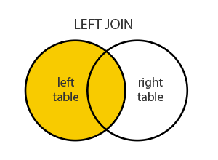
SQL LEFT JOIN
LEFT JOIN: This join returns all the rows of the table on the left side of the join and matching rows for the table on the right side of join.
The rows for which there is no matching row on right side, the result-set will contain null. LEFT JOIN is also known as LEFT OUTER JOIN.

Slide 82
The SQL LEFT JOIN syntax
The general LEFT JOIN syntax is
SELECT column-names
FROM table-name1 LEFT JOIN table-name2
ON column-name1 = column-name2
WHERE condition
The general LEFT OUTER JOIN syntax is
SELECT column-names
FROM table-name1 LEFT OUTER JOIN table-name2
ON column-name1 = column-name2
WHERE condition

Slide 83
SELECT Student.NAME,StudentCourse.COURSE_ID FROM Student LEFT JOIN StudentCourse ON StudentCourse.ROLL_NO = Student.ROLL_NO;

Slide 84
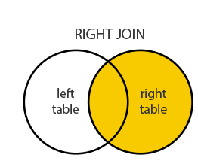
SQL RIGHT JOIN
RIGHT JOIN is similar to LEFT JOIN. This join returns all the rows of the table on the right side of the join and matching rows for the table on the left side of join. The rows for which there is no matching row on left side, the result-set will contain null. RIGHT JOIN is also known as RIGHT OUTER JOIN.

Slide 85
The SQL RIGHT JOIN syntax
The general syntax is
SELECT column-names
FROM table-name1 RIGHT JOIN table-name2
ON column-name1 = column-name2
WHERE condition
The general RIGHT OUTER JOIN syntax is:
SELECT column-names
FROM table-name1 RIGHT OUTER JOIN table-name2
ON column-name1 = column-name2
WHERE condition

Slide 86
SELECT Student.NAME,StudentCourse.COURSE_ID FROM Student RIGHT JOIN StudentCourse ON StudentCourse.ROLL_NO = Student.ROLL_NO;

Slide 87
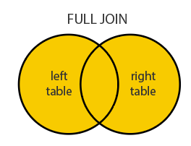
SQL FULL JOIN Statement
FULL JOIN returns all matching records from both tables whether the other table matches or not.
Be aware that a FULL JOIN can potentially return very large datasets.
These two: FULL JOIN and FULL OUTER JOIN are the same.

Slide 88
The SQL FULL JOIN syntax
The general syntax is:
SELECT column-names
FROM table-name1 FULL JOIN table-name2
ON column-name1 = column-name2
WHERE condition
The general FULL OUTER JOIN syntax is:
SELECT column-names
FROM table-name1 FULL OUTER JOIN table-name2
ON column-name1 = column-name2
WHERE condition

Slide 89
SELECT Student.NAME,StudentCourse.COURSE_ID FROM Student FULL JOIN StudentCourse ON StudentCourse.ROLL_NO = Student.ROLL_NO;

Slide 90
NESTING OF QUERIES
A complete SELECT query, called a nested query , can be specified within the WHERE-clause of another query, called the outer query
SQL query which is on the inner part of the main query is called inner query while the outer part of the main query is called outer query.

Slide 91
Subqueries can be categorized into two types:
A noncorrelated (simple) subquery obtains its results independently of its containing (outer) statement.
A correlated subquery requires values from its outer query in order to execute.

Slide 92
A noncorrelated subquery executes independently of the outer query.
The subquery executes first, and then passes its results to the outer query,
For example:
Find the instructor who draws second highest salary
SELECT MAX(salary) from instructor WHERE salary NOT IN (SELECT MAX(salary) FROM instructor)

Slide 93
SELECT MAX(`salary`) from instructor WHERE salary NOT IN (SELECT MAX(salary) FROM instructor)

Slide 94
SELECT MAX(salary) from instructor WHERE salary NOT IN (SELECT MAX(salary) FROM instructor)
Here the subquery is SELECT MAX(salary) FROM instructor , you can execute and substitute the result of that query e.g. if subquery return 95000 then the outer query is reduced to
SELECT MAX(`salary`) from instructor where salary NOT IN (95000)

Slide 95
Q. Returns the names of employees whose salary is greater than the salary of all the employees in department 5

Slide 96
Q 16. Retrieve the name of each employee who has a dependent with the same first name and is the same sex as the employee.

Slide 97
CORRELATED NESTED QUERIES
If a condition in the WHERE-clause of a nested query references an attribute of a relation declared in the outer query , the two queries are said to be correlated
The result of a correlated nested query is different for each tuple (or combination of tuples) of the relation(s) the outer query

Slide 98
Find all the employees who earn more than the average salary in their department.
SELECT last_name, salary, department_id FROM employees E
WHERE
salary > (SELECT AVG(salary)
FROM employees
WHERE department_id = E.department_id);

Slide 99
A Simple Retrieval Query in SQL
A simple retrieval query in SQL can consist of up to four clauses,
but only the first two SELECT and FROM are mandatory
the clauses between square brackets [ ... ] being optional:

Slide 100
The SELECT-clause lists the attributes or functions to be retrieved
The FROM-clause specifies all relations (or aliases) needed in the query but not those needed in nested queries
The WHERE-clause specifies the conditions for selection and join of tuples from the relations specified in the FROM-clause
GROUP BY specifies grouping attributes
HAVING specifies a condition for selection of groups
ORDER BY specifies an order for displaying the result of a query
A query is evaluated by first applying the WHERE-clause, then GROUP BY and HAVING, and finally the SELECT-clause
There are three SQL commands to modify the database; INSERT, DELETE, and UPDATE

Slide 101
The EXISTS and UNIQUE Functions in SQL
EXISTS function in SQL is used to check whether the result of a correlated nested query is empty (contains no tuples) or not
The result of EXISTS is a Boolean value
TRUE if the nested query result contains at least one tuple, or
FALSE if the nested query result contains no tuples.

Slide 102
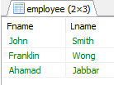
SELECT E.Fname, E.Lname
FROM EMPLOYEE AS E
WHERE EXISTS
( SELECT *
FROM DEPENDENT AS D
WHERE E.Ssn=D.Essn AND E.Sex=D.Sex
);

Slide 103
OUTPUT

Slide 104
EXISTS(Q) returns TRUE if there is at least one tuple in the result of the nested query Q, and it returns FALSE otherwise.
On the other hand, NOT EXISTS(Q) returns TRUE if there are no tuples in the result of nested query Q, and it returns FALSE otherwise

Slide 105
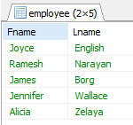
Q. Retrieve the names of employees who have no dependents.

Slide 106
OUTPUT

Slide 107
Specifying Constraints as Assertions and Actions as Triggers

Slide 108
Specifying General Constraints as Assertions in SQL
Assertions = conditions that the database must always satisfy
Domain constraints and referential-integrity constraints are specific forms of assertions
CHECK – verify the assertion on one-table, one-attribute
ASSERTION – verify one or more tables, one or more attributes
Some constraints cannot be expressed by using only domain constraints or referential-integrity constraints; for example,
“Every department must have at least five courses offered every semester” – must be expressed as an assertion

Slide 110
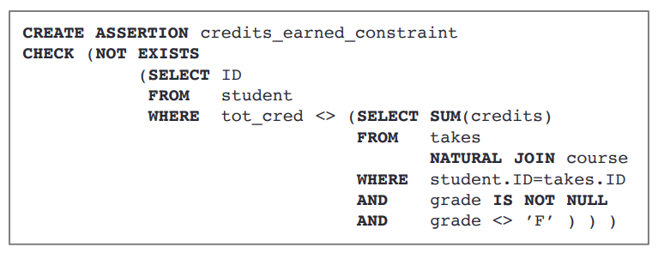
Example 1
For each tuple in the student relation, the value of the attribute tot_cred must equal the sum of credits of courses that the student has completed successfully.

Slide 111
The total length of all movies by a given studio shall not exceed 10,000 minutes
Since this constraint involves only the relation Movies, it can be expressed as a tuple-based CHECK constraint

Slide 113
TRIGGER
A trigger is a stored procedure in database which automatically invokes whenever a special event in the database occurs.
action to be taken when certain events occur and when certain conditions are satisfied.
For example,
a trigger can be invoked when a row is inserted into a specified table or when certain table columns are being updated.
it may be useful to specify a condition that, if violated, causes some user to be informed of the violation

Slide 114
Benefits of Triggers
Generating some derived column values automatically
Enforcing referential integrity
Event logging and storing information on table access
Auditing
Synchronous replication of tables
Imposing security authorizations
Preventing invalid transactions

Slide 115
Creating Triggers

Slide 116
CREATE [OR REPLACE] TRIGGER trigger_name
Creates or replaces an existing trigger with the trigger_name.
{BEFORE | AFTER | INSTEAD OF}
This specifies when the trigger will be executed.
The INSTEAD OF clause is used for creating trigger on a view.
{INSERT [OR] | UPDATE [OR] | DELETE}
This specifies the DML operation.
[OF col_name]
This specifies the column name that will be updated.
[ON table_name]
This specifies the name of the table associated with the trigger.

Slide 117
[REFERENCING OLD AS o NEW AS n]
This allows you to refer new and old values for various DML statements, such as INSERT, UPDATE, and DELETE.
[FOR EACH ROW]
This specifies a row-level trigger, i.e., the trigger will be executed for each row being affected.
Otherwise the trigger will execute just once when the SQL statement is executed, which is called a table level trigger.
WHEN (condition)
This provides a condition for rows for which the trigger would fire.
This clause is valid only for row-level triggers.

Slide 118
Example
creates a row-level trigger for the customers table that would fire for INSERT or UPDATE or DELETE operations performed on the CUSTOMERS table.
This trigger will display the salary difference between the old values and new values

Slide 120
Triggering a Trigger
Here is one INSERT statement, which will create a new record in the table
When a record is created in the CUSTOMERS table, the above create trigger, display_salary_changes will be fired and it will display the following result
Because this is a new record, old salary is
not available and the above result comes as null.

Slide 121
The UPDATE statement will update an existing record in the table
When a record is updated in the CUSTOMERS table, the above create trigger, display_salary_changes will be fired and it will display the following result

Slide 122
VIEWS
In SQL, a view is a virtual table based on the result-set of an SQL statement.
A view contains rows and columns, just like a real table.
The fields in a view are fields from one or more real tables in the database.
You can add SQL statements and functions to a view and present the data as if the data were coming from one single table.
A view is created with the CREATE VIEW statement.

Slide 123
CREATE VIEW Syntax
CREATE VIEW view_name AS SELECT column1, column2, ... FROM table_name WHERE condition;
Eg:
CREATE VIEW Brazil Customers AS SELECT CustomerName, ContactName FROM Customers WHERE Country = 'Brazil';

Slide 124
SQL Updating a View
A view can be updated with the CREATE OR
REPLACE VIEW statement.
CREATE OR REPLACE VIEW view_name AS SELECT column1, column2, ... FROM table_name WHERE condition;

Slide 125
CREATE OR REPLACE VIEW [Brazil Customers] AS SELECT CustomerName, ContactName, City FROM Customers WHERE Country = 'Brazil';

Slide 126
SQL Dropping a View
DROP VIEW view_name;
DROP VIEW [Brazil Customers];

Slide 127
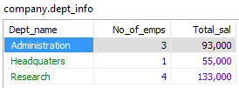
V1
V2

Slide 128
We can specify SQL queries on a view in the same way we specify queries involving base tables.
For example,
to retrieve the last name and first name of all employees who work on the ‘ProductX’ project, we can utilize the WORKS_ON1 view and specify the query as in QV1:

Slide 129
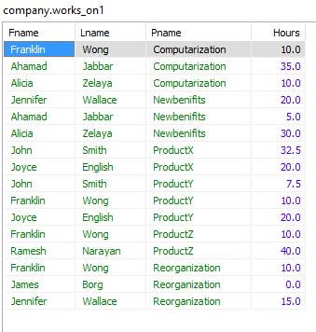

Slide 130
SYLLABUS
SQL DML (Data Manipulation Language)
▫ SQL queries on single and multiple tables, Nested queries (correlated and non-correlated), Aggregation and grouping, Views, assertions, Triggers, SQL data types.
Physical Data Organization
▫ Review of terms: physical and logical records, blocking factor, pinned and unpinned organization. Heap files, Indexing, Singe level indices, numerical examples, Multi-level-indices, numerical examples, B-Trees & B+-Trees (structure only, algorithms not required), Extendible Hashing, Indexing on multiple keys – grid files

Slide 132
SYLLABUS
SQL DML (Data Manipulation Language)
▫ SQL queries on single and multiple tables, Nested queries (correlated and non-correlated), Aggregation and grouping, Views, assertions, Triggers, SQL data types.
Physical Data Organization
▫ Review of terms: physical and logical records, blocking factor, pinned and unpinned organization. Heap files, Indexing, Singe level indices, numerical examples, Multi-level-indices, numerical examples, B-Trees & B+-Trees (structure only, algorithms not required), Extendible Hashing, Indexing on multiple keys – grid files

Slide 133
Fixed and Variable length records
A file is a sequence of records.
In many cases, all records in a file are of the same record type.
If every record in the file has exactly the same size (in bytes), the file is said to be made up of fixed-length records.
If different records in the file have different sizes, the file is said to be made up of variable-length records.

Slide 134
Spanned and Unspanned Organization
Part of the record can be stored on one block and the rest on another.
A pointer at the end of the first block points to the block containing the remainder of the record.
This organization is called spanned because records can span more than one block.
Whenever a record is larger than a block, we must use a spanned organization.
If records are not allowed to cross block boundaries, the organization is called unspanned.

Slide 135
Blocking factor for the file
The records of a file must be allocated to disk blocks because a block is the unit of data transfer between disk and memory.
When the block size is larger than the record size,
Suppose that the block size is B bytes.
For a file of fixed-length records of size R bytes, with B ≥ R, we can fit bfr =B / R records per block.
The value bfr is called the blocking factor for the file.

Slide 136
Index Structures
Indexing is a data structure technique to efficiently retrieve records from the database files based on some attributes on which the indexing has been done.
An index on a database table provides a convenient mechanism for locating a row (data record) without scanning the entire table and thus greatly reduces the time it takes to process a query.
The index is usually specified on one field of the file.
One form of an index is a file of entries <field value, pointer to record>, which is ordered by field value.
The index file usually occupies considerably less disk blocks than the data file because its entries are much smaller.

Slide 137
Types of index
Indexes can be characterized as
Dense index
Sparse index
A dense index has an index entry for every search key value (and hence every record) in the data file.
A sparse (or nondense) index, on the other hand, has index entries for only some of the search values.

Slide 138
Advantages:
▫ Stores and organizes data into computer files.
▫ Makes it easier to find and access data at any given time.
▫ It is a data structure that is added to a file to provide faster access to the data.
▫ It reduces the number of blocks that the DBMS has to check.
Disadvantages
▫ Index needs to be updated periodically for insertion or deletion of records in the main table.

Slide 139
Structure of index
An index is a small table having only two columns.
The first column contains a copy of the primary or candidate key of a table
The second column contains a set of pointers holding the address of the disk block where that particular key value can be found.
If the indexes are sorted, then it is called as ordered indices.

Slide 140
Example
Suppose we have an ordered file with 30,000 records and stored on a disk of block size 1024 bytes and records are of fixed size, unspanned organisation. Record length = 100 bytes. How many block access needed to search a record?

Slide 141
Primary Index
Primary index is defined on an ordered data file.
The data file is ordered on a key field.
The key field is generally the primary key of the relation.
A primary index is a nondense (sparse) index, since it includes an entry for each disk block of the data file and the keys of its anchor record rather than for every search value.

Slide 142
Figure 5.1: Primary Index on the Ordering Key Field of the File

Slide 143
Example
Suppose we have an ordered file with 30,000 records and stored on a disk of block size 1024 bytes and records are of fixed size, unspanned organisation.Record length is 100 bytes. How many block access if using a primary index file, with an ordering key field of the file 9 bytes and block pointer size 6 bytes.

Slide 144
Ordered file r = 30000 records
Disk with block size B=1024 B
Record length R= 100 B
Bfr =B/R = 1024/100 = 10 records per block
No : of blocks needed for a file b=r/bfr= 30000/10 =3000 blocks
Binary search block access=log2 b=log2 3000
= 12 block access

Slide 145
Considering primary index

Slide 146
Secondary Index
A secondary index provides a secondary means of accessing a file for which some primary access already exists.
The secondary index may be on a field which is a candidate key and has a unique value in every record, or a non-key with duplicate values.
The index is an ordered file with two fields.
The first field is of the same data type as some non-ordering field of the data file that is an indexing field.
The second field is either a block pointer or a record pointer.
There can be many secondary indexes (and hence, indexing fields) for the same file.
Includes one entry for each record in the data file; hence, it is a dense index.

Slide 147
Figure 5.3: Dense Secondary Index (with Block Pointer) on a Non Ordering Key Field of the File

Slide 148
PREPARED BY SHARIKA T R,
SNGCE
Figure 5.4: Secondary Index (with Record Pointer) on a Non Key Field implemented using one level of indirection so that Index entries are of Fixed Length and have unique field values

Slide 149
Example
Suppose we have an ordered file with 30,000 records and stored on a disk of block size 1024 bytes and records are of fixed size, unspanned organisation. Record length = 100 bytes. How many block access if using a secondary index file.

Slide 150
Clustering Index
Defined on an ordered data file.
The data file is ordered on a non-key field unlike primary index, which requires that the ordering field of the data file have a distinct value for each record.
Includes one index entry for each distinct value of the field;
▫ the index entry points to the first data block that contains records with that field value.
It is another example of nondense index where Insertion and Deletion is relatively straightforward with a clustering index.

Slide 151
Figure 5.2: A Clustering Index on Dept_number Ordering Nonkey Field of a File

Slide 153
Single level and Multi-level indexing
single-level index is an ordered file, we can create a primary index to the index itself;
In this case, the original index file is called the first- level index and the index to the index is called the second-level index.
We can repeat the process, creating a third, fourth, ..., top level until all entries of the top level fit in one disk block.
A multi-level index can be created for any type of first- level index (primary, secondary, clustering) as long as the first-level index consists of more than one disk block

Slide 154
If single-level index is used, then a large size index cannot be kept in memory which leads to multiple disk accesses.
Multilevel Indexing in Database is created when a primary index does not fit in memory. In this type of indexing method, you can reduce the number of disk accesses to short any record and kept on a disk as a sequential file and create a sparse base on that file.

Slide 156
Figure 5.5: Two-Level Primary Index

Slide 157
Multilevel indices used to reduce the part of the index that we contribute to search by bfri(blocking factor)
Hence the search space is reduced much faster
Value bfri is called fan out of multilevel index(f0)

Slide 158
Consider blocking factor or fan out is 68 index entries per block for multilevel index.first level consistes of 442 blocks.Find the block access?
No : of Ist level blocks b1=442 blocks
No : of 2nd level blocks b2=b1/fo =442/68
=7 blocks
No : of 3rd level blocks b3=b2/fo=7/68
=1 block
Hence 3rd level is the top level of the index
Ie t=3
Block access=t+1 =3+1
= 4 block access

Slide 159
Heap File
Heap File Organization works with data blocks.
In this method records are inserted at the end of the file, into the data blocks.
No Sorting or Ordering is required in this method.
If a data block is full, the new record is stored in some other block
Here the other data block need not be the very next data block, but it can be any block in the memory.
It is the responsibility of DBMS to store and manage the new records.

Slide 160
Insertion of new record
Suppose we have four records in the heap R1, R5, R6, R4 and R3
new record R2 has to be inserted in the heap then, since the last data block
i.e data block 3 is full it will be inserted in any of the data blocks selected by the DBMS, lets say data block 1.

Slide 163
If we want to search, delete or update data in heap file Organization the we will traverse the data from the beginning of the file till we get the requested record.
Thus if the database is very huge, searching, deleting or updating the record will take a lot of time.

Slide 164
Advan–
Fetching and retrieving records is faster than sequential record but only in case of small databases.
When there is a huge number of data needs to be loaded into the database at a time, then this method of file Organization is best suited.

Slide 165
Disadv –
Problem of unused memory blocks.
Inefficient for larger databases.

Slide 166
Extendible Hashing
Extendible Hashing is a dynamic hashing method wherein directories, and buckets are used to hash data. It is an aggressively flexible method in which the hash function also experiences dynamic changes.
The main features in this hashing technique are:
Directories:
The directories store addresses of the buckets in pointers.
An id is assigned to each directory which may change each time when Directory Expansion takes place.
Buckets:
The buckets are used to hash the actual data.

Slide 167
Basic Structure of Extendible Hashing:

Slide 168
Step 1 – Analyze Data Elements
Step 2 – Convert into binary format
Step 3 – Check Global Depth of the directory.
Step 4 – Identify the Directory
Step 5 – Navigation:
Step 6 – Insertion and Overflow Check
Step 7 – Tackling Over Flow Condition during Data Insertion
Step 8 – Rehashing of Split Bucket Elements:
Step 9 – The element is successfully hashed.

Slide 169
Example based on Extendible Hashing: Now, let us consider a prominent example of hashing the following elements: 16,4,6,22,24,10,31,7,9,20,26. Bucket Size: 3 (Assume) Hash Function: Suppose the global depth is X. Then the Hash Function returns X LSBs.

Slide 170
Solution: First, calculate the binary forms of each of the given numbers. 16- 10000 4- 00100 6- 00110 22- 10110 24- 11000 10- 01010 31- 11111 7- 00111 9- 01001 20- 10100 26- 11010
Initially, the global-depth and local-depth is always 1. Thus, the hashing frame looks like this:

Slide 172
Inserting 16: The binary format of 16 is 10000 and global-depth is 1. The hash function returns 1 LSB of 10000 which is 0. Hence, 16 is mapped to the directory with id=0.

Slide 173
Inserting 4 and 6: Both 4(100) and 6(110)have 0 in their LSB. Hence, they are hashed as follows:

Slide 174
Inserting 22: The binary form of 22 is 10110. Its LSB is 0. The bucket pointed by directory 0 is already full. Hence, Over Flow occurs.

Slide 175
Dynamic Hashing
The dynamic hashing method is used to overcome the problems of static hashing like bucket overflow.
In this method, data buckets grow or shrink as the records increases or decreases. This method is also known as Extendable hashing method.
This method makes hashing dynamic, i.e., it allows insertion or deletion without resulting in poor performance.

Slide 176
How to search a key
First, calculate the hash address of the key.
Check how many bits are used in the directory, and these bits are called as i.
Take the least significant i bits of the hash address. This gives an index of the directory.
Now using the index, go to the directory and find bucket address where the record might be.

Slide 177
How to insert a new record
Firstly, you have to follow the same procedure for retrieval, ending up in some bucket.
If there is still space in that bucket, then place the record in it.
If the bucket is full, then we will split the bucket and redistribute the records.

Slide 178
Consider the following grouping of keys into buckets, depending on the prefix of their hash address:

Slide 179
The last two bits of 2 and 4 are 00. So it will go into bucket B0. The last two bits of 5 and 6 are 01, so it will go into bucket B1. The last two bits of 1 and 3 are 10, so it will go into bucket B2. The last two bits of 7 are 11, so it will go into B3.

Slide 181
Insert key 9 with hash address 10001 into the above structure:
Since key 9 has hash address 10001, it must go into the first bucket. But bucket B1 is full, so it will get split.
The splitting will separate 5, 9 from 6 since last three bits of 5, 9 are 001, so it will go into bucket B1, and the last three bits of 6 are 101, so it will go into bucket B5.
Keys 2 and 4 are still in B0. The record in B0 pointed by the 000 and 100 entry because last two bits of both the entry are 00.
Keys 1 and 3 are still in B2. The record in B2 pointed by the 010 and 110 entry because last two bits of both the entry are 10.
Key 7 are still in B3. The record in B3 pointed by the 111 and 011 entry because last two bits of both the entry are 11.

Slide 183
Advantages of dynamic hashing
In this method, the performance does not decrease as the data grows in the system. It simply increases the size of memory to accommodate the data.
In this method, memory is well utilized as it grows and shrinks with the data. There will not be any unused memory lying.
This method is good for the dynamic database where data grows and shrinks frequently.

Slide 184
Disadvantages of dynamic hashing
In this method, if the data size increases then the bucket size is also increased. These addresses of data will be maintained in the bucket address table. This is because the data address will keep changing as buckets grow and shrink. If there is a huge increase in data, maintaining the bucket address table becomes tedious.
In this case, the bucket overflow situation will also occur. But it might take little time to reach this situation than static hashing.

Slide 185
B+-Trees
In a B+-tree, data pointers are stored only at the leaf nodes of the tree; hence, the structure of leaf nodes differs from the structure of internal nodes.
The leaf nodes have an entry for every value of the search field, along with a data pointer to the record.

Slide 186
The structure of the internal nodes of a B+ tree of order p is as follows:
Each internal node is of the form <P1, K1, P2, K2, ..., Pq
– 1, Kq –1, Pq> where q ≤ p and each Pi is a tree
pointer.
Within each internal node, K1 < K2 < ... < Kq−1.
For all search field values X in the subtree pointed at by Pi, we have Ki−1 < X≤ Ki for 1 < i < q; X ≤ Ki for i = 1; and Ki−1 < X for i = q.
Each internal node has at most p tree pointers.
Each internal node, except the root, has at least
┌(p/2)┐ tree pointers. The root node has at least two
tree pointers if it is an internal node.
An internal node with q pointers, q ≤ p, has q − 1
search field values.

Slide 187
The structure of the leaf nodes of a B+-tree of order p is as follows:
Each leaf node is of the form <<K1, Pr1>, <K2, Pr2>, ..., <Kq–1, Prq–1>, Pnext> where q ≤ p, each Pri is a data pointer, and Pnext points to the next leaf node of the B+-tree.
Within each leaf node, K1 ≤ K2 ... , Kq−1, q ≤ p.
Each Pri is a data pointer that points to the record whose search field value is Ki or to a file block containing the record
Each leaf node has at least ┌(p/2)┐ values.
All leaf nodes are at the same level.

Slide 188
Figure 5.8: The nodes of a B+-tree. (a) Internal node of a B+-tree
with q – 1 search values.
(b) Leaf node of a B+-tree with q – 1 search values and q – 1 data pointers.

Slide 189
When a leaf node is full and a new entry is inserted there, the node overflows and must be split.
The first j = ┌((pleaf + 1)/2)┐entries in the original node are kept there, and the remaining entries are moved to a new leaf node.
The jth search value is replicated in the parent internal node, and an extra pointer to the new node is created in the parent.
These must be inserted in the parent node in their correct sequence.
If the parent internal node is full, the new value will cause it to overflow also, so it must be split.
The entries in the internal node up to Pj—the jth tree pointer after inserting the new value and pointer, where j = ⎣((p + 1)/2)⎦—are kept, while the jth search value is moved to the parent, not replicated.
A new internal node will hold the entries from Pj+1 to the end of the entries in the node
This splitting can propagate all the way up to create a new root

Slide 190
Building a B+tree

Slide 191
When we come to insert Key 3, we find that in doing so we will exceed the capacity of the root node.Similar to a normal B-tree this means we need to perform a split operation. However, unlike with the B-tree, we must copy-up the first key in the new rightmost leaf node. As mentioned, this is so we can make sure we have a key/value pair for Key 2 in the leaf nodes:

Slide 192
Next, we add Key 4 to the rightmost leaf node. Since it’s full, we need to
perform another a split operation and copy-up Key 3 to the root node:

Slide 193
Now, let’s add 5 to the rightmost leaf node. Once again to keep the order, we’ll split the leaf node and copy-up 4. Since that will overflow the root node, we’ll have to perform another split operation splitting the root node into two nodes and promoting 3 into a new root node
Notice the difference between splitting a leaf node and splitting an internal node. When we split the internal node in the second split operation we didn’t copy-up Key 3.

Slide 194
In the same way, we keep adding the keys from 6 to 10, each time splitting and
copying-up when necessary until we have reached our final tree:

Slide 195
Searching a B+tree
Searching for a specific key within a B+tree is very similar to searching for a key in a normal B-tree.
Let’s see what it would be like to search for Key 6 again but on the
B+tree:

Slide 196
The shaded nodes show us the path we have taken in order to find our match. Deduction tells us that searching within a B+tree means that we must go all the way down to a leaf node to get the satellite data. As opposed to B-trees where we could find the data at any level.
In addition to exact key match queries, B+trees support range queries. This is enabled by the fact that the B+tree leaf nodes are all linked together. To perform a range query all we need to do is:
▫ find an exact match search for the lowest key
▫ and from there, follow the linked list until we reach the leaf node with the maximum key

Slide 197
Example of an Insertion in a B+-tree
Figure 5.9: An example of insertion in a B+-tree with p = 3 and pleaf = 2.
The values were inserted in the order 8, 5, 1, 7, 3, 12, 9, 6

Slide 198
Example of a Deletion in a B+tree
When an entry is deleted, it is always removed from the leaf level. If it happens to occur in an internal node, it must also be removed from there.
In the latter case, the value to its left in the leaf node must replace it in the internal node because that value is now the rightmost entry in the subtree.
Deletion may cause underflow by reducing the number of entries in the leaf node to below the minimum required.
In this case, we try to find a sibling leaf node
▫ a leaf node directly to the left or to the right of the node with underflow
and
▫ redistribute the entries among the node and its sibling so that both are at least half full;
▫ otherwise, the node is merged with its siblings and the number of leaf

Slide 199
Figure 5.10: An example of deletion from a B+-tree with Deletion
sequence: 5, 12, 9

Slide 200
Most multi-level indexes use B-tree or B+-tree data structures because of the
insertion and deletion problem.
This leaves space in each tree node (disk block) to allow for new index entries.
These data structures are variations of search trees that allow efficient insertion and deletion of new search values.
In B-Tree and B+-Tree data structures, each node corresponds to a disk
block.
Each node is kept between half-full and completely full.
An insertion into a node that is not full is quite efficient.
If a node is full the insertion causes a split into two nodes.
Splitting may propagate to other tree levels.
A deletion is quite efficient if a node does not become less than half full.
If a deletion causes a node to become less than half full, it must be merged with neighboring nodes

Slide 201
Difference between B-tree and B+-tree
In B+trees, search keys can be repeated but this is not the case for B-trees
B+trees allow satellite data to be stored in leaf nodes only, whereas B-trees store data in both leaf and internal nodes
In B+trees, data stored on the leaf node makes the search more efficient since we can store more keys in internal nodes
▫ this means we need to access fewer nodes
Deleting data from a B+tree is easier and less time consuming because we only need to remove data from leaf nodes
Leaf nodes in a B+tree are linked together making range search operations efficient and quick

Slide 202
Finally, although B-trees are useful, B+trees are more popular. In fact, 99% of database management systems use B+trees for indexing.
This is because the B+tree holds no data in the internal nodes.
This maximizes the number of keys stored in a node thereby minimizing the number of levels needed in a tree.
Smaller tree depth invariably means faster search.

