Slide 1
Module II
Line Drawing Algorithm- DDA, Bresenham’s algorithm – Circle Generation Algorithms –Mid point circle algorithm, Bresenham’s algorithm- Scan Conversion-frame buffers – solid area scan conversion – polygon filling algorithms

Slide 2
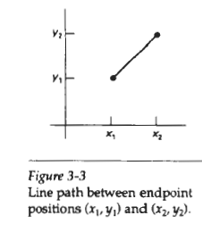

Slide 3
LINE-DRAWING ALGORITHMS
The Cartesian slope-intercept equation for a straight line is y = m.x + b (1)
m - slope of the line & b is the y intercept
Given that the two endpoints of a line segment are specified at positions (x₁, y₁) and (x₂, y₂),

Slide 5
  we can determine values for the slope m and y intercept b with the following calculations:
  m = (y2-y1)/(x2-x1) (2)
  b = y1 – m.x1 (3)
Algorithms for displaying straight lines are based on the line equation (1) & the calculations given in Eqs. (2) & (3).
For any given x interval ∆x along a line, we can compute the corresponding y interval from (2) as
∆y = m∆x (4)
Similarly, ∆x=∆y/m (5)

Slide 6
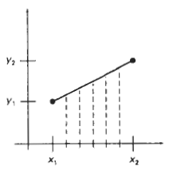


Slide 7
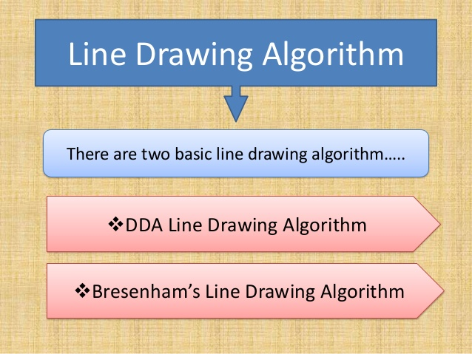

Slide 8
DDA line drawing algorithm
The digital differential analyzer (DDA) is an incremental scan-conversion line algorithm
calculating either ∆y or ∆x
performing calculations at each step using results from the preceding step.

Slide 9
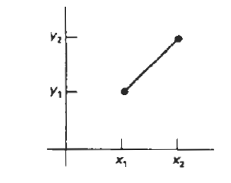
DDA line drawing algorithm
Consider first a line with positive slope
If the slope is less than or equal to 1,
we sample at unit x intervals
and compute each successive y value as
Subscript k takes integer values starting from 1, for the first point, and increases by 1 until the final endpoint is reached.
Since m can be any real number between 0 and 1, the calculated y values must be rounded to the nearest integer.

Slide 10
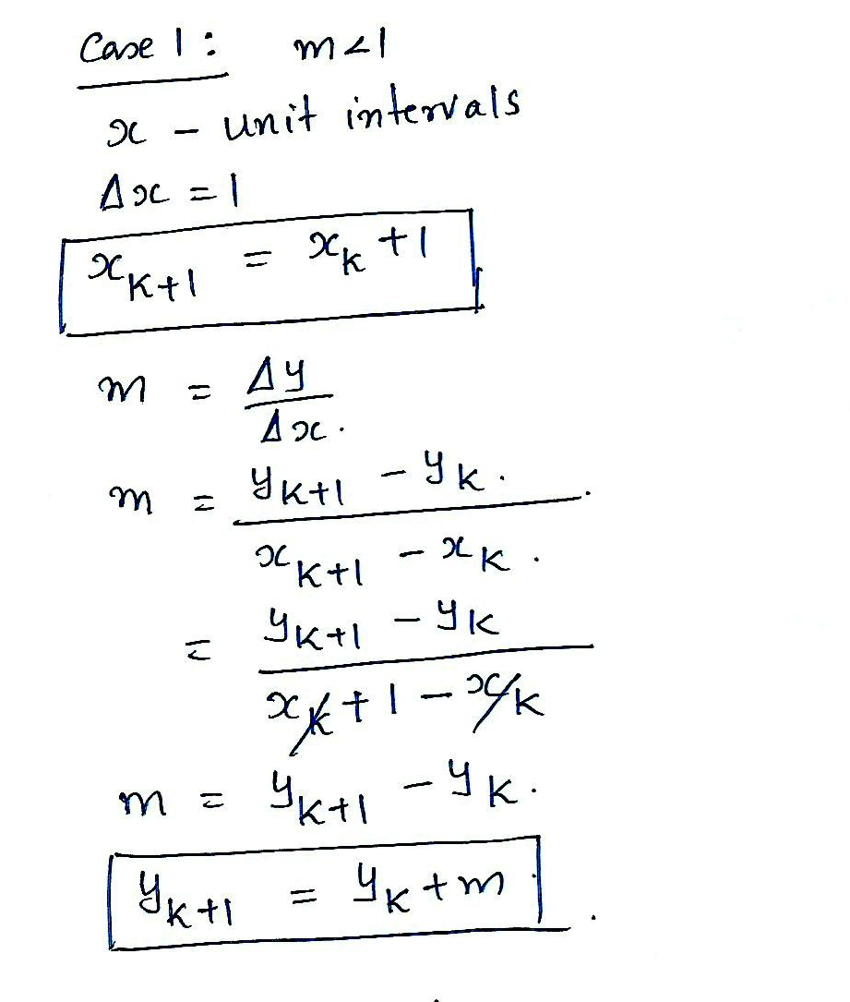

Slide 11
For lines with a positive slope greater than 1, we reverse the roles of x and y.
That is, we sample at unit y intervals
calculate each succeeding x value as

Slide 12
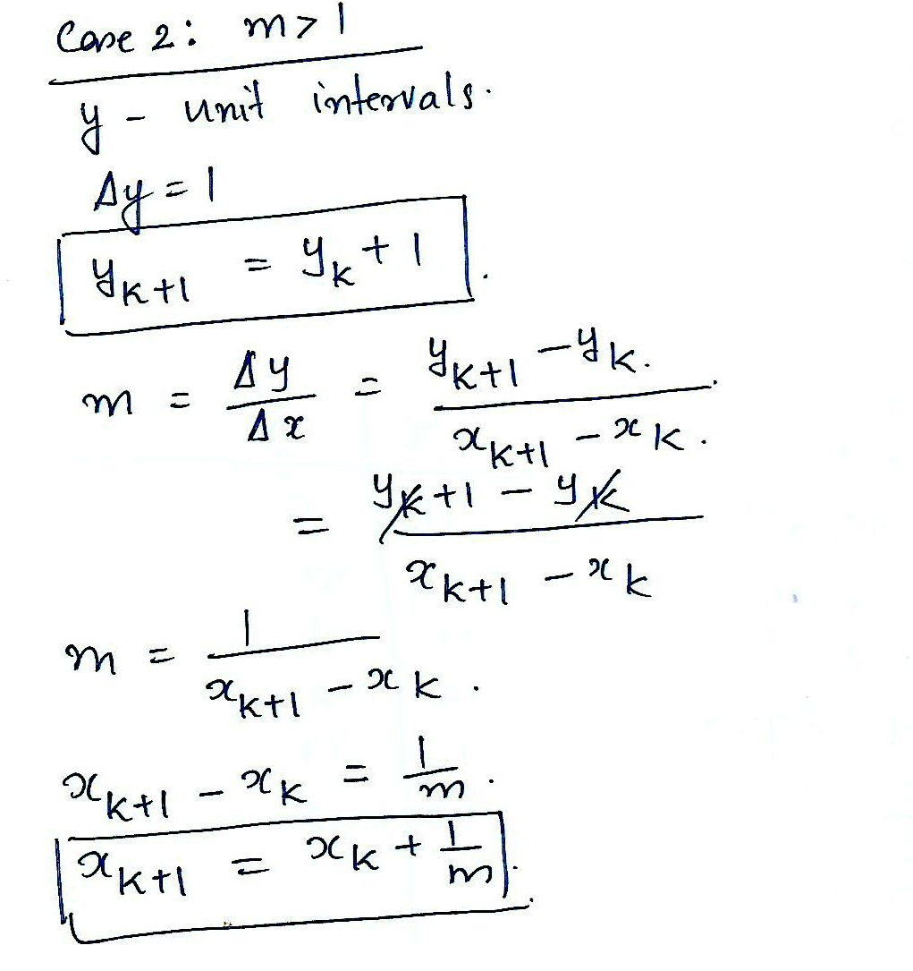

Slide 13
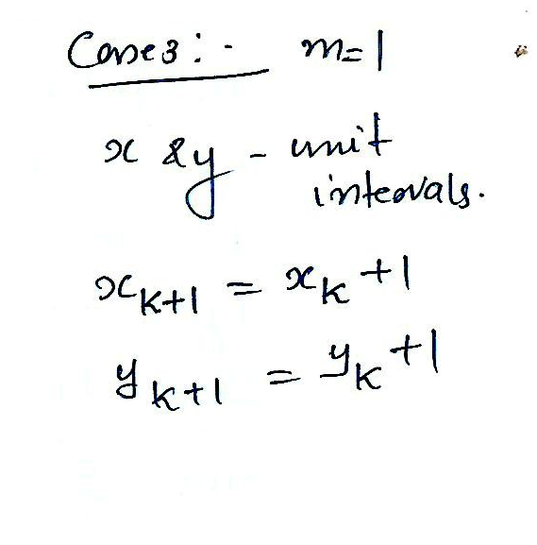

Slide 14
the above equations are based on the assumption that lines are to be processed from the left endpoint to the right endpoint .
If this processing is reversed, so that the starting endpoint is at the right, then either we have
or (when the slope is greater than I) we have

Slide 15
These equations can also be used to calculate pixel positions along a line with negative slope.
If the absolute value of the slope is less than I and the start endpoint is at the left, we set
and calculate y values with
When the start endpoint is at the right (for the same slope), we set
and calculate x values with

Slide 16
DDA Algorithm
void lineDDA( int xa,intya,int xb, int yb)
{
int dx=xb-xa, dy=yb-ya ,steps, k ;
float xIncrement , yIncrement, x=xa, y=ya ;
if(abs(dx)> abs(dy))
steps = abs(dx) ;
else
steps = abs(dy) ;
xIncrement= dx/(float) steps ;
yIncrement= dy/(float) steps ;
setPixel(ROUND(x), ROUND(y)) ;
for(k=0 ;k<steps ;k++){
x +=xIncrement ;
y +=yIncrement ;
setPixel(ROUND(x), ROUND(y)) ;
}
}

Slide 17
Advantages of DDA
Faster than direct use of line equation
Does not do any floating point application

Slide 18
Disadvantages of DDA
Drift away from actual line path because rounding off float value to integer
Causes jaggies or stair-step effect
Floating point addition is still needed
Precision loss because of rounding off
Pixels drift farther apart if line is relatively larger

Slide 19
Consider a line from (2,3) to (8,10). Using simple DDA Algorithm, rasterize this line

Slide 20
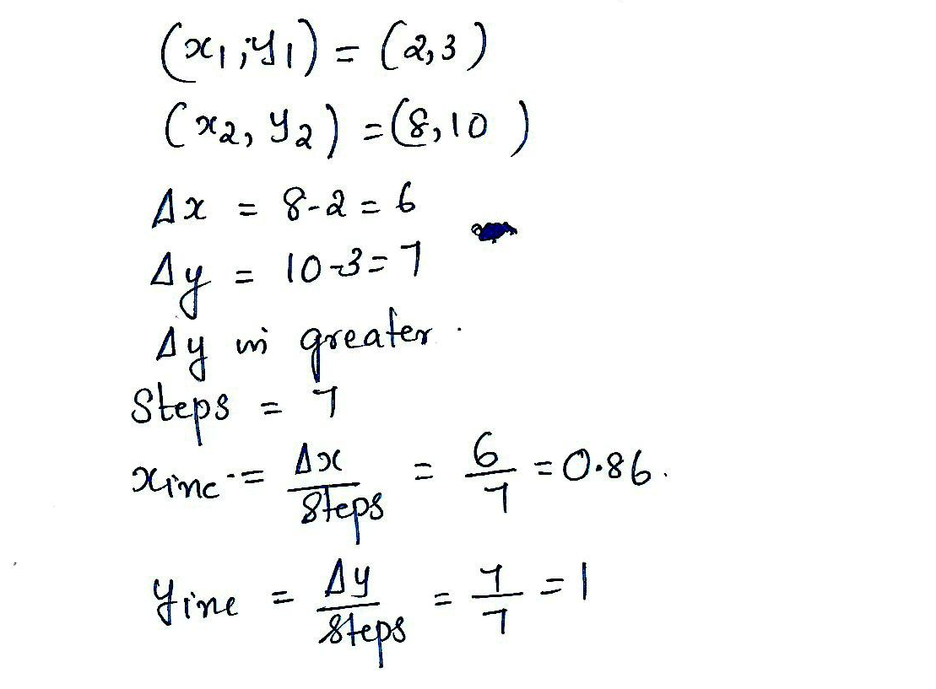

Slide 21
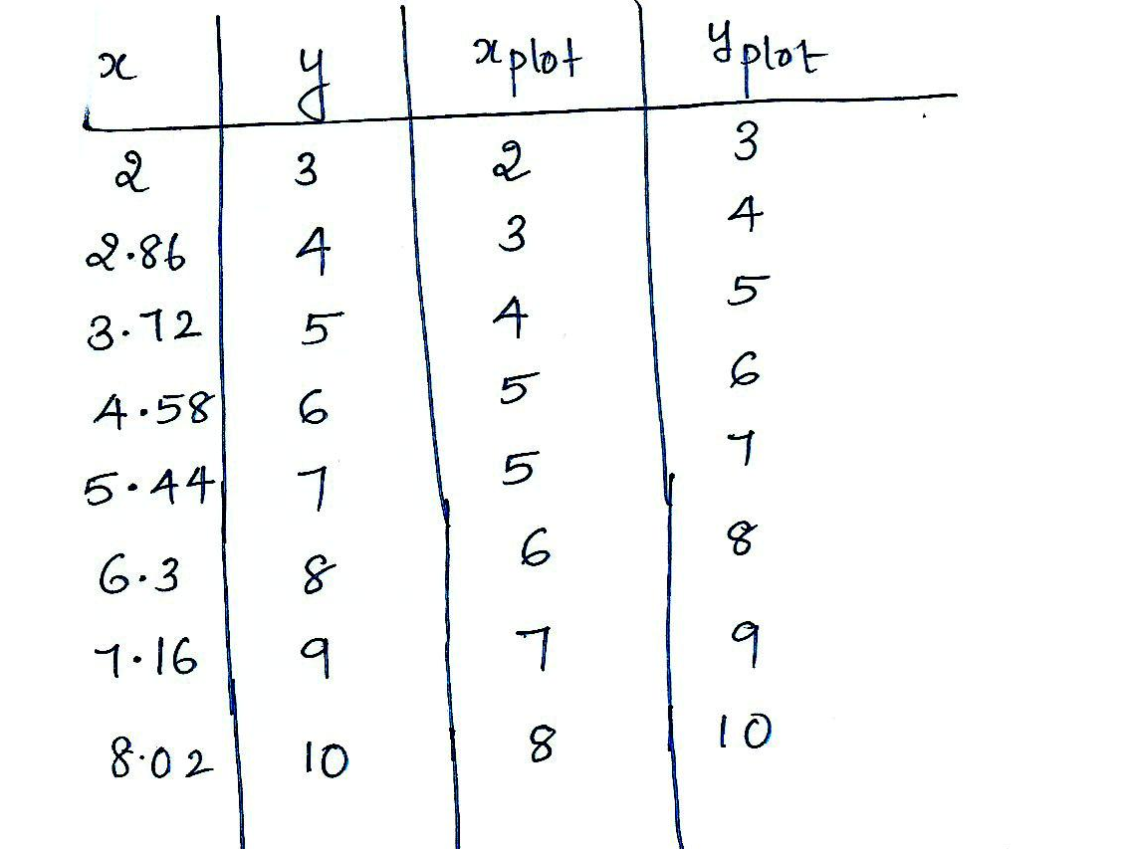

Slide 22
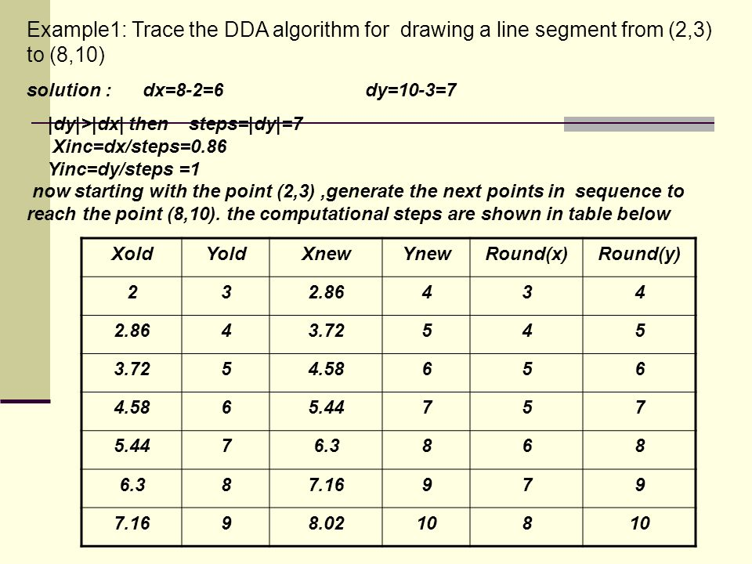

Slide 23
Consider a line from (0,0) to (6,7). Using simple DDA Algorithm, rasterize this line

Slide 24
Bresenham’s line algorithms
an accurate and efficient raster line generating algorithms
developed by bresenham
scan converts lines using only incremental integer calculations that can be adapted to display circles and other curves

Slide 25
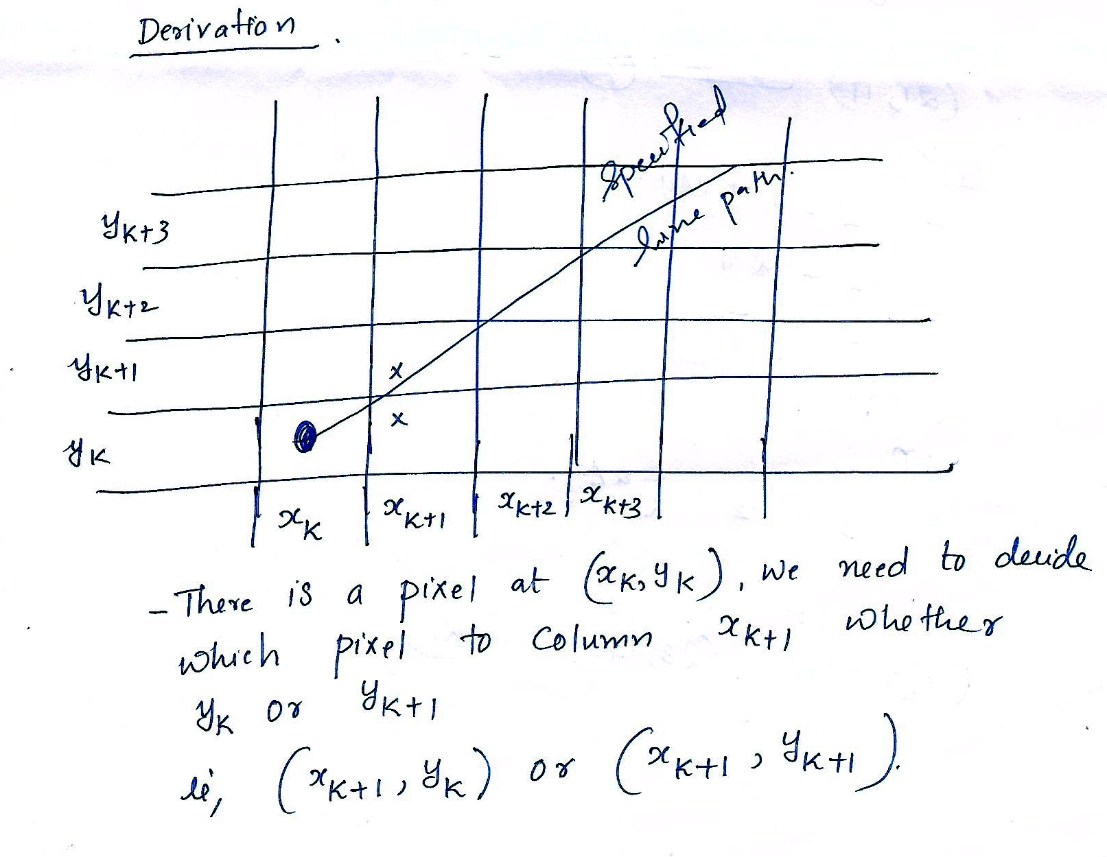

Slide 26
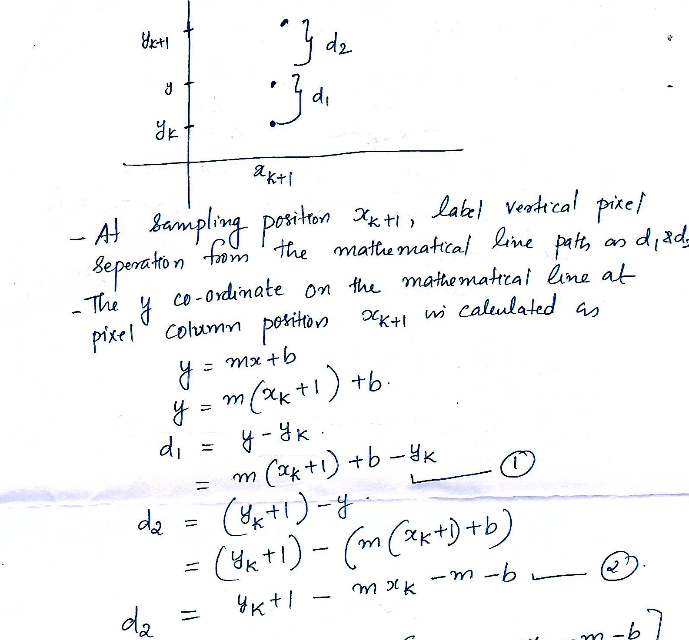

Slide 27
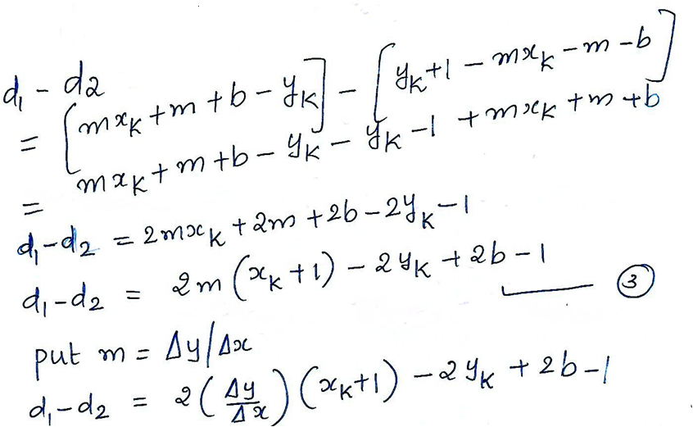
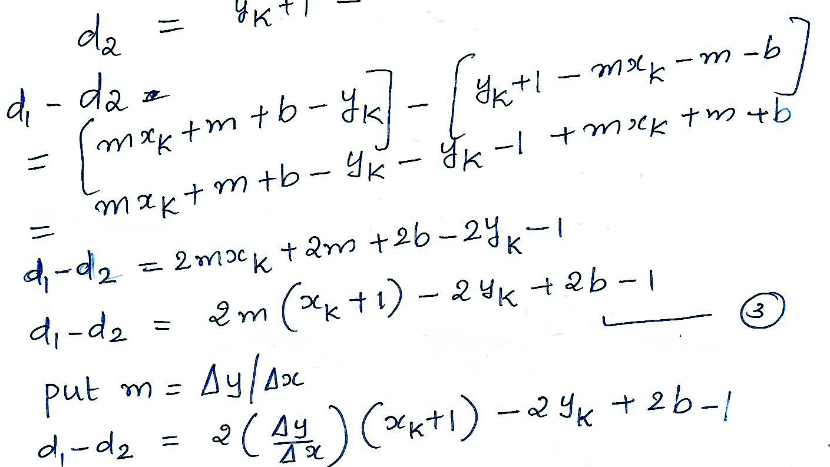

Slide 28
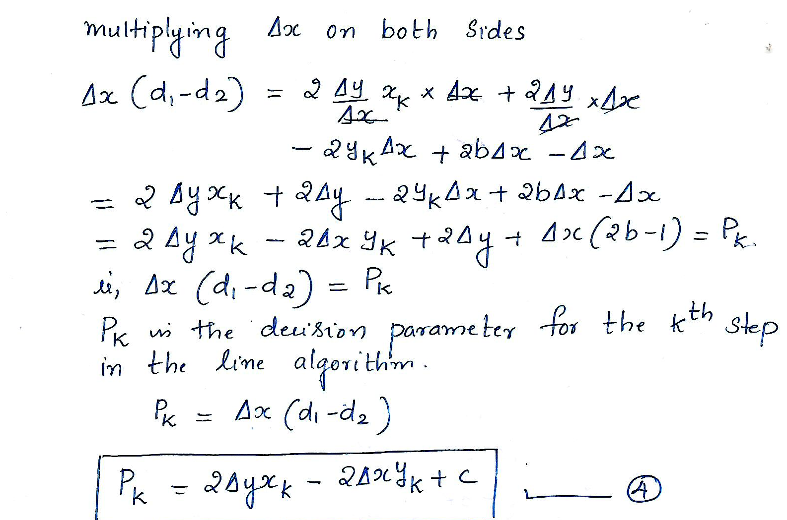

Slide 29
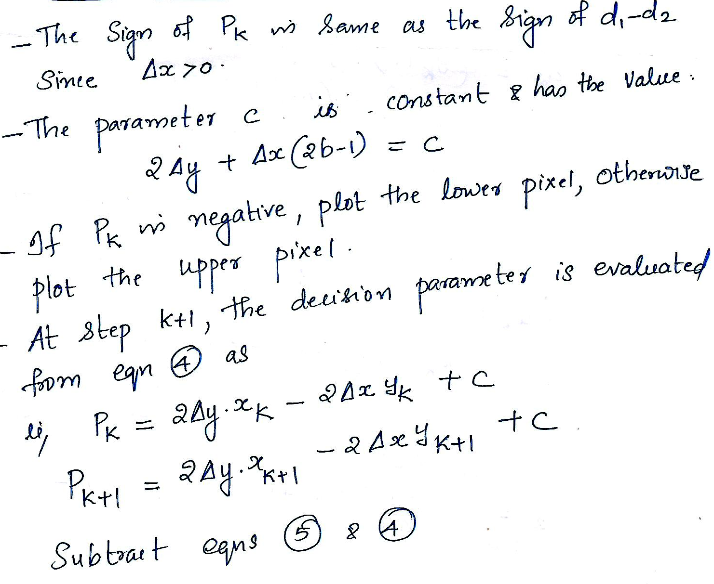

Slide 30
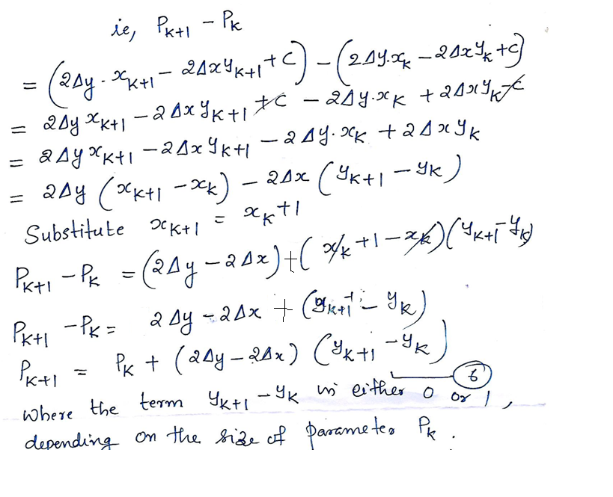
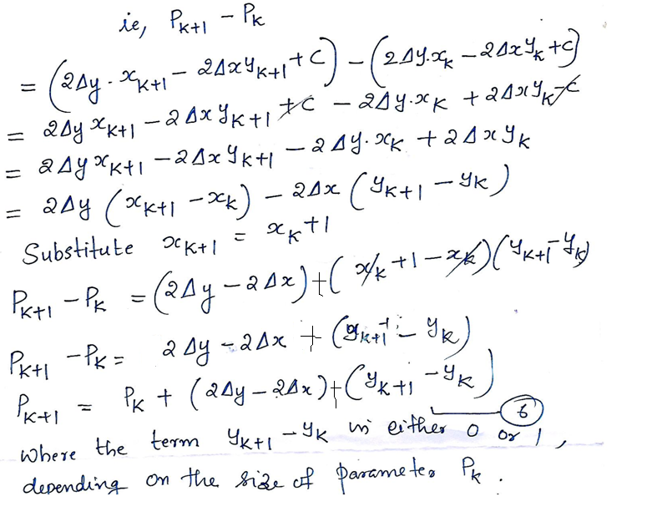
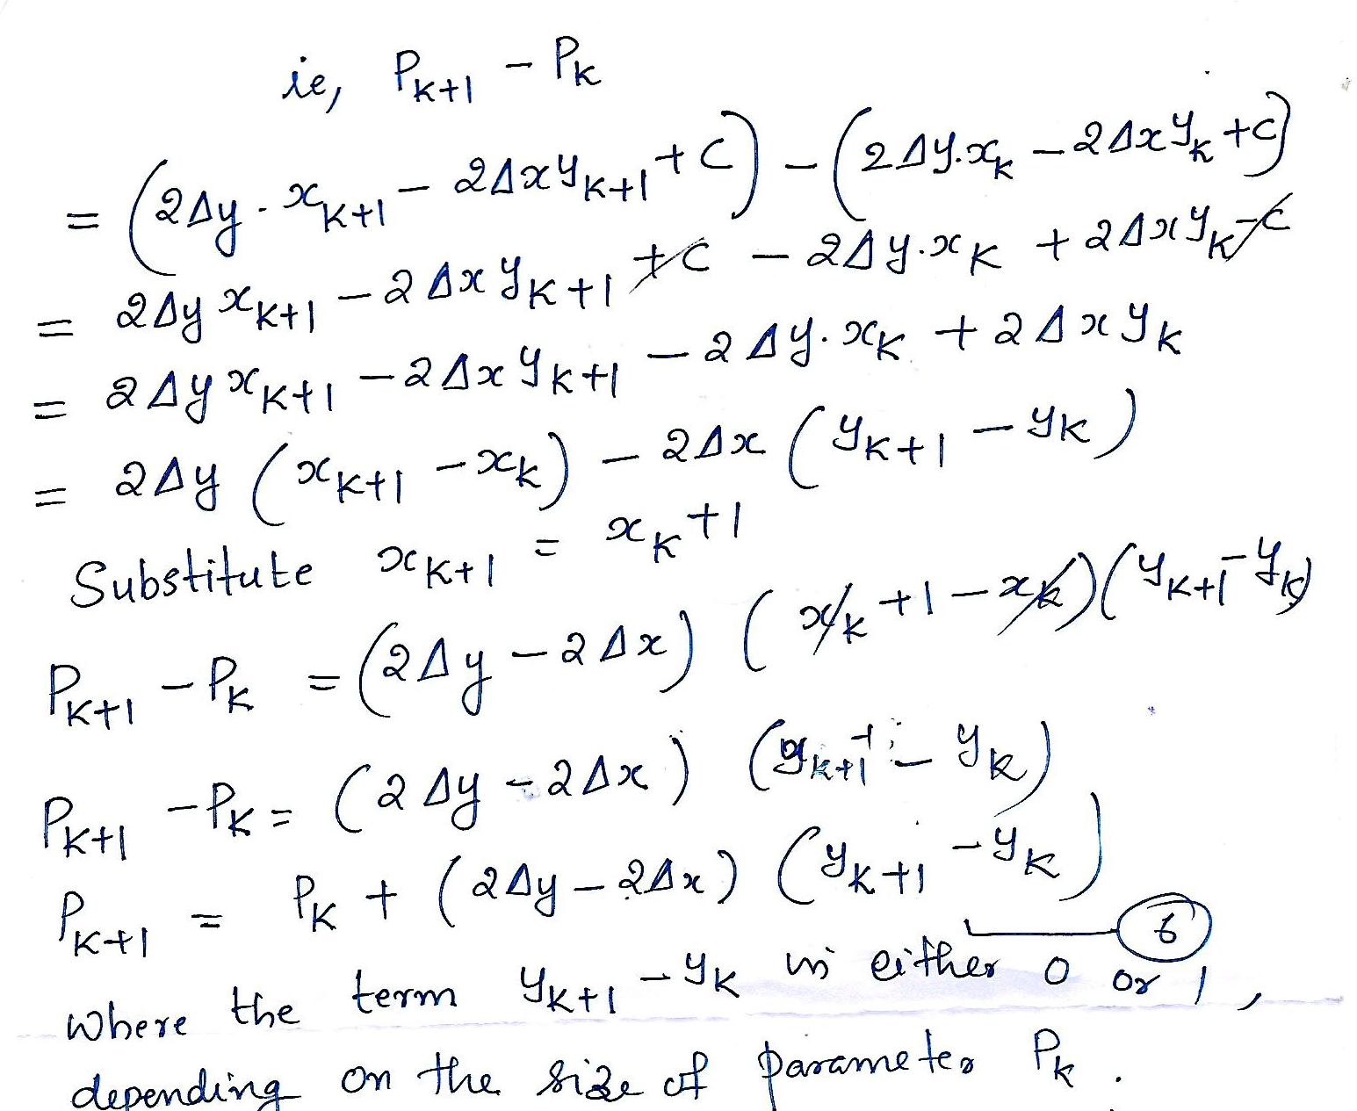

Slide 31
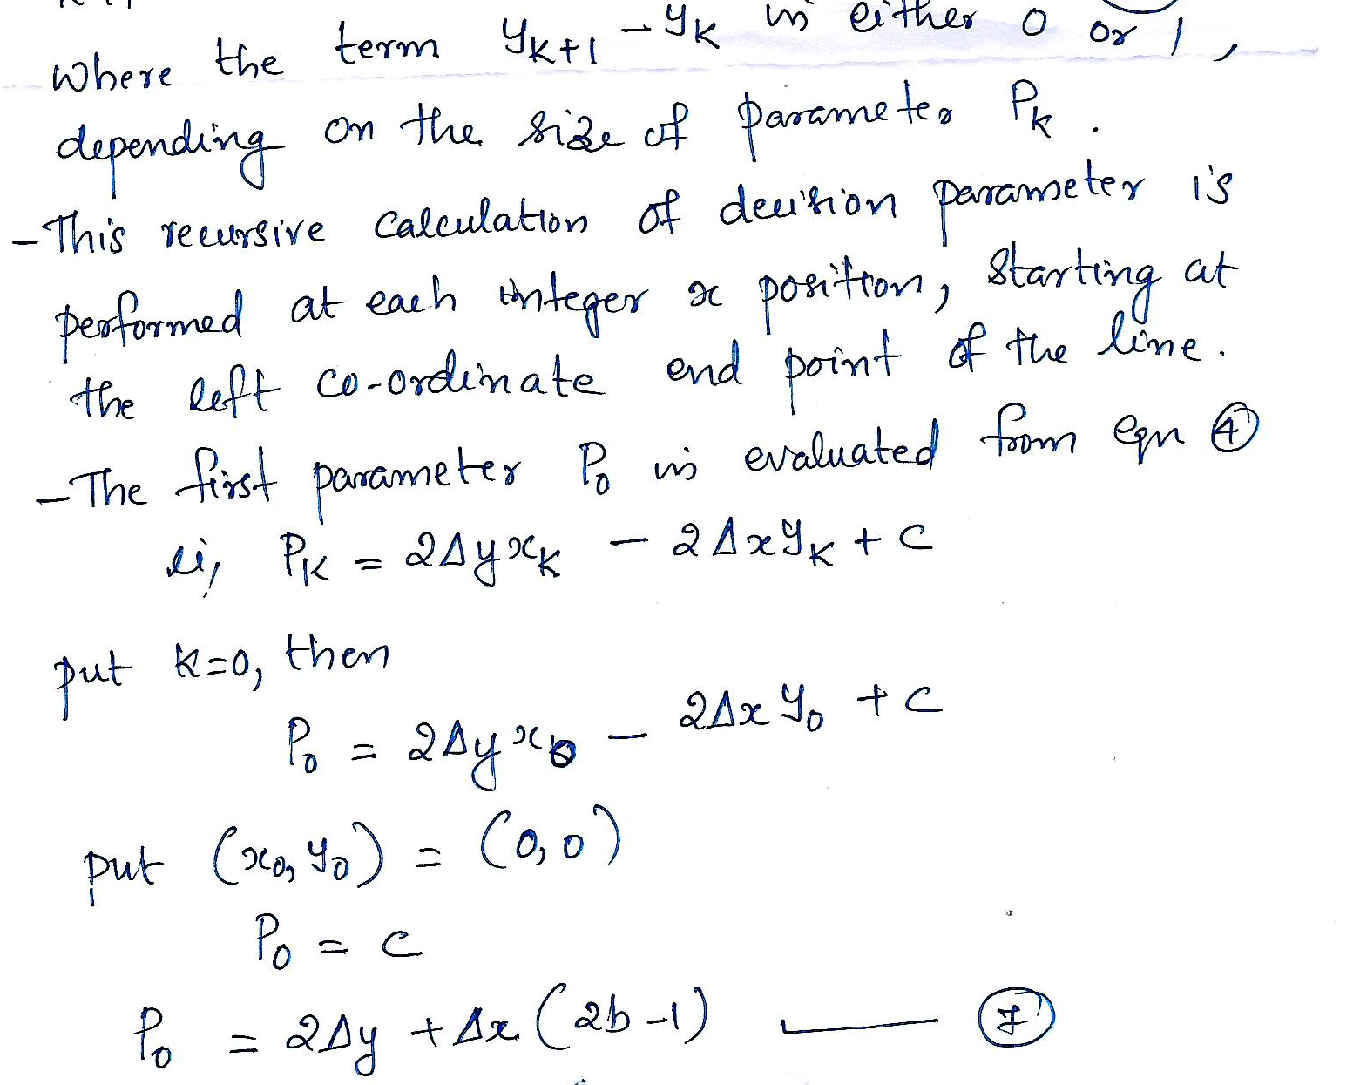

Slide 32
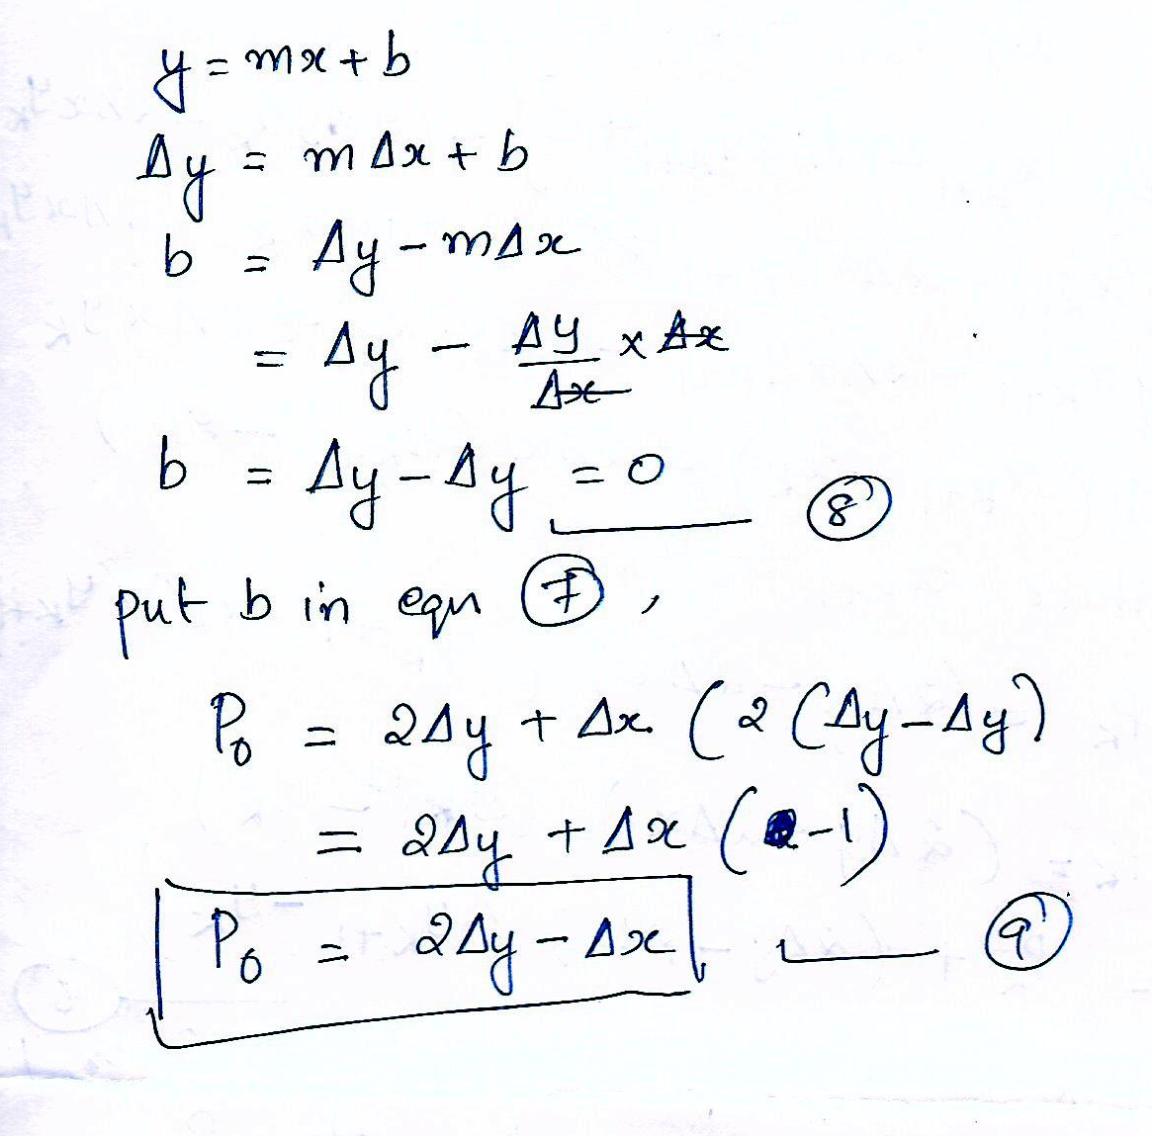

Slide 33
Bresenham’s line drawing algorithm for |m| < 1
Input the two line end points and store the left endpoint in ( x₀, y₀)
Load (x₀,y₀) into the frame buffer; that is plot the first point.
Calculate constants ∆x,∆y,2∆y – 2∆x, and the obtain the starting value for the decision parameters as p₀= 2∆y- ∆x
At each x_{k} along the line , starting at k= 0 perform the following test
if p _{k} < 0 the next point to plot is ( x_{k} + 1, y_{k} )
and
p_{k + 1} = p_{k} + 2∆y
otherwise the next point to plot is (x_{k} +1, y_{k} +1) and
p_{k + 1} = p_{k} + 2∆y - 2∆x
Repeat step 4, ∆x times

Slide 34
To illustrate the algorithm, digitize the line with endpoints (20, 10) and (30, 18) this line has a slope of 0.8 with ∆x=10, ∆y=8
the initial decision parameter has the value
p₀= 2∆y- ∆x = 6
and increments for calculating successive decision parameters are 2∆y = 16 , 2∆y- 2∆x = -4
plot the initial point ( x₀, y₀) = (20,10) and determine successive pixel position along the line path from the decision parameter as

Slide 35
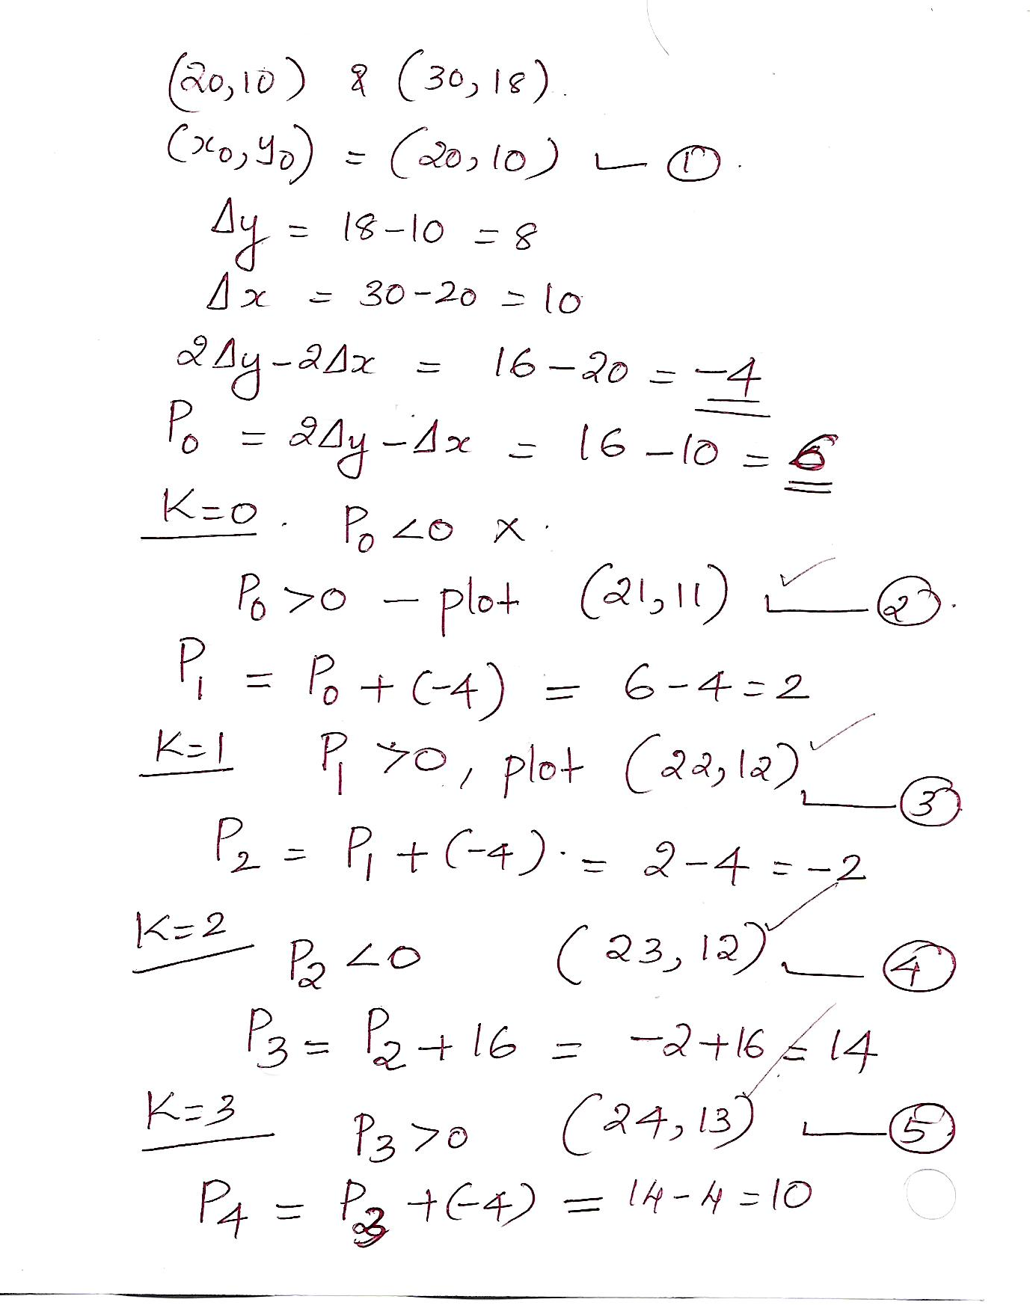

Slide 36
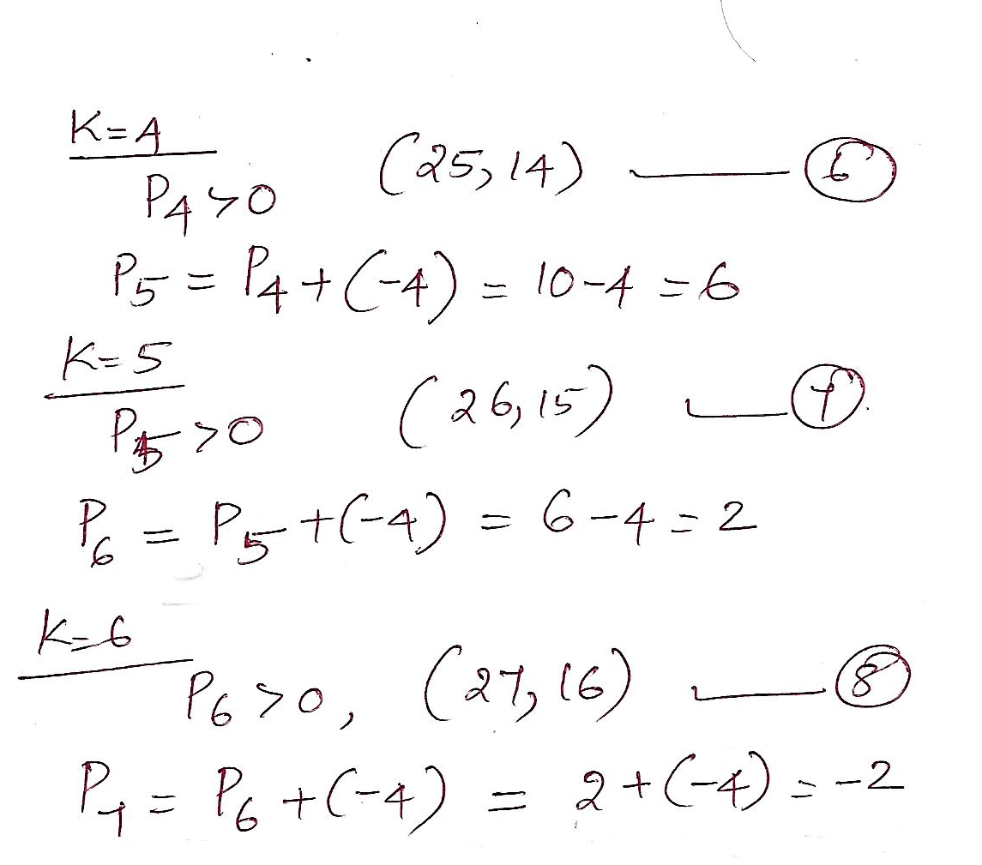

Slide 37
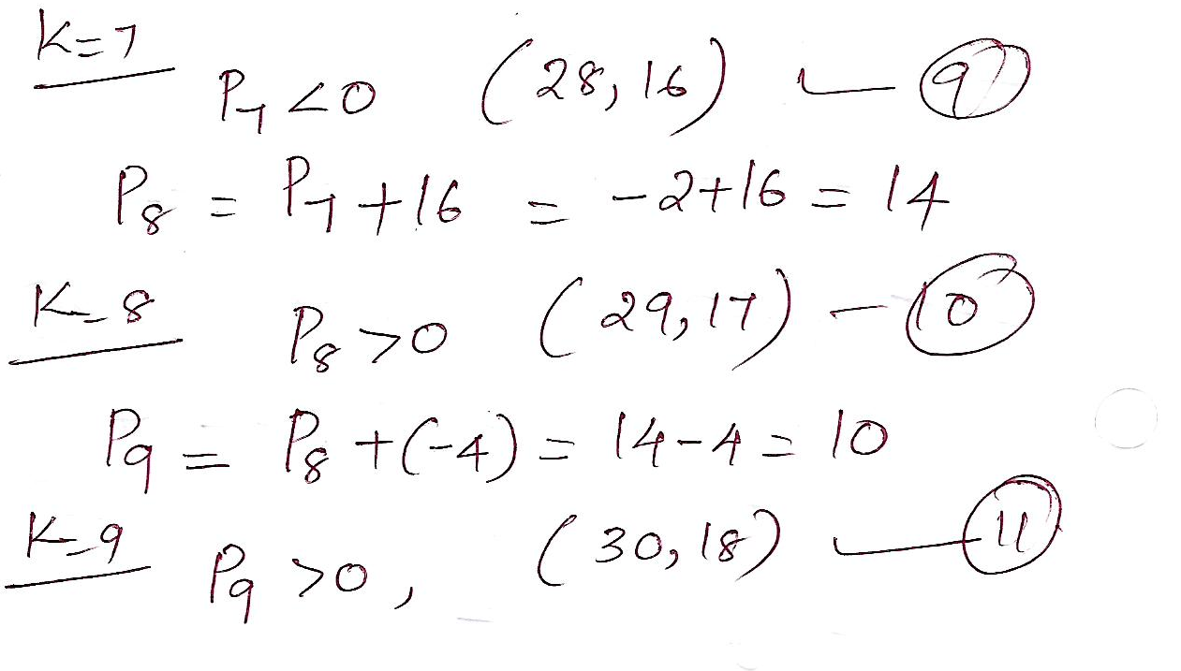

Slide 38
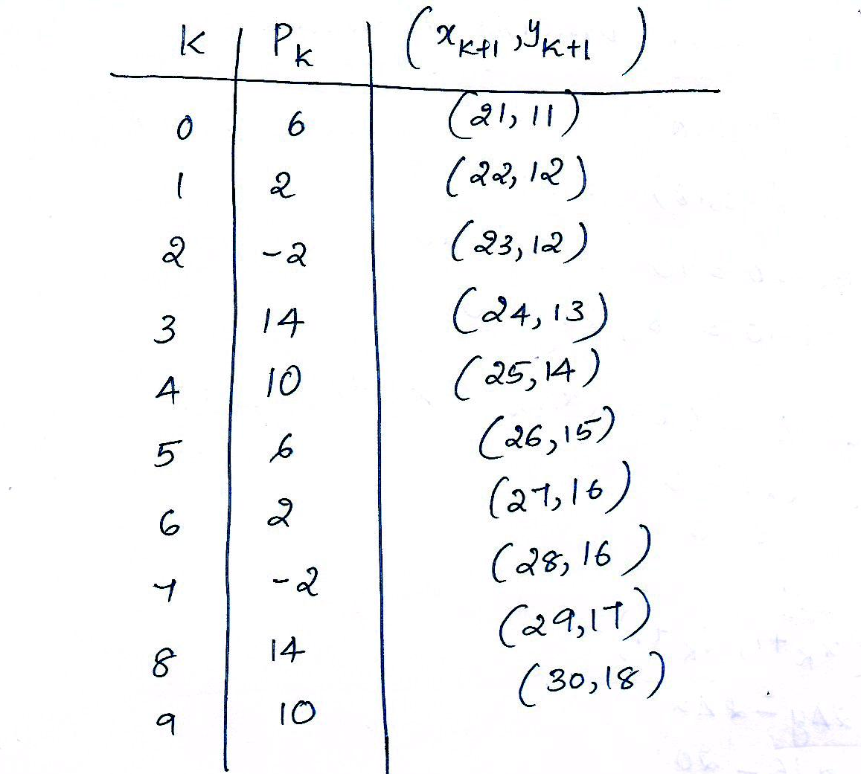

Slide 39
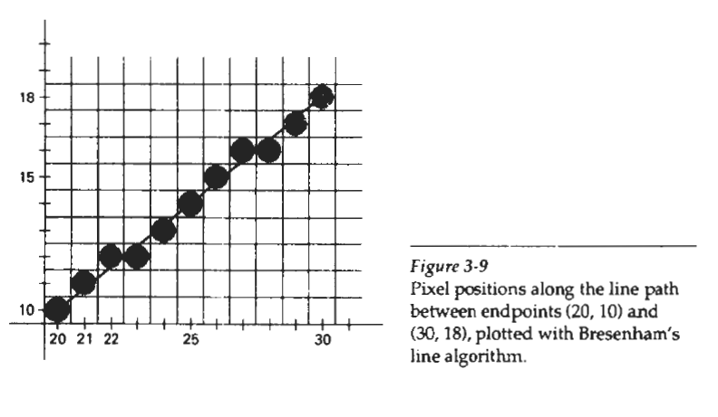

Slide 40
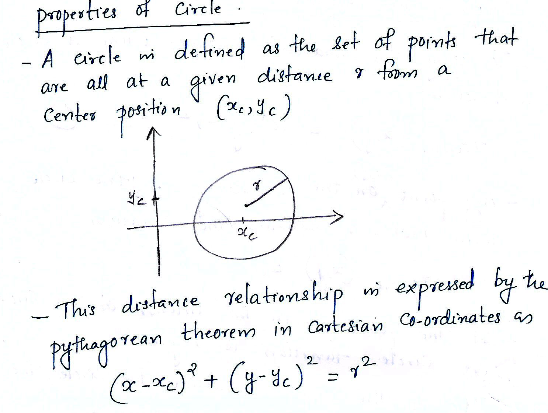
CIRCLE GENERATING ALGORITHMS

Slide 41
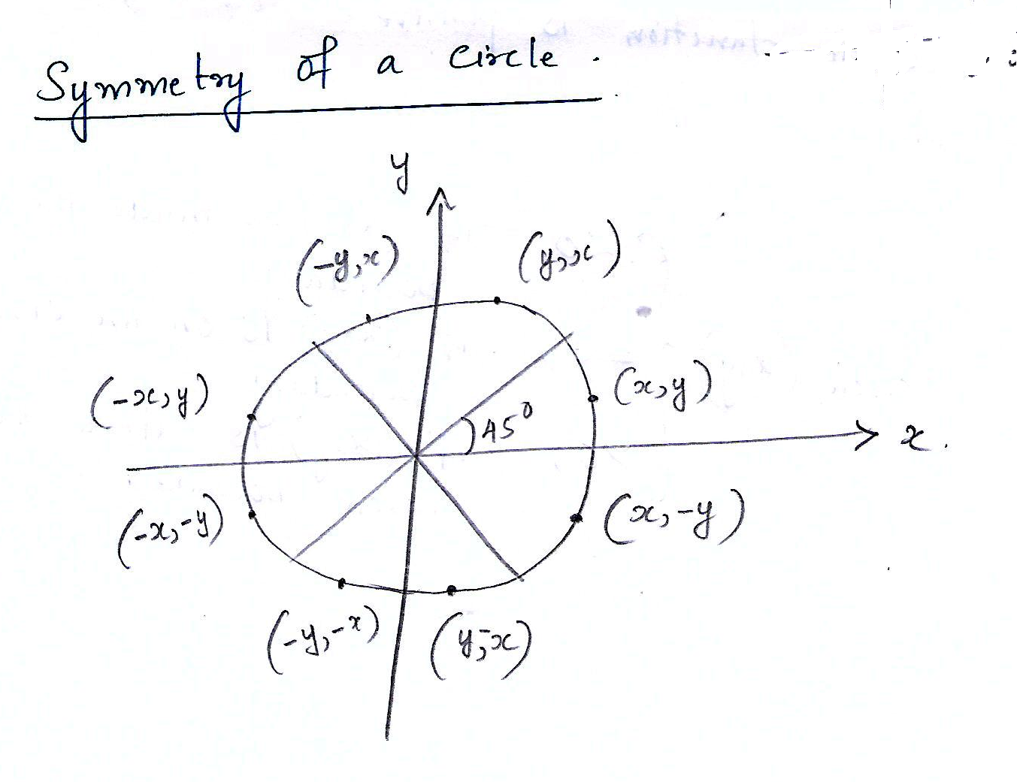

Slide 42
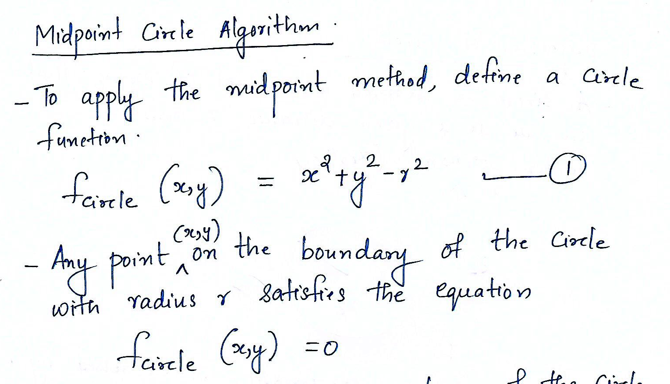

Slide 43
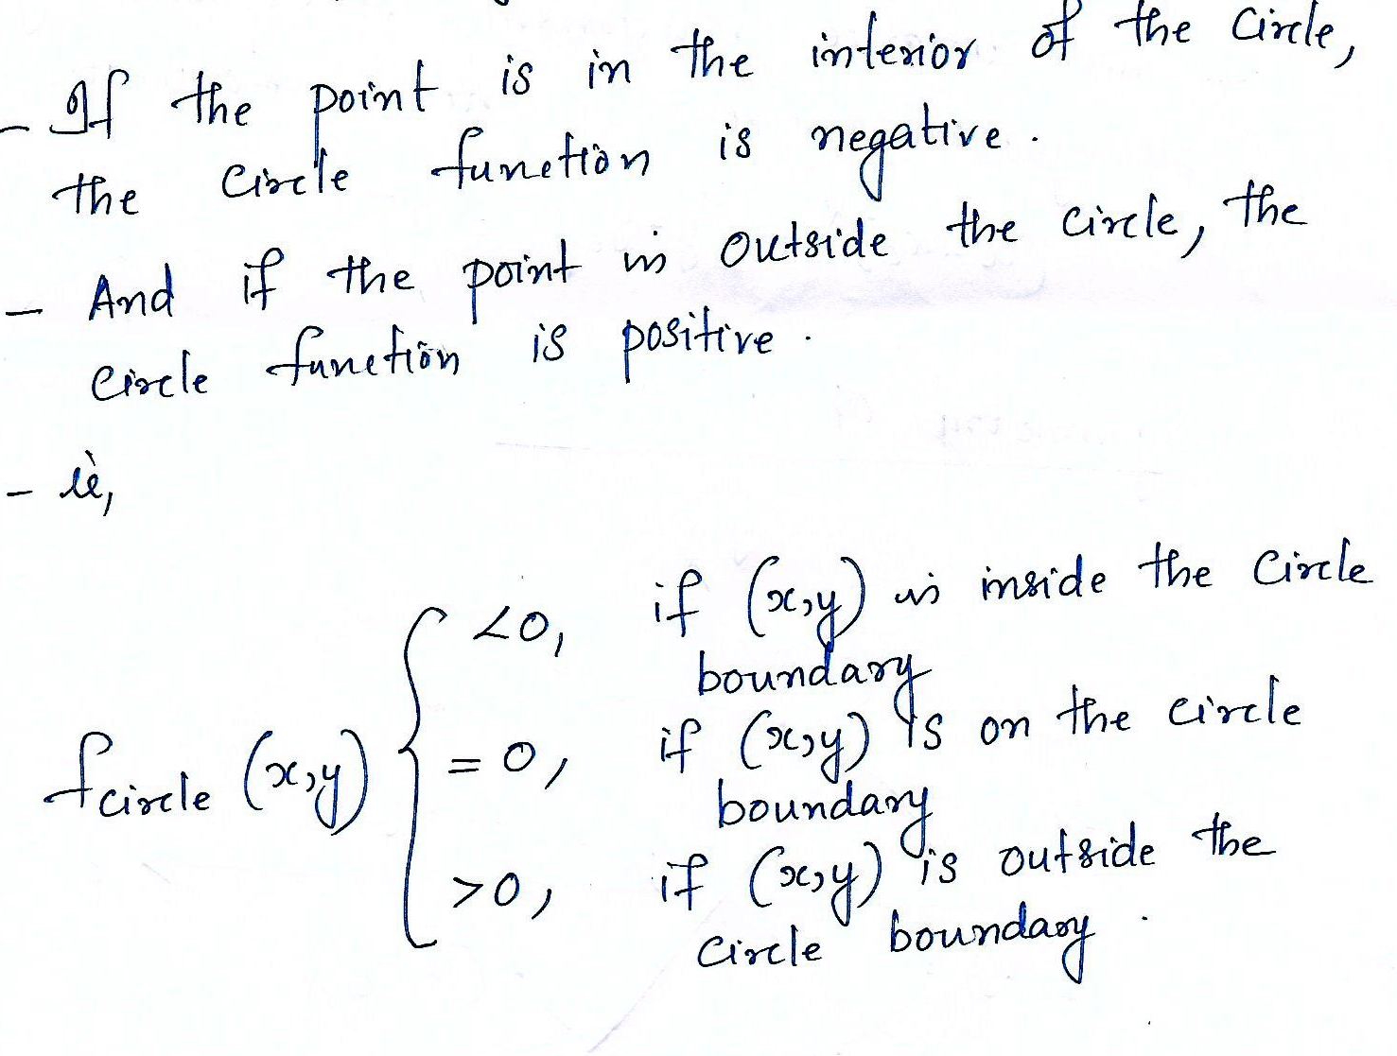

Slide 44
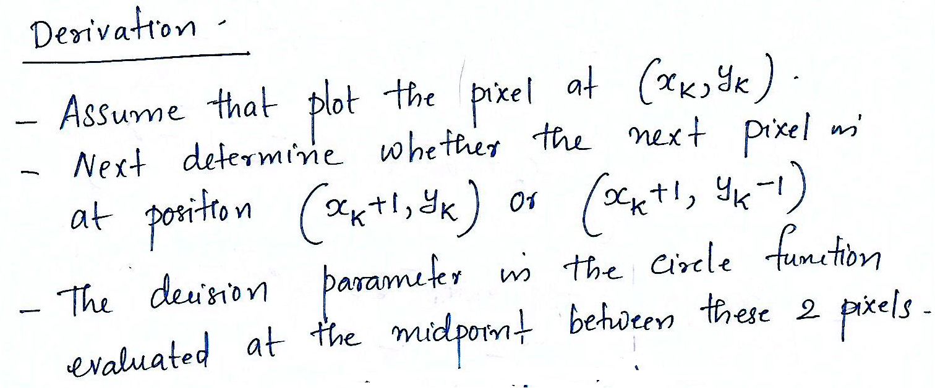

Slide 45
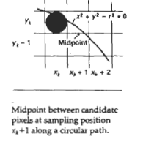

Slide 46
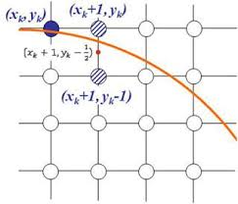

Slide 47
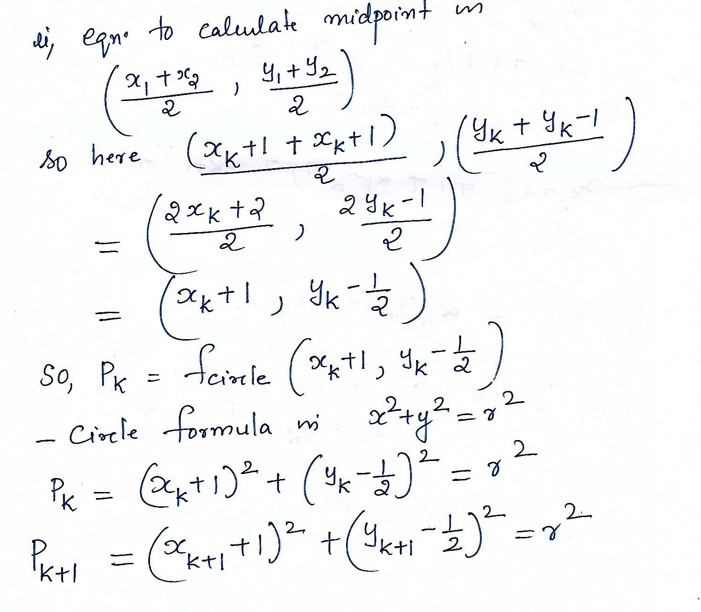

Slide 48
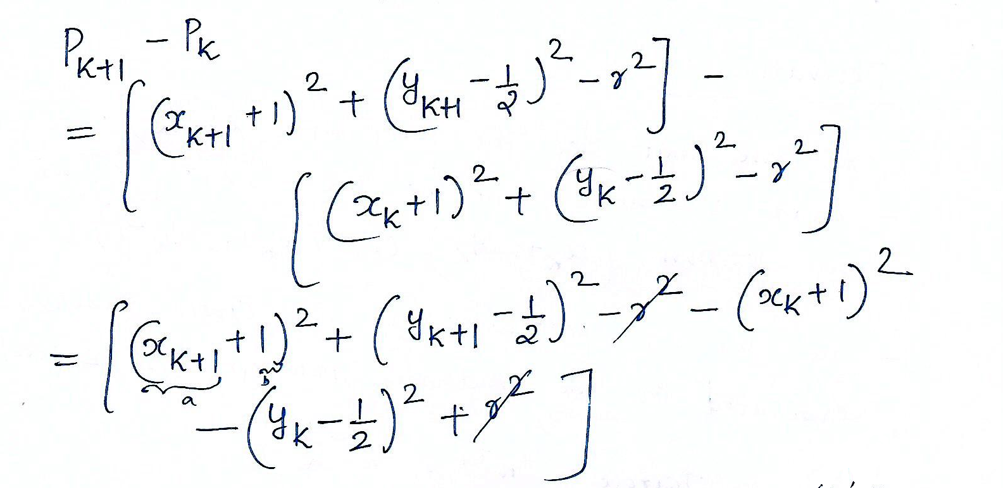

Slide 49
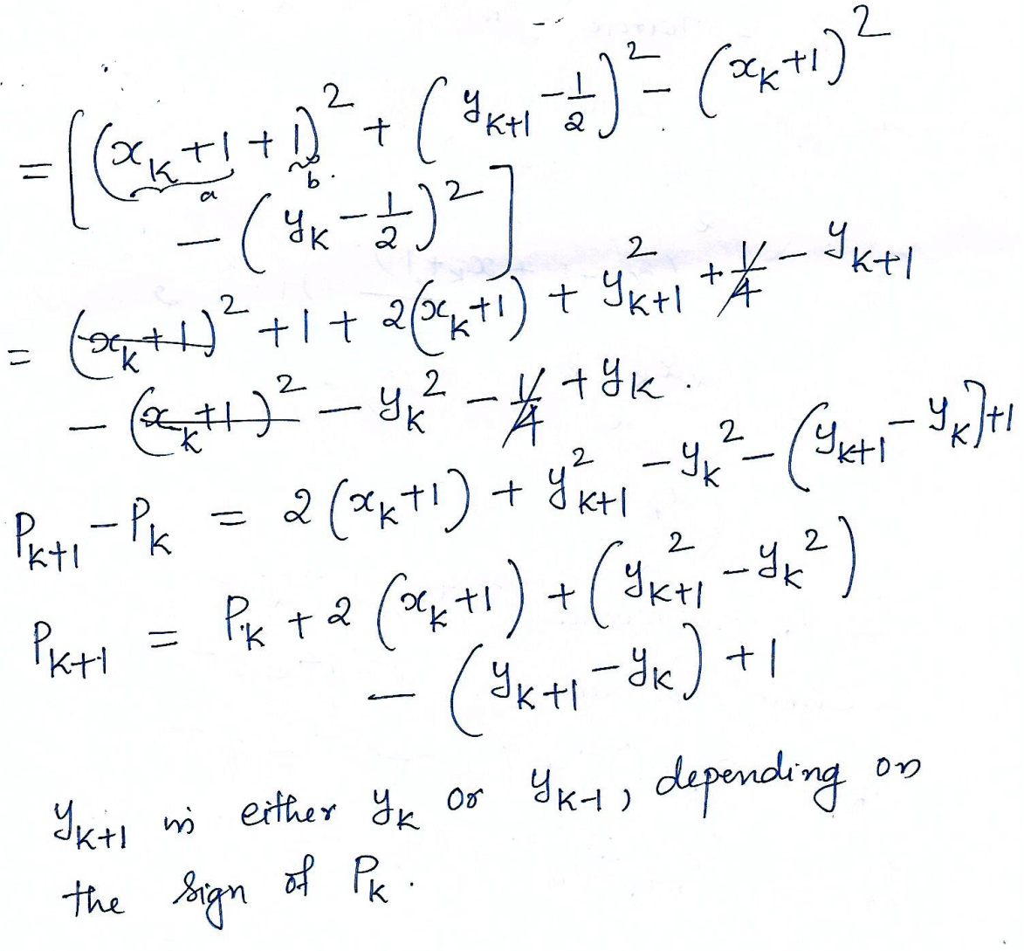

Slide 50
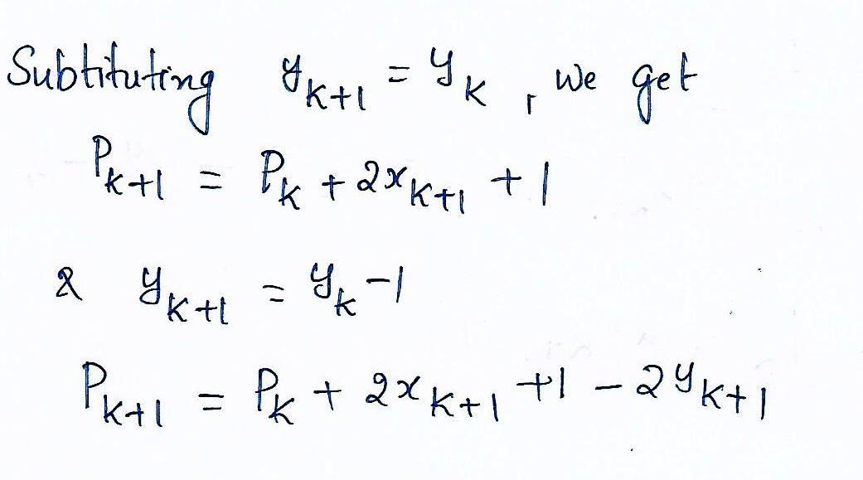

Slide 51
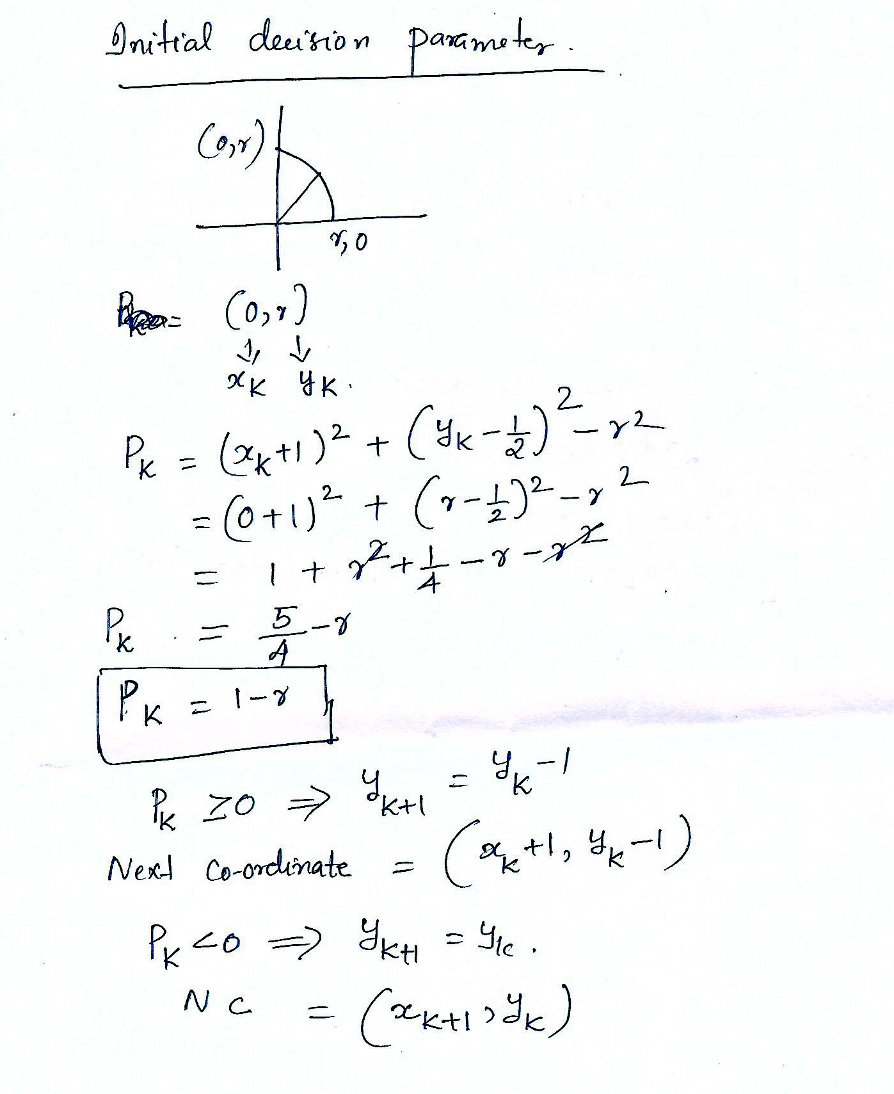

Slide 52
Midpoint circle algorithm (1)
1) Input radius r an circle center (x_{c,} y_{c}) and obtain the first point on the circumference of the circle centered on origin as (x₀,y₀) = r
2) Calculate the initial value of the decision parameter as
p₀ = 5/4 - r

Slide 53
Midpoint circle algorithm (2)
3) At each x_{k} position starting at k = 0 , perform following test
If p_{k} <0 , the next point along the circle centered on (0,0) is (x_{k}+1, y) and
p_{k + 1} = p_{k}+2x_{k+1} +1
Otherwise the next point on the circle is (x_{k} + 1,, y_{k} -1) and
p_{k + 1} = p_{k} + 2x_{k+1}+1 – 2y_{k+1}
where 2x_{k+1} = 2 x_{k}+2 and 2y_{k+1} = 2y_{k}-2

Slide 54
Midpoint circle algorithm (3)
4) Determine symmetry points in the other
seven octants
5) Move each pixel position (x,y) on to the circular path centered on (x_{c},y_{c}) and plot he co-ordinate values as
x=x + x_{c} and y= y + y_{c}
6) Repeat steps 3 through 5 until x>=y

Slide 55
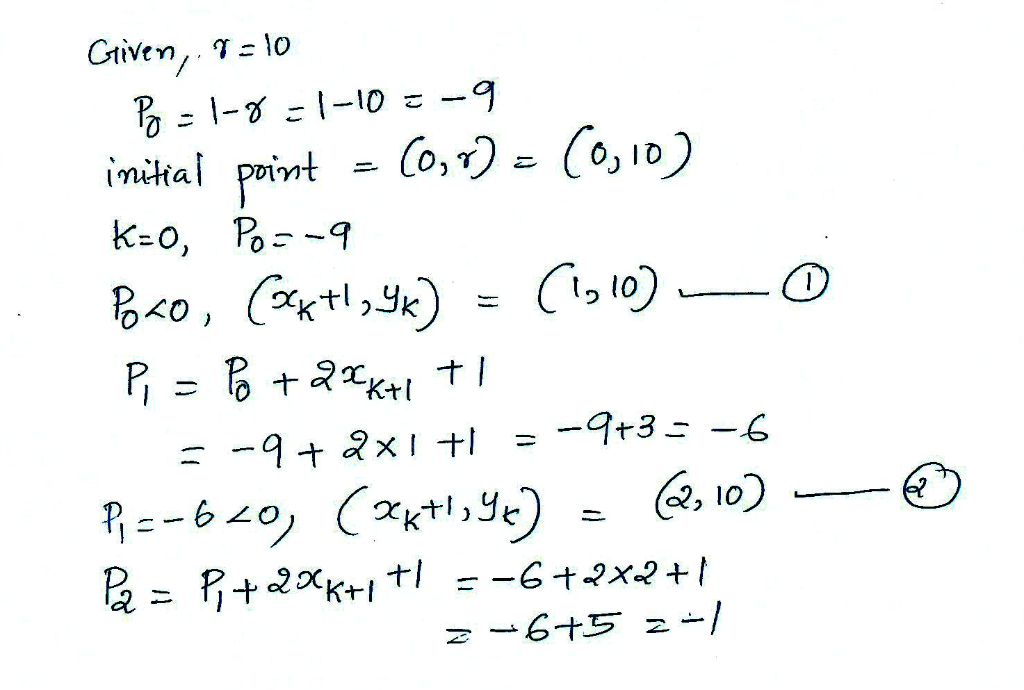
Given a circle radius r = 10 , demonstrate the mid point circle generating algorithm by determining positions along the circle octant in the first quadrant from x =0 to x = y.

Slide 56
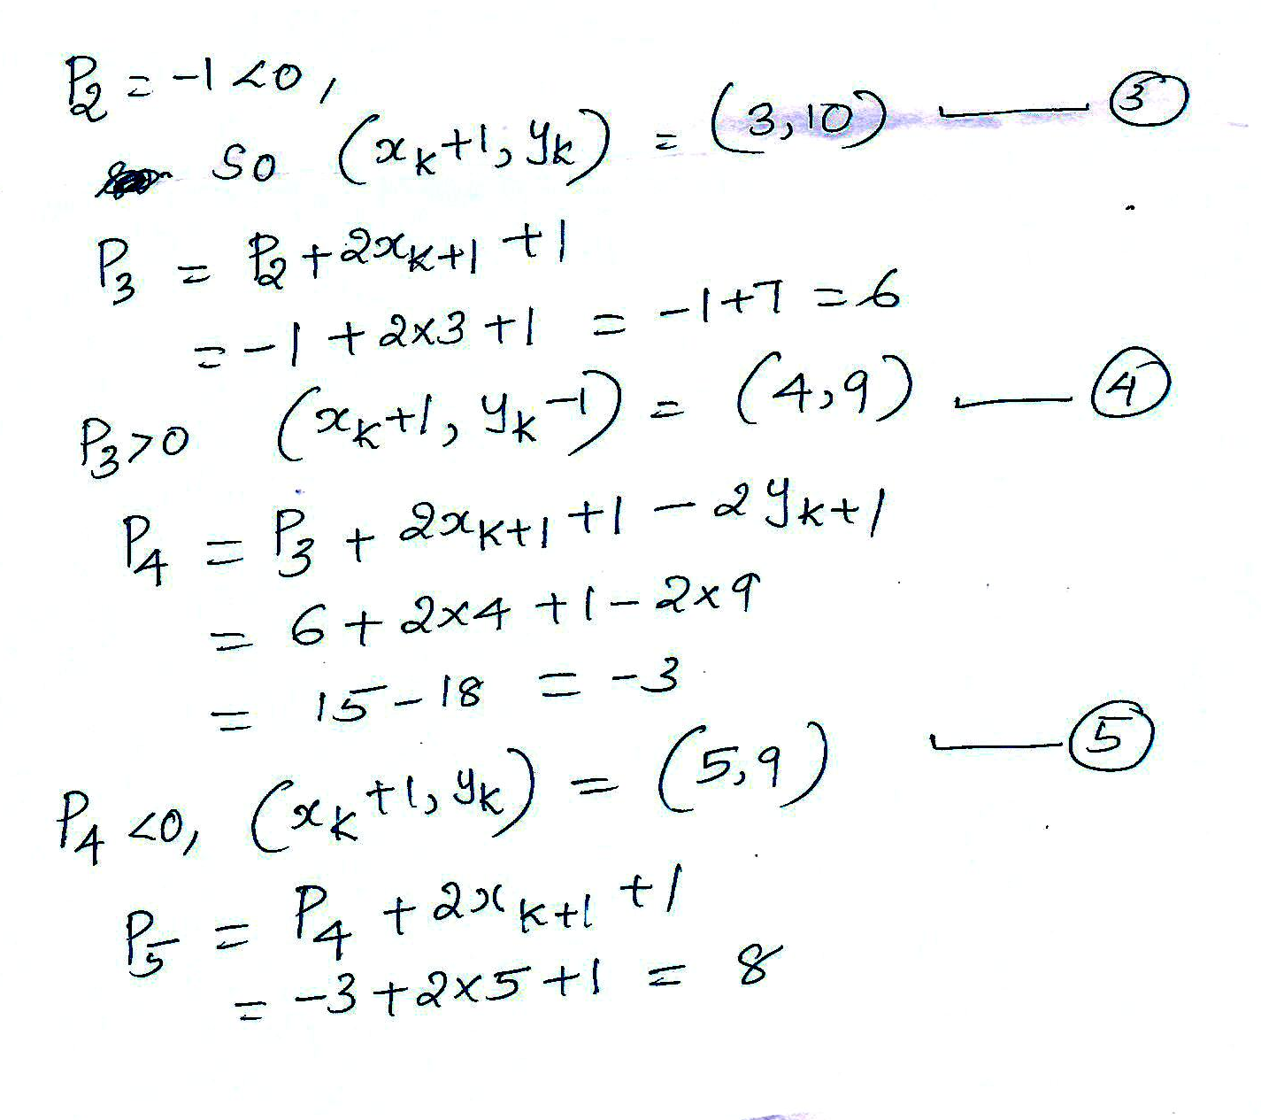

Slide 57
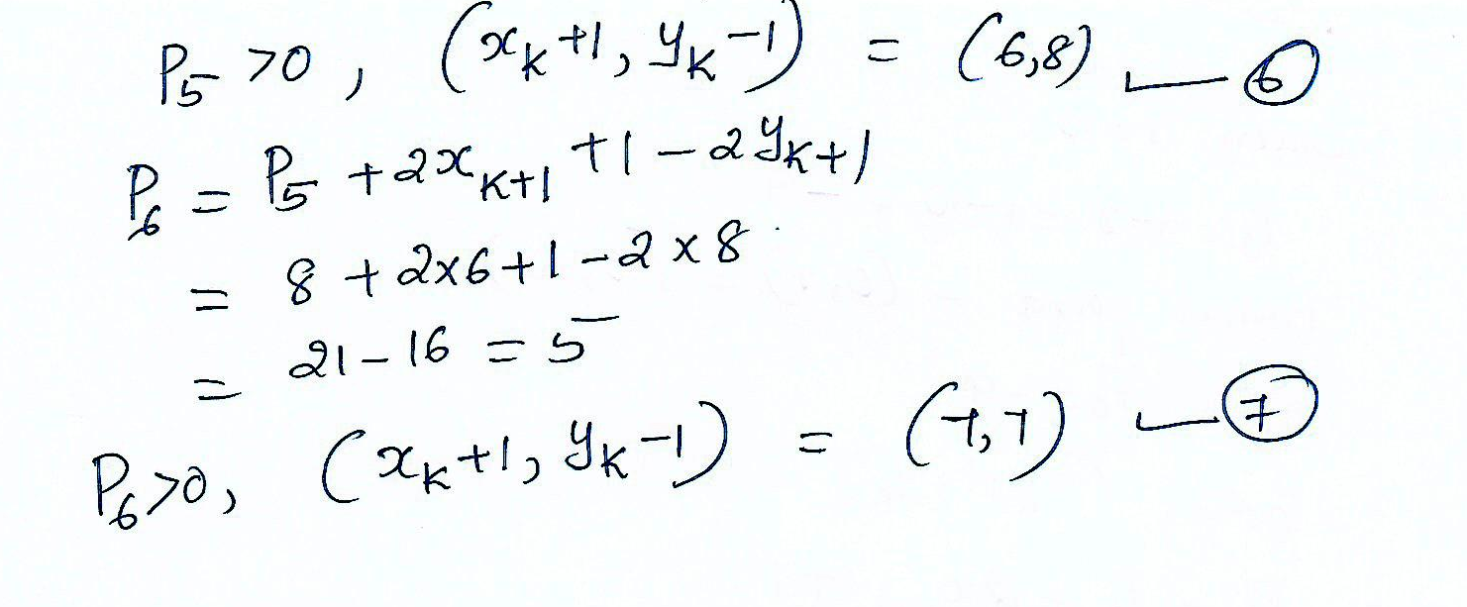

Slide 58
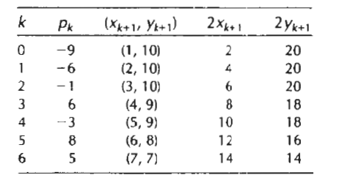

Slide 59
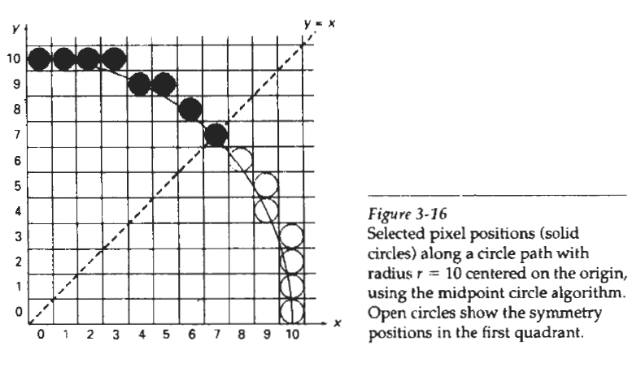

Slide 60
Filled - Area Primitives
(polygon filling)
Seed Fill Approaches
  2 algorithms: Boundary Fill and Flood Fill
  works at the pixel level
  suitable for interactive painting aplications
Scanline Fill Approaches
  works at the polygon level
  better performance

Slide 61
Seed Fill Approaches
Start from a given interior point (seed point) and paint outward from this point until the specified condition is encountered.
  2 algorithms: Boundary Fill and Flood Fill
  works at the pixel level

Slide 62
Scan line Fill Approaches
Fill an area by determining the overlap intervals for scan lines that cross that area.
  used in general graphics packages to fill polygons, circles etc.
  better performance.

Slide 63
Boundary Fill Algorithm
Starts from a seed point inside the region.
Paint the interior outward to the boundary.
Fill algorithm proceeds outward pixel by pixel until the boundary colour is encountered.
The edge must be specified in a single color.

Slide 64
The procedure accepts the coordinates of an interior point ( x, y), fill colour and a boundary colour as input .
Starting from (x, y) the procedure tests neighbouring positions to determine whether they are of the boundary colour.
If not paint them with fill colour and test their neighbours and process continues until all pixels up to the boundary colour for the area have been tested.

Slide 65
There are 2 methods for proceeding to neighbouring pixels from the current test positions.
4 connected method.
8 connected method.

Slide 66
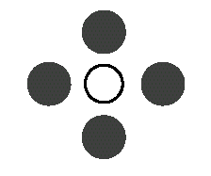
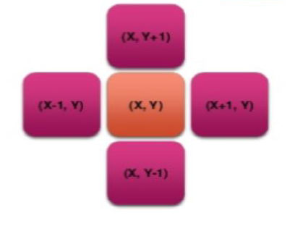
4-connected region: From a given pixel, the region that you can get to by a series of 4 way moves (N, S, E and W).
The neighbouring 4 pixel positions are tested.
If the selected pixel is (x, y) the neighbouring pixels are (x+1, y) , (x-1, y)
(x, y+1) , (x, y-1)
4-connected fill is faster
4-connected

Slide 67
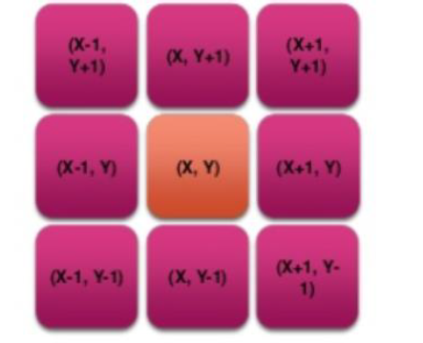
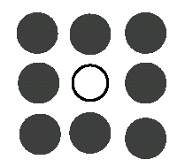
8-connected region: From a given pixel, the region that you can get to by a series of 8 way moves (N, S, E, W, NE, NW, SE, and SW), the 4 diagonal pixels are also included.
If the selected pixel is (x, y) the 8 neighbouring pixels are
(x-1, y+1), (x, y+1) (x+1, y+1)
(x-1, y-1), (x, y-1), (x+1, y-1)
(x-1, y), (x+1, y)
8-connected

Slide 68
Boundary Fill Algorithm
void BoundaryFill4(int x, int y, int fillcolor, int boundarycolor)
{
int current;
current = getpixel(x, y);
if(current != boundarycolor && current != fillcolor)
{
putpixel(x, y, fillcolor);
BoundaryFill4(x+1, y, fillcolor, boundarycolor);
BoundaryFill4(x-1, y, fillcolor, boundarycolor);
BoundaryFill4(x, y+1, fillcolor, boundarycolor);
BoundaryFill4(x, y-1, fillcolor, boundarycolor);
}
}

Slide 69
Flood Fill Algorithm
Used when an area defined with multiple color boundaries.
Start at seed point inside a region
Replace a specified interior color (old color) with fill color instead of searching for a boundary color value and the method is called flood fill.

Slide 70
Start from a specified interior point (x, y) and reassign all pixel values that are set to a given interior color with the desired fill color.
Fill the 4-connected or 8-connected region until all interior points being replaced.

Slide 71
Flood Fill Algorithm
void FloodFill4(int x, int y, int newcolor, int oldColor)
{
if(getPixel(x, y) == oldColor)
{
putpixel(x,y,newcolor);
FloodFill4(x+1, y, newcolor, oldColor);
FloodFill4(x-1, y, newcolor, oldColor);
FloodFill4(x, y+1, newcolor, oldColor);
FloodFill4(x, y-1, newcolor, oldColor);
}
}

Slide 72
Flood Fill & Boundary Fill
Similarities
  Seed fill approach
  Both starts from a seed point
  Both supports 4 connected and 8 connected approach
  Uses recursive function

Slide 73
Differences
Boundary Fill
Flood Fill
Check whether current pixel is of boundary color .If not it will color with new color
Only single colored boundary possible
Arguments to the function are seed point,new color and boundary color
Check whether current pixel is of old color .If so it will color with new color
Can have multiple color boundary
Arguments to the function are seed point, new color and old color

Slide 74
Module II
Line Drawing Algorithm- DDA, Bresenham’s algorithm – Circle Generation Algorithms –Mid point circle algorithm, Bresenham’s algorithm- Scan Conversion-frame buffers – solid area scan conversion – polygon filling algorithms

Slide 75
LINE-DRAWING ALGORITHMS
The Cartesian slope-intercept equation for a straight line is y = m.x + b (1)
m - slope of the line & b is the y intercept
Given that the two endpoints of a line segment are specified at positions (x₁, y₁) and (x₂, y₂),

Slide 76
  we can determine values for the slope m and y intercept b with the following calculations:
  m = (y2-y1)/(x2-x1) (2)
  b = y1 – m.x1 (3)
Algorithms for displaying straight lines are based on the line equation (1) & the calculations given in Eqs. (2) & (3).
For any given x interval ∆x along a line, we can compute the corresponding y interval from (2) as
∆y = m∆x (4)
Similarly, ∆x=∆y/m (5)

Slide 79
DDA line drawing algorithm
The digital differential analyzer (DDA) is an incremental scan-conversion line algorithm
calculating either ∆y or ∆x
performing calculations at each step using results from the preceding step.

Slide 80
DDA line drawing algorithm
Consider first a line with positive slope
If the slope is less than or equal to 1,
we sample at unit x intervals
and compute each successive y value as
Subscript k takes integer values starting from 1, for the first point, and increases by 1 until the final endpoint is reached.
Since m can be any real number between 0 and 1, the calculated y values must be rounded to the nearest integer.

Slide 82
For lines with a positive slope greater than 1, we reverse the roles of x and y.
That is, we sample at unit y intervals
calculate each succeeding x value as

Slide 85
the above equations are based on the assumption that lines are to be processed from the left endpoint to the right endpoint .
If this processing is reversed, so that the starting endpoint is at the right, then either we have
or (when the slope is greater than I) we have

Slide 86
These equations can also be used to calculate pixel positions along a line with negative slope.
If the absolute value of the slope is less than I and the start endpoint is at the left, we set
and calculate y values with
When the start endpoint is at the right (for the same slope), we set
and calculate x values with

Slide 87
DDA Algorithm
void lineDDA( int xa,intya,int xb, int yb)
{
int dx=xb-xa, dy=yb-ya ,steps, k ;
float xIncrement , yIncrement, x=xa, y=ya ;
if(abs(dx)> abs(dy))
steps = abs(dx) ;
else
steps = abs(dy) ;
xIncrement= dx/(float) steps ;
yIncrement= dy/(float) steps ;
setPixel(ROUND(x), ROUND(y)) ;
for(k=0 ;k<steps ;k++){
x +=xIncrement ;
y +=yIncrement ;
setPixel(ROUND(x), ROUND(y)) ;
}
}

Slide 88
Advantages of DDA
Faster than direct use of line equation
Does not do any floating point application

Slide 89
Disadvantages of DDA
Drift away from actual line path because rounding off float value to integer
Causes jaggies or stair-step effect
Floating point addition is still needed
Precision loss because of rounding off
Pixels drift farther apart if line is relatively larger

Slide 90
Consider a line from (2,3) to (8,10). Using simple DDA Algorithm, rasterize this line

Slide 94
Consider a line from (0,0) to (6,7). Using simple DDA Algorithm, rasterize this line

Slide 95
Bresenham’s line algorithms
an accurate and efficient raster line generating algorithms
developed by bresenham
scan converts lines using only incremental integer calculations that can be adapted to display circles and other curves

Slide 104
Bresenham’s line drawing algorithm for |m| < 1
Input the two line end points and store the left endpoint in ( x₀, y₀)
Load (x₀,y₀) into the frame buffer; that is plot the first point.
Calculate constants ∆x,∆y,2∆y – 2∆x, and the obtain the starting value for the decision parameters as p₀= 2∆y- ∆x
At each x_{k} along the line , starting at k= 0 perform the following test
if p _{k} < 0 the next point to plot is ( x_{k} + 1, y_{k} )
and
p_{k + 1} = p_{k} + 2∆y
otherwise the next point to plot is (x_{k} +1, y_{k} +1) and
p_{k + 1} = p_{k} + 2∆y - 2∆x
Repeat step 4, ∆x times

Slide 105
To illustrate the algorithm, digitize the line with endpoints (20, 10) and (30, 18) this line has a slope of 0.8 with ∆x=10, ∆y=8
the initial decision parameter has the value
p₀= 2∆y- ∆x = 6
and increments for calculating successive decision parameters are 2∆y = 16 , 2∆y- 2∆x = -4
plot the initial point ( x₀, y₀) = (20,10) and determine successive pixel position along the line path from the decision parameter as

Slide 111
CIRCLE GENERATING ALGORITHMS

Slide 123
Midpoint circle algorithm (1)
1) Input radius r an circle center (x_{c,} y_{c}) and obtain the first point on the circumference of the circle centered on origin as (x₀,y₀) = r
2) Calculate the initial value of the decision parameter as
p₀ = 5/4 - r

Slide 124
Midpoint circle algorithm (2)
3) At each x_{k} position starting at k = 0 , perform following test
If p_{k} <0 , the next point along the circle centered on (0,0) is (x_{k}+1, y) and
p_{k + 1} = p_{k}+2x_{k+1} +1
Otherwise the next point on the circle is (x_{k} + 1,, y_{k} -1) and
p_{k + 1} = p_{k} + 2x_{k+1}+1 – 2y_{k+1}
where 2x_{k+1} = 2 x_{k}+2 and 2y_{k+1} = 2y_{k}-2

Slide 125
Midpoint circle algorithm (3)
4) Determine symmetry points in the other
seven octants
5) Move each pixel position (x,y) on to the circular path centered on (x_{c},y_{c}) and plot he co-ordinate values as
x=x + x_{c} and y= y + y_{c}
6) Repeat steps 3 through 5 until x>=y

Slide 126
Given a circle radius r = 10 , demonstrate the mid point circle generating algorithm by determining positions along the circle octant in the first quadrant from x =0 to x = y.

Slide 131
Filled - Area Primitives
(polygon filling)
Seed Fill Approaches
  2 algorithms: Boundary Fill and Flood Fill
  works at the pixel level
  suitable for interactive painting aplications
Scanline Fill Approaches
  works at the polygon level
  better performance

Slide 132
Seed Fill Approaches
Start from a given interior point (seed point) and paint outward from this point until the specified condition is encountered.
  2 algorithms: Boundary Fill and Flood Fill
  works at the pixel level

Slide 133
Scan line Fill Approaches
Fill an area by determining the overlap intervals for scan lines that cross that area.
  used in general graphics packages to fill polygons, circles etc.
  better performance.

Slide 134
Boundary Fill Algorithm
Starts from a seed point inside the region.
Paint the interior outward to the boundary.
Fill algorithm proceeds outward pixel by pixel until the boundary colour is encountered.
The edge must be specified in a single color.

Slide 135
The procedure accepts the coordinates of an interior point ( x, y), fill colour and a boundary colour as input .
Starting from (x, y) the procedure tests neighbouring positions to determine whether they are of the boundary colour.
If not paint them with fill colour and test their neighbours and process continues until all pixels up to the boundary colour for the area have been tested.

Slide 136
There are 2 methods for proceeding to neighbouring pixels from the current test positions.
4 connected method.
8 connected method.

Slide 137
4-connected region: From a given pixel, the region that you can get to by a series of 4 way moves (N, S, E and W).
The neighbouring 4 pixel positions are tested.
If the selected pixel is (x, y) the neighbouring pixels are (x+1, y) , (x-1, y)
(x, y+1) , (x, y-1)
4-connected fill is faster
4-connected

Slide 138
8-connected region: From a given pixel, the region that you can get to by a series of 8 way moves (N, S, E, W, NE, NW, SE, and SW), the 4 diagonal pixels are also included.
If the selected pixel is (x, y) the 8 neighbouring pixels are
(x-1, y+1), (x, y+1) (x+1, y+1)
(x-1, y-1), (x, y-1), (x+1, y-1)
(x-1, y), (x+1, y)
8-connected

Slide 139
Boundary Fill Algorithm
void BoundaryFill4(int x, int y, int fillcolor, int boundarycolor)
{
int current;
current = getpixel(x, y);
if(current != boundarycolor && current != fillcolor)
{
putpixel(x, y, fillcolor);
BoundaryFill4(x+1, y, fillcolor, boundarycolor);
BoundaryFill4(x-1, y, fillcolor, boundarycolor);
BoundaryFill4(x, y+1, fillcolor, boundarycolor);
BoundaryFill4(x, y-1, fillcolor, boundarycolor);
}
}

Slide 140
Flood Fill Algorithm
Used when an area defined with multiple color boundaries.
Start at seed point inside a region
Replace a specified interior color (old color) with fill color instead of searching for a boundary color value and the method is called flood fill.

Slide 141
Start from a specified interior point (x, y) and reassign all pixel values that are set to a given interior color with the desired fill color.
Fill the 4-connected or 8-connected region until all interior points being replaced.

Slide 142
Flood Fill Algorithm
void FloodFill4(int x, int y, int newcolor, int oldColor)
{
if(getPixel(x, y) == oldColor)
{
putpixel(x,y,newcolor);
FloodFill4(x+1, y, newcolor, oldColor);
FloodFill4(x-1, y, newcolor, oldColor);
FloodFill4(x, y+1, newcolor, oldColor);
FloodFill4(x, y-1, newcolor, oldColor);
}
}

Slide 143
Flood Fill & Boundary Fill
Similarities
  Seed fill approach
  Both starts from a seed point
  Both supports 4 connected and 8 connected approach
  Uses recursive function

Slide 144
Differences
Boundary Fill
Flood Fill
Check whether current pixel is of boundary color .If not it will color with new color
Only single colored boundary possible
Arguments to the function are seed point,new color and boundary color
Check whether current pixel is of old color .If so it will color with new color
Can have multiple color boundary
Arguments to the function are seed point, new color and old color

