Slide 1
Andrew S Tanenbaum 4th Edition

Slide 2
Syllabus
Module I
Introduction – Uses – Network Hardware – LAN – MAN – WAN, Internetworks – Network Software –Reference models – OSI – TCP/IP.
Physical Layer – Modes of communication,
Physical topologies, Signal encoding, Repeaters and hub, Transmission media overview. Performance indicators – Bandwidth, Throughput, Latency,Queuing time,Bandwidth–Delay product.

Slide 3
Introduction
Computer Network:
Interconnected collection of autonomous computers
2 computers are interconnected if they are able to exchange information
Communication is the process of exchanging information between two persons or devices
Connection can be made via copper wire, fiber optics, microwaves or communication satellites etc

Slide 4
Computer Networks
A computer network is a set of computers connected together for the purpose of sharing resources and information (communication).
A computer a digital
network, or data network, is
telecommunications network which
allows nodes to share resources.
In computer
exchange
networks, networked computing
devices
data with each other using a data link. The connections
between nodes are established using
either wired
or wireless media.

Slide 5
Computer Networks Example

Slide 6
Computer Networks Example

Slide 7
Uses of Computer Networks
Business Applications or
Networks for companies
Home applications or
Networks for People
Mobile Network Users
Social Issues

Slide 8
Uses of Computer Networks
Business Applications
Resource Sharing
programs, equipment, data etc
High reliability
alternative sources of supply
Saving money
by having client server model
Scalability
Ability to increase system performance
Powerful Communication medium
online documents, human to human communication

Slide 9
USES OF COMPUTER NETWORKS
Business Applications
Resource Sharing
In a Web application, in which the server generates Web pages based on its database in response to client requests that may update the database.

Slide 10
USES OF COMPUTER NETWORKS cont.
Communication
Email
IP Telephony or Voice over IP
Desktop Sharing
C) Doing Business Electronically (E-commerce)

Slide 11
Business Applications of Networks
The client-server model involves requests and replies.

Slide 12
Home Network Applications
Access to remote information
Home shopping
Online newspaper
Access to WWW
Person-to-person communication
E-mails
Video conference
Worldwide newsgroup

Slide 13
Home Network Applications
Interactive entertainment
Video on demand
Live Television
Game playing
Electronic commerce (e-commerce)
convenience of shopping from home with online catalogs

Slide 14
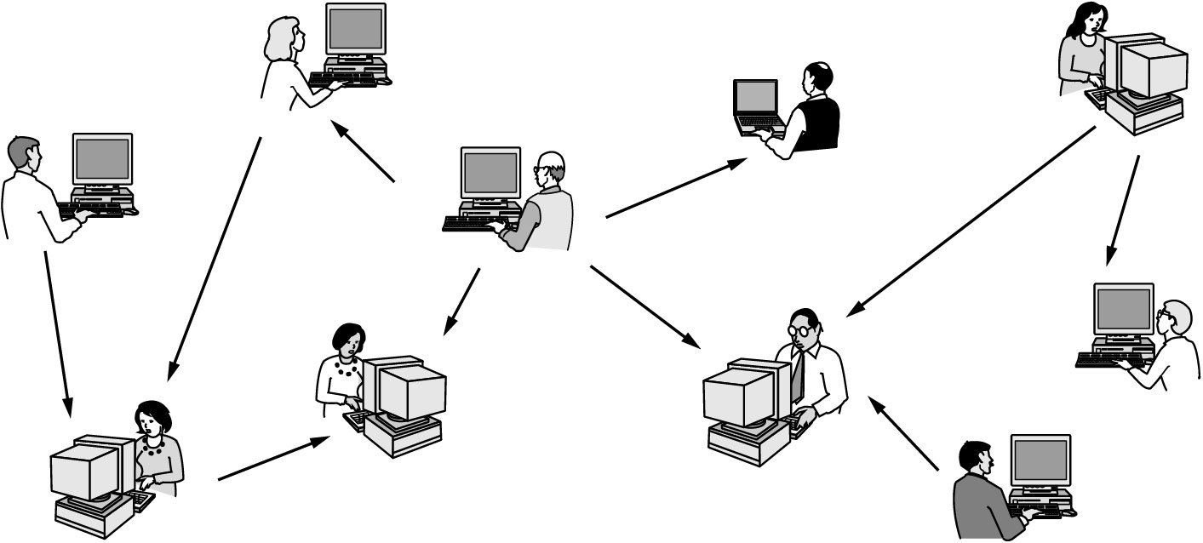
Home Network Applications
In peer-to-peer system there are no fixed clients and servers.

Slide 15
Mobile Network Users
Mobile commerce (m-commerce)
Social Issues
Exchange messages using newsgroup may lead to conflicts
Employee rights vs employer rights
Network offers the potential to send anonymous messages
Electronic junk mails (Spam) may contain viruses
Copyright violation due to transmission of music & videos

Slide 16
Social Issues
Views that are publicly posted may be deeply offensive to some people.
Verbal attacks on particular countries or religions.
Cyber bullying or cyber harassment.
Pirated music and movies fueled the massive growth of peer-to-peer networks
Small files called cookies that Web browsers store on users’ computers allow companies to track users’ activities in cyberspace and may also allow credit card numbers, social security numbers, and other confidential information to leak all over the Internet
Hacking, Phishing, Identity Thefts and other cyber network attacks.
Virus, Adware and spam's.

Slide 17
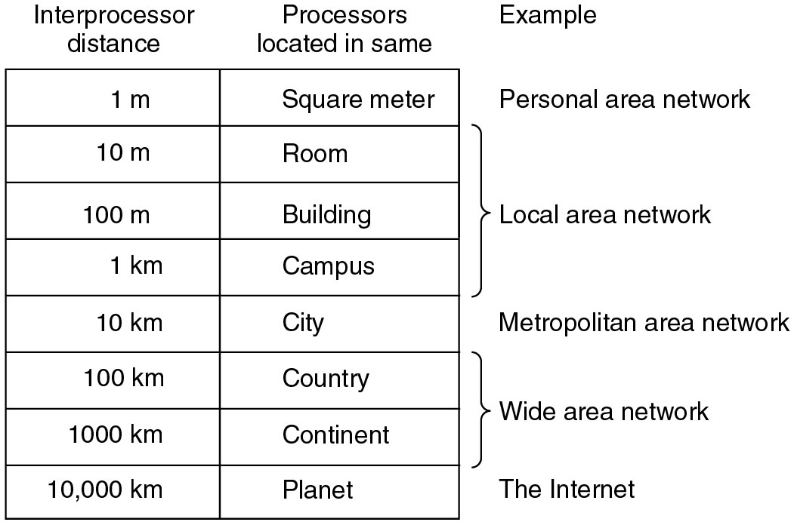
Network Hardware
Based on types of transmission technology
Broadcast Networks
Point-to-point Networks
Based on Scale

Slide 18
Network Hardware
Broadcast Networks
A single communication channel is shared by all the machines on the network
Short messages called packets sent by any machine are received by all the others
Address field in a packet specifies the recipient
After receiving the packet, the address field is checked
If it is intended for itself, it processes the packet, otherwise it is ignored

Slide 19
NETWORK HARDWARE cont.
Some broadcast systems also support transmission to a subset of the machines, which known as multicasting

Slide 20
Network Hardware
Multicasting
Broadcast systems also support transmission to a subset of the machines
By reserving a bit to indicate multicasting & the remaining n-1 address bits can hold the group number
Each machine can subscribe to any or one of the groups

Slide 21
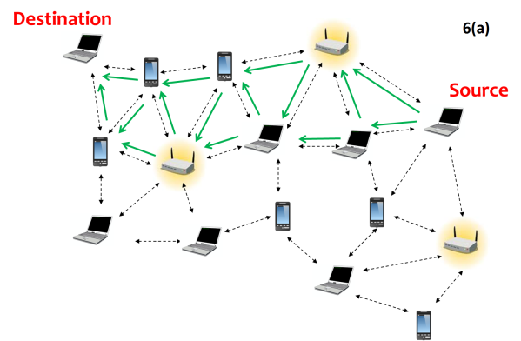
Network Hardware
Point-to-point Networks
Many connections between individual pair of machines
Transfer from source to destination may includes one or more intermediate machines
Multiple routes of different lengths leads to the role of routing algorithm for route selection
Larger networks use point-to-point
Point-to-point transmission with one sender and one receiver is sometimes called unicasting

Slide 22
Network Hardware
Based on Scale
Personal Area Networks
Local Area Networks
Metropolitan Area Networks
Wide Area Networks
Internetworks or Internet

Slide 24
Network Hardware
Personal Area Networks
Networks that are meant for one person
Eg: a wireless network connecting a computer with its mouse, keyboard, and printer
Local Area Networks
Generally called as LANs
Privately owned networks
Inter-processor distance:10m to 1km
Networks placed in a single room or building or campus
LANs are distinguished by 3 characteristics –
Size
Transmission Technology
Topology

Slide 25
LAN
Size :-
Worst-case transmission time is bounded and known in advance.
Knowing this bound makes it possible to use certain kinds of designs
Simplifies Network management.
Transmission Technology :-
consist of a single cable to which all the machines are attached .
Traditional LAN runs at speed of 10 to 100 Mbps
Newer LANs operate at 10 Gbps
Low delay
Makes very few errors

Slide 26
Wired LAN

Slide 27
Wireless LAN

Slide 28
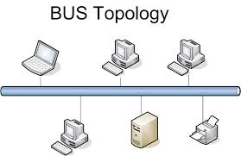
LAN
Topology :-
2 broadcast network types:
Bus & Ring
Bus (Linear cable) network
at any instant, at most one machine is the master and is allowed to transmit.
All other machines are required to refrain from sending
Arbitration mechanism :- to resolve conflicts when two or more machines want to transmit simultaneously.
It may be Centralized or distributed (decentralized)

Slide 29
LAN
Eg:-IEEE 802.3 popularly called Ethernet is bus based broadcast network with decentralized control
operates at 10 Mbps to 10 Gbps
Computers on an Ethernet can transmit whenever they want to;
if two or more packets collide, each computer just waits a random time and tries again later

Slide 30
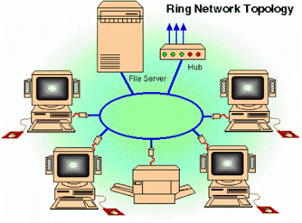
LAN
Ring Network:
Devices acts as repeaters to boost the signal
The transmission of data takes place by token passing.
A token is a special series of bits that contains control information.
Possession of the token allows a network device to transmit data to the network.
Each network has only one token.

Slide 31
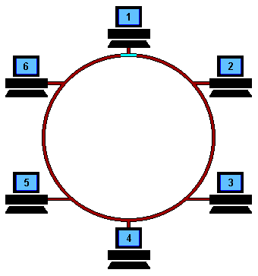
LAN
Working of Ring Network:
The sending computer removes the token from the ring and sends the requested data around the ring.
Each computer passes the data until the packet finds the computer that matches the address on the data.
The receiving computer then returns a message to the sending computer indicating that the data has been received.
After verification, the sending computer creates a new token and releases it to the network.

Slide 32
LAN
Ring Network:
Advantages:
Very orderly network where every device has access to the token and the opportunity to transmit
Performs better than a bus topology under heavy network load
Does not require network server to manage the connectivity between the computers
Disadvantages:
One malfunctioning workstation or bad port can create problems for the entire network
Devices moved, added and changed can affect the network
Network adapter cards are much more expensive than Ethernet cards and hubs
Much slower than an Ethernet network under normal load

Slide 33
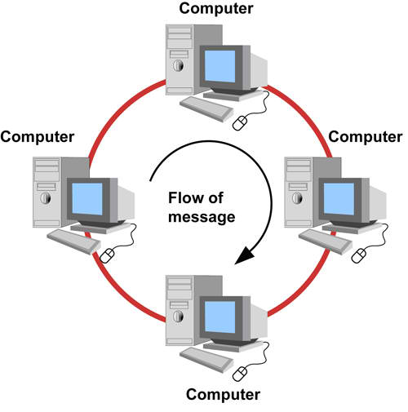
LAN
Ring Network:
Egs:
IEEE 802.5 (the IBM token ring), is a ring-based LAN
operates at 4 and 16 Mbps.
FDDI (Fiber Distributed Data Interface) is another example of a ring network

Slide 34
LAN
Broadcast networks can be further divided into 2, depending on how the channel is allocated
Static and Dynamic
A typical static allocation is
to divide time into discrete intervals and use a round-robin algorithm
allowing each machine to broadcast only when its time slot comes up
Drawback: wastes channel capacity when a machine has nothing to say during its allocated slot
So, most systems attempt to allocate the channel dynamically (i.e., on demand).

Slide 35
LAN
Dynamic allocation methods are either centralized or decentralized.
In the centralized channel allocation method,
there is a single entity,
for example, a bus arbitration unit,
which determines who goes next.
It might do this by accepting requests and making a decision according to some internal algorithm.
In the decentralized channel allocation method,
there is no central entity;
each machine must decide for itself whether to transmit.

Slide 36
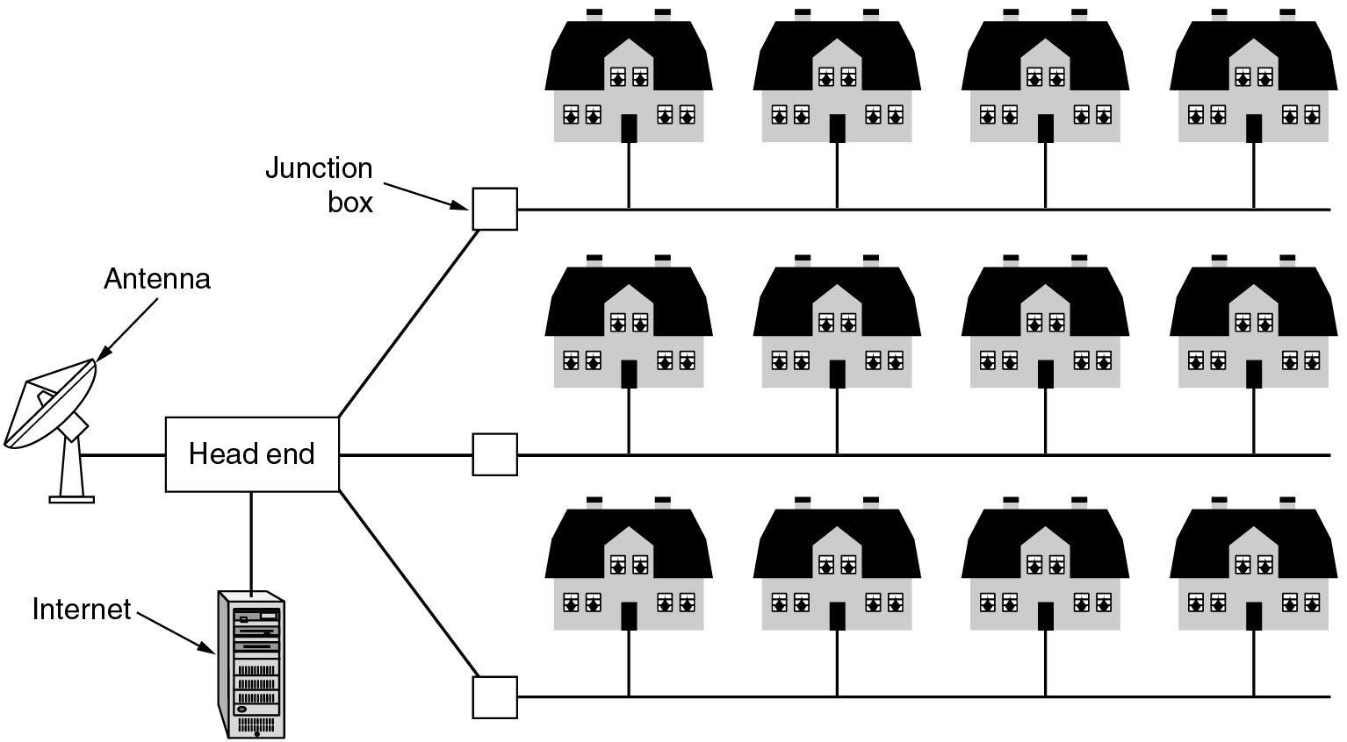
Metropolitan Area Networks (MAN)
A metropolitan area network based on cable TV in a city.
Another eg: IEEE 802.16 (Broadband wireless MANs) for high-speed wireless Internet access

Slide 37
Metropolitan Area Network
A metropolitan area network (MAN) is a computer network that interconnects users with computer resources in a geographic area or region larger than that covered by even a large local area network (LAN) but smaller than the area covered by a wide area network
A MAN (Metropolitan Area Network) covers a city.
The best-known examples of MANs are the cable television networks available in many cities.

Slide 38
Metropolitan Area Network cont.

Slide 39
Wide Area Networks (WAN)
WAN spans a large geographical area, often a country or continent
It contains a collection of machines called hosts intended for running user (i.e., application) programs
The hosts are connected by a communication subnet
The communication subnet is typically owned and operated by a telephone company or Internet service provider
The job of the subnet is to carry messages from host to host, just as the telephone system carries words from speaker to listener

Slide 40
Wide Area Networks (WAN)
Subnet consists of two distinct components:
transmission lines
switching elements
Transmission lines
move bits between machines.
made of copper wire, optical fiber, or even radio links.
Switching elements
Specialized computers that connect three or more transmission lines.
When data arrive on an incoming line, it must choose an outgoing line on which to forward them.
Switching elements are also called as routers

Slide 41
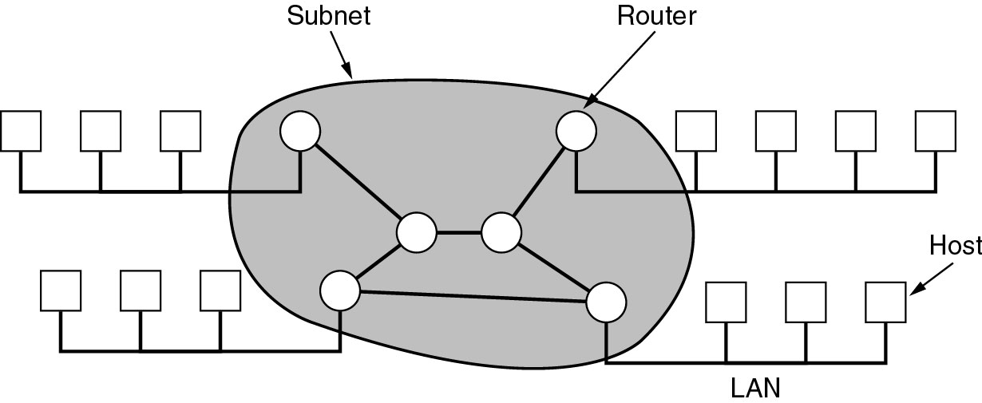
Wide Area Networks (WAN)
Relation between hosts on LANs and the subnet.

Slide 42
Wide Area Networks (WAN)
Store-and-forward or packet-switched subnet
When a packet is sent from one router to another via one or more intermediate routers,
the packet is received at each intermediate router in its entirety,
stored there until the required output line is free, and then forwarded.
When the packets are small and all of the same size, they are often called cells

Slide 43
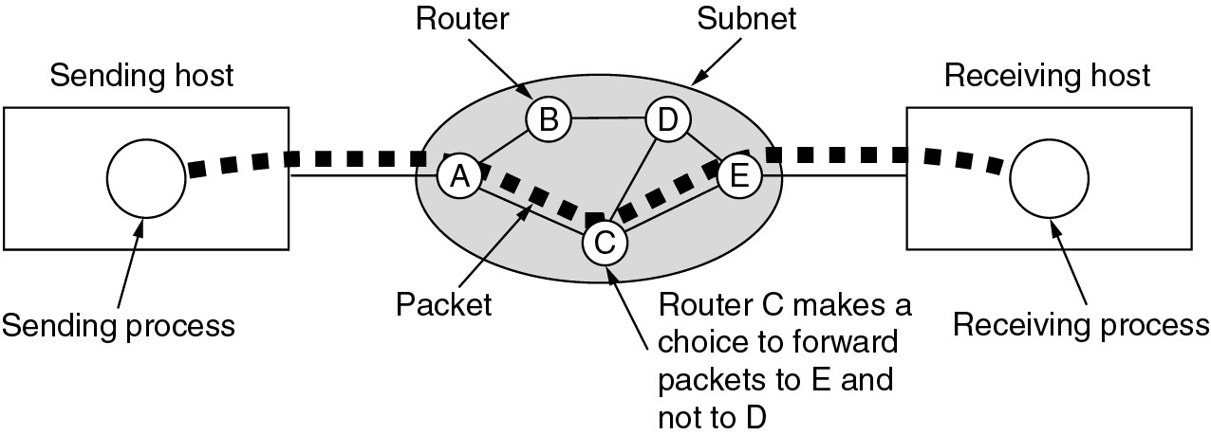
Wide Area Networks
A stream of packets from sender to receiver.
Routing decisions are made locally.
When a packet arrives at router A, it is up to A to decide if this packet should be sent on the line to B or the line to C.
How A makes that decision is called the routing algorithm.

Slide 44
Internetworks
A collection of interconnected networks is called an internetwork or internet
A common form of internet is a collection of LANs connected by a WAN
If the intermediate system contains only routers, it is a subnet
if it contains both routers and hosts, it is a WAN
An internetwork is formed when distinct networks are interconnected

Slide 45
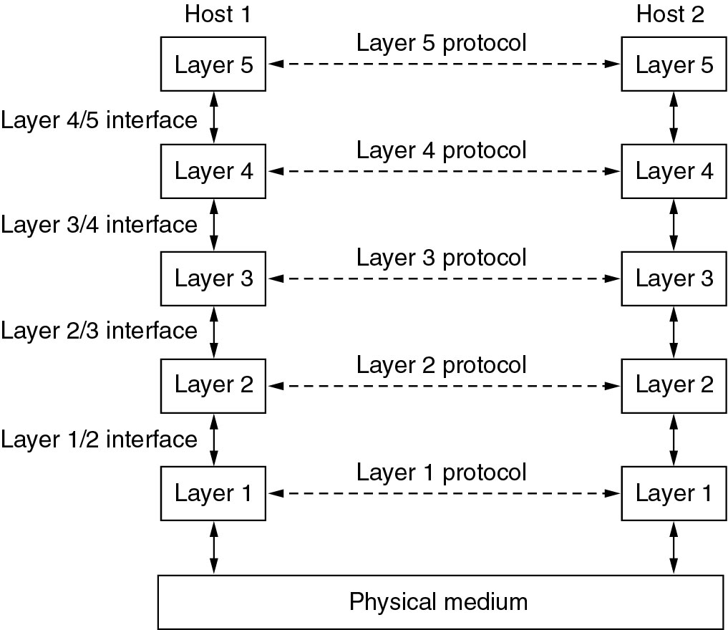
Network Software Protocol Hierarchies

Slide 46
Protocol Hierarchies
To reduce their design complexity, most networks are organized as a stack of layers or levels
Number of layers, name of each layer, contents of each layer, and function of each layer differ from network to network
Purpose of each layer
to offer certain services to the higher layers,
shielding those layers from the details of how the offered services are actually implemented
The rules and conventions used in this conversation are collectively known as the layer n protocol
Protocol is an agreement between the communicating parties on how communication is to proceed

Slide 47
Protocol Hierarchies
No data are directly transferred from layer n on one machine to layer n on another machine.
Instead, each layer passes data and control information to the layer immediately below it, until the lowest layer is reached.
Below layer 1 is the physical medium through which actual communication occurs
Between each pair of adjacent layers is an interface
Interface defines which primitive operations and services the lower layer makes available to the upper one

Slide 48
Protocol Hierarchies
A set of layers and protocols is called a network architecture
A list of protocols used by a certain system, one protocol per layer, is called a protocol stack

Slide 49
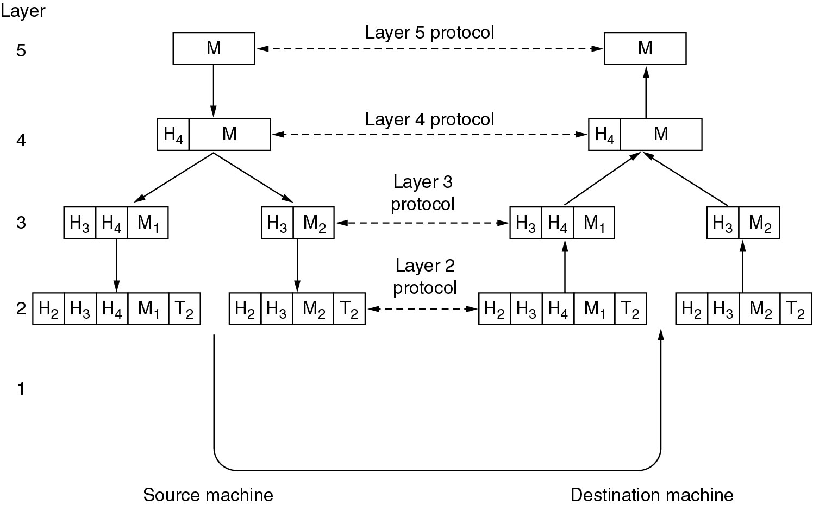
Protocol Hierarchies
header & trailer includes control information, such as sequence numbers, sizes, times, and other control fields

Slide 50
Reference Models
The OSI Reference Model
The TCP/IP Reference Model

Slide 51
OSI Reference Model
The model is called the ISO OSI (International Organization for Standardization Open Systems Interconnection) Reference Model.
because it deals with connecting open systems
ie, systems that are open for communication with other systems
OSI model has seven layers
Physical layer
Data link layer
Network Layer
Transport Layer
Session Layer
Presentation Layer
Application Layer

Slide 52
OSI Reference Model
Principles behind the seven layer design
A layer should be created where a different abstraction (concept).
Each layer should perform a well-defined function.
The function of each layer should be based on internationally Standardized Protocols
The layer boundaries should be chosen to minimize the information flow across the interfaces
number of layers should be
large enough that distinct functions need not be thrown together in the same layer out of necessity
small enough that the architecture does not become unmanageable

Slide 53
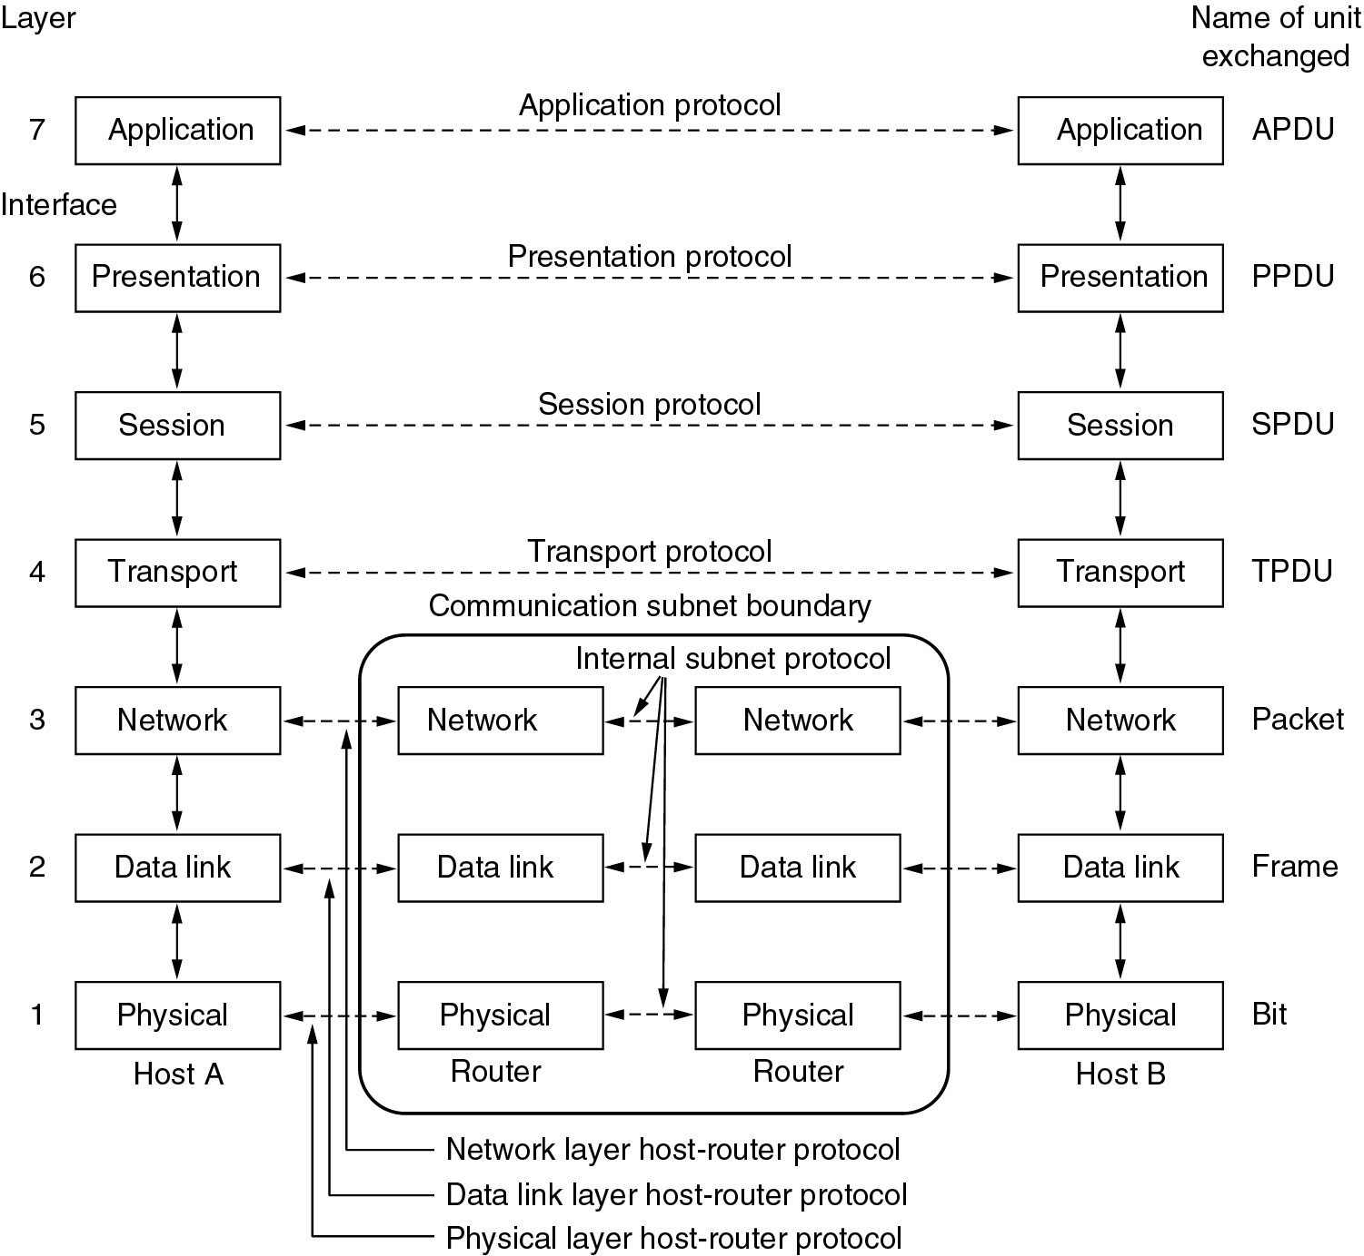
OSI Reference Models

Slide 54
OSI Reference Model
Physical Layer
concerned with transmitting raw bits over a communication channel
Design issues are
when one side sends a 1 bit, it is received by the other side as a 1 bit, not as a 0 bit.
how many volts should be used to represent a 1 and how many for a 0,
how many nanoseconds a bit lasts,
whether transmission may proceed simultaneously in both directions,
how the initial connection is established and
how it is torn down when both sides are finished,
how many pins the network connector has
what each pin is used for

Slide 55
OSI Reference Model
Physical Layer
Design issues deal with
Mechanical, electrical, & timing interfaces, and
physical transmission medium, which lies below the physical layer
Data link Layer
Main task: Error Control
to transform a raw transmission facility into a line that appears free of undetected transmission errors to the network layer
sender break up the input data into data frames (typically a few hundred or a few thousand bytes) and transmit the frames sequentially
If the service is reliable, the receiver confirms correct receipt of each frame by sending back an acknowledgement frame

Slide 56
OSI Reference Model
Data link Layer
Another Issue: Flow control
how to keep a fast transmitter from drowning a slow receiver in data
traffic regulation mechanism is often needed to let the transmitter know how much buffer space the receiver has
Additional issue in broadcast networks:
how to control access to the shared channel
Data link layer is subdivided into 2 for this purpose
Logical Link Control (LLC) sub layer
Medium Access Control (MAC) sub layer
MAC handles the broadcast networks

Slide 57
OSI Reference Model
Network Layer
controls the operation of the subnet
design issues
determining how packets are routed from source to destination
Routes
can be based on static tables that are fixed into the network and are rarely changed
can be highly dynamic, being determined anew for each packet, to reflect the current network load
can also be determined at the start of each conversation (e.g., a login to a remote machine)

Slide 58
OSI Reference Model
Network Layer
Congestion control
If too many packets are present in the subnet at the same time, they will get in one another's way creating congestion
Providing QOS
transit time, delay, jitter, error rate, bandwidth, availability, throughput, etc
to allow heterogeneous networks (different addressing, protocols, message size, etc) to be interconnected

Slide 59
OSI Reference Model
Transport Layer
Basic function
to accept data from above,
split it up into smaller units if needed,
pass these to the network layer, and
ensure that all the pieces arrive correctly at the other end.
All this must be done efficiently in a way that isolates the upper layers from the inevitable changes in the hardware technology
determines what type of service to provide to the session layer, and, ultimately, to the users of the network

Slide 60
OSI Reference Model
Transport Layer
most popular type of transport connection
error-free point-to-point channel that delivers messages or bytes in the order in which they were sent
other possible kinds of transport service
transporting of isolated messages, with no guarantee about the order of delivery, and
the broadcasting of messages to multiple destinations
Type of service is determined when the connection is established

Slide 61
OSI Reference Model
Session Layer
allows users on different machines to establish sessions between them
Sessions offer various services, including
Dialog control
keeping track of whose turn it is to transmit
Token management
preventing two parties from attempting the same critical operation at the same time
Synchronization
check pointing long transmissions to allow them to continue from where they were after a crash

Slide 62
OSI Reference Model
Presentation Layer
concerned with the syntax and semantics of the information transmitted
In order to make it possible for computers with different data representations to communicate
the data structures to be exchanged can be defined in an abstract way
along with a standard encoding to be used on the wire
manages these abstract data structures and allows higher-level data structures (e.g., banking records) to be defined and exchanged

Slide 63
OSI Reference Model
Application Layer
Contains a variety of protocols that are commonly needed by users
Widely-used application protocol
HTTP (Hyper Text Transfer Protocol)
basis for the World Wide Web
When a browser wants a Web page, it sends the name of the page it wants to server using HTTP
server then sends the page back
Other application protocols
File transfer (FTP)
Electronic mail (SMTP)
Domain Name System (DNS)
Network News Transfer Protocol (NNTP)

Slide 64
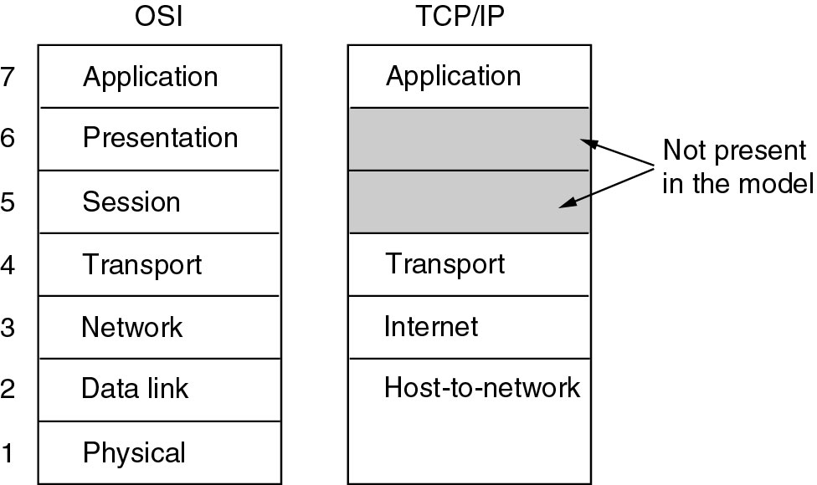
TCP/IP Reference Models

Slide 65
TCP/IP Reference Model
Reference model used in the ARPANET (grandparent of all WAN) and its successor, the worldwide Internet
ARPANET (Advanced Research Projects Agency Network)
Research network sponsored by the DoD (U.S. Department of Defense)
Connected hundreds of Universities and Government installations, using leased telephone lines
When satellite and radio networks were added later, the existing protocols had trouble interworking with them
So, a new reference architecture was needed
Thus, the ability to connect multiple networks in a seamless way was one of the major design goals from the very beginning
This architecture later became known as the TCP/IP Reference Model, after its two primary protocols

Slide 66
TCP/IP Reference Model
Another major goal
network must be able to survive loss of subnet hardware, with existing conversations not being broken off.
ie, DoD wanted connections to remain intact as long as the source and destination machines were functioning
even if some of the machines or transmission lines in between were suddenly put out of operation.
Also, a flexible architecture was needed

Slide 67
TCP/IP Reference Model
Host-to-Network Layer
host has to connect to the network using some protocol so that it can send IP packets to it
protocol is not defined and varies from host to host and network to network
Internet Layer
All requirements of DoD led to the choice of a packet-switching network based on a connectionless internetwork layer
This layer is called the internet layer, because it is the key player that holds the whole architecture together

Slide 68
TCP/IP Reference Model
Internet Layer
Job is to permit hosts to inject packets into any network and have them travel independently to the destination on a different network
They may even arrive in a different order than they were sent
it is the job of higher layers to rearrange them, if in-order delivery is desired

Slide 69
TCP/IP Reference Model
Internet Layer
Internet layer defines an official packet format and protocol called IP (Internet Protocol).
The job of the internet layer is to deliver IP packets where they are supposed to go.
Packet routing & avoiding congestion are the major issue here
For these reasons, it is reasonable to say that the TCP/IP internet layer is similar in functionality to the OSI network layer

Slide 70
TCP/IP Reference Model
Transport Layer
designed to allow peer entities on the source and destination hosts to carry on a conversation
Two end-to-end transport protocols
TCP (Transmission Control Protocol)
UDP (User Datagram Protocol)
TCP
Reliable connection-oriented protocol
allows a byte stream originating on one machine to be delivered without error on any other machine in the internet.
It fragments the incoming byte stream into discrete messages and passes each one on to the internet layer.

Slide 71
TCP/IP Reference Model
Transport Layer
TCP
At the destination, the receiving TCP process reassembles the received messages into the output stream
TCP also handles flow control to make sure a fast sender cannot swamp a slow receiver with more messages than it can handle

Slide 72
TCP/IP Reference Model
Transport Layer
UDP
Unreliable connectionless protocol
for applications that do not want TCP's sequencing or flow control and wish to provide their own
also widely used for one-shot, client-server-type request-reply queries and
applications in which prompt delivery is more important than accurate delivery, such as transmitting speech or video

Slide 73
TCP/IP Reference Model
Application Layer
TCP/IP model does not have session or presentation layers
Because they are of little use to most applications
contains all the higher-level protocols like
virtual terminal (TELNET)
file transfer (FTP)
electronic mail (SMTP)
Domain Name System (DNS)
Network News Transfer Protocol (NNTP)
Hyper Text Transfer Protocol (HTTP)

Slide 74
TCP/IP Reference Model
Application Layer
TELNET
virtual terminal protocol allows a user on one machine to log onto a distant machine and work there
FTP (File Transfer Protocol )
provides a way to move data efficiently from one machine to another
SMTP (Simple Mail Transfer Protocol)
Electronic mail was originally just a kind of file transfer, but later a specialized protocol (SMTP) was developed for it

Slide 75
TCP/IP Reference Model
Application Layer
DNS (Domain Name System)
for mapping host names onto their network addresses
NNTP (Network News Transfer Protocol )
protocol for moving USENET news articles around
USENET (worldwide distributed Internet discussion system)
HTTP (Hyper Text Transfer Protocol )
protocol for fetching pages on the World Wide Web (WWW)

Slide 76
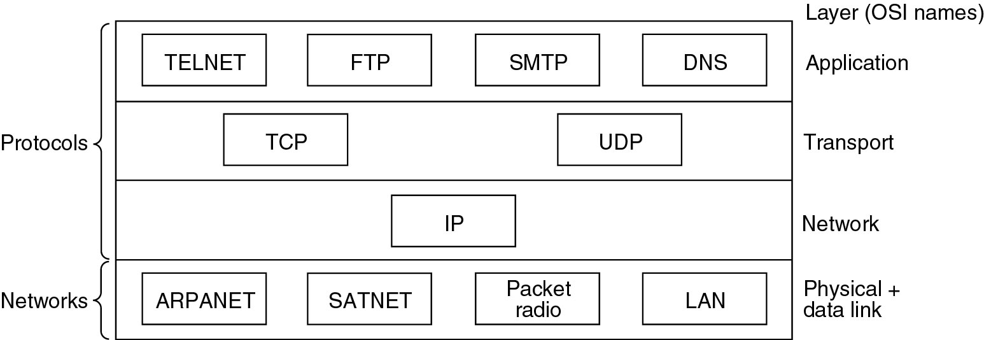
Reference Models
Protocols and networks in the TCP/IP model initially.
ARPANET - Advanced Research Projects Agency Network
SATNET – Sustainable Agriculture Trainers Network

Slide 77
Comparison

Slide 78
A data communications system has five components
Message
The message is the information (data) to be communicated.
Popular forms of information include text, numbers, pictures, audio, and video.
Sender
The sender is the device that sends the data message.
It can be a computer, workstation, telephone handset, video camera, and so on.
Receiver.
The receiver is the device that receives the message.
It can be a computer, workstation, telephone handset, television, and so on.

Slide 79
Transmission medium
The transmission medium is the physical path by which a message travels from sender to receiver.
Some examples of transmission media include twisted-pair wire, coaxial cable, fiber-optic cable, and radio waves.
Protocol.
A protocol is a set of rules that govern data communications.
It represents an agreement between the communicating devices. Without a protocol, two devices may be connected but not communicating, just as a person speaking French cannot be understood by a person who speaks only Japanese.

Slide 81
Data RepresentationText
Numbers
Images
Audio
Video

Slide 82
Data Flow Communication between two devices can be simplex, half-duplex, or full-duplex as shown in Figure .

Slide 83
Simplex
In simplex mode, the communication is unidirectional, as on a one way street.
Only one of the two devices on a link can transmit; the other can only receive (Figure a).
Keyboards and traditional monitors are examples of simplex devices.
Half-Duplex
In half-duplex mode, each station can both transmit and receive, but not at the
same time.
When one device is sending, the other can only receive, and vice
versa (Figure b).
Walkie-talkies and CB (citizens band) radios are both half duplex systems.
Full-Duplex
In full-duplex, both stations can transmit and receive simultaneously (Figure c).
One common example of full-duplex communication is the telephone network.
When two people are communicating by a telephone line, both can talk and
listen at the same time. T
he full-duplex mode is used when communication in
both directions is required all the time.

Slide 84
Network Criteria
A network must be able to meet a certain number of criteria. The most important of these are performance, reliability, and security.
Performance
Performance can be measured in many ways, including transit time and response time.
Transit time is the amount of time required for a message to travel from one device to another.
Response time is the elapsed time between an inquiry and a response.
The performance of a network depends on a number of factors, including the number of users, the type of transmission medium, the capabilities of the connected hardware, and the efficiency of the software.

Slide 85
Performance is often evaluated by two networking metrics: throughput and delay
.We often need more throughput and less delay.
If we try to send more data to the network, we may increase throughput but we increase the delay because of traffic congestion in the network.
Reliability:
In addition to accuracy of delivery, network reliability is measured by the frequency of failure, the time it takes a link to recover from a failure, and the network's robustness in a catastrophe.
Security:
Network security issues include protecting data from unauthorized access, protecting data from damage and development, and implementing policies and procedures for recovery from breaches and data losses.

Slide 86
Physical Structures
Type of Connection
A network is two or more devices connected through links.
A link is a communications pathway that transfers data from one device to another.
There are two possible types of connections: point-to-point and multipoint.
Point-to-Point
A point-to-point connection provides a dedicated link between two devices.
The entire capacity of the link is reserved for transmission between those two devices.
Most point-to-point connections use an actual length of wire or cable to connect the two ends, but other options, such as microwave or satellite links, are also possible

Slide 87
Multipoint
A multipoint (also called multi-drop) connection is one in which more than two specific devices share a single link
In a multipoint environment, the capacity of the channel is shared, either spatially or temporally.
If several devices can use the link simultaneously, it is a spatially shared connection. If users must take turns, it is a timeshared connection.

Slide 89
Physical Topology
The term physical topology refers to the way in which a network is laid out physically.
Two or more devices connect to a link; two or more links form a topology.
The topology of a network is the geometric representation of the relationship of all the links and linking devices (usually called nodes) to one another.
There are four basic topologies possible: mesh, star, bus, and ring

Slide 91
MESH:

Slide 92
A mesh topology is the one where every node is connected to every other node in the network.
A mesh topology can be a full mesh topology or a partially connected mesh topology
In a full mesh topology every computer in the network has a connection to each of the other computers in that network.
The number of connections in this network can be calculated using the following formula (n is the number of computers in the network): n(n-1)/2
In a partially connected mesh topology at least two of the computers in the network have connections to multiple other computers in that network.
It is an inexpensive way to implement redundancy in a network. In the event that one of the primary computers or connections in the network fails, the rest of the network continues to operate normally.

Slide 93
Advantages of a mesh topology
Can handle high amounts of traffic, because multiple devices can transmit data simultaneously.
A failure of one device does not cause a break in the network or transmission of data.
Adding additional devices does not disrupt data transmission between other devices.

Slide 94
Disadvantages of a mesh topology
The cost to implement is higher than other network topologies, making it a less desirable option.
Building and maintaining the topology is difficult and time consuming.
The chance of redundant connections is high, which adds to the high costs and potential for reduced efficiency.

Slide 95
STAR:

Slide 96
A star networkstar topology is one of the most common network setups. In this configuration, every node connects to a central network device, like a hubswitch, or computer.
The central network device acts as a server and the peripheral devices act as clients
Depending on the type of network card used in each computer of the star topology, a coaxial cable or a RJ-45 network cable is used to connect computers together.

Slide 97
Advantages of star topology
Centralized management of the network, through the use of the central computer, hub, or switch.
Easy to add another computer to the network.
If one computer on the network fails, the rest of the network continues to function normally.
The star topology is used in local-area networks (LANs), High-speed LANs often use a star topology with a central hub

Slide 98
Disadvantages of star topology •
Can have a higher cost to implement, especially when using a switch or
router as the central network device.
•
The central network device determines the performance and number of
nodes the network can handle.
•
If the central computer, hub, or switch fails, the entire network goes down
and all computers are disconnected from the network

Slide 99
BUS:

Slide 100
a line topology a bus topology is a network setup in which each computer and network device are connected to a single cable or backbone
Advantages of bus topology
It works well when you have a small network.
It's the easiest network topology for connecting computers or peripherals in a linear fashion.
It requires less cable length than a star topology.

Slide 101
Disadvantages of bus topology
It can be difficult to identify the problems if the whole network goes down.
It can be hard to troubleshoot individual device issues.
Bus topology is not great for large networks.
Terminators are required for both ends of the main cable.
Additional devices slow the network down.
If a main cable is damaged, the network fails or splits into two.

Slide 102
RING:

Slide 103
A ring topology is a network configuration in which device connections create a circular data path.
In a ring network, packets of data travel from one device to the next until they reach their destination.
Most ring topologies allow packets to travel only in one direction, called a unidirectional ring network. Others permit data to move in either direction, called bidirectional
The major disadvantage of a ring topology is that if any individual connection in the ring is broken, the entire network is affected.
Ring topologies may be used in either local area networks (LANs) or wide area networks (WANs).

Slide 104
Advantages of ring topology
All data flows in one direction, reducing the chance of packet collisions.
A network server is not needed to control network connectivity between
each workstation.
Data can transfer between workstations at high speeds.
Additional workstations can be added without impacting performance of the network.

Slide 105
Disadvantages of ring topology
All data being transferred over the network must pass through each workstation on the network, which can make it slower than a star topology
The entire network will be impacted if one workstation shuts down.
The hardware needed to connect each workstation to the network is more expensive than Ethernet cards and hubs/switches.

Slide 106
Hybrid Topology
A network can be hybrid. For example, we can have a main star topology with each branch connecting several stations in a bus topology as shown in Figure

Slide 108
Classes of transmission media:

Slide 109
Guided Media
Guided media, which are those that provide a medium from one device to another, include twisted-pair cable, coaxial cable, and fiber-optic cable.
Twisted-Pair Cable
A twisted pair consists of two conductors (normally copper), each with its own plastic insulation, twisted together.
One of the wires is used to carry signals to the receiver, and the other is used only as a ground reference.

Slide 111
Physical Description:
A twisted pair consists of two insulated copper wires arranged in a regular spiral pattern.
A wire pair acts as a single communication link.
a number of these pairs are bundled together into a cable by wrapping them in a tough protective sheath.
Over longer distances, cables may contain hundreds of pairs.
On long-distance links, the twist length typically varies from 5 to 15 cm.
The wires in a pair have thicknesses of from 0.4 to 0.9 mm.

Slide 112
Unshielded Versus Shielded Twisted-Pair Cable
The most common twisted-pair cable used in communications is referred to as unshielded twisted-pair (UTP).
STP cable has a metal foil or braided mesh covering that encases each pair of insulated conductors.
Although metal casing improves the quality of cable by preventing the penetration of noise or crosstalk, it is bulkier and more expensive.

Slide 114
The most common UTP connector is RJ45 (RJ stands for registered jack)
Applications
Twisted-pair cables are used in telephone lines to provide voice and data channels.
Local-area networks, such as l0Base-T and l00Base-T, also use twisted-pair cables.

Slide 115
Coaxial Cable
Coaxial cable (or coax) carries signals of higher frequency ranges than those in twisted pair cable.
coax has a central core conductor of solid or stranded wire (usuallycopper) enclosed in an insulating sheath, which is, in turn, encased in an outer conductor of metal foil, braid, or a combination of the two.
The outer metallic wrapping serves both as a shield against noise and as the second conductor, which completes the circuit.
This outer conductor is also enclosed in an insulating sheath, and the whole cable is protected by a plastic cover.

Slide 117
The most common type of connector used today is the Bayone-Neill-Concelman (BNC), connector.
Applications
Coaxial cable was widely used in analog telephone networks,digital telephone networks
Cable TV networks also use coaxial cables.
Another common application of coaxial cable is in traditional Ethernet LANs

Slide 118
OPTICAL FIBER

Slide 119
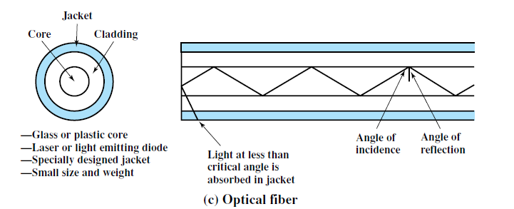
Physical Description:
An optical fiber is a thin (2 to 125 µm)
flexible medium capable of guiding an optical ray.
Various glasses and plastics can be used to make optical fibers.
An optical fiber cable has a cylindrical shape and consists of three concentric sections:
the core
the cladding
the jacket.
The core
innermost section
consists of one or more very thin strands, or fibers, made of glass or plastic;
the core has a diameter in the range of 8 to 50 µm.

Slide 120
Each fiber is surrounded by its own cladding,
a glass or plastic coating that has optical properties different from those of the core
a diameter of 125 µm.
The outermost layer, surrounding one or a bundle of cladded fibers, is the jacket.
The jacket is composed of plastic and other material
layered to protect against moisture, abrasion, crushing, and other environmental dangers.

Slide 121
Advantages of Optical Fiber:
Higher bandwidth –
Fiber-optic cable can support dramatically higher bandwidths (and hence data rates) than either twisted-pair or coaxial cable. Currently, data rates and bandwidth utilization over fiber-optic cable are limited not by the medium but by the signal generation and reception technology available.
Less signal attenuation –
Fiber-optic transmission distance is significantly greater than that of other guided media. A signal can run for 50 km without requiring regeneration. We need repeaters every 5 km for coaxial or twisted-pair cable.
Immunity to electromagnetic interference –
Electromagnetic noise cannot affect fiber optic cables.
Resistance to corrosive materials –
Glass is more resistant to corrosive materials than copper.
Light weight –
Fiber-optic cables are much lighter than copper cables.
Greater immunity to tapping –
Fiber-optic cables are more immune to tapping than copper cables. Copper cables create antenna effects that can easily be tapped.

Slide 122
Disadvantages of Optical Fiber:
Installation and maintenance –
Fiber-optic cable is a relatively new technology. Its installation and maintenance require expertise that is not yet available everywhere.
Unidirectional light propagation –
Propagation of light is unidirectional. If we need bidirectional communication, two fibers are needed.
Cost –
The cable and the interfaces are relatively more expensive than those of other guided media. If the demand for bandwidth is not high, often the use of optical fiber cannot be justified.

Slide 123
Transmission characteristics:
Optical fiber transmits a signal-encoded beam of light by means of total internal reflection.
Total internal reflection can occur in any transparent medium that has a higher index of refraction than the surrounding medium.
the optical fiber acts as a waveguide for frequencies in the range of about 10¹⁴ to 10¹⁵ Hertz; this covers portions of the infrared and visible spectra.

Slide 124
Fiber Optic cable Connectors:

Slide 125
Three types:
The subscriber channel (SC) connector is used for cable TV. It uses a push/pull locking system.
The straight-tip (ST) connector is used for connecting cable to networking devices. It uses a bayonet locking system
The MT-RJ is a connector that is the same size as RJ45.

Slide 126
Fiber Sizes:
Optical fibers are defined by the ratio of the diameter of their core to the diameter of their cladding, both expressed in micrometers.

Slide 127
Propagation Modes

Slide 128
Multimode is so named because multiple beams from a light source move
through the core in different paths.
How these beams move within the cable depends on the structure of the core, as shown in Figure
.

Slide 129
(a) Multimode step – index fiber:
the density of the core remains constant from the center to the edges.
A beam of light moves through this constant density in a straight line until it reaches the interface of the core and the cladding.
At the interface, there is an abrupt change due to a lower density; this alters the angle of the beam's motion.
The term step index refers to the suddenness of this change, which contributes to the distortion of the signal as it passes through the fiber.

Slide 131
2.Single mode:
Single-mode uses step-index fiber
highly focused source of light that limits beams to a small range of angles, all close to the horizontal.
The single mode fiber itself is manufactured with a much smaller diameter than that of multimode fiber, and with substantially lower density (index of refraction).

Slide 132
Two different types of light source are used in fiber optic systems:
the light emitting diode (LED) and the injection laser diode (ILD).
Both are semiconductor devices that emit a beam of light when a voltage is applied.
The LED is less costly, operates over a greater temperature range, and has a longer operational life.
The ILD, which operates on the laser principle, is more efficient and can sustain greater data rates.

Slide 133
8,31,34,43,

Slide 134
WIRELESS TRANSMISSION
Frequencies in the range of about 1 GHz to 40 GHz are referred to as microwave frequencies.
Microwave is suitable for point-to-point transmission.
Microwave is also used for satellite communications.
Frequencies in the range of 30 MHz to 1 GHz are suitable for omni directional applications.
This range is the radio range.

Slide 135
Antennas:
An antenna can be defined as an electrical conductor or system of conductors used either for radiating electromagnetic energy or for collecting electromagnetic energy.
For transmission of a signal, radio-frequency electrical energy from the transmitter is converted into electromagnetic energy by the antenna and radiated into the surrounding environment (atmosphere, space, water).
For reception of a signal, electromagnetic energy impinging on the antenna is converted into radio-frequency electrical energy and fed into the receiver.
An isotropic antenna is a point in space that radiates power in all directions equally.
The actual radiation pattern for the isotropic antenna is a sphere with the antenna at the center.

Slide 136
Parabolic Reflective Antenna:

Slide 137
An important type of antenna is the parabolic reflective antenna, which is used in terrestrial microwave and satellite applications.
A parabola is the locus of all points equidistant from a fixed line and a fixed point not on the line.
The fixed point is called the focus and the fixed line is called the directrix.
If a parabola is revolved about its axis, the surface generated is called a paraboloid.
A cross section through the paraboloid parallel to its axis forms a parabola and a cross section perpendicular to the axis forms a circle.
Such surfaces are used in headlights, optical and radio telescopes, and microwave antennas because of the following property:
If a source of electromagnetic energy (or sound) is placed at the focus of the paraboloid, and if the paraboloid is a reflecting surface, then the wave will bounce back in lines parallel to the axis of the paraboloid.

Slide 138
Antenna Gain:
Antenna gain is a measure of the directionality of an antenna.
Antenna gain is defined as the power output, in a particular direction, compared to that produced in any direction by a perfect omnidirectional antenna (isotropic antenna).
G_{dB} = 10 log (P₂/P₁),
where G is the antenna gain,
P₁ is the radiated power of the directional antenna
P₂ is the radiated power from the reference antenna.

Slide 139
Terrestrial Microwave:
Physical Description:
The most common type of microwave antenna is the parabolic “dish.”
A typical size is about 3 m in diameter.
The antenna is fixed rigidly and focuses a narrow beam to achieve line-of-sight transmission to the receiving antenna.
Microwave antennas are usually located at substantial heights above ground level to extend the range between antennas and to be able to transmit over intervening obstacles.
To achieve long distance transmission, a series of microwave relay towers is used, and point-to-point microwave links are strung together over the desired distance.

Slide 140
Applications:
Long-haul telecommunications service, as an alternative to coaxial cable or optical fiber.
Microwave is commonly used for both voice and television transmission.
Short point-to-point links between buildings.

Slide 141
Satellite Microwave:
Physical description:
It is used to link two or more ground based microwave transmitter/receivers, known as earth stations, or ground stations.
The satellite receives transmissions on one frequency band (uplink), amplifies or repeats the signal, and transmits it on another frequency (downlink).
A single orbiting satellite will operate on a number of frequency bands, called transponder channels, or simply transponders.

Slide 143
Applications:
Television distribution
Long-distance telephone transmission
Private business networks
Global positioning

Slide 144
Transmission Characteristics:
The optimum frequency range for satellite transmission is in the range 1 to 10 GHz.
Below 1 GHz, there is significant noise from natural sources, including galactic, solar, and atmospheric noise, and human made interference from various electronic devices.
Above 10 GHz, the signal is severely attenuated by atmospheric absorption and precipitation.
5.925 to 6.425 GHz for transmission from earth to satellite (uplink) and a bandwidth in the range 3.7 to 4.2 GHz for transmission from satellite to earth (downlink). This combination is referred to as the 4/6-GHz band.

Slide 145
WIRELESS PROPOGATION
A signal radiated from an antenna travels along one of three routes:
ground wave
sky wave
line of sight (LOS).

Slide 146
Ground Wave Propagation:

Slide 147
Ground wave can propagate considerable distances,
This effect is found in frequencies up to about 2 MHz.
Several factors affect the propagation--
One factor is that the electromagnetic wave induces a current in the earth’s surface, the result of which is to slow the wavefront near the earth, causing the wavefront to tilt downward and hence follow the earth’s curvature
Another factor is diffraction, which is a phenomenon having to do with the behavior of electromagnetic waves in the presence of obstacles.
Electromagnetic waves in this frequency range are scattered by the atmosphere in such a way that they do not penetrate the upper atmosphere.
The best-known example of ground wave communication is AM radio.

Slide 148
Sky Wave Propagation:

Slide 149
Sky wave propagation is used for amateur radio, and international broadcasts such as BBC and Voice of America.
With sky wave propagation, a signal from an earth-based antenna is reflected from the ionized layer of the upper atmosphere (ionosphere) back down to earth.
This is caused by refraction.
A sky wave signal can travel through a number of hops, bouncing back and forth between the ionosphere and the earth’s surface.
With this propagation mode, a signal can be picked up thousands of kilometers from the transmitter.

Slide 150
Line-of-Sight Propogation:
Above 30 MHz, neither ground wave nor sky wave propagation modes operate, and communication must be by line of sight.
For satellite communication, a signal above 30 MHz is not reflected by the ionosphere and therefore a signal can be transmitted between an earth station and a satellite overhead that is not beyond the horizon.
Line of sight (LoS) is a type of propagation that can transmit and receive data only where transmit and receive stations are in view of each other without any sort of an obstacle between them. FM radio, microwave and satellite transmission are examples of line-of-sight communication.

Slide 151
Connection-Oriented Services
Similar to telephone service
to use a connection-oriented network service, the service user
establishes a connection,
uses the connection, and
releases the connection
acts like a tube
sender pushes objects (bits) in at one end, and the receiver takes them out at the other end
the order is preserved so that the bits arrive in the order they were sent

Slide 152
Connection-Oriented Services
When a connection is established, the sender, receiver, and subnet conduct a negotiation
about parameters to be used, such as
maximum message size,
quality of service
error rates,
bandwidth,
throughput,
transmission delay,
jitter,
Availability
other issues.
Typically, one side makes a proposal and the other side can accept it, reject it, or make a counterproposal

Slide 153
Connectionless Services
Similar to postal system
Each message (letter) carries the full destination address
Each one is routed through the system independent of all the others

Slide 154
Connection-Oriented Services
Classifications: Reliable & Unreliable
Each service can be characterized by a quality of service
Some services are reliable that they never lose data.
A reliable service is implemented by having the receiver acknowledge the receipt of each message so the sender is sure that it arrived.
The acknowledgement process introduces overhead and delays, which are often worth it but are sometimes undesirable
Eg for reliable connection-oriented service is file transfer
Reliable connection-oriented service has two minor variations:
message sequences and
byte streams

Slide 155
Connection-Oriented Services
Message sequences
message boundaries are preserved.
When two 1024-byte messages are sent, they arrive as two distinct 1024-byte messages, never as one 2048-byte message
Eg: Sending the pages of book
Byte streams
connection is simply a stream of bytes, with no message boundaries.
When 2048 bytes arrive at the receiver, there is no way to tell if they were sent as one 2048-byte message, two 1024-byte messages, or 2048 1-byte messages
Eg: user logging details to a remote server

Slide 156
Connection-Oriented Services
For some applications, transit delays introduced by acknowledgements are unacceptable. (Unreliable is better)
Application 1: digitized voice traffic.
It is preferable for telephone users to hear a bit of noise on the line from time to time than to experience a delay waiting for acknowledgements.
Application 2: video conference
when transmitting a video conference, having a few pixels wrong is no problem, but having the image jerk along as the flow stops to correct errors is irritating

Slide 157
Connectionless Services
Connectionless service is often called datagram service
Unreliable (meaning not acknowledged) datagram service
does not return an acknowledgement to the sender
Eg: junk mails
acknowledged datagram service
convenience of not having to establish a connection to send one short message is desired,
but reliability is essential.
Eg: sending a registered letter and requesting a return receipt
request-reply service
the sender transmits a single datagram containing a request; the reply contains the answer
Egs: a query to the local library, Client server model

Slide 158
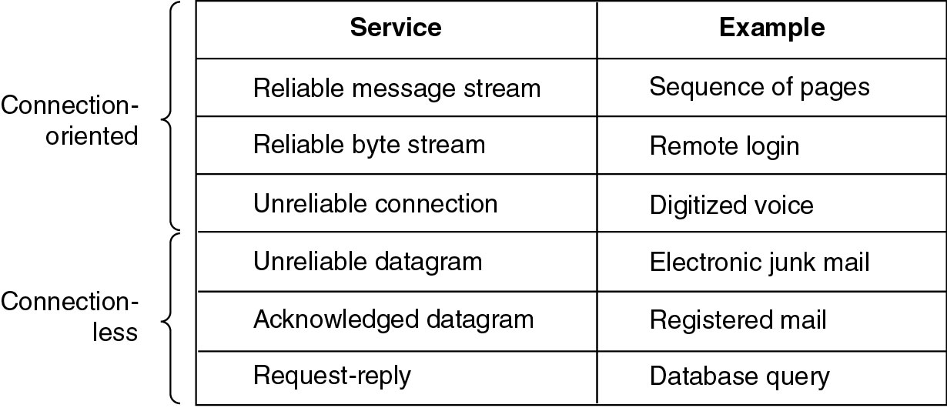
Connection-Oriented and Connectionless Services
Six different types of service.

Slide 159
Interfaces & Services
active elements in each layer are called entities
An entity can be a
software entity (such as a process), or
hardware entity (such as an intelligent I/O chip)
Entities in the same layer on different machines are called peer entities
entities in layer n implement a service used by layer n+ 1
Layer n is the service provider
Layer n + 1 is the service user
Classes of services
Fast & expensive communication
Slow & cheap communication

Slide 160
Interfaces & Services
Services are available at SAPs (Service Access Points)
IDU
Layer n+1
ICI
IDU – Interface Data Unit
ICI – Interface Control Information
SDU – Service Data Unit
SAP – Service Access Point
SDU
SAP
Interface
Layer n
ICI
SDU
Each SAP has an address that uniquely identifies it
Eg: SAPs are the sockets into which telephones are plugged
SAP addresses are telephone numbers of sockets

Slide 161
Service Primitives
A service is specified by a set of primitives (operations) available to a user process to access the service.
These primitives tell the service to perform some action or report on an action taken by a peer entity.
If the protocol stack is located in the operating system, the primitives are normally system calls.

Slide 162
Service Primitives
Five service primitives for implementing a simple connection-oriented service.

Slide 163
Service Primitives
Packets sent in a simple client-server interaction on a connection-oriented network.

Slide 164
Service Primitives
Eg Illustration:
Server executes LISTEN to indicate that it is prepared to accept incoming connections.
A common way to implement LISTEN is to make it a blocking system call.
After executing the primitive, the server process is blocked until a request for connection appears
Client process executes CONNECT to establish a connection with the server
Operating system then typically sends a packet to the peer asking it to connect
Client process is suspended until there is a response

Slide 165
Service Primitives
When the packet arrives at the server, it is processed by its operating system
When the system sees that the packet is requesting a connection, it checks to see if there is a listener.
If so, it does two things:
unblocks the listener and
sends back an acknowledgement
arrival of this acknowledgement then releases the Client
At this point the Client and Server are both running and they have a connection established
If a connection request arrives and there is no listener, the result is undefined

Slide 166
Service Primitives
The next step is for the Server to execute RECEIVE to prepare to accept the first request.
Normally, the server does this immediately upon being released from the LISTEN, before the acknowledgement can get back to the client.
The RECEIVE call blocks the Server
Then the Client executes SEND to transmit its request followed by the execution of RECEIVE to get the reply
The arrival of the request packet at the server machine unblocks the Server process so it can process the request.
After it has done the work, it uses SEND to return the answer to the Client.
The arrival of this packet unblocks the Client, which can now inspect the answer.

Slide 167
Service Primitives
If the Client has additional requests, it can make them now.
If it is done, it can use DISCONNECT to terminate the connection.
Usually, an initial DISCONNECT is a blocking call, suspending the client and sending a packet to the server saying that the connection is no longer needed.
When the Server gets the packet, it also issues a DISCONNECT of its own, acknowledging the client and releasing the connection.
When the Server's packet gets back to the Client machine, the Client process is released and the connection is broken.

Slide 168
THANK YOU

