Slide 1
CST 204 Database Management Systems
1
MODULE 1
PREPARED BY NITHA L ROZARIO

Slide 2
2
Syllabus
Introduction & Entity Relationship (ER) Model
Concept & Overview of Database Management
Systems (DBMS).
Characteristics of Database system,
Database Users, structured, semi-structured and unstructured data.
Data Models and Schema - Three Schema architecture.
Database Languages, Database architectures and classification.
ER model - Basic concepts, entity set & attributes, notations, Relationships and constraints,
cardinality, participation, notations, weak entities, relationships of degree 3.

Slide 3
3
Data, Database & DBMS
Data
▫ Known facts that can be recorded and have implicit meaning
Data is nothing but facts and statistics stored or free flowing over a network, generally it's raw and unprocessed
Data becomes information when it is processed, turning it into something meaningful.

Slide 4
Database
The collection of data
A Database is a collection of related data organised in a way that data can be easily accessed, managed and updated.
Database-management system (DBMS)
is a collection of interrelated data and a set of programs to access those data.
General purpose software system that facilitates process of defining, constructing, manipulating, and sharing database

Slide 5
A DBMS is a software that allows creation, definition and manipulation of database, allowing users to store, process and analyse data easily.
DBMS also provides protection and security to the databases.
It also maintains data consistency in case of multiple users.
Here are some examples of popular DBMS used these days:
MySql
Oracle
SQL Server
IBM DB2
Amazon SimpleDB (cloud based) etc.

Slide 6
4
The primary goal of a DBMS is to provide a way to store and retrieve database information that is
both convenient and efficient.

Slide 7
5
Database systems are designed to manage large bodies of information.
Management of data involves both storage of information and mechanisms for manipulation of information.
The database system must ensure the safety of the information stored
If data are to be shared among several users, the system must avoid possible anomalous results.

Slide 8
6
Database implicit properties
Universe of discourse(UoD) or Miniworld
▫ Database represent some aspects of real world
▫ Changes to miniworld affects database
A database is a logically coherent collection of data with some inherent meaning
A database is designed, built and populated with data for specific purpose

Slide 9
7
DBMS is a general purpose software system that facilitates process of defining, constructing,
manipulating, and sharing database

Slide 10
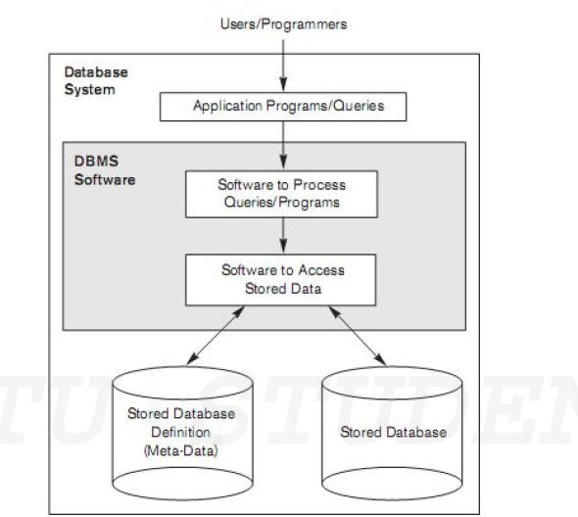
8
Database System Environment

Slide 11
Characteristics
Data stored into Tables
Reduced Redundancy
Data Consistency
Support Multiple user and Concurrent Access
Query Language
Security
DBMS supports transactions

Slide 12
9
Characteristics of the Database Approach
Self describing nature of a database system
Insulation between programs and data, and data abstraction
Support of multiple views of the data

Slide 13
10
Self-Describing Nature of a Database
System
database system contains not only the database itself but also a complete definition or description of the database structure and constraints.
This definition is stored in the DBMS catalog
information stored in the catalog is called meta- data and it describes the structure of the primary database.

Slide 14
11
Insulation between Programs and Data, and Data Abstraction
The structure of data files is stored in the DBMS catalog separately from the access programs.
This property is called program-data independence
An operation (also called a function or method) is specified in two parts.
Interface
▫ The interface (or signature) of an operation includes the operation name and the data types of its arguments (or parameters).
Implementation
▫ The implementation (or method) of the operation is specified separately and can be changed without affecting the interface.

Slide 15
12
The characteristic that allows program-data independence and program operation independence is called data abstraction.

Slide 16
13
Support of Multiple Views of the Data
A database has many users, each user may require a different perspective or view of the database.
A view may be a subset of the database or it may contain virtual data that is derived from the database files but is not explicitly stored.

Slide 17
14
Sharing of Data and Multiuser Transaction Processing
DBMS must include concurrency control
software
▫ to ensure that several users trying to update the same data do so in a controlled manner so that the result of the updates is correct
DBMS must enforce several transaction properties(ACID)
▫ Isolation property
▫ Atomicity property

Slide 18
15
Isolation Property
ensures that each transaction appears to execute in isolation from other transactions
even though hundreds of transactions may be executing
concurrently.

Slide 19
16
Atomicity Property
ensures that either all the database operations in a transaction are executed or none are.
Any mechanical or electrical device is subject to failure, and so is the computer system.
In this case we have to ensure that data should be restored to a consistent state.
For example an amount of Rs 50 has to be transferred from
Account A to Account B.
Let the amount has been debited from account A but have not been credited to Account B and in the meantime, some failure occurred.
▫ So, it will lead to an inconsistent state.
▫ So, we have to adopt a mechanism which ensures that either full transaction should be executed or no transaction should be executed i.e. the fund transfer should be atomic.

Slide 20
17
Concurrent access Problems
Many systems allows multiple users to update the data simultaneously.
It can also lead the data in an inconsistent state.
Suppose a bank account contains a balance of Rs 500 & two customers want to withdraw Rs100 & Rs 50 simultaneously.
Both the transaction reads the old balance & withdraw from that old balance which will result in Rs 450 , Rs 400 which is incorrect.

Slide 21
18
Security Problems
All the user of database should not be able to access all the data.
For example a payroll Personnel needs to access only that part of data which has information about various employees & are not needed to access information about customer accounts.

Slide 22
19
Advantages of DBMS
Controlling Redundancy
Restricting Unauthorized Access
Providing Storage Structures for Efficient
Query Processing
Providing Backup and Recovery
Providing Multiple User Interfaces
Representing Complex Relationship among Data
Enforcing Integrity Constraints
Permitting Inferencing and Actions using Rules

Slide 23
^{Controlling Redundancy}
In traditional file processing, every user group maintains its own files for handling its data-processing applications.
^{example,UNIVERSITY database}
redundancy in storing the same data multiple times leads to several problems.
logical update has to be performed multiple times: once for each file where student data is recorded.
This leads to duplication of data.
storage space is wasted when the same data is stored repeatedly.

Slide 24
Restricting Unauthorized Access
When multiple users share a large database, most users will not be authorized to access all information in the database.
example, financial data is considered confidential, and only authorized persons are allowed to access such data
the type of access operation— retrieval or update—is also controlled.
Users are given account numbers protected by passwords
A DBMS should provide a security and authorization subsystem, which the DBA uses to create accounts and to specify account restrictions

Slide 25
Providing Persistent Storage for Program Objects
The values of program variables or objects are discarded once a program terminates
To store it permanently convert these complex structures into a format suitable for file storage
the DBMS software automatically performs any necessary conversions.
Hence, a complex object in C++ can be stored permanently in an object-oriented DBMS. Such an object is said to be persistent

Slide 26
Providing Storage Structures and Search Techniques for Efficient Query Processing
the DBMS must provide specialized data structures and search techniques to speed up disk search for the desired records. Auxiliary files called indexes are used for this purpose.
In order to process the database records they are copied from disk to main memory.
DBMS has a buffering or caching module that maintains parts of the database in main memory buffers.
The query processing and optimization module of the DBMS is responsible for choosing an efficient query execution plan

Slide 27
^{Providing Backup and Recovery}
The backup and recovery subsystem of the DBMS is responsible for recovery
the recovery subsystem is responsible to restore the state it was in before the transaction started executing.
Also ensure that the transaction is resumed from the point at which it was interrupted

Slide 28
Providing Multiple User Interfaces
a DBMS should provide a variety of user interfaces.
  query languages for casual users
  programming language interfaces for application programmers
  forms and command codes for parametric users
  menu-driven interfaces and natural language interfaces for standalone users.

Slide 29
Representing Complex Relationships among Data
  A database may include numerous varieties of data that are interrelated in many ways.
Enforcing Integrity Constraints
  integrity constraints involves specifying that a record in one file must be related to records in other files .This is known as a referential integrity constraint.
  Another type of constraint specifies uniqueness on data item values. This is known as a key or uniqueness constraint.

Slide 30
20
Disadvantages of DBMS
Cost of Hardware & Software
Cost of Data Conversion
Cost of Staff Training
Appointing Technical Staff
Database Damage

Slide 31
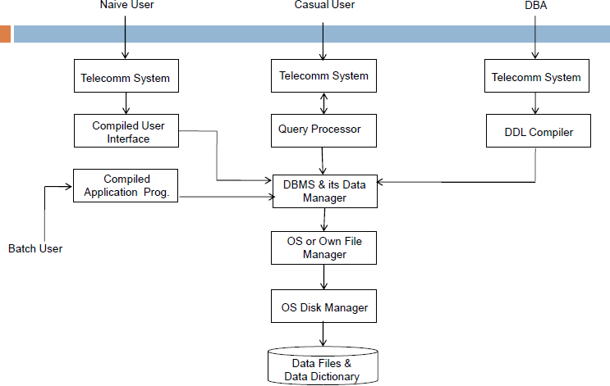
21
DBMS Structure

Slide 32
22
Database Users and Administrators
A primary goal of a database system is to retrieve information from and store new information in the database.
People who work with a database can be categorized as database users or database administrators.

Slide 33
Users of Database
Depending on the degree of expertise or mode of interaction with DBMS the users of database
Database Administrator
Application Programmers
Sophisticated Users
Naive Users

Slide 34
Database Administrator (DBA)
Database Administrator (DBA) is a person/team who defines the schema and also controls the 3 levels of database.
The DBA will then create a new account id and password for the user if he/she need to access the data base.
DBA is also responsible for providing security to the data base and he allows only the authorized users to access/modify the data

Slide 35
DBA also monitors the recovery and back up and provide technical support.
The DBA has a DBA account in the DBMS which called a system or superuser account.
DBA repairs damage caused due to hardware and/or software failures.

Slide 36
Application Programmer
Application Programmer are the back end programmers who writes the code for the application programs.
They are the computer professionals.
These programs could be written in Programming languages such as Visual Basic, Developer, C, FORTRAN, COBOL etc.

Slide 37
Sophisticated Users
Sophisticated users can be engineers, scientists, business analyst, who are familiar with the database.
They can develop their own data base applications according to their requirement.
They don’t write the program code but they interact the data base by writing SQL queries directly through the query processor.

Slide 38
Naive Users
Parametric End Users are the unsophisticated who don’t have any DBMS knowledge but they frequently use the data base applications in their daily life to get the desired results.
For examples, Railway’s ticket booking users are naive users.
Clerks in any bank is a naive user because they don’t have any DBMS knowledge but they still use the database and perform their given task.

Slide 39
29
ACTORS ON THE SCENE
The people whose jobs involve the day-to-day use of a large database are called as the actors on the scene.
  Database Administrators
  Database Designers
  End Users
  System Analyst and Application Programmers(Software engineers)

Slide 40
30
WORKERS BEHIND THE SCENE
The people who work to maintain the database system environment but who are not actively interested in the database contents as part of their daily job are called as the workers behind the scene
DBMS system designers and implementers
Tool developers
Operators and maintenance personnel (system administration personnel)

Slide 41
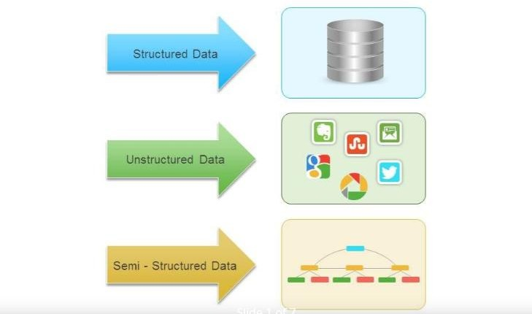
31
Structured, Semi-structured and Unstructured data

Slide 42
32
Structured data
Represented in a strict format
It has been organized into a formatted repository that is typically a database.
It concerns all data which can be stored in database SQL in a table with rows and columns
. Example: Relational data

Slide 43
33
Semi-Structured data
information that does not reside in a relational database but that have some organizational properties that make it easier to analyze
With some process, you can store them in the relation database
but Semi-structured exist to ease space.
Example: XML data

Slide 44
34
Unstructured data
data which is not organized in a predefined manner or does not have a predefined data model
thus it is not a good fit for a mainstream relational database
there are alternative platforms for storing and managing, used by organizations in a variety of business intelligence and analytics applications.
Example: Word, PDF, Text, Media logs.

Slide 45
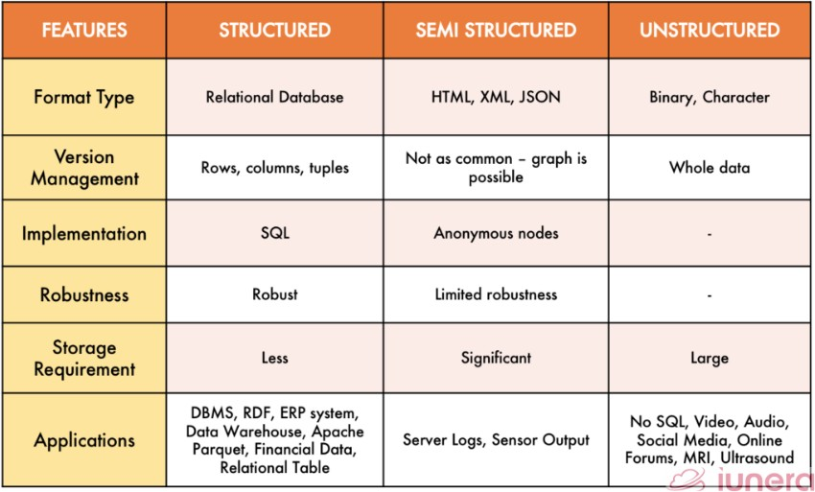
35

Slide 46
36
Data Models
a collection of concepts that can be used to describe the structure of a database
structure of a database we mean the data types, relationships, and constraints that should hold on the data.
Most data models also include a set of basic operations for specifying retrievals and updates on the database.

Slide 47
37
Categories of Data Models
High-level or conceptual data models
Low-level or physical data models
Representational (or implementation) data models

Slide 48
38
High-level or conceptual data models
provide concepts that are close to the way many users perceive data
use concepts such as entities, attributes, and relationships
An entity represents a real-world object or concept
An attribute represents some property of interest that further describes an entity,
A relationship among two or more entities represents an interaction among the entities

Slide 49
39
Low-level or physical data models
Provide concepts that describe the details of how data is stored in the computer.
Concepts provided by low-level data models are generally meant for computer specialists, not for typical end users.
Describe how data is stored in the computer by representing information such as record formats, record orderings, and access paths.
An access path is a structure that makes the search for particular database records efficient.

Slide 50
41
Schemas, Instances, and Database State
The description of a database is called the database schema, which is specified during database design and is not expected to change frequently
A displayed schema is called a schema diagram. We call each object in the schema a schema construct.
The data in database at particular instant or moment of time is called database state or snapshot

Slide 51
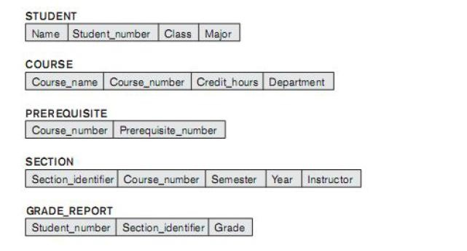
42
PREPARED BY
SHARIKA T R
Database schema
Name | Student_number | Class | Major
Ram | CS001 | R4 | CSE
Shyam | CS002 | R4 | CSE
Database state

Slide 52
43
The schema is not supposed to change frequently, but it is not uncommon that changes occasionally need to be applied to the schema as the application requirements change. It is called schema evolution.

Slide 53
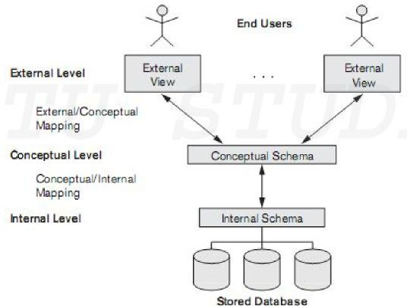
44
The Three-Schema Architecture

Slide 54
45
Internal level
The internal level has an internal schema, which describes the physical storage structure of the database.
The internal schema uses a physical data model and describes the complete details of data storage and access paths for the database.

Slide 55
46
Conceptual level
Describes the structure of the whole database for a community of users.
The conceptual schema hides the details of physical storage structures and concentrates on describing entities, data types, relationships, user operations, and constraints.
A high-level data model or an implementation data model can be used at this level.

Slide 56
47
External or view level
The external or view level includes a number of external schemas or user views.
Each external schema describes the part of the database that a particular user group is interested in and hides the rest of the database from that user group.
A high-level data model or an implementation data model can be used at this level.

Slide 57
48
In a DBMS based on the three-schema architecture, each user group refers only to its own external schema.
Hence, the DBMS must transform a request specified on an external schema into a request against the conceptual schema, and then into a request on the internal schema for processing over the stored database.
If the request is a database retrieval, the data extracted from the stored database must be
reformatted to match the user’s external view.

Slide 58
49
Mappings
The processes of transforming requests and results between levels are called mappings.
These mappings may be time-consuming, so some DBMSs—especially those that are meant to support small databases—do not support external views.
a certain amount of mapping is necessary to transform requests between the conceptual and internal levels.

Slide 59
50
Data Independence
The capacity to change the schema at one level of a database system without having to change the schema at the next higher level.
Two types of data independence:
  Logical data independence
  Physical data independence

Slide 60
51
Logical data independence
Logical data independence is the capacity to change the conceptual schema without having to change external schemas or application programs.

Slide 61
52
Physical data independence
Physical data independence is the capacity to change the internal schema without having to change the conceptual schema.
Data independence occurs because when the schema is changed at some level, the schema at the next higher level remains unchanged; only the mapping between the two levels is changed.

Slide 62
53
Database Languages and Interfaces DBMS Languages
Data definition language ( DDL ), is used by the DBA and by database designers to define conceptual and internal schemas.
Storage definition language ( SDL ), is used to specify the internal schema.
View definition language ( VDL ), to specify user views and their mappings to conceptual schema
Data Manipulation Language(DML) is used for retrieval, insertion, deletion, and modification of the data

Slide 63
54
There are two main types of DMLs.
High-level or nonprocedural DML can be used on its own to specify complex database operations concisely.
Low-level or procedural DML must be embedded in a general-purpose programming language.
This type of DML typically retrieves individual records or objects from the database and processes each separately.
Low-level DMLs are also called record-at-a- time DMLs

Slide 64




56

Slide 65
57
ER Diagram
It is not a technical method
High level conceptual data model
It is used for conceptual data design of database applications
Collection of entities and their properties called
attributes and relationship between them
Diagrammatic representation and easy to understand for non technical users

Slide 66
58
Entity
The basic object that the ER model represents
A thing in real world with existence
Entity is distinguished from other objects on basis of attributes
Entities can be tangible and intangible

Slide 67
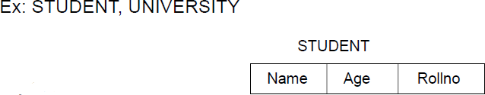
59
Entity Type
The entity type is a collection of the entity having similar attributes.
an entity type in an ER diagram is defined by a name and a set of attributes
We use a rectangle to represent an entity type in the E-R diagram, not entity.

Slide 68
60
Entity set
The collection of same type of entities that is their attributes are same is called entity set

Slide 69
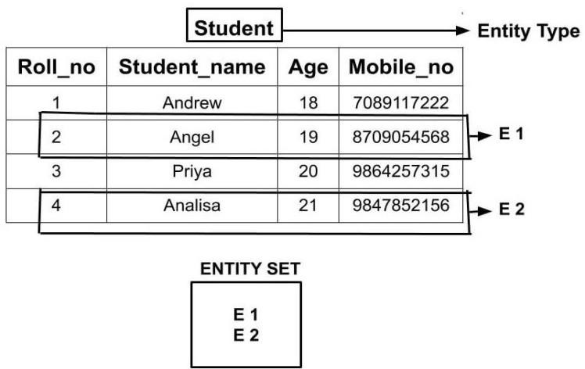
61

Slide 70
63
Attributes
The properties of entity that basically describes it
Attributes describes characteristics of entity
Suppose we have a entity EMPLOYEE and its attributes are ENO, ESAL, ENAME etc..
Attributes have some set of allowed or permitted values called Domain
Attributes are represented by OVAL
Each attribute of an entity set is associated with domain that means the set of values that can be assigned to that attribute for an entity

Slide 71
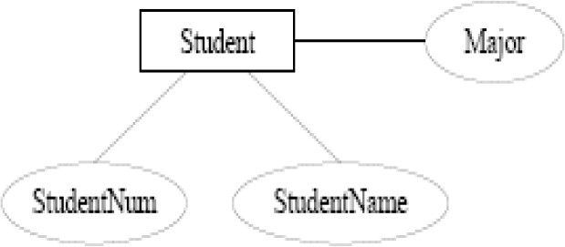
62

Slide 72
64
Types of attribute
Simple attribute vs Composite attribute
Single valued vs Multivalued attributes
Stored vs Derived attributes

Slide 73
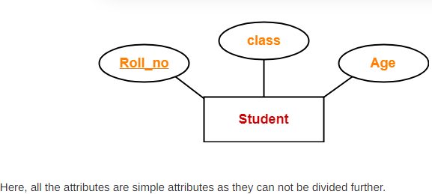
65
Simple attribute vs Composite attribute
Simple attributes
▫ Attributes which are not divisible; that is they cannot be divided
▫ Eg: City, State, etc,.

Slide 74
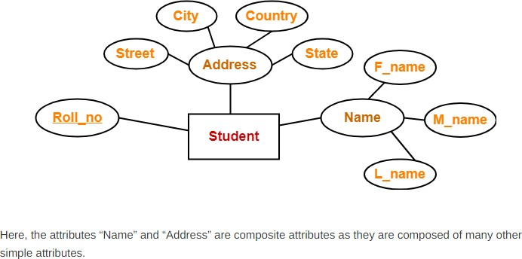
66
Composite Attribute
▫ Attributes that can be divided into smaller sub parts
▫ Example: Name attribute can be divided into FirstName, MiddleName, LastName

Slide 75
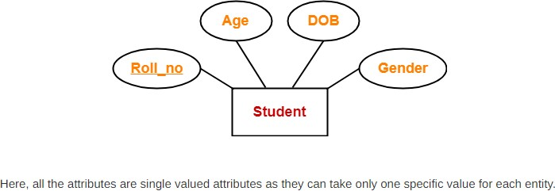
67
Single valued vs Multivalued Attributea
Single Valued
▫ Attributes which are having single values
▫ Example: Age

Slide 76
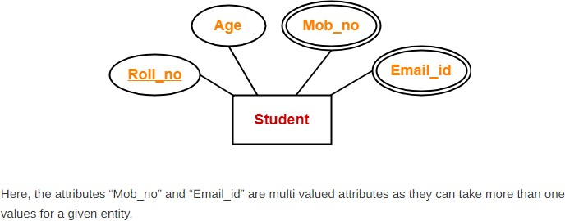
68
Multi Valued Attributes
▫ Multi valued attributes are those attributes which can take more than one value for a given entity from an entity set.
▫ Represented by double oval

Slide 77
69
Stored Vs Derived Attribute
In some cases, two (or more) attribute values are related ,for example, the Age and Birthdate attributes of a person.
For a particular person entity, the value of Age can be determined from the current (today’s) date and the value of that person’s birthdate.
The Age attribute is hence called a derived attribute and is said to be derivable from the birthdate attribute, which is called a stored attribute .

Slide 78
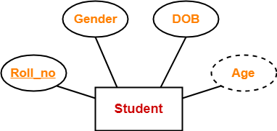
70

Slide 79
71
Complex Attribute
Complex attribute is a combination of composite and multi-valued attributes.
Complex attributes are represented by { } and composite attributes are represented by ( ).
Example: Address_phone attribute will hold both the address and phone_no of any person.
Example: {(2-A, St-5, Sec-4, Bhilai), 2398124}

Slide 80
72
Null Valued Attributes
The attributes which can have a null value called null valued attributes.
Example: Mobile_no attributes of a person may not be having mobile phones.

Slide 81
73
Key attribute in an entity type
Key attributes will be having a unique value for each entity of that attribute.
It identifies every entity in the entity set.
Key attribute will never be a null valued attribute.
Any composite attribute can also be a key attribute.
There could be more than one key attributes for an entity type.
Example: roll_no, enrollment _no

Slide 82
74
Domain of value set of an attribute
Domain of an attribute is the allowed set of values of that attribute.
Example: if attribute is ‘grade’, then its allowed values are A,B,C,F.
Grade ={A, B,C,F}

Slide 83
75
Relationship
Relates two or more distinct entities with a specific
meaning.
It is an association between two or more entities of same or different entity set
▫ For example, EMPLOYEE John works on the ProductX PROJECT or
▫ EMPLOYEE Franklin manages the Research
DEPARTMENT.

Slide 84
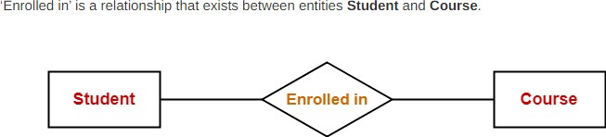
76
Relationship type
A set of similar types of relationship

Slide 85
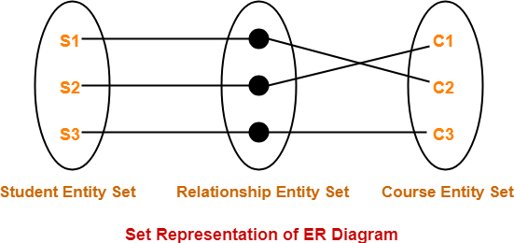
77
Relationship Set
A relationship set is a set of relationships of the same type.

Slide 86
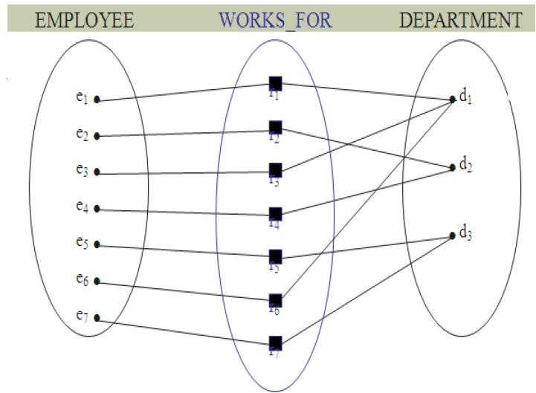
78

Slide 87
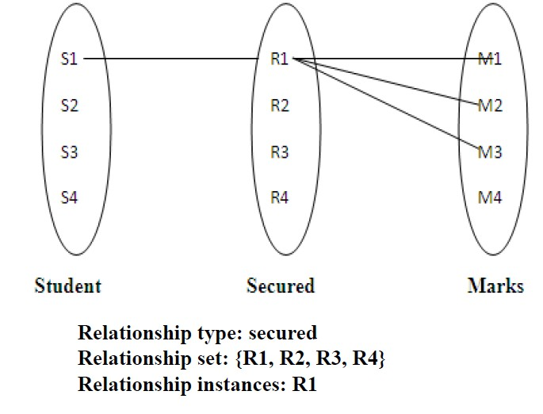
79

Slide 88
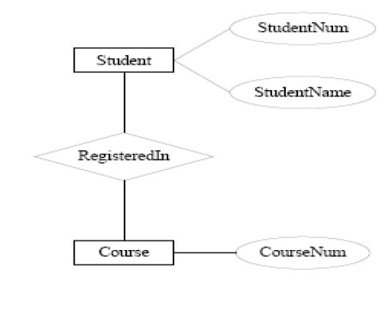
80
Graphical Representation of Relationship Sets

Slide 89
81
NOTATIONS USED IN E-R DIAGRAM
Key
attribute
Entity
Derived attribute
Weak Entity
Attribute
Multivalued Attribute

Slide 90
82
Composite Attribute
Relationship type
Identifying Relationship

Slide 91
83
Constraints
Relationship types usually have certain constraints. Two main types of relationship constraints:
  Mapping cardinalities
  Participation constraints

Slide 92
84
Degree of a relationship
It is the number of entity set which are participating in a relationship
▫ Unary relationship
▫ Binary Relationship
▫ Ternary Relationship

Slide 93
86
Unary Relationship
Student
monitor

Slide 94
85
Binary Relationship
Employee
Department
Works in
Ternary Relationship
Course
Teacher
Student
Teach

Slide 95
87
Each relationship has
▫ Name
▫ Degree
▫ Cardinality ratio

Slide 96
88
Cardinality Ratio
The cardinality ratio for a binary relationship specifies the maximum number of relationship instances to which an entity can take part in it
It also specifies number of entities to which other entity can be related by a relationship
Types
▫ One-to-one (1:1)
▫ One-to-many (1: N)
▫ Many-to-one (N: 1)
▫ Many-to-many (M: N)

Slide 97
89
We express cardinality ratio by drawing
directed line (→), signifying “one,” or an
undirected line (—), signifying “many,”

Slide 98
90
One to One(1:1)
When only a single instance of an entity is associated with single instance of other entity by a relationship
When every entity of one entity set is related to maximum one entity of other entity set

Slide 99
91
Male
1
1 | Female
married
F1 F2 F3 F4 F5 F6 F7
M1
M2 M3 M4 M5 M6

Slide 100
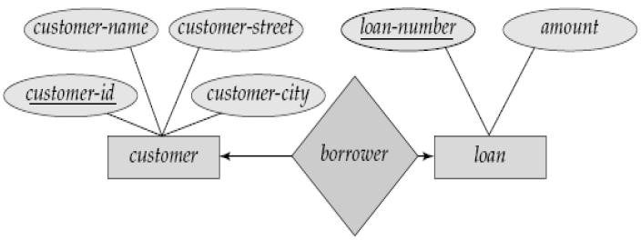
92

Slide 101
93
One to Many (1:M)
When every entity of first entity set is related to at most (max) n entities of other entity set then it is one to many

Slide 102
94
Department
1
M | Employees
has
d1 d2 d3 d4 d5
e1 e2 e3 e4 e5 e6 e7

Slide 103
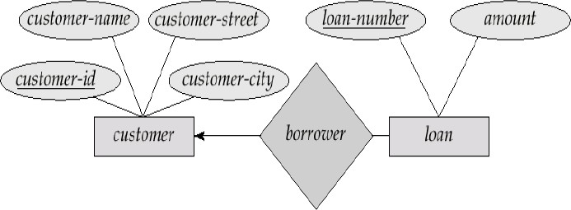
95
In the one-to-many relationship a customer is associated with several loans via borrower

Slide 104
96
Manager
1
M | Projects
manages
m1 m2 m3 m4
p1 p2 p3 p4 p5 p6 p7

Slide 105
97
Many to One (M:1)
When many entities of first entity set is related to 1 entity of other entity set then it is many to one

Slide 106
98
Employee
M
1
Department
Works
for
e1 e2 e3 e4 e5 e6 e7
d1 d2 d3 d4

Slide 107
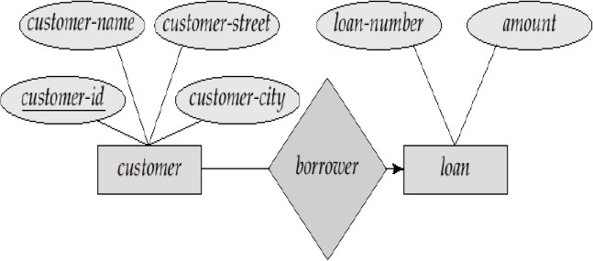
99
In a many-to-one relationship a loan is associated with several customers via borrower.

Slide 108
100
Many to Many(M:N)
When many occurrences of one entity is related to many occurrences of another entity

Slide 109
101
M
N | Students
Teacher
has
s1 s2 s3 s4 s5 s6
t1
t2
t3

Slide 110
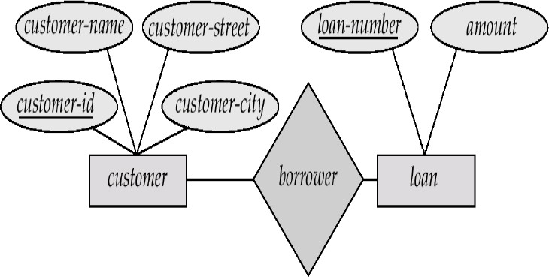
102

Slide 111
103
Exercise
Author
Books
writes
Indian citizen
Pan card
has
Indian citizen
Mobile number
has

Slide 112
104
Homework
Prime minister-country
classroom –students
students –classroom
customer -loan

Slide 113
16.05.22—3rd hr 15,20,24,25,28,31,42,46,52,53,60,62

Slide 114
105
Participation constraints
It specifies whether the existence of an entity depends on being related to another entity through relationship types
These constraints defines max and min number of relationship instance that each entity can participate in
Maximum cardinality
▫ It defines maximum number of times an entity can participate in a relationship
Minimum Cardinality
▫ It defines minimum number of times an entity can participate in a relationship

Slide 115
106
There are two types of participation constraints
  Total Participation
  Partial Participation

Slide 116
107
Total participation
every entity in the entity type participates in at least one relationship in the relationship type
Represented by double lines
Minimum and maximum cardinality represented as (m,n)

Slide 117
108
Employee
M
1 | Department
Works
for
e1 e2 e3 e4 e5 e6 e7
d1 d2 d3 d4

Slide 118
109
Partial participation
Some entities may not participate in any relationship in the relationship type
Represented by single line

Slide 119
111
TYPES OF ENTITY TYPES
Strong entity type
▫ Entity types that have at least one key attribute.
▫ A strong entity is not dependent of any other entity in the schema.
▫ A strong entity will always have a primary key.
▫ Strong entities are represented by a single rectangle.
▫ The relationship of two strong entities is represented by a single diamond.
▫

Slide 120
112
Weak entity type
▫ Entity type that does not have any key attribute.
▫ A weak entity is dependent on a strong entity to ensure the its existence.
▫ Unlike a strong entity, a weak entity does not have any primary key.
▫ It instead has a partial discriminator key.
▫ A weak entity is represented by a double rectangle.
The relation between one strong and one weak entity is represented by a double diamond.
•

Slide 121
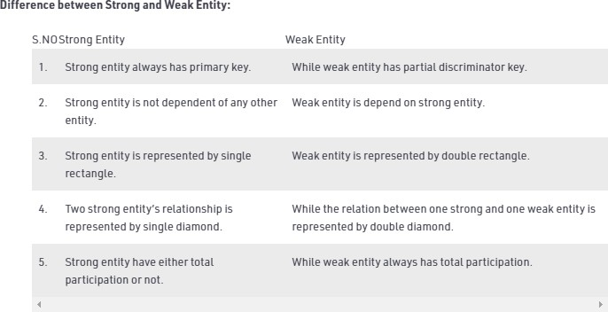
113

Slide 122
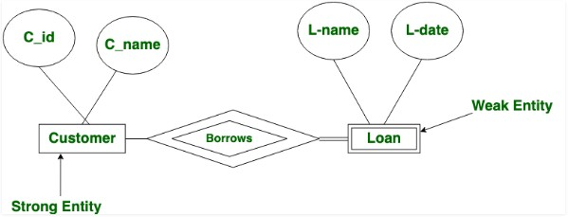
114

Slide 123
116
Identifying Relationship
It links the strong and weak entity and is represented by a double diamond sign.
Let us see with an example to link both the entities using Identifying Relationships:

Slide 124
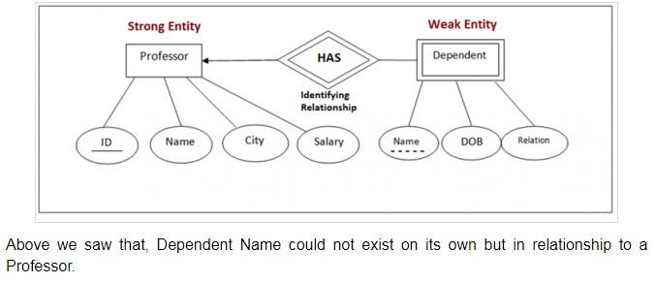
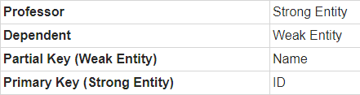
117
PREPARED BY SHARIKA T R

Slide 125
118
Relationship of degree 3
In Ternary relationship three different Entities takes part in a Relationship.
Relationship Degree = 3
For Example: Consider a Mobile manufacture company. Three different entities involved:
▫ Mobile - Manufactured by company.
▫ Part - Mobile Part which company get from Supplier.
▫ Supplier - Supplier supplies Mobile parts to Company.
Mobile, Part and Supplier will participate simultaneously in a relationship. because of this fact when we consider cardinality we need to consider it in the context of two entities simultaneously relative to third entity.

Slide 126
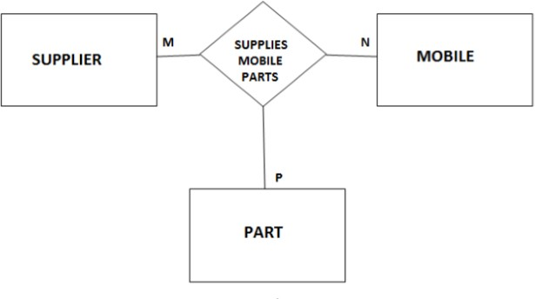
119

Slide 127
120
Cardinality in Ternary Relationship
Say for a given instance of Supplier and an Instance of Part, can that supplier supply that particular part for multiple Mobile models.
Example − Consider a Supplier S1 that supplies a Processor P1 to the company and the uses the Processor P1 supplied by Supplier S1 in its multiple Models in that case the cardinality of Mobile relative to Supplier and Part is N (many).

Slide 128
121
In case of Supplier’s cardinality we can say for a given instance of Mobile one of its Part can be supplied by multiple Suppliers.
Example − Consider a Mobile M1 that has a Part P1 and it is being supplied by multiple Suppliers in that case the cardinality of Supplier relative to Mobile and Part is M (many).

Slide 129
122
Similarly, for a given instance of Supplier and an instance for Mobile does the Supplier supply multiple Parts.
Example − Consider a Supplier S1 supplying parts for Mobile M1 like screen, Processor etc. in that case the cardinality of Part relative to Supplier and Mobile is P (many).

Slide 130
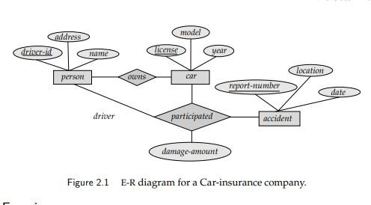
123
Construct an E-R diagram for a car-insurance company whose customers own one or more cars each. Each car has associated with it zero to any number of recorded accidents

Slide 131
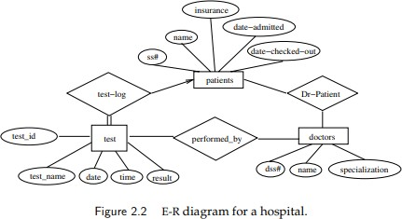
125
Construct an E-R diagram for a hospital with a set of patients and a set of medical doctors. Associate with each patient a log of the various tests and examinations conducted

Slide 132
127
A university registrar’s office maintains data about the
following entities: (a) courses, including number, title, credits, syllabus, and prerequisites; (b) course offerings, including course number, year, semester, section number, instructor(s), timings, and classroom; (c) students, including student-id, name, and program; and (d) instructors, including identification number, name, department, and title. Further, the enrollment of students in courses and grades awarded to students in each course they are enrolled for must be appropriately modeled.
Construct an E-R diagram forthe registrar’s office. Document all assumptions that you make about the mapping constraints.

Slide 133
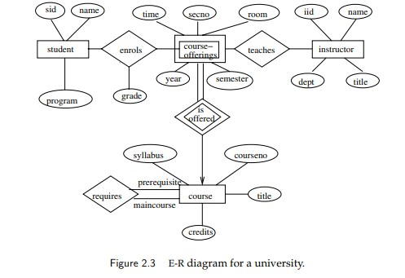
128
PREPARED BY SHARIKA T R

Slide 134
Consider a database used to record the marks that students get in different exams of different course offerings.
Construct an E-R diagram that models exams as entities, and uses a ternary relationship, for the above database.

Slide 135
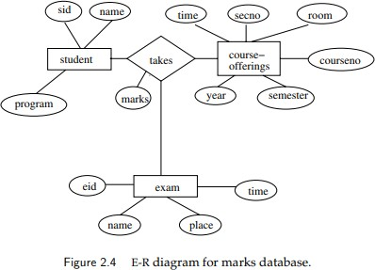
129

